Slide 1
Brünlital TEM 2025
Measurements from July 10th, 2025
Jakob Welkens & Peter Balogh

Slide 2
Map of Soundings

Slide 3
Measurement Parameters
All soundings were aquired using the following parameters on July 10th
4A of current
24 V
Timekey 3 (later values with timekey 4 were erroneous)
Stacking paramter 10
15m loop side length

Slide 4
Inversion Parameters – Starting Model
3 layer inversion
Filter 5-100μs
thk = [5, 5, 8]
res = [50, 1500, 1500, 500]
mpa = [0.0, 0.4, 0.4, 0.0]
taup = [1e-6, 5e-4, 5e-4, 1e-6]
c = [0.1, 0.7, 0.7, 0.1]
4 layer inversion
Filter 5-100μs
thk = [4, 4, 4, 8]
res = [50, 1500, 1500, 500, 500]
mpa = [0.0, 0.4, 0.4, 0.4, 0.0]
taup = [1e-6, 5e-4, 5e-4, 1e-6, 1e-6]
c = [0.1, 0.7, 0.7, 0.1, 0.1]

Slide 5
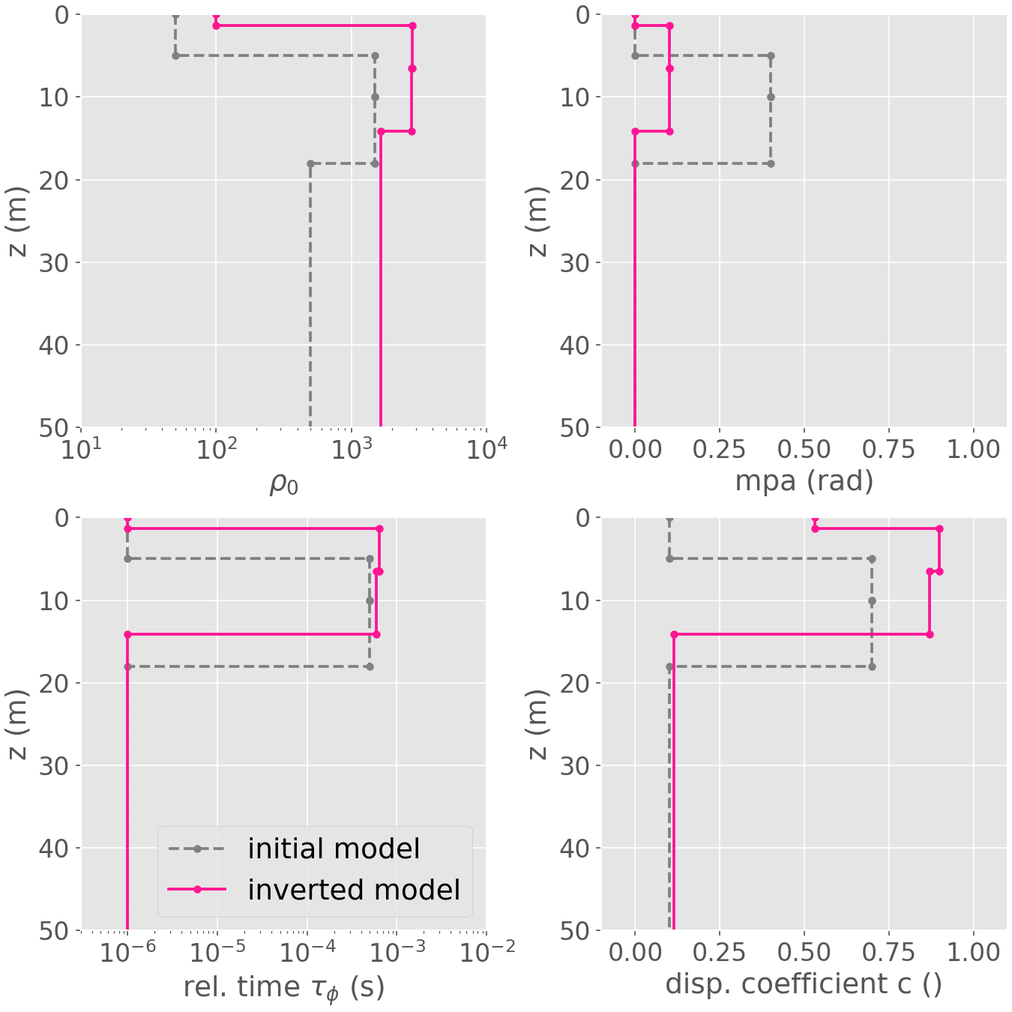
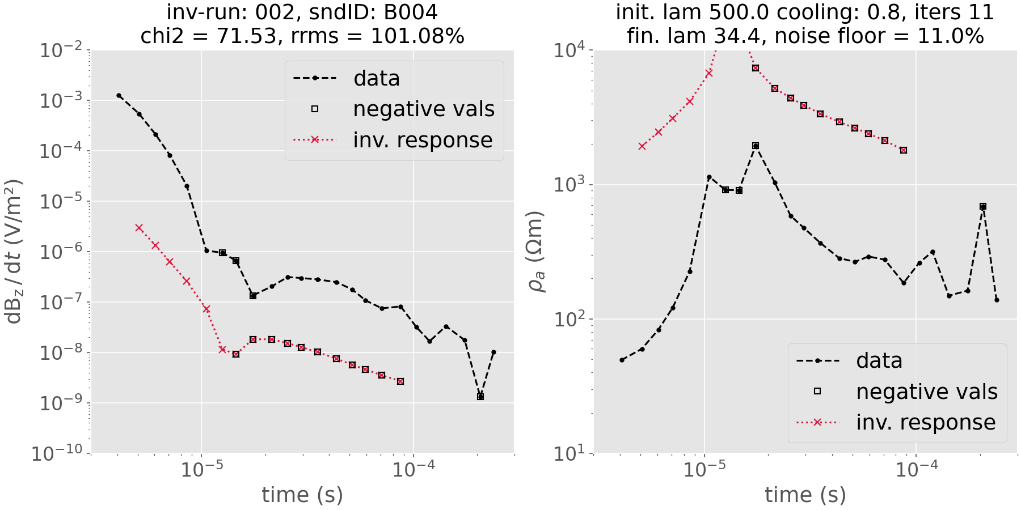
Inversion Parameters – Starting Model
Sounding B004, 3 layer model

Slide 6
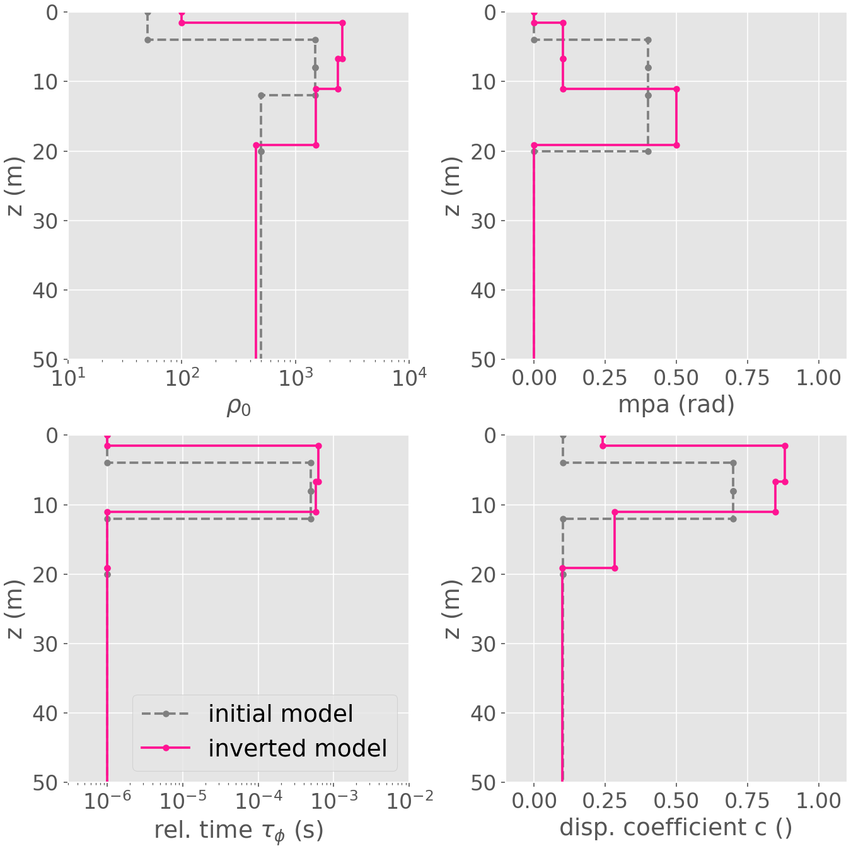
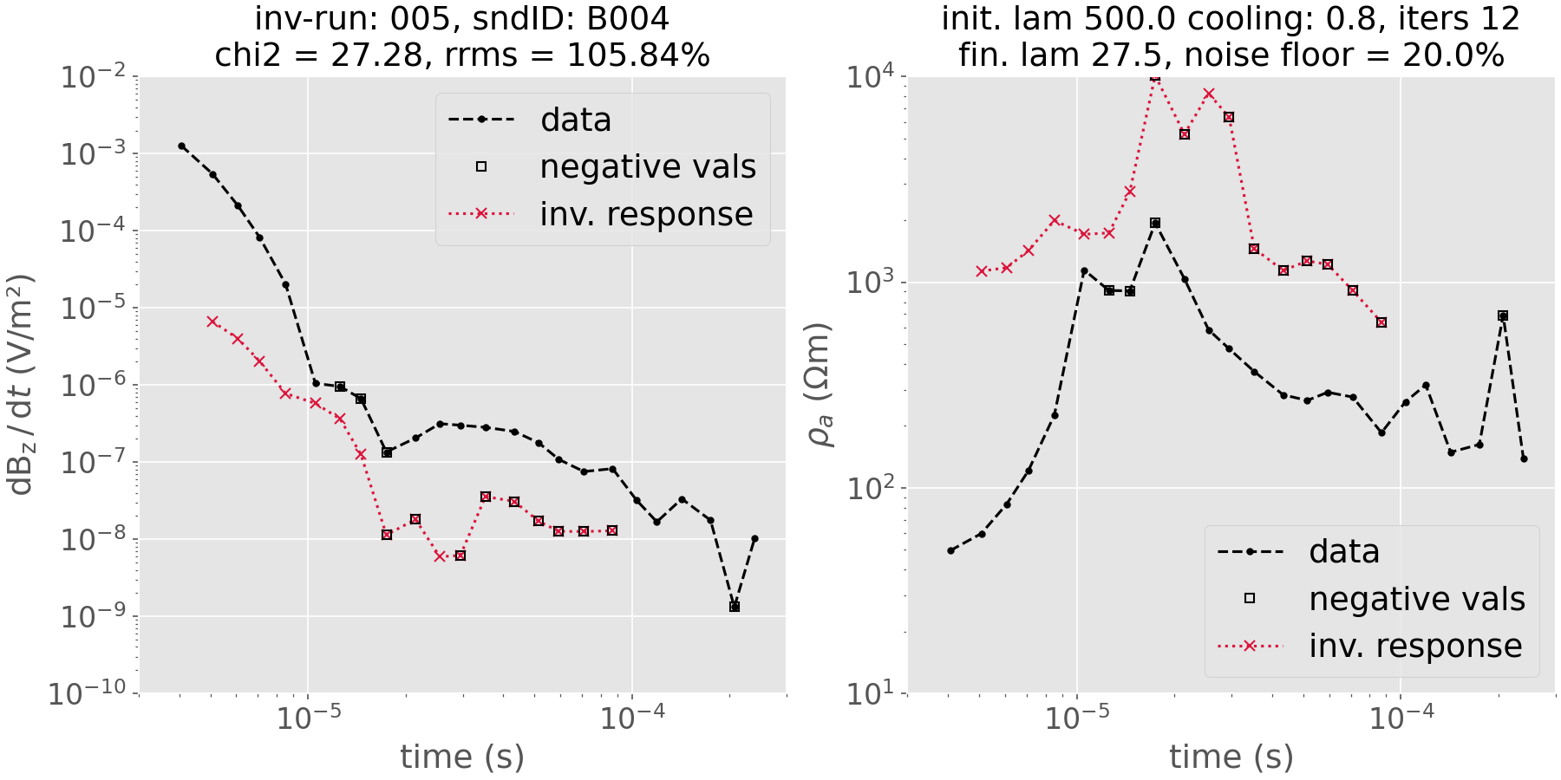
Inversion Parameters – Starting Model
Sounding B004, 4 layer model

