Slide 1
Hiding text in images using steganography
CAPSTONE PROJECT
Student Name : Prabhav Madhukeshwar Naik
College Name & Department : Jain Deemed to be University – CSE Cyber Security

Slide 2
OUTLINE
Problem Statement
Technology used
Wow factor
End users
Result
Conclusion
Git-hub Link
Future scope

Slide 3
Problem Statement
Secure communication is crucial in today's digital world, but traditional encryption methods can attract unwanted attention. There is a need for a way to hide sensitive messages within images without raising suspicion.

Slide 4
Technology used
Python – Large number of Modules for cryptographic methods
PIL – for image processing and analysis
Stepic – Steganographic encoding and decoding python module
Tkinter – User friendly GUI interface based off on python

Slide 5
Wow factors
Easy to use GUI using Tkinter
Easy File browsing
Stegano Module which is maintained and uses good encoding algorithms

Slide 6
End users
Who are the end users

Slide 7
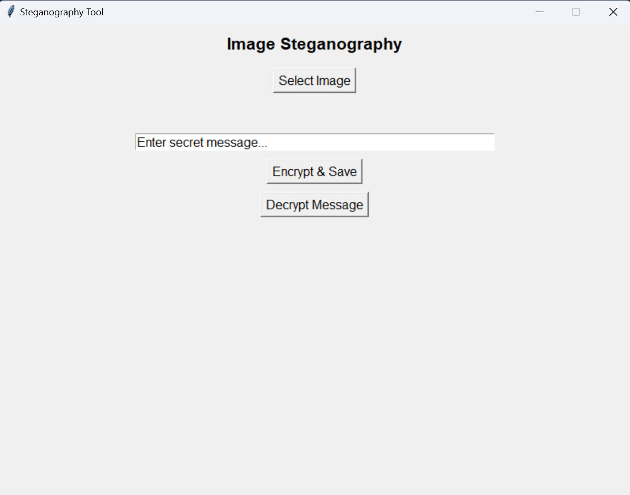
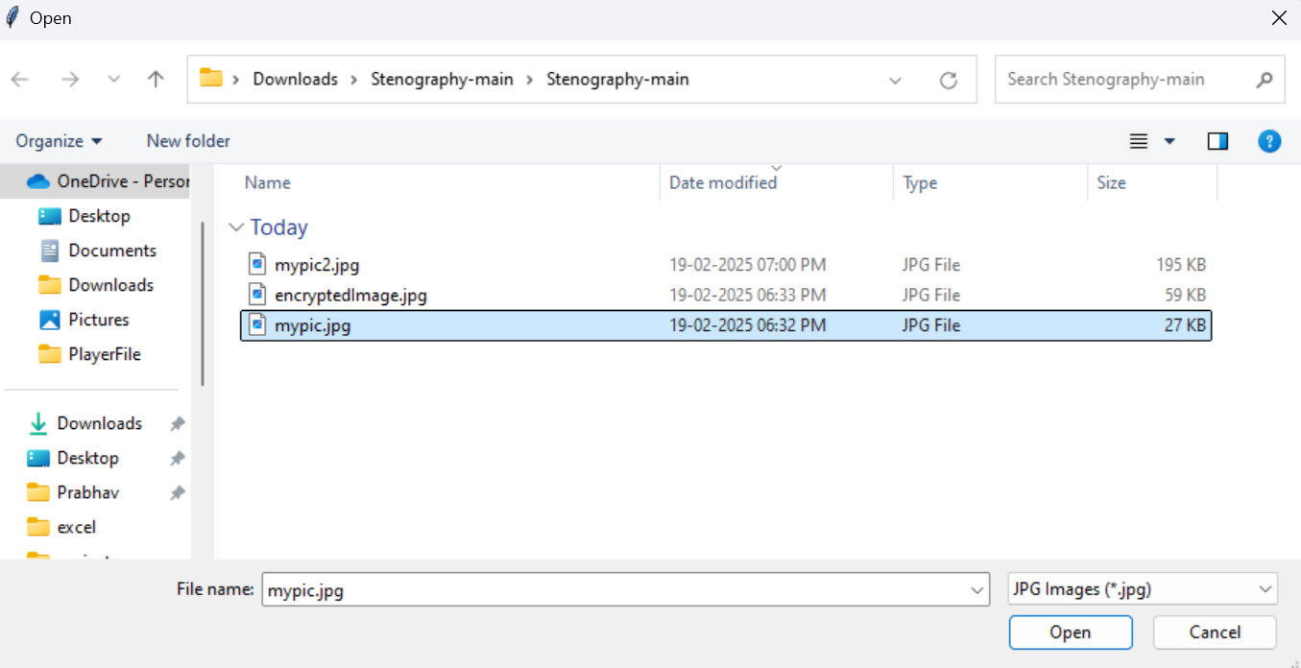
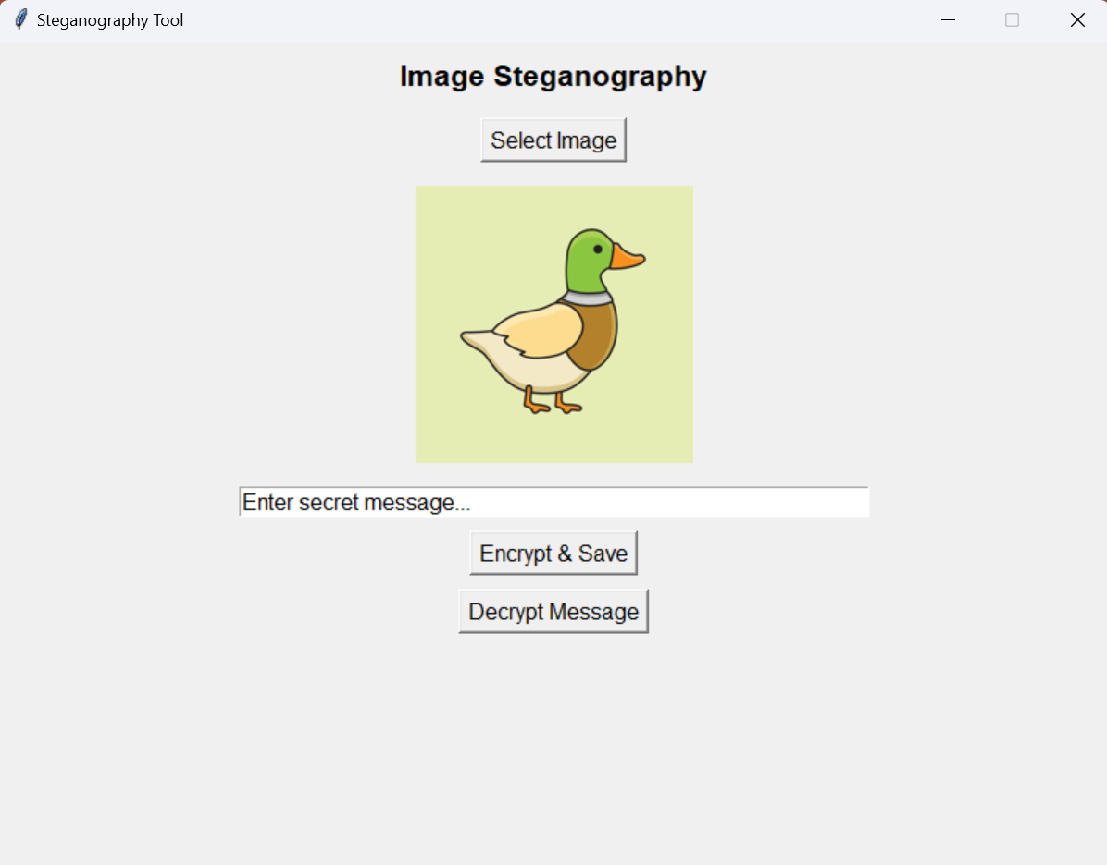
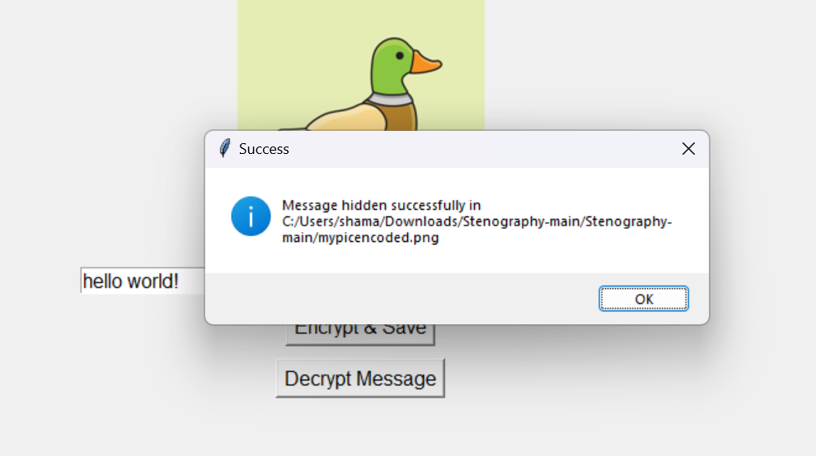
Results - ENcryption
Program Main Page
Easy File Browsing
Encrypting or Decrypting
Notification of successful encryption

Slide 8
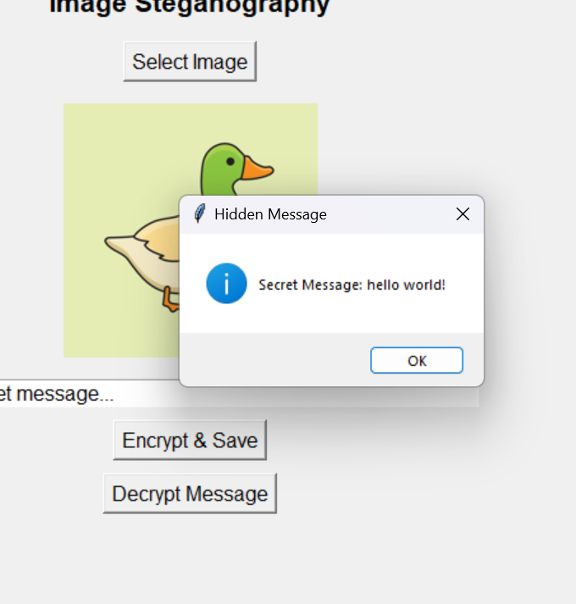
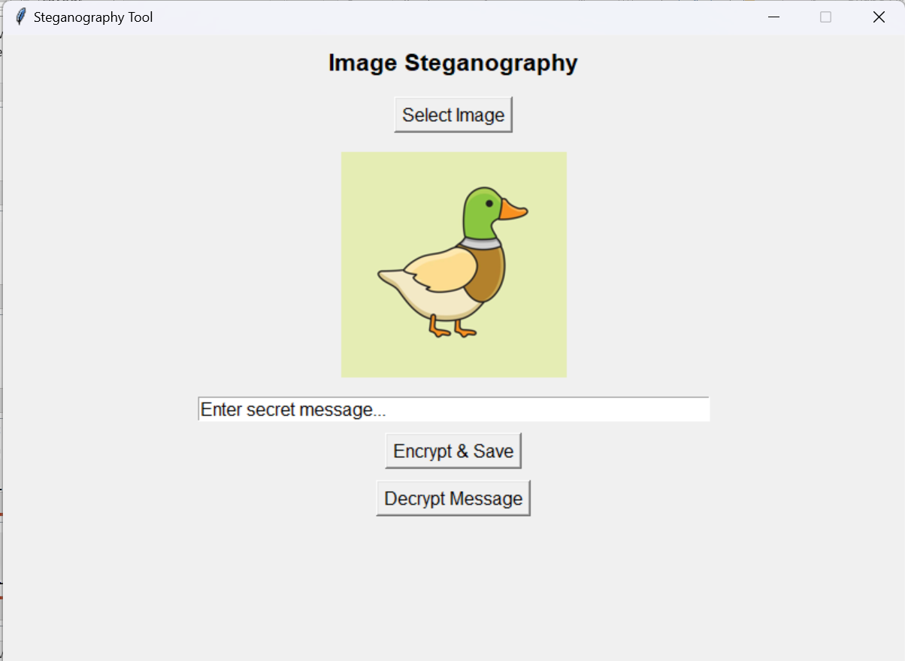
Results - Decryption
Main Page
Notification of successful Decryption

Slide 9
Conclusion
This project fulfills the gap of excluding unwanted attention and secret messages can be sent without any worry as decoding it without the encoding algorithm is impossible and sending of an image doesn’t raise any suspicion. Such fascinating methods of cyber security truly make it interesting topic of study for anyone

Slide 10
GitHub Link
https://github.com/pb2106/stegnography

Slide 11
Future scope(optional)
Improvement of the GUI
Usage of a custom algorithm of steganography instead of pre-written modules to increase security
Adding support of not only text but also hiding other files into one single file

Slide 12
THANK YOU

