Slide 1
An Introduction to
Peter Bräuer
Wolfson Atmospheric Chemistry Laboratories
peter.brauer@york.ac.uk
GitHub: pb866

Slide 2
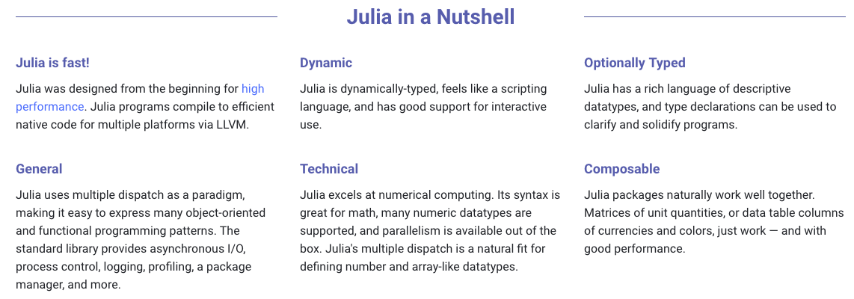
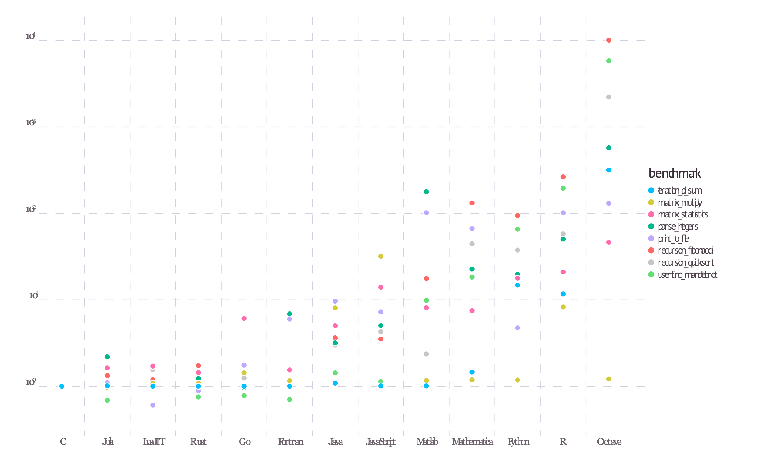
Key Features
C
Julia
LuaJIT
Rust
Go
Fortran
Java
JavaScript
Matlab
Mathematica
Python
R
Octave
10⁴
10³
10²
10¹
10⁰

Slide 3
My Pros and Cons
Pros
Very legible code
Compact code (broadcasting, list comprehensions…)
Intuitive code ➟ easy to read/learn the language
1-index-based (Con for you?)
End statements (for … end/while … end/ if … end)
Use of precompiled modules/functions ➟ fast
Easy implementation of other coding languages as native Julia functions (imports available for C, Fortran, Python, R, …)
Use of environments for Julia projects
Support for UTF-8 characters
Workflow around git/GitHub
Cons
Very young language ➟ small user base difficult to get support Difficult to find existing package for your needs Slow updates of community packages after Julia updates
Language used to change frequently, many deprecations ➟ resolved with Julia 1.0?
Limited IDE/debugger support

Slide 4
Getting started with
Available for Linux/Unix, MacOS, and Windows on https://julialang.org/
Instant command line use with the REPL (read-eval-print loop)
Libraries (packages) available for many (most?) scientific tasks
Good for:
Parallel computing
High-performance calculations
Machine learning

Slide 5
Getting started with
Plotting available for the following backends (no native Julia plotting):
PyPlot
Plotly(JS)
GR
InspectDR
PGFPlots
UnicodePlots
HDF5
…
If you require… | …then use…
Features | PyPlot, Plotly(JS), GR
Speed | GR, InspectDR
Interactivity | Plotly(JS), PyPlot, InspectDR
Beauty | Plotly(JS), PGFPlots
REPL Plotting | UnicodePlots
3D plots | PyPlot, GR, Plotly(JS)
A GUI Window | GR, PyPlot, PlotlyJS, InspectDR
A small footprint | UnicodePlots, Plotly
Plot+data ➟ .hdf5 file | HDF5

Slide 6
The REPL
Similar to Python’s ipython
Code is interpreted immediately and results printed to screen
Even plotting is available with UnicodePlots (or displayed in separate window)
Interfaces to shell environment with ; , help/documentation ? , and package manager ]
REPL output in Markdown for nice display, e.g., in jupyter

Slide 7
The package manager
Works around environments
Main environment for every major Julia version (e.g., (v1.0) )
Project environments
Lets you install your own packages on servers independently
Julia package manager is a package
Run with using Pkg or got to package manager with ]
Package dependencies defined in Project.toml/Manifest.toml
Pinned versions used for each package dependency
Different versions can be used for different projects/faster installation of versions already used ➟ garbage collect old package versions not used in a long time

Slide 8
Develop your own package
Run generate in package manager
creates Project.toml with version number set to 0.1.0; Project name; project UUID (unique identifier); and author name/email (from git)
Generates src folder with example “hello world” function
add packages in the package manager or with Pkg.add(“…”)
Julia works around modules, functions, and structs (types)
Add Documentation in Markdown syntax to modules, functions, and structs
Show documentation in Julia through help with ?function
instantiate : easily installs all dependencies on new systems

Slide 9
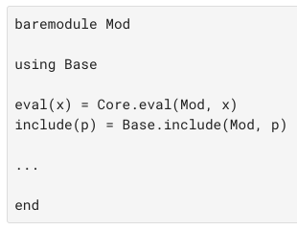
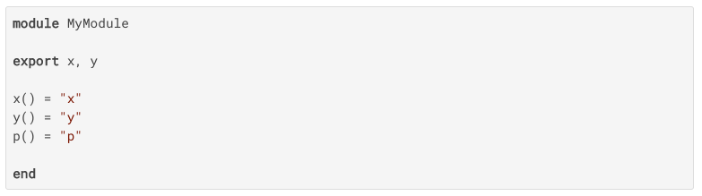
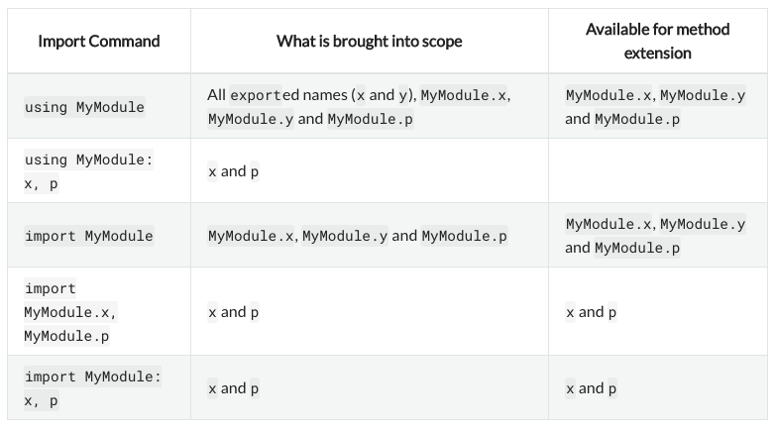
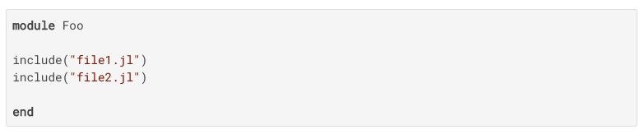
modules/packages
Add to Project.toml in package manager
Import in source code

Slide 10



functions
Traditional “programming function syntax” as used in most languages and shorter more “mathematical syntax”
Arguments are ”passed by sharing”: function arguments themselves act as new variable bindings (new location that refer to values) like in Scheme, Python, Ruby, Perl

Slide 11


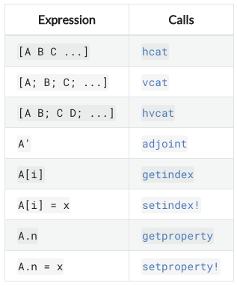
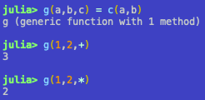
functions
By default the value of the last expression(s) is return
return keyword to modify return values or exit functions prematurely
Operators are functions
Operators with special names

Slide 12
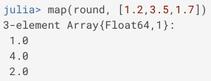
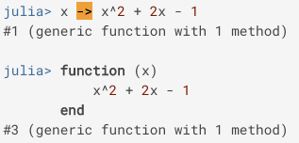
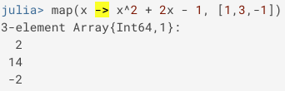
functions
args: with/without default type/value
kwargs: preceeded by semicolon ;
varargs: indicated by … (have to be last in arg list)
See notebook
Anonymous functions

Slide 13


Control flow in
No parenthesis, no colons, single and multiline use possible
if … elseif … else … end
for … end
while … end
[f(x) for x in vector]
Nested loops
Variables inside loops are local, will not be seen outside
Initialise, if you want to use it after loop
See notebook for examples

Slide 14

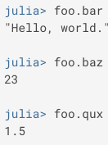
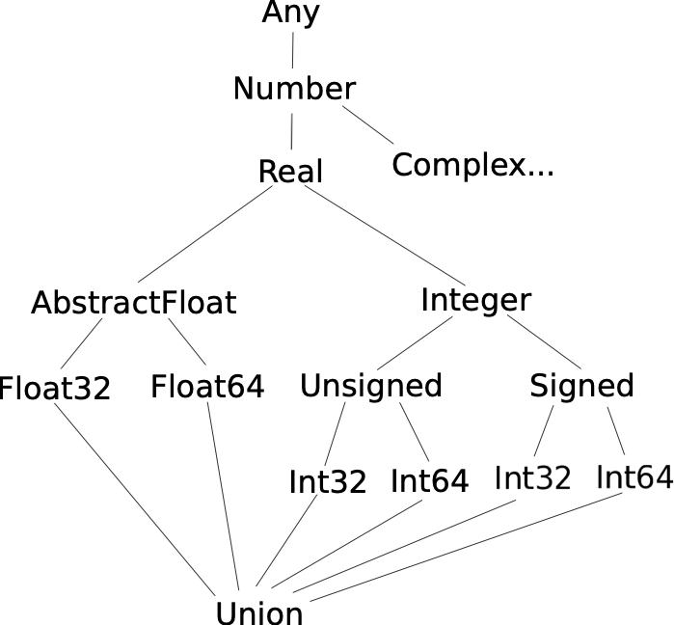
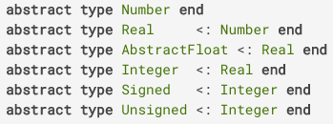
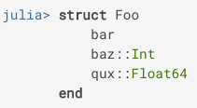
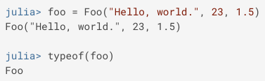
Type system
Type system organised in abstract types (supertypes) and types/subtypes
Top AbstractType: Any (all types are subtype of Any )
Bottom AbstractType: Union{} (all types are supertype of Union )
Primitive types: concrete types with data consisting of bits (e.g., Numbers, you can define your own primitive types)
Composite types
immutable struct
mutable struct
Named tuples, fields callable with foo.bar

Slide 15
Strings & Co.
See notebook
Special String types:
r”” : Regex expression
v”” : Version string
b”” : byte literal
L”” : LaTeXString
raw””: Raw string that doesn’t do interpolation
Flags can be used for regex, too: e.g., r””I
Available flags: i, m, s, x
match : See notebook

Slide 16
Arrays in
Vectors: [1 2 3] ➟ horizontal; [1, 2, 3] ➟ vertical
Matrices: [1 2; 3 4] ➟
Vector{Type} = Array{Type, 1} ; Matrix{Type} = Array{Type, 2}
Nested: [[1, 2], [3, 4]] vs. concatenated: [[1, 2]; [3, 4]] ≡ [1, 2, 3, 4]
Splicing
[1, 2, 3, 4][2:3] ➟ [2, 3]
[1, 2, 3, 4][[1, 2, 4]] = [1, 2, 3, 4][[1:2; 4]] ➟ [1, 2, 4]
[1, 2, 3, 4][2:end-1] ➟ [2, 3]
Types for missing data: missing , NaN
Numbers in Julia: See notebook
1 | 2
3 | 4

Slide 17
Flavours of syntax
Many tiny details that can make the difference (or annoy you like hell, you decide!)
/ vs. ÷
Strings vs. characters
typeof(“a”) ➟ String ; typeof(‘a’) ➟ Char ; Symbol(“a”) ≡ :a (of type Symbol)
”hello”[1:1] = “h” (of type String) (not “e”!); “hello”[1] = ‘h’ (of type Char)
Julia can broadcast functions/operations/values to arrays
Syntax like 1.+2. not allowed (disembogues; use 1. + 2. or 1.0+2.0 )
See notebook

Slide 18
Include code from other languages
Use `…` for bash command calls
Include C, Fortran, Python, R routines as native Julia functions
Include Julia functions in Python with PyJulia
See PyCall, PyPlot
Use e.g. ax[:plot](x,y) instead of ax.plot(x,y)
Compile Fortran with flags -shared -fPIC
Use name mangling for Fortran
Pass variables with Pointers
See notebook

Slide 19
Useful packages
CSV ➟ read from/write to CSV
DataFrames ➟ Similar to Python’s dataframes with Symbols in header
OhMyREPL ➟ syntax highlighting/pairing & autocompletion of parentheses
IJulia ➟ Interface for jupyter
Plots ➟ Plotting backends
PyCall/PyPlot ➟ Python wrapper/Matplotlib.pyplot wrapper
Conda ➟ Conda environment for Julia’s python (unless build with system python)

Slide 20
Useful packages
ccall ➟ Call C and Fortran code as native Julia functions
Revise ➟ track changes during package development
HDF5 ➟ read/write HDF5 files
LsqFit ➟ Least square fitting
ProgressMeter ➟ add progress bar for long processes
Base Functions
Printf ➟ Formatted print statements
LinearAlgebra ➟ e.g., nicer maths: use · instead of * for times
Dates: for Date/DateTime format

Slide 21
IDEs
Juno (works around Atom editor)
Jupyter notebooks
Juliabox (online interpreter, no Julia installation needed, log in with Github, email, Google or LinkedIn)
Visual code
gdb works supposedly with Julia

Slide 22
Getting started – useful links
Documentation: https://docs.julialang.org
Try out yourself: https://juliabox.com/
Tutorials:
https://learnxinyminutes.com/docs/julia/ (short and sweet overview of key features)
https://scls.gitbooks.io/ljthw/content/_chapters/16-ex13.html (very comprehensive tutorial – WIP)
https://en.wikibooks.org/wiki/Category:Book:Introducing_Julia
https://lectures.quantecon.org/jl/getting_started.html#overview
Plotting examples:
https://gist.github.com/gizmaa/7214002

Slide 23
Thank you for your attention!
Enjoy getting started with Julia!
Jupyter notebook available at: github.com/pb866/JuliaIntro.git

Slide 24
Flavours of syntax
Highly legible through Unicode character with additional capabilities
x >= y vs. x ≥ y / x != y vs. x ≠ y
Division: 3/2 = 1.5 ; 3÷2 = 1; 3//2 = 3//2 ; 2\3 = 1.5 ; 1/0 = Inf
Compact expressions
Combine conditions: x < 2 && x >= 1 vs. 1 ≤ x < 2
Initialise variables with the same value as one-liner: a = b = 0
Broadcast features to arrays with . Syntax: x = 5; A = [2, 3, 5]; x .* A = [10, 15, 25]
Implicit broadcasts: 5x = 25; 5(x .+ A) = [35, 40, 50]
How to write 2y^{2x}, where y = 4 and x = 3?
Python/Fortran: 2*y**(2*x) = 24 ( 2*y**2*x = 128 )
Julia: 2y^2x = 24 or 2*y^(2*x) = 24 ; 2*y**(2*x) ➟ERROR: syntax: use "^" instead of "**"

