Slide 1
A concurrent DEX for Cardano
Bsc thesis
Peter Brühwiler
16.12.21

Slide 2
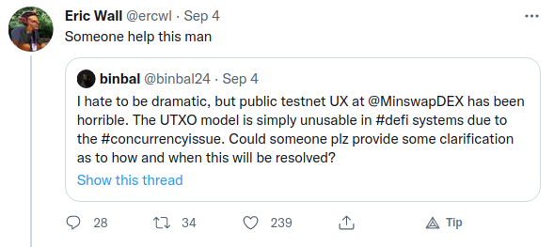
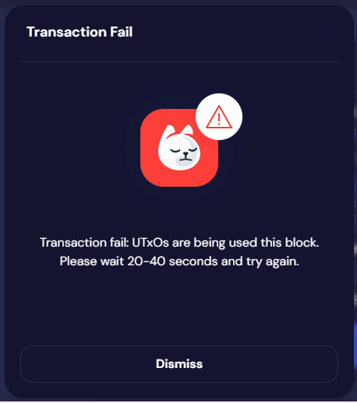
The Concurrency Issue
Minswap blog post:
“.. It’s not a fundamental flaw, but is simply a design challenge that must be addressed.”

Slide 3
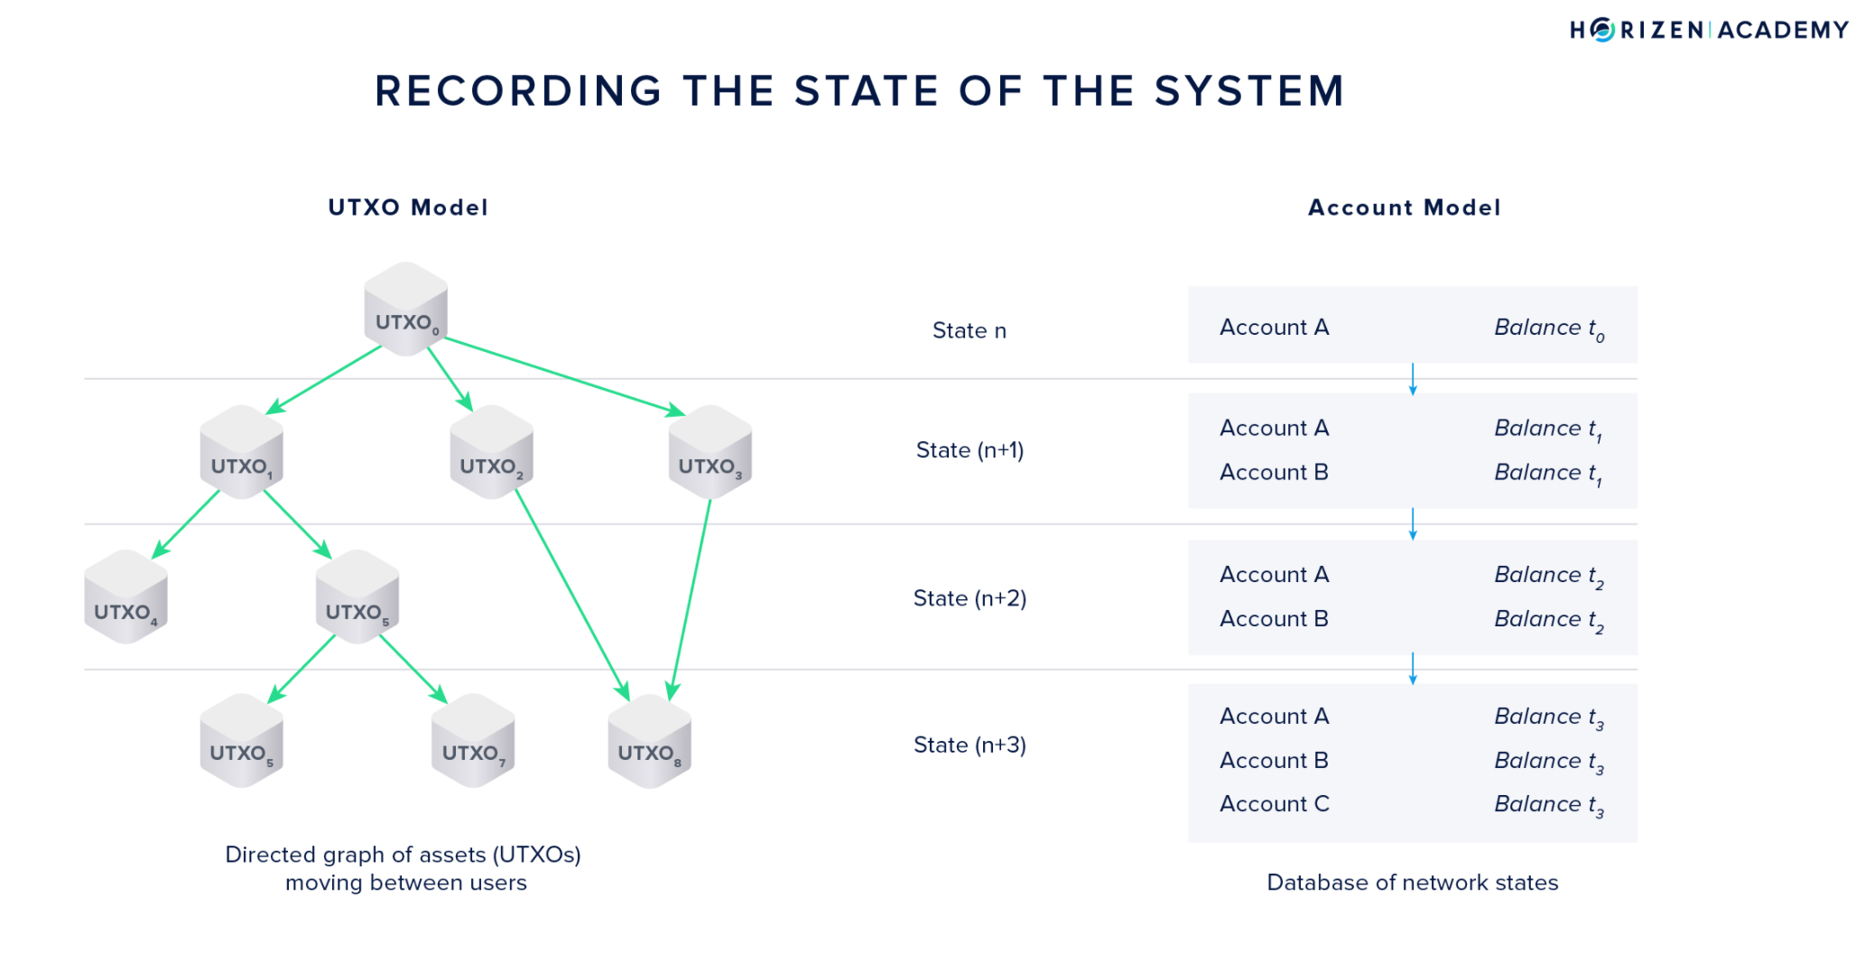
The UTxO model

Slide 4
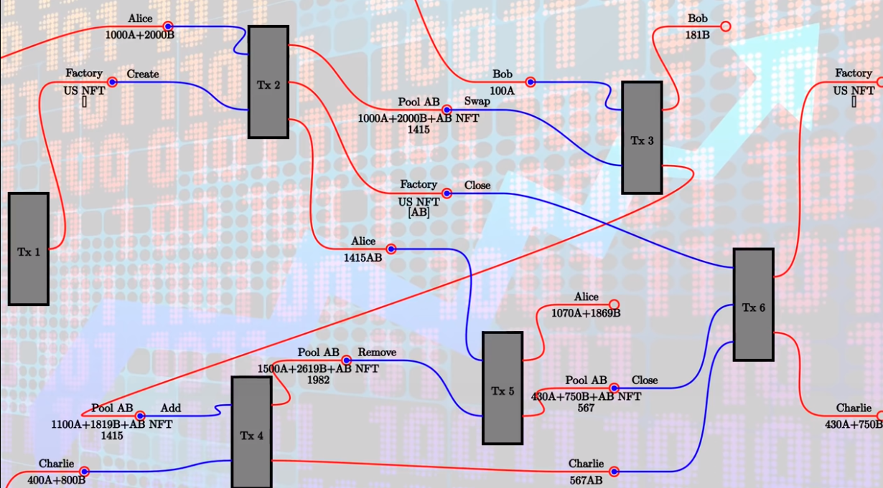
Simple AMM style DEX

Slide 5

The extended UTxO
Datum to describe a state
Redeemer to describe an action

Slide 6
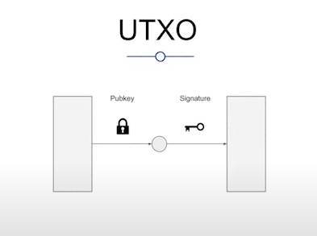
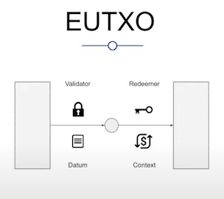
Generalized

Slide 7

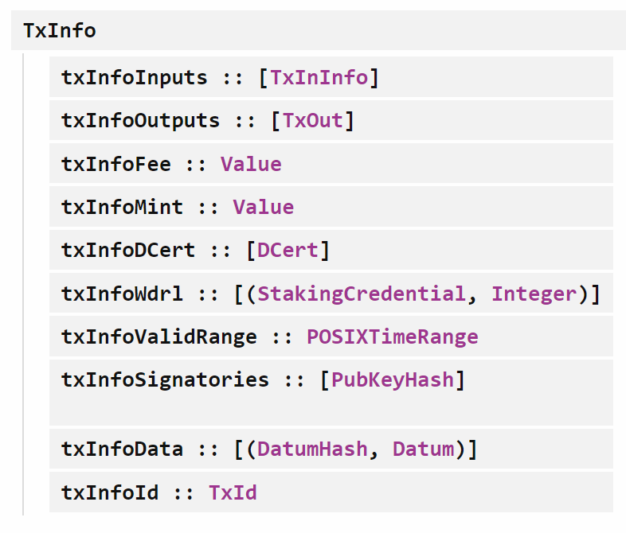
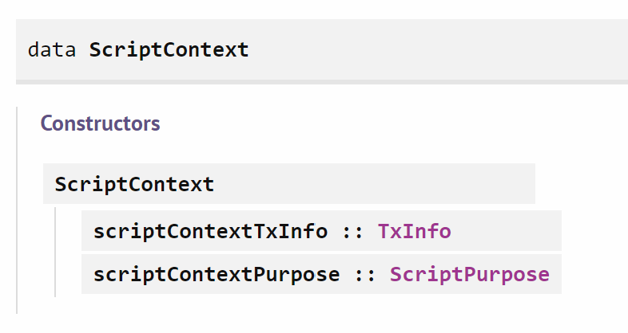
Simple validator

Slide 8
So, Bob can Swap 100A for 181B..
But only once per block ..

Slide 9
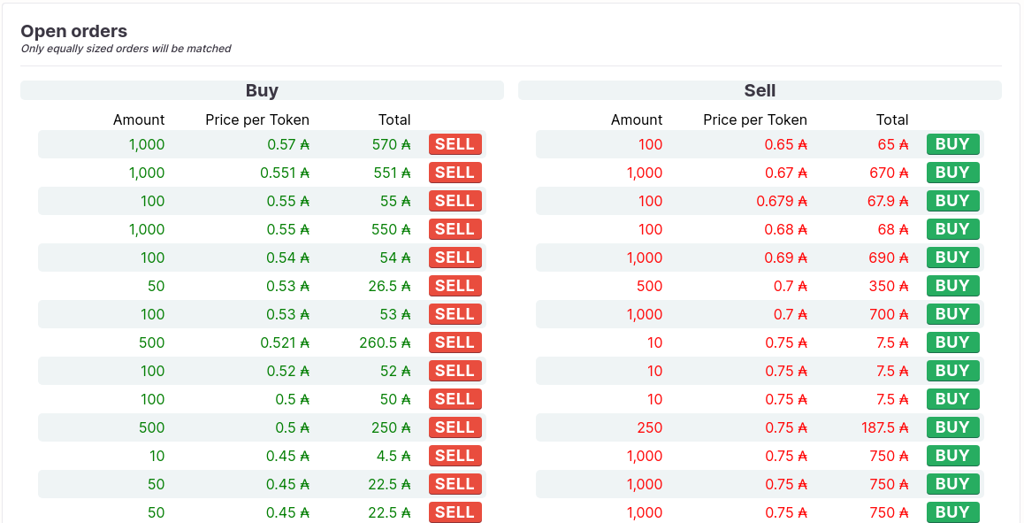
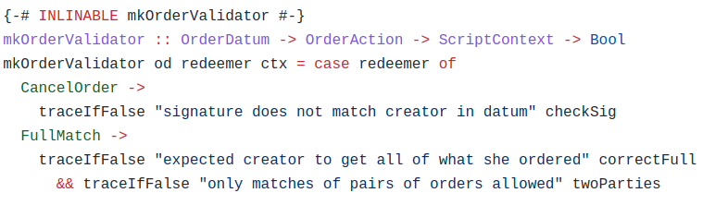
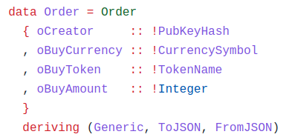
Order book

Slide 10
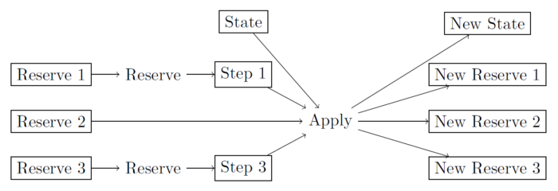
Back to the AMM model, but with ..
.. multiple state UtxOs
.. a batching mechanism

Slide 11
So one more time..
With the following changes:
Tx2: Create n Reserve UTxOs
Let users reserve and retrieve Reserve UtxOs
Tx3: Include n Reserve UTxOs
Tx6: Burn n Reserve UTxOs

Slide 12
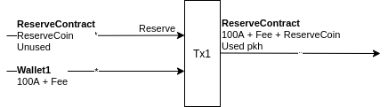
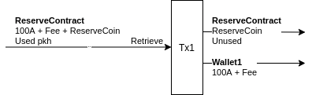
Reserve and Retrieve

Slide 13
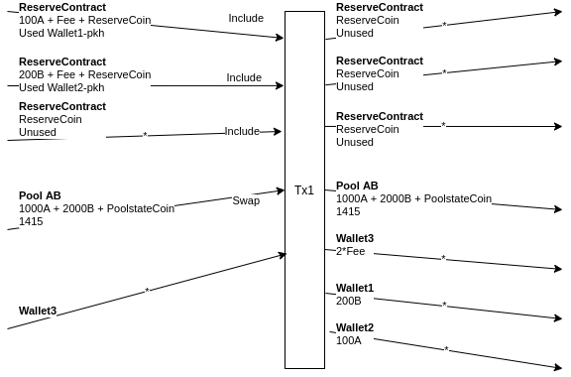
The Swap transaction
1)
2)
2)
2)
1)
Nr of Reserve UTxOs variable
2)
Wallet3 gets all the ‘leftovers’

Slide 14
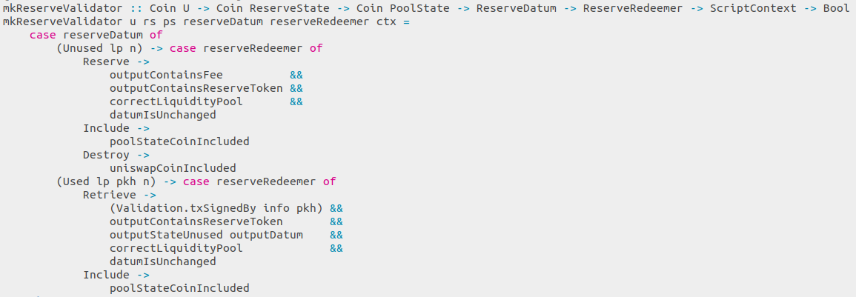
Reserve validation logic
‘Include’ validation is delegated to the Swap validator
Coins needed to identify the correct UTxO

Slide 15

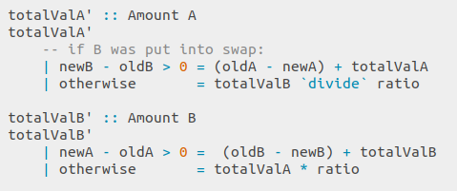
Swap validation
x % of total value of A as input → x % of total value of B as output
Only the ‘excess’ part of the currency with the higher value is put into the swap
oldA, newA, oldB, newB are the values
in the liquidity pool before and after the swap
Swap is deterministic, no arbitrary order of execution

Slide 16
So, given these inputs, the liquidity pool stays unchanged

Slide 17
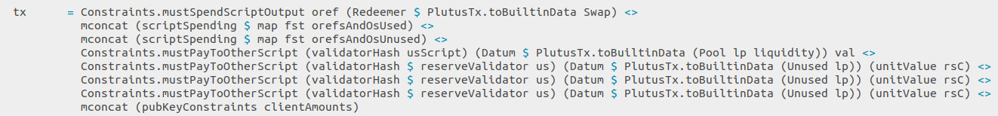
OffChain code
.. basically spends and creates UtxOs without breaking the rules of the validator
Building the swap transaction

Slide 18
Demonstration

Slide 19
How decentralized is the DEX?
Execution of the Swap happens OffChain
Large OffChain part is in the nature of Cardano, a validator can not jump into action on it’s own.
But: The Validator guarantees the outcome
So, six smileys for decentralization → → →

Slide 20
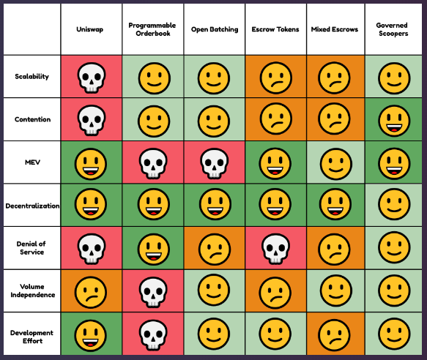
Sundaeswap
The ‘Escrow Tokens’ approach “crashes head first into the sizing limits of the Cardano blockchain.” getting minimal contention “depends on hundreds of escrow tokens, and in practice, our first implementation of this was hitting the Cardano protocol limits with 5 or 6 escrow tokens, before even adding in features like governance.”
Finally, they went for the ‘Governed Scoopers’ model:
“by aligning incentives and creating systems of self-governance, you can scale a system by building trust into the protocol.”

Slide 21
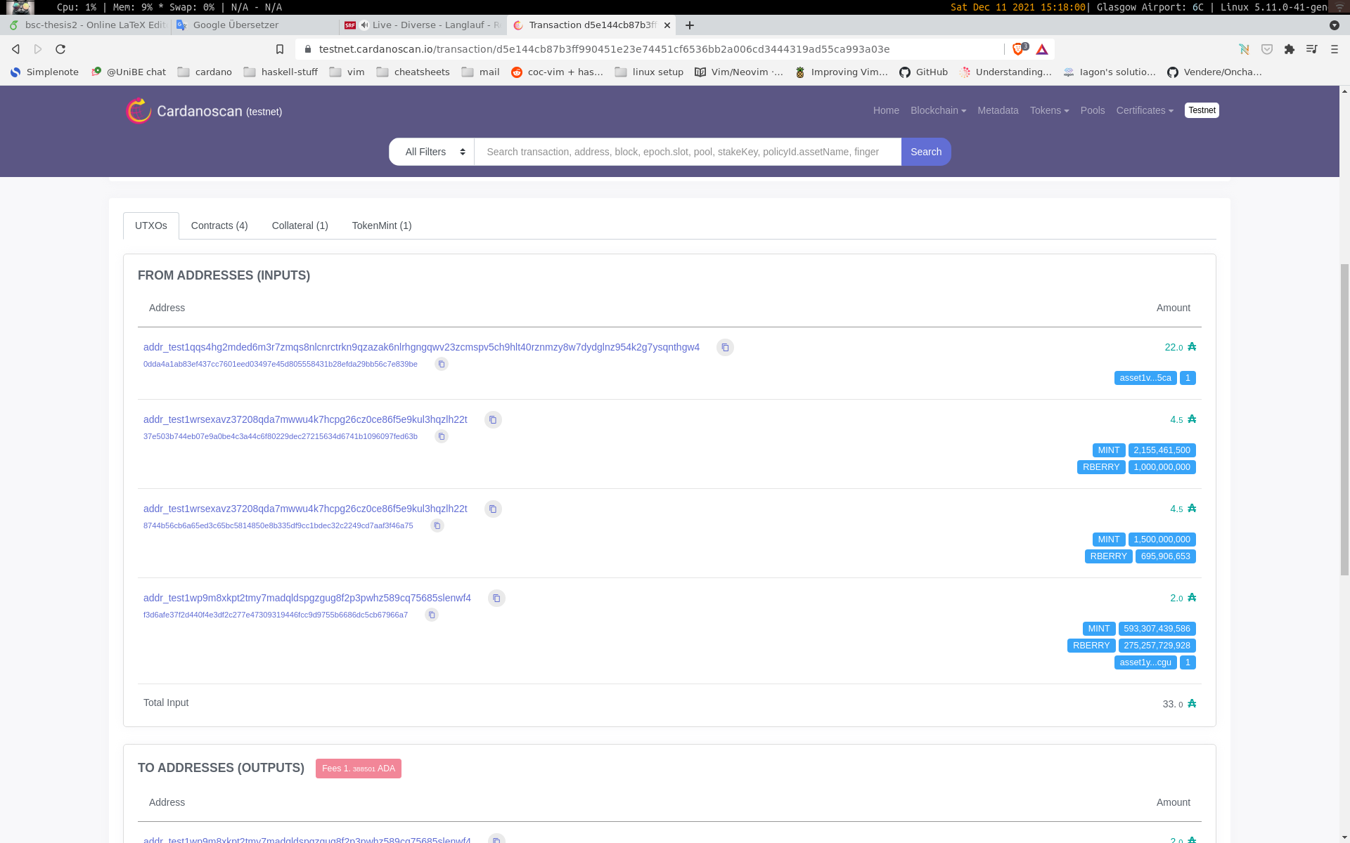
Batching ‘Add to Liquitidy Pool’

Slide 22
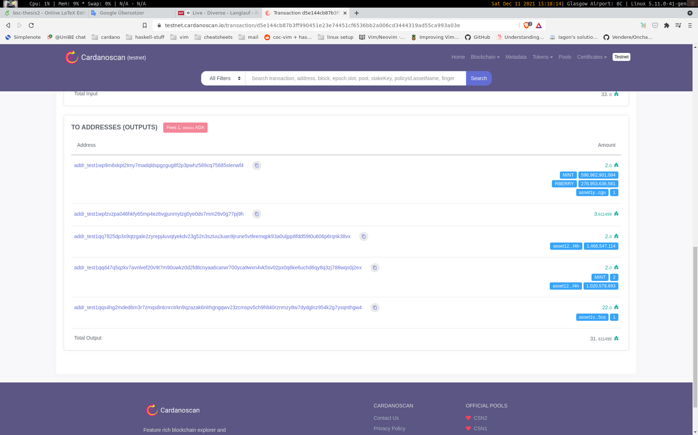

Slide 23
Further improvements
Use order tokens instead of order UtxOs, because the reserve validator gets executed n times
Steps, described by IOG:
Order submission:
User submits ‘order’ token to own public key address.
User sends PubKeyHash to the request script for order notification.
Order processing:
Batcher inspects the UTXOs at the request script address
Batcher collects ‘order’ tokens and builds the aggregated transaction.
users to sign the transaction to spend their funds.

Slide 24
Is the UTxO model worth all the trouble?
Transactions and fees are deterministic
Cannot fail, if the inputs are present
Every token is a native token
Layer 2 solutions easier to implement

