Slide 1
The Word Embedding Fairness Evaluation Framework

Slide 2
Team
Pablo Badilla | Felipe Bravo Marquez | Jorge Pérez | María José Zambrano
MsC in Computer Science from Department of Computer Science at the University of Chile Developer at CENIA | Assistant Professor in the Department of Computer Science at the University of Chile Associate Researcher CENIA | CoFounder at Cero.AI | Computer Engineer from Department of Computer Science at the University of Chile

Slide 3
Fairness in ia
This makes these systems
prone to learning our biases
and
replicating them by making unfair decisions.

Slide 4
Fairness in Word Embeddings
We will discuss about our contribution [1]
in the fairness and bias issues of one of the main
Building Blocks of Natural Language Processing (NLP) systems:
Word Embeddings.

Slide 5
outline
A brief background on Word Embeddings.
Objectives.
WEFE Framework.
WEFE Tutorial.
Conclusion.

Slide 6
Background on word representations

Slide 7
Word EmbeddingS
Models that capture the meaning of words within
low dimensional continuous vectors.
Based on Distributional Hypotesis
“Words that occur in the same context tend to have similar meanings”.
Words that appear in similar contexts will tend to have similar vectors

Slide 8
Word EmbeddingS
Set of models that capture the meaning of words within dense vectors of small dimensionality.
Trained from massive document corpora using neural networks.
The meaning of the words is distributed in all the dimensions.
The dimensions are not interpretable.

Slide 9
Fairness in Word Embeddings
Word Embeddings
are prone to inherit stereotypical social biases
from the corpus they were built on.

Slide 10
Motivation

Slide 11
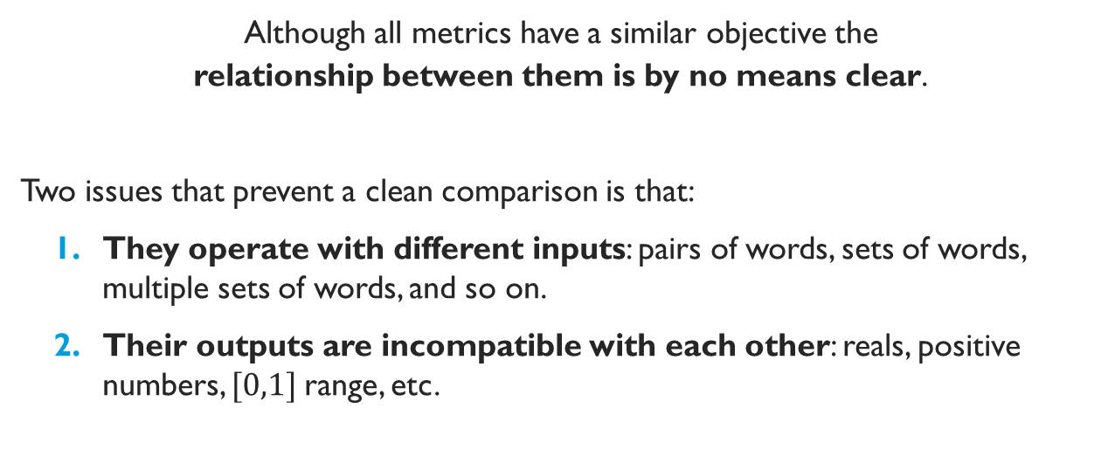
Research Problems
Although all metrics have a similar objective the
relationship between them is by no means clear.
Two issues that prevent a clean comparison is that:
They operate with different inputs: pairs of words, sets of words, multiple sets of words, and so on.
Their outputs are incompatible with each other: reals, positive numbers, $[0,1]$range, etc.

Slide 12
Research Problems
Research has tended to focus on studying biases of a few popular embedding models.
As far as we know, there is
no method to rank word embeddings
models according to their bias detected.

Slide 13
Research Problems
Like metrics, mitigation methods are also poorly standardized:
Different inputs.
Poorly standardized internal processes and concept separation.
Some accept multiclass criteria as input.
Furthermore, everyone tests with their own set of data, making them difficult to compare objectively.

Slide 14
Objectives
To Develop a framework to standardize the
Measurement and mitigation of bias in
Word Embedding models.

Slide 15
Wefe: The Word Embedding Fairness Evaluation Framework

Slide 16
Wefe: The Word Embedding Fairness Evaluation Framework
WEFE is framework for measuring and mitigating bias in word embedding models.
It:
Formalizes existing Fairness Metrics into a unified framework.
Encapsulates the test words into standard objects called queries.
Quantify the bias of word embeddings using these queries.
Formalizes the bias mitigation methods in two stages: fit and transform.

Slide 17
Target sets
A target word set is a set of words intended to denote a particular social group, which is defined by a certain criterion (gender, social class, age, and ethnicity, among others…).
Women | Men
“She” | “He”
“Woman” | “Man”
“Girl” | “Boy”

Slide 18
attribute sets
An attribute word set is a set of words representing some attitude, characteristic, trait, occupational field, etc. that can be associated with individuals from any social group.
Science | Arts
“Technology” | “Poetry”
“Physics” | “Dance”
“Chemistry” | “Literature”

Slide 19
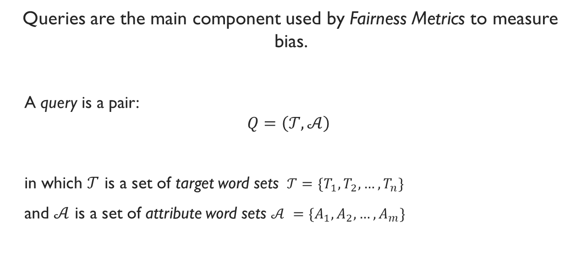
Query
Queries are the main component used by Fairness Metrics to measure bias.
A query is a pair:
$$Q=\left(𝒯,𝒜\right)$$
in which $𝒯$ is a set of target word sets $𝒯={\{T}_{1}, T_{2}, …, T_{n}\}$
and $𝒜$ is a set of attribute word sets $𝒜 ={\{A}_{1},A_{2},…, A_{m}\}$

Slide 20
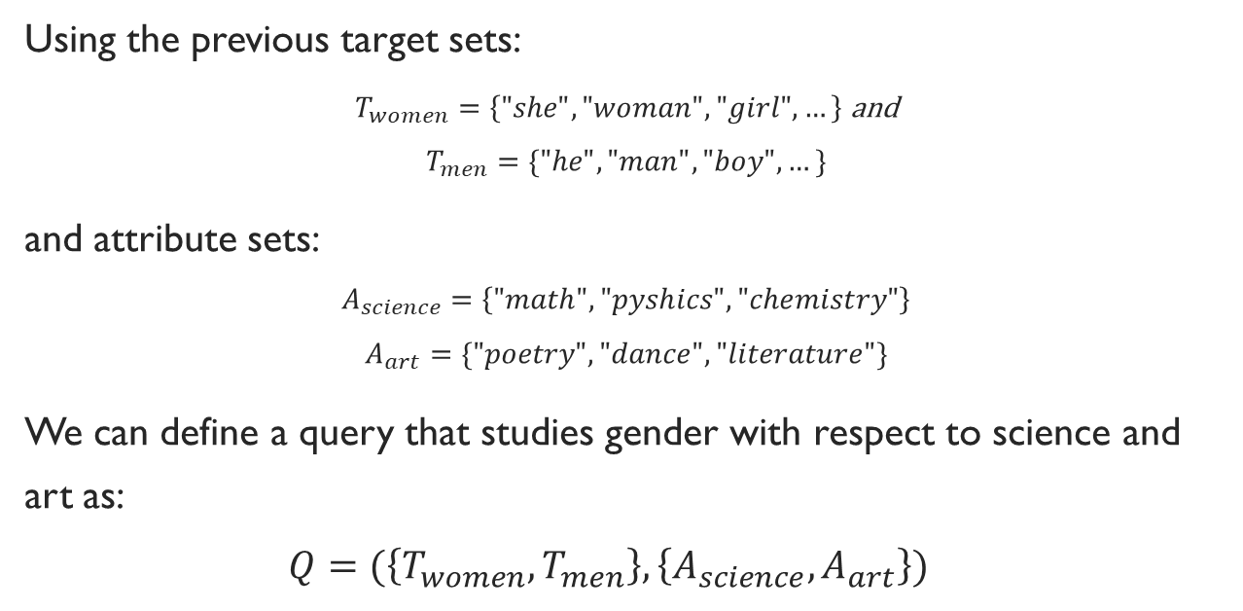
Example Query
Using the previous target sets:
$T_{women}=\left\{"she", "woman", "girl", …\right\}$ and
$$T_{men}=\{"he", "man", "boy", …\}$$
and attribute sets:
$$A_{science}=\left\{"math", "pyshics", "chemistry"\right\}$$
$$A_{art}=\{"poetry", "dance", "literature"\}$$
We can define a query that studies gender with respect to science and art as:
$$Q=(\left\{T_{women}, T_{men}\right\},\left\{A_{science}, A_{art}\right\})$$

Slide 21
Fairness Metric
A Fairness Metric is a function that
quantifies the degree of association between target and attribute sets
in a word embedding model.

Slide 22
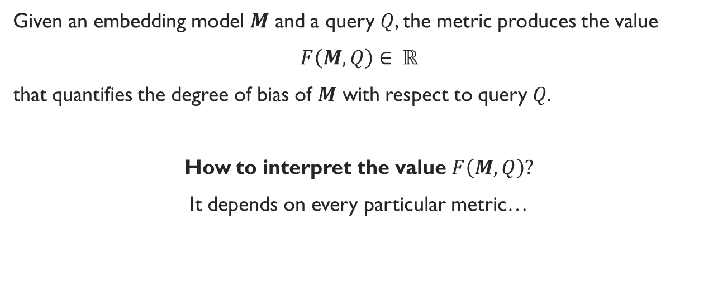
Fairness Metric
Given an embedding model $M$ and a query $Q$, the metric produces the value
$F\left(M, Q\right)∈ ℝ$
that quantifies the degree of bias of $M$ with respect to query $Q.$
How to interpret the value $F\left(M,Q\right)?$
It depends on every particular metric…

Slide 23

Fairness Metric
We assume that all metrics are equipped with a total order relation $≤_{F}.$
If
$$F\left(M_{1}, Q\right) ≤_{F}F\left(M_{2}, Q\right)$$
We can say that an $M_{1}$ is less biased than an $M_{2}$ in the metric and query tested.

Slide 24
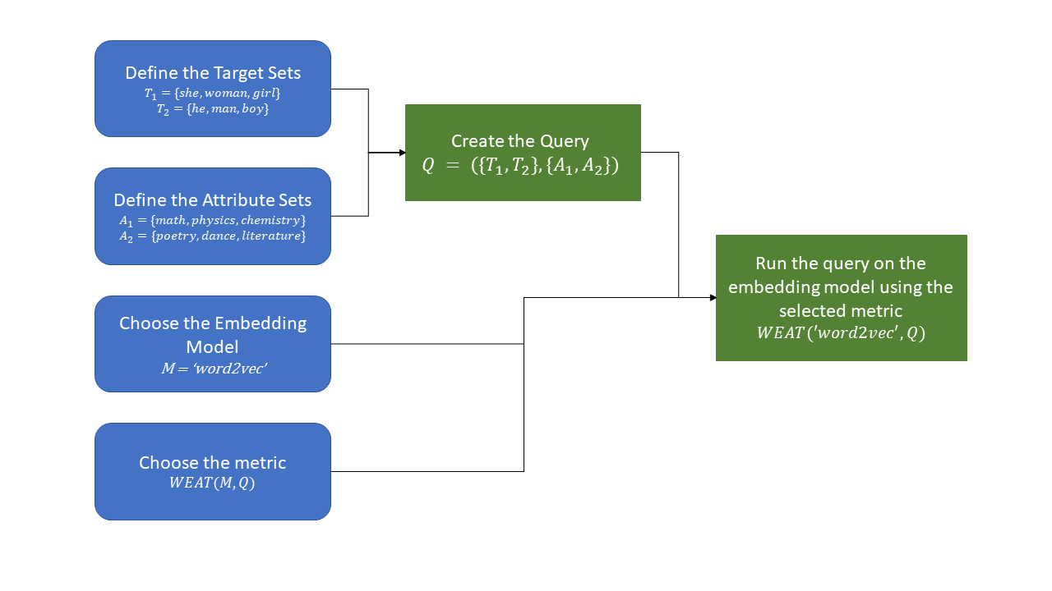
Standard usage pattern of WEFE

Slide 25
WEAT: Word Embedding Association Test
Proposed By | Operation | Score Interpretation | Case Study
Caliskan et al. 2017 [2] | Degree of association between two sets of target words and two sets of attribute words. | The larger the value, the greater the relationship between target-attribute one and target-attribute two. The ideal score is 0. | Studies biases regarding ethnicity (in relation to pleasant-unpleasant words) and gender (in relation to occupations).
Target Words | Attribute Words | WEAT Score
Flowers vs insects | Pleasant vs unpleasant | 1.54
Eur.-American vs Afr.-American names | Pleasant vs unpleasant | 0.58
Male vs female names | Career vs family | 1.89
Science vs arts | Male vs female terms | 1.24
… | … | …

Slide 26
Tutorial 1
😊

Slide 27
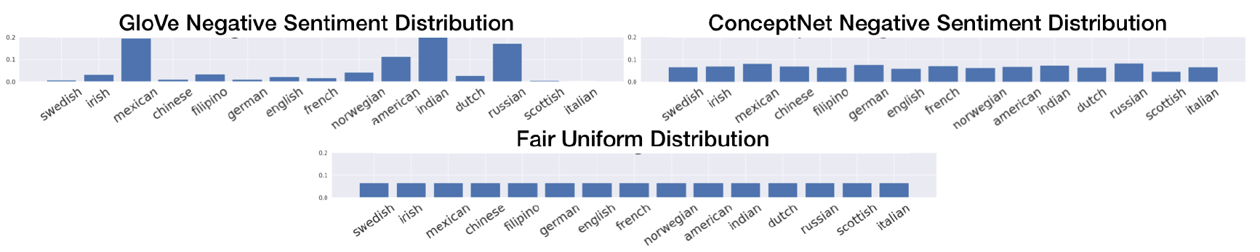
RNSB: Relative Negative Sentiment Bias
Proposed By | Operation | Score Interpretation | Case Study
Sweeney and Najafian in 2019 [4]. | Trains a logistic regression to predict the embedding sentiments. Then, calculates the KL divergence between the negative sentiment probability of the embeddings and a uniform distribution. | The higher the score, the greater the difference between a uniform distribution and the obtained. The ideal score is 0. | Test a set of national origin identity terms such as American, Mexican, and Canadian.

Slide 28
Tutorial 2
😊

Slide 29
Mitigation of Word Embeddings
WEFE standardizes all mitigation methods through an interface inherited from scikit-learn basic data transformations:
the fit-transform interface.

Slide 30
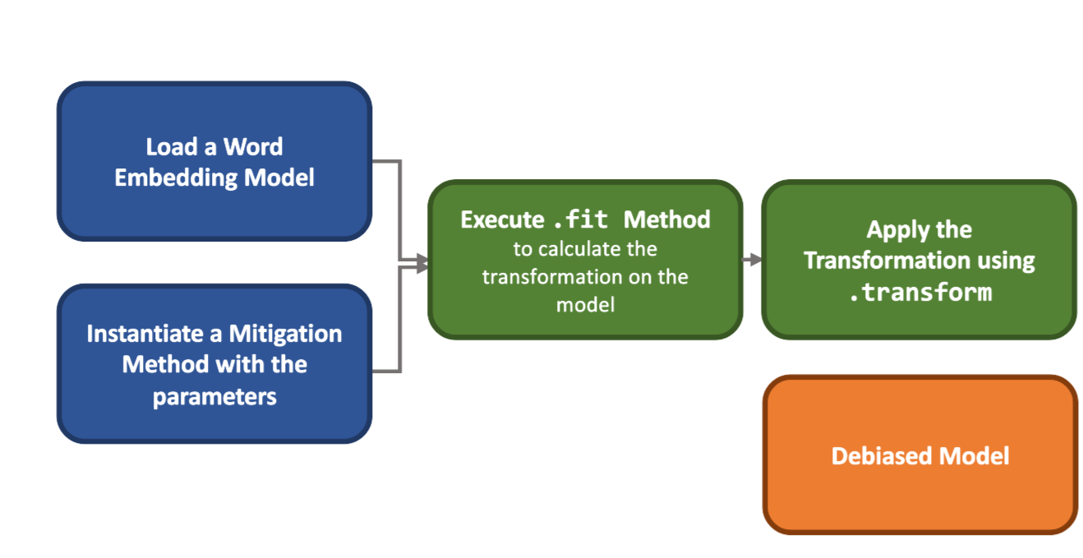
Mitigation Word Embeddings
Fit method
Learns the corresponding mitigation transformation.
This method is quite flexible: it can accept multiple sets of words and other parameters.
Transform method
Applies the transformation learned in the previous step to the original embedding space.
The method is rigid and only accepts lists of words that should be mitigated (target) or words that should be omitted (ignore).

Slide 31
Hard Debias
Hard debias [6] is a method that allows mitigating biases through geometric operations on embeddings.
This method is binary because it only allows 2 classes of the same bias criterion, such as male or female.
Identify Gender Direction.
Neutralize.
Equalize.

Slide 32
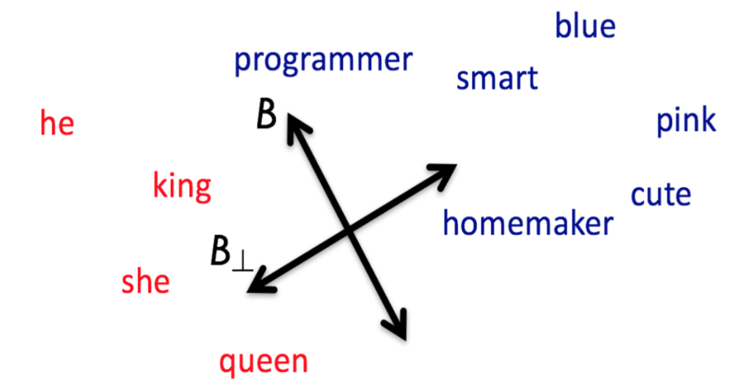
Hard Debias: Identify Gender Direction
1. Identify a bias subspace through the defining sets. In the case of gender, these could be e.g.
[['woman', 'man'], ['she', 'he'], ...]

Slide 33
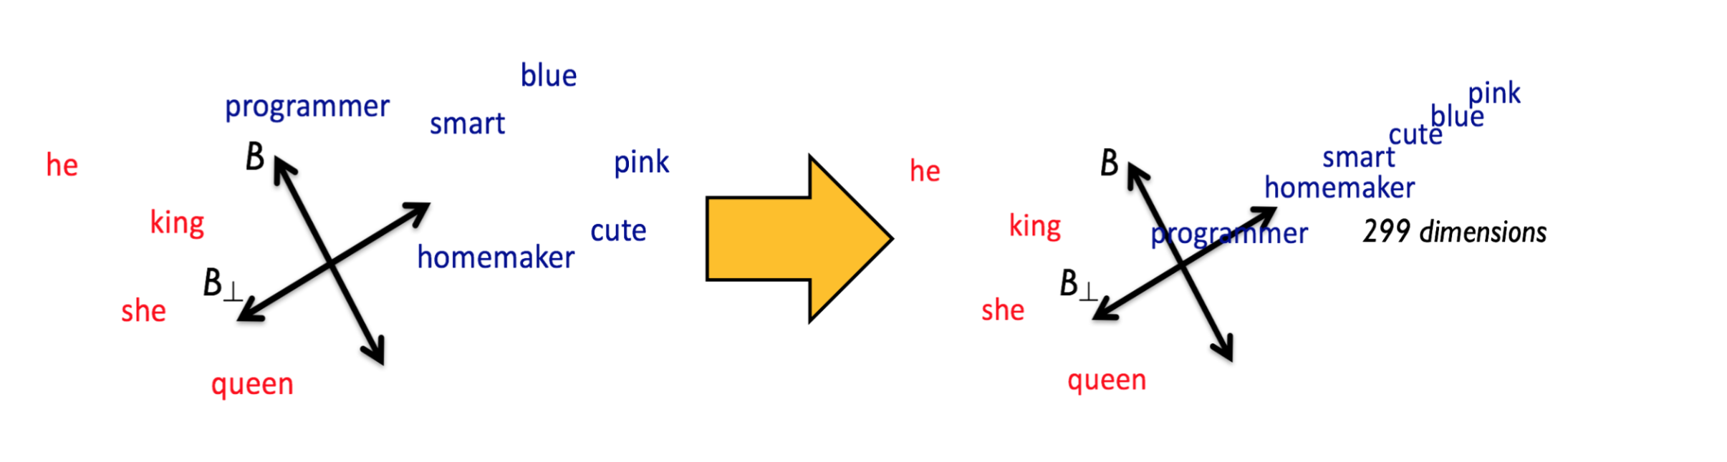
Hard Debias: Neutralization
2. Neutralize the bias subspace of embeddings that should not be biased:
Define a set of words that are correct to be related to the bias criterion (criterion specific words):
['he', 'his', 'He', 'her', 'she', 'him', 'him', 'She', 'man', 'women', 'men'...].
- Then all words outside this set should have no relation to the bias criterion and thus have the possibility of being biased
[programmer', ‘homemaker', ...]).
. Those words are neutralized:

Slide 34
Hard Debias: Equalization
Given an equalization set; e.g. ,
['she', 'he'], ['men', 'women’], …
This step executes, for each pair, an equalization with respect to the bias direction.
That is, it takes both embeddings of the pair and distributes them at the same distance from the bias direction, so that neither is closer to the bias direction than the other.

Slide 35
Tutorial 3
😊

Slide 36
WEFE implementation
We released WEFE as an open source library (0.4.0 🥳)!
The full documentation can be found in
https://wefe.readthedocs.io/
And the repository in:
https://github.com/dccuchile/wefe

Slide 37
Conclusions and future work

Slide 38
Conclusions
WEFE allows to cleanly compare bias measurements by abstracting away several components:
Target and Attribute sets.
Queries.
Templates.
Fairness Metrics and Scores.
Order relations among those scores.

Slide 39
Conclusions
WEFE standardizes all mitigation methods through an interface inherited from scikit-learn basic data transformations:
the fit-transform interface.

Slide 40
Conclusions
All the work was released as an open-source library so that the community can access these methods.

Slide 41
Future work
Most of the work has been done for the English language.
It is also important to work on defining queries for other languages and societies.

Slide 42
Future work
Fairness metrics is that they are not able to identify the source of the bias.
Biases may come from the corpus on which the embeddings are trained, but this is only a supposition.
The bias may also come in part from the algorithm.
Is still not clear why some models are less biased than others.

Slide 43
Future work
Implement measurement framework for contextualized embedding models.

Slide 44
thanks for your attention
WEFE: The Word Embedding Fairness Evaluation Framework
https://wefe.readthedocs.io/en/latest/

Slide 45
Annexes

Slide 46
Case study

Slide 47
Case Study
We conducted a case study in which we:
evaluate seven word embedding models according to three criteria of bias: gender, ethnicity and religion.
aggregate these scores and use them to rank the embeddings according to their bias.
compare the bias rankings with the performance rankings of Word Embedding Benchmarks (WEB).

Slide 48
Word Embeddings Benchmarks (WEB)
“Word Embeddings Benchmarks (WEB) is a package is focused on providing methods for easy evaluating and reporting results on common benchmarks (analogy, similarity and categorization).”
It measure and ranks embeddings performance in those downstream tasks.
WEB does not measure fairness in embeddings.
https://github.com/kudkudak/word-embeddings-benchmarks

Slide 49
Embedding models
The following are the pre-trained embedding models that we consider:
conceptnet
fasttext-wikipedia
glove-twitter
glove-wikipedia
lexvec-commoncrawl
word2vec-googlenews
word2vec-gender-hard-debiased

Slide 50

queries
Based on previous words, we constructed 3 query sets:
$𝒬_{gender}$with 7 queries
$𝒬_{ethnicity},$with 9 queries,
$𝒬_{religion}$with 9 queries.

Slide 51
Queries examples
Criteria | Target 1 | Target 2 | Attribute 1 | Attribute 2
Gender | Male terms 'he', 'son', 'his’, … | Female terms 'she', 'daughter', 'hers’, … | Career 'executive', 'management', 'professional’, … | Family 'home', 'parents', 'children’, …
Ethnicity | White Names 'harris’, 'nelson’, 'robinson’, … | Black Names 'howard’, 'thompson’, 'moore’, … | Pleasant 'caress', 'freedom', 'health’, … | Unpleasant 'abuse', 'crash', 'filth’, …
Religion | Christianity terms 'bible', 'christian', 'christianity’, … | Islam terms imam', 'islam', 'mosque’, … | Pleasant 'judgemental', 'conservative', 'familial’, … | Unpleasant 'violent', 'terrorist', 'dirty’, …

Slide 52
fairness metrics
The following metrics are those we will consider in the case study.
Word Embedding Association Test (WEAT)
WEAT Effect Size (WEAT-EZ)
Relative Norm Distance (RND)
Relative Negative Sentiment Bias (RNSB)

Slide 53
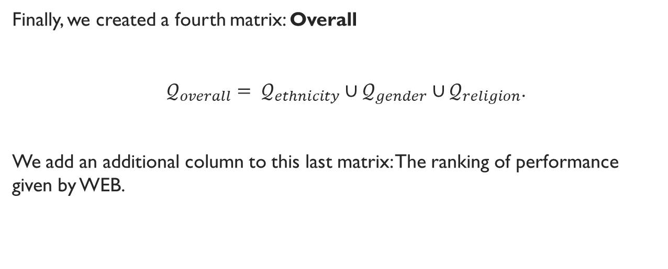
Case study: Overall And Web
Finally, we created a fourth matrix: Overall
${𝒬_{overall}= 𝒬}_{ethnicity}∪𝒬_{gender}∪𝒬_{religion}$.
We add an additional column to this last matrix: The ranking of performance given by WEB.

Slide 54
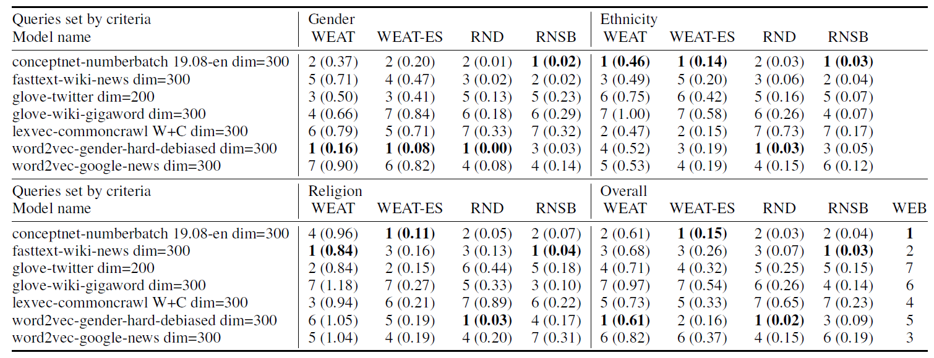
Case Study: Results

Slide 55
Case Study: Gender Results
Notes:
We can observe a clear tendency for word2vec-gender-hard-debiased and conceptnet to be at the top of the ranking

Slide 56
Case Study: Gender Results
Notes:
We can observe a clear tendency for word2vec-gender-hard-debiased and conceptnet to be at the top of the ranking

Slide 57
Case Study: Gender Results
Notes:
We can also observe that the debiased version of word2vec outperforms the non-debiased version across all metrics.

Slide 58
Case Study: Ethnicity and religion Results
,
Notes:
Conceptnet consistently outperforms other models in ethnicity and religion

Slide 59
Case Study: Ethnicity and religion Results
,
,
Notes:
The differences in terms of absolute scores of conceptnet with the closest fast are very small.

Slide 60
Case Study: Overall Results
Notes:
Conceptnet and fastext take the first two places in all metrics.

Slide 61
Case Study: overall Results
Notes:
Debiased outperforms in every test except in WEB, where it gets really bad results

Slide 62
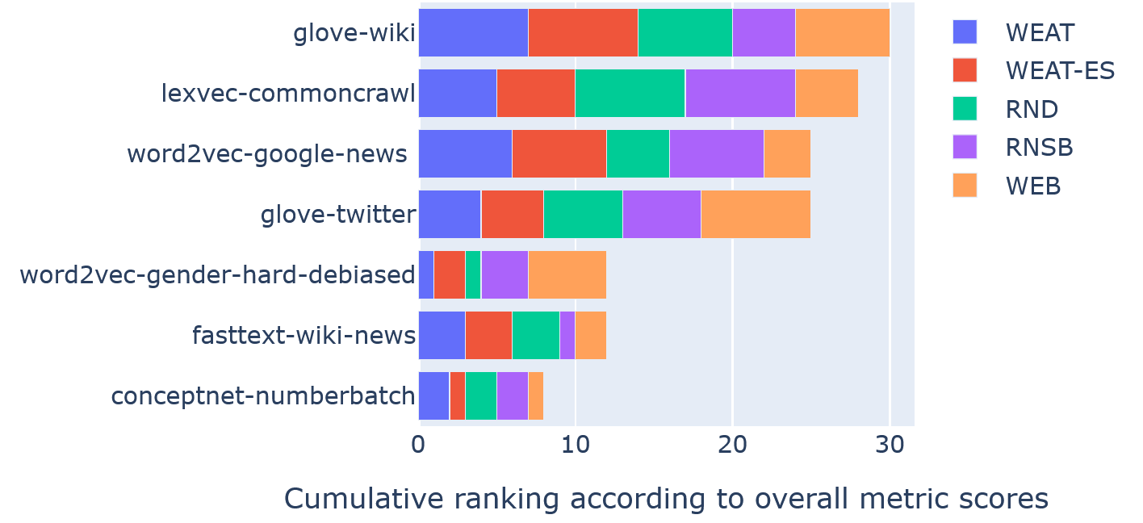
Case Study: Overall Rankings by metric
Notes:
WEFE rankings and WEB results using cumulative graph bars

Slide 63
Case Study: Overall Rankings by metric
Notes:
Conceptnet and fasttext maintain their leading positions,
However, there is no clear correlation between WEB and WEFE rankings.

Slide 64
Case Study: Overall Rankings by metric
Notes:
In the case of word2vec and its gender debiased variation, their positions in WEB and WEFE rankings are swapped by WEB and WEFE rankings.
This suggests that the gender debiasing method can affect the performance of the embedding model in word similarity and analogy tests.

Slide 65
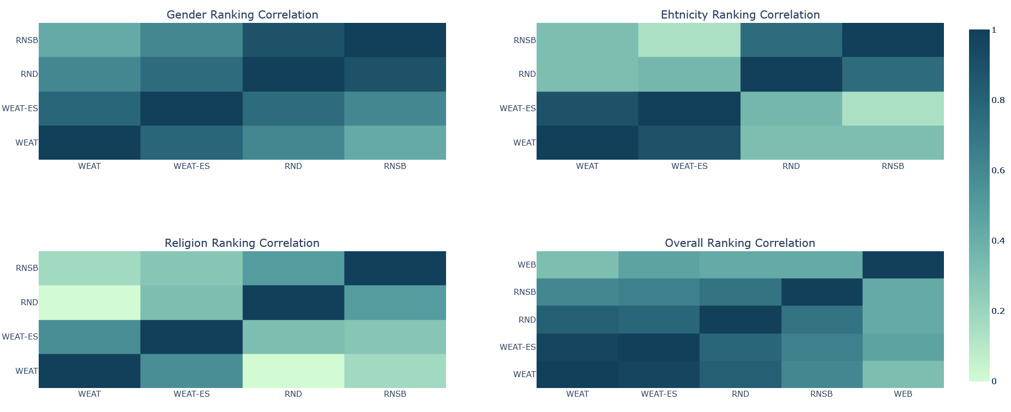
Case Study: Spearman’s Correlation between rankings
Notes:
These matrices allow us to state whether or not the rankings are aligned with each other according to the criteria evaluated.
Such agreement would enable us to establish whether the rankings obtained are reliable.

Slide 66
Case Study: Spearman’s Correlation between rankings
Notes:
High correlations can be observed between all metrics for gender.
This implies a consistency between metrics with respect to gender bias.

Slide 67
Case Study: Spearman’s Correlation between rankings
Notes:
Moreover, for ethnicity and religion the correlations between each ranking are significantly lower than for gender matrix.

Slide 68
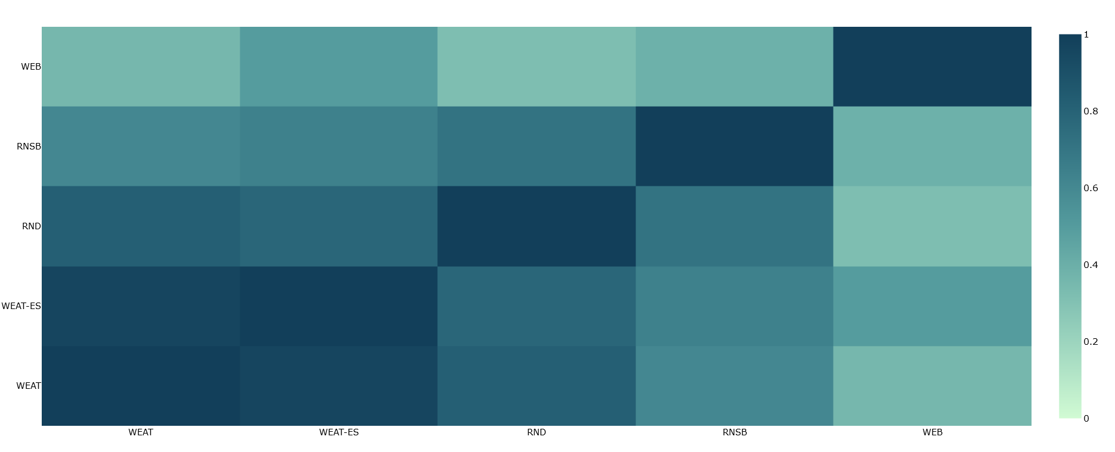
Case Study: Overall ranking Correlations with WEB
Notes:
The four fairness metrics for overall results exhibit clear positive ranking correlations in the overall matrix.

Slide 69
Case Study: Overall ranking Correlations with WEB
Notes:
However, there is no clear correlation between WEB and WEFE rankings

Slide 70
References
[1] P. Badilla, F. Bravo-Marquez, and J. Pérez WEFE: The Word Embeddings Fairness Evaluation Framework In Proceedings of the 29th International Joint Conference on Artificial Intelligence and the 17th Pacific Rim International Conference on Artificial Intelligence (IJCAI-PRICAI 2020), Yokohama, Japan.
[2] Caliskan, A., Bryson, J. J., & Narayanan, A. (2017). Semantics derived automatically from language corpora contain human-like biases. Science, 356(6334), 183-186..
[3] Garg, N., Schiebinger, L., Jurafsky, D., & Zou, J. (2018). Word embeddings quantify 100 years of gender and ethnic stereotypes. Proceedings of the National Academy of Sciences, 115(16), E3635-E3644..
[4] Sweeney, C., & Najafian, M. (2019, July). A Transparent Framework for Evaluating Unintended Demographic Bias in Word Embeddings. In Proceedings of the 57th Annual Meeting of the Association for Computational Linguistics (pp. 1662-1667)..

Slide 71
References
[5] Black is to Criminal as Caucasian is to Police: Detecting and Removing Multiclass Bias in Word Embeddings.
[6] Bolukbasi, T., Chang, K. W., Zou, J., Saligrama, V., & Kalai, A. (2016). Quantifying and reducing stereotypes in word embeddings. arXiv preprint arXiv:1606.06121..
[7] Mehrabi, N., Morstatter, F., Saxena, N., Lerman, K., & Galstyan, A. (2019). A survey on bias and fairness in machine learning. arXiv preprint arXiv:1908.09635..
[8] Yoav Goldberg. Neural network methods for natural language processing. Synthesis Lectures on Human. Language Technologies, 10(1):1–309, 2017.

Slide 72
References
[9] Gonen, H., & Goldberg, Y. (2019). Lipstick on a pig: Debiasing methods cover up systematic gender biases in word embeddings but do not remove them. arXiv preprint arXiv:1903.03862.

Slide 73
Quick Start
In the following code we will show how to implement this example query:

Slide 74
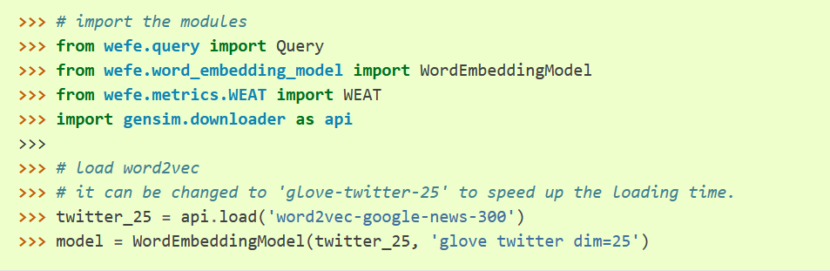
quick start
Load the Word Embedding pretrained model from gensim and then, create a WordEmbeddingModel instance with it.

Slide 75
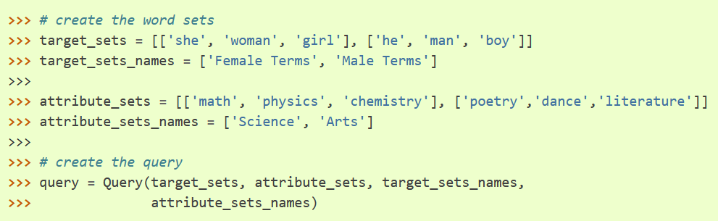
quick start
Create the Query with a target words and attribute words.

Slide 76
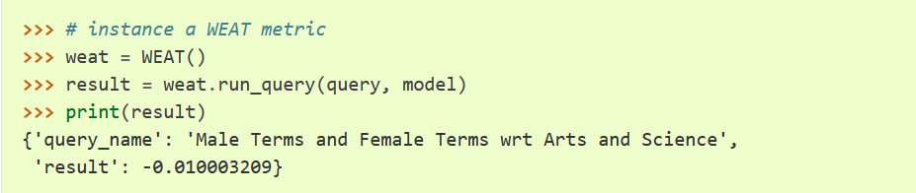
quick start
Instantiate the metric to be used and then, execute run_query with the query and the model in the past steps. In this case we will use WEAT.

Slide 77




WEAT
WEAT metric receives two sets $T_{1}$ and $T_{2}$ of target words, and two sets $A_{1}$ and$A_{2}$of attribute words.
$$=$$

Slide 78


WEAT Effect SIZE
$$=$$

Slide 79




RND
it receives queries with template $s_{RND}= (2, 1)$
where $| . {\left.​\right|}_{2}$ represents the Euclidean norm, and $avg(T)$ is the vector resulting from averaging all the vectors in $T$.
$$=$$

Slide 80
RNSB
Detailed explanation in the paper [1].

