Slide 1


ING
Theme: [ Experience / Automate ]
AI-Leave Assistant
One-line summary: apply for leave in plain English — an AI agent extracts, validates, confirms and routes it.
CodING is my cardio
19th – 20th June 2026
RISING STAR
Prakash Bagsariya · Krupal Tasare
Global Cognizant ING Hackathon 2026
1

Slide 2

PROBLEM & CONTEXT
Current Pain
Employees fight forms & codes; managers get scattered requests in email/chat that are easy to miss.
What problem are you solving?
!
Problem Statement
Applying for leave is slow and error-prone: HRMS forms, cryptic leave codes, hidden balances/policies, and manual routing.
●
Scale of Impact
Thousands of leave requests a year, org-wide — every one is manual today.
Use Case at ING
Every employee applying for leave and every manager approving it — across all teams.
Who Is Affected?
Employees, managers, and HR / Operations.
⚡
Business Relevance
Theme: Experience + Automate. Less HR overhead, fewer errors, happier employees.
In one sentence: the problem is manual, error-prone leave management, affecting every employee & manager, costing time and accuracy.
Why Solve It Now?
Leave is high-volume and repetitive — small frictions and errors scale across the whole org.
Global Cognizant ING Hackathon 2026
2

Slide 3
THE SOLUTION
What's the Hack?
Solution in a Nutshell
An AI agent: tell it your leave in plain English. It extracts a structured request, validates every rule, shows a confirmation card, and routes it to the right manager.
Architecture / Solution Flow
Input / Trigger
Employee chat
→
Processing
AI + Rules
→
Output
Card → approve
How It Works
Input: a chat message → Processing: Claude drafts + deterministic rules validate (balance, doc policy, overlap) → Output: confirmation card, submission, dept-routed approval + email.
Chat UI
↓
FastAPI orchestrator
TECH STACK
↓
AI / GenAI
Python · FastAPI
SQLite
Tailwind / JS
AI/Claude + Rules engine
↓
SQLite store
Software Craftsmanship
Deterministic guardrails, confirmation gate, role-based auth, dept routing, auto-approval SLA, audit log.
SMTP
↓
Confirmation gate
↓
Manager approval (by dept) + email
Global Cognizant ING Hackathon 2026
3

Slide 4
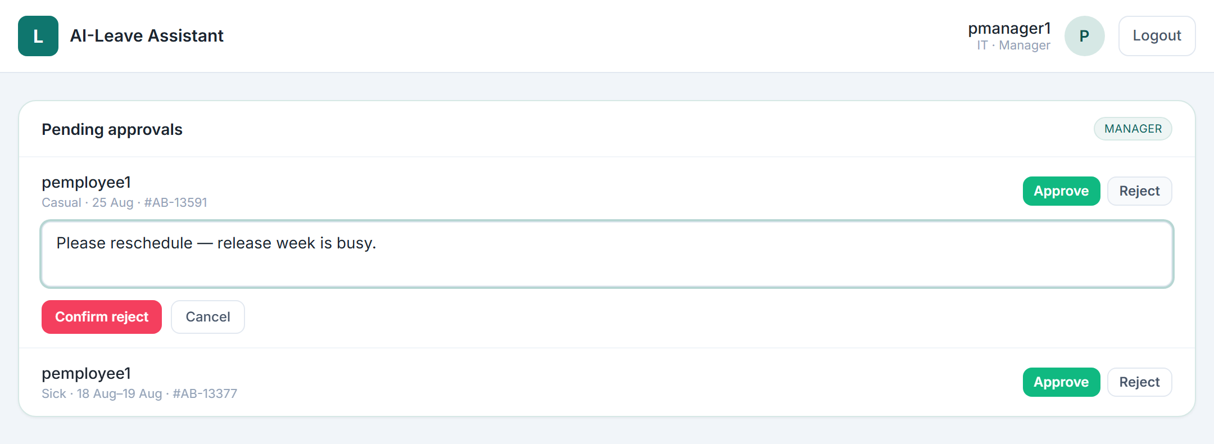
WORKING PROTOTYPE
Show us what you built
1
Feature 1
Apply in plain English — dates, type & reason parsed automatically.
2
Feature 2
Department approvals — routed to your team's manager; approve/reject with comments.
3
Feature 3
Status: [ Working prototype / MVP ] Repo: github.com/pbagsariya/AI-Leave-System
Guardrails + SLA — balance / overlap checks; sick leave auto-approves after 3 days.
Global Cognizant ING Hackathon 2026
4

Slide 5
IMPACT & BUSINESS VALUE
Why does it matter?
~90%
0
100%
Less time per request
Invalid requests submitted
Routed to the right manager
Seconds vs minutes of forms & codes
Balance · policy · overlap checks block them
By department, automatically
Quantifiable Benefits
Alignment & Risks
• Apply in plain English — no leave codes or forms
• Guardrails stop balance / overlap / policy errors
• Auto-routing + 3-day sick-leave SLA — nothing stuck
• Audit trail + email on every decision
Hackathon theme: Experience / Automate
ING goal: simpler, faster employee experience
Key assumption: extraction quality (mitigated by deterministic checks + offline fallback)
Risks: HRMS / SSO integration, email deliverability
Estimates based on the working prototype.
Global Cognizant ING Hackathon 2026
5

Slide 6

TEAM & ART OF POSSIBLE
The team behind the hack + what comes next
PB
KT
Prakash Bagsariya
Krupal Tasare
Lead Developer
Developer
Art of Possible — Broader Vision
Phase 1 (Done): Working app — NL apply, validation, dept approvals, notifications, auth.
Phase 2 (Next): Microsoft Teams bot; richer policies & reminders.
Phase 3 (Future): Live HRMS + SSO, multi-language, analytics dashboard.
SimplifyING · AutomatING · InnovatING
Global Cognizant ING Hackathon 2026
6

