Slide 1
Solution Challenge 1
Bike Count Estimation Challenge – Supervised Learning – Sommer Term 2026
Joris Engels
Paul Bahde
Florian Zink

Slide 2
Our Approach
Feature Engineering and Model Selection
Feature Engineering
Model Selection
Lag Features (1, 2, 3, 24, 48, 168)
Rolling Mean (3, 6, 12, 24, 168)
Split 90% Training Data & 10% Testing
Sorted according to time
December and parts of November as Testing
Grid Search for Parameters
MSE as Decision Criterion
Models
Linear Regression
Random Forests
XGBoost
Neural Network

Slide 3
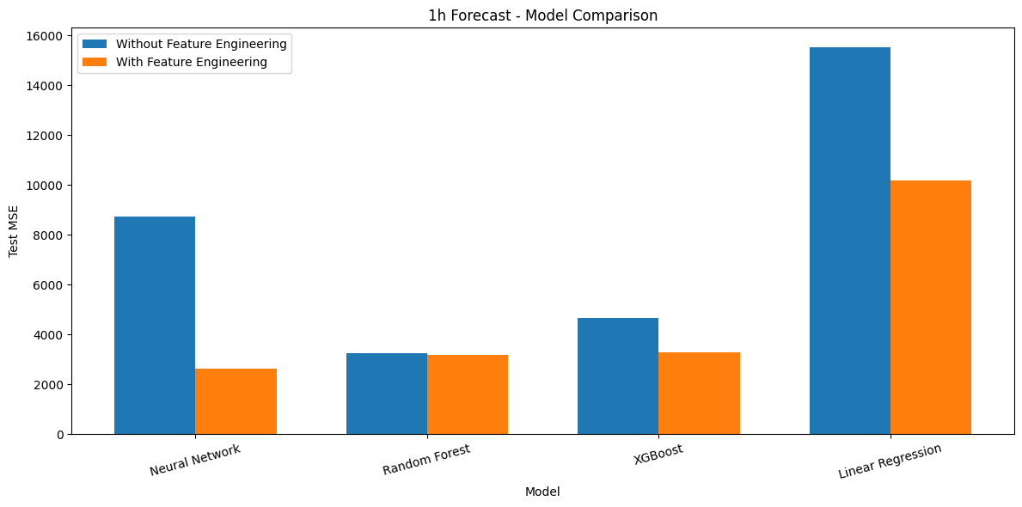
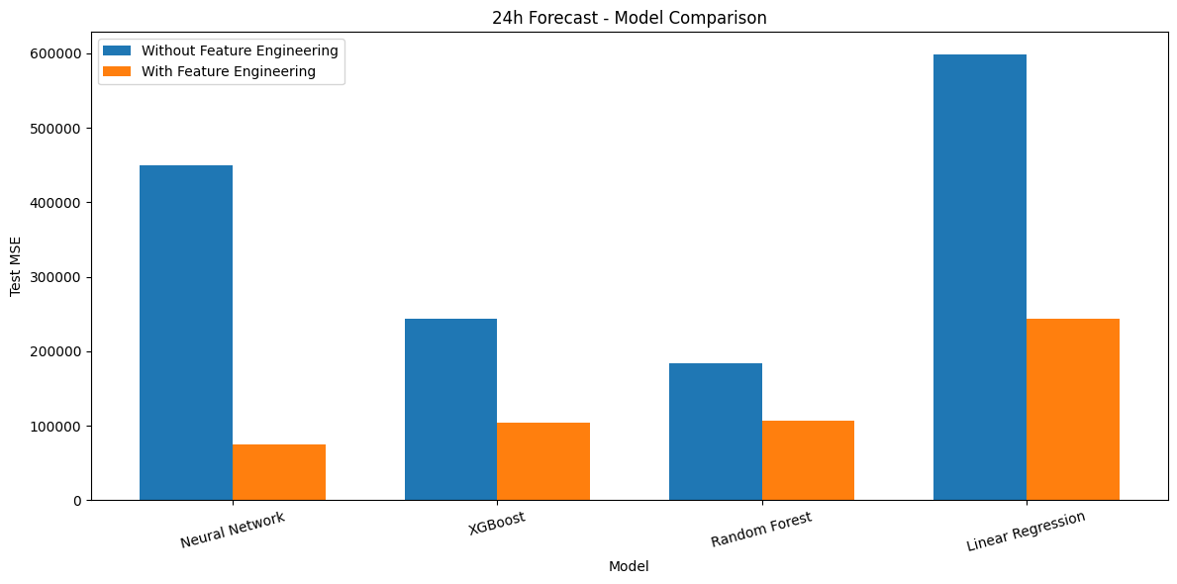
Our Results
Evaluation of 1h and 24h Forecast With and Without Feature Engineering

