Slide 1
FHIR API usage example
Retrieving appointments

Slide 2
Step 1 – get the 1st page
Query appointments with filter criteria
E.g.: appointments between -2019-01-01 01:02:03 and 2019-01-02 03:02:01 -modality=US (And also include actors, and based-on-information in the response)
https://capra.edison.health.ge.com:32763/etl-fhir-service/fhir/Appointment?date=gt2019-01-01T01%3A02%3A03&date=lt2019-01-02T03%3A02%3A01&modality=US&_include=Appointment%3Aactor&_include=Appointment%3Abased-on

Slide 3
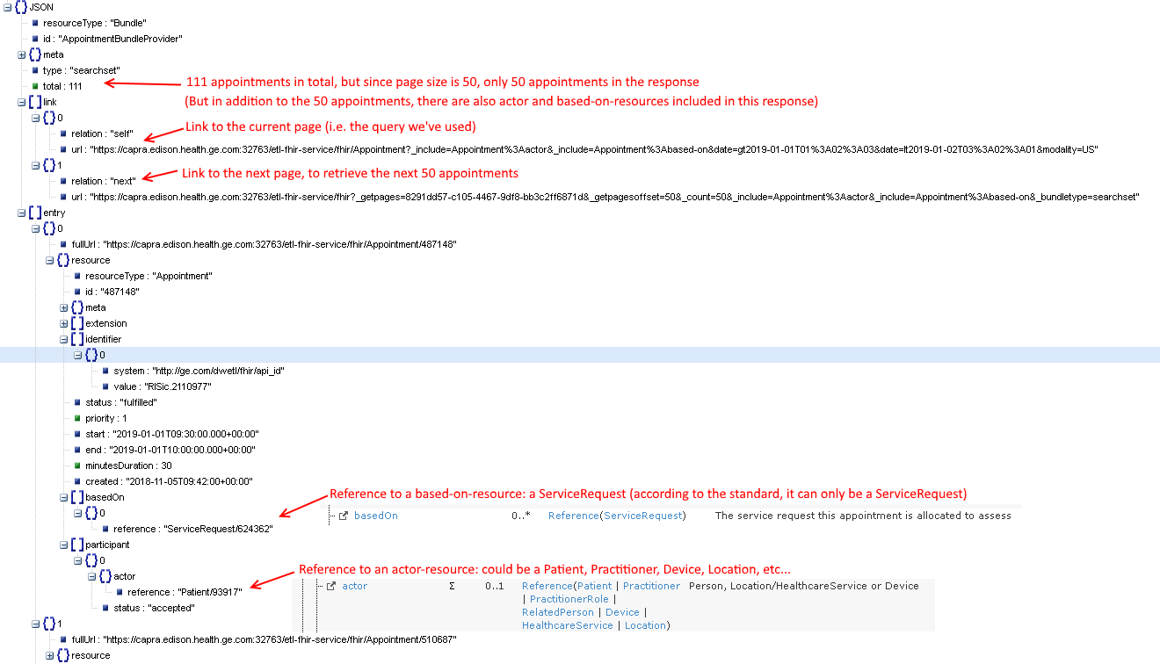
Step 1 – get the 1st page
The response

Slide 4
Step 1 – get the 1st page
The response - overview
Response JSON
Legend
Appointment 1
Appointment resource
Appointment 2
ServiceRequest (basedOn) reference
.
.
.
Actor reference
Appointment 50
HealthcareService reference
ServiceRequest (basedOn) resource
Actor resource
.
.
.
HealthcareService resource

Slide 5
Step 2 – get subsequent pages
While there is a next page, fetch it
Bundle response = getAppointmentsFromServer(appointmentFilters);
collectResources(response, appointments, patients, resources);
while (response.getLink(Bundle.LINK_NEXT) != null) {
response = client.loadPage().next(response).execute();
collectResources(response, appointments, patients, resources);
}

Slide 6
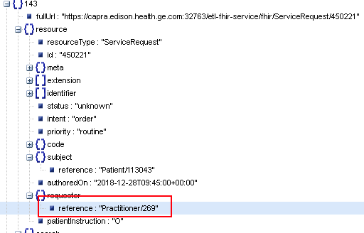
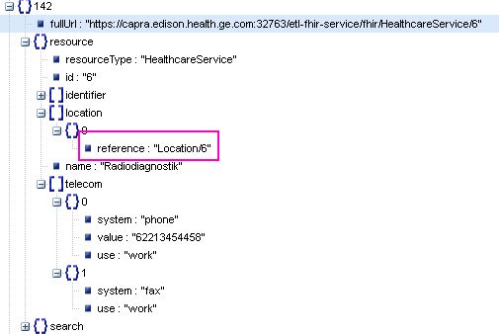
Step 3 – get resources not included directly
For resources that were not included in the paged appointment bundle, issue separate requests, by Id
Appointment Response JSON
Appointment
ServiceRequest
Actor
HealthcareService
ServiceRequest -> Practitioner
HealthcareService -> Location

Slide 7
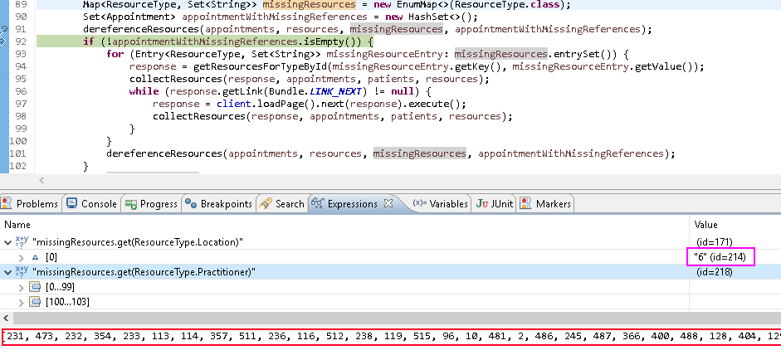
Step 3 – get resources not included directly
For resources that were not included in the paged appointment bundle, issue separate requests, by Id – continued: Gather the list of Ids, and then issue a (paged) request for each resource type
ServiceRequest -> Practitioner
HealthcareService -> Location

Slide 8
Step 3 – get resources not included directly
Example requests
Get location resources
https://capra.edison.health.ge.com:32763/etl-fhir-service/fhir/Location?_id:in=6
Get practitioner resources
https://capra.edison.health.ge.com:32763/etl-fhir-service/fhir/Practitioner?_id:in=48,190,151,273,394,395,274,275,431,156,113,433,279,159,314,435,92,95,51,96,59,15,240,163,241,285,440,321,167,288,125,444,323,402,127,325,369,205,206,8,60,528,68,26,171,370,172,451,496,254,454,455,334,257,533,335,258,414,535,459,537,416,417,419,73,77,184,382,185,186,187,540,387,301,268,103,467,501,105,304,109,508,85,509
Get practitioner resources – 2nd page
https://capra.edison.health.ge.com:32763/etl-fhir-service/fhir?_getpages=a7540b00-a716-453c-b7fc-77487b704f88&_getpagesoffset=50&_count=50&_bundletype=searchset

Slide 9
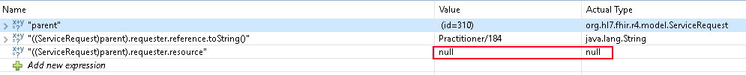
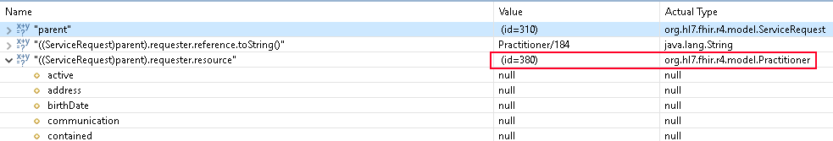
Step 4 – dereference resource references
Might be framework specific – Adding child object instance references to parents
Going from this:
To this:

