Slide 1
Gitlab DevOps Tool

Slide 2
Gitlab Dev Ops Tool
Gitlab will be used during the course to progressively build our secure software development build pipeline.
Gitlab provides the follow key capabilities:
Git repositories
Controlled change management through branch protection and change review
Automated build process based on triggers such as code checkins
Execution of compile, tests, scanning, packaging, and deployment of applications
Repository to manage dependencies

Slide 3
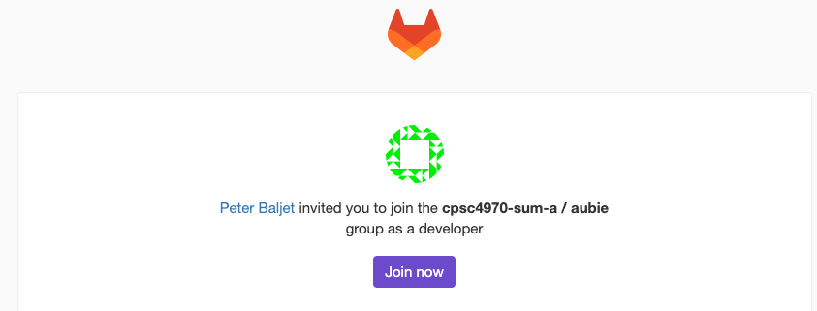
Gitlab Setup
You should have received an email providing access your Gitlab group.
Group: “CPSC4970-summer-a/<student>”
Setup an account with your Auburn email address
This Gitlab group will be used throughout the course
Assignment repositories will be added throughout the course.

Slide 4
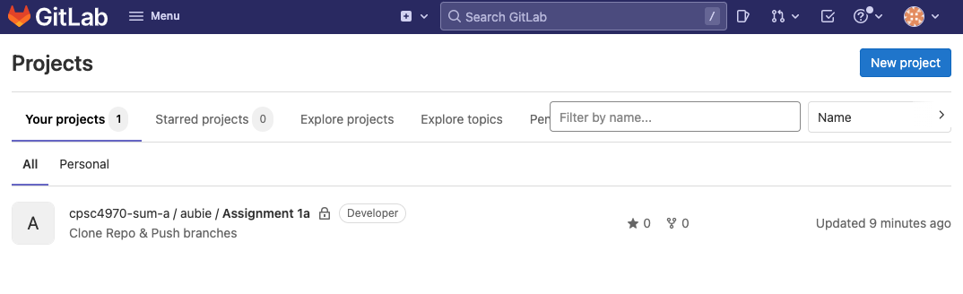
Gitlab Overview - Login View

Slide 5
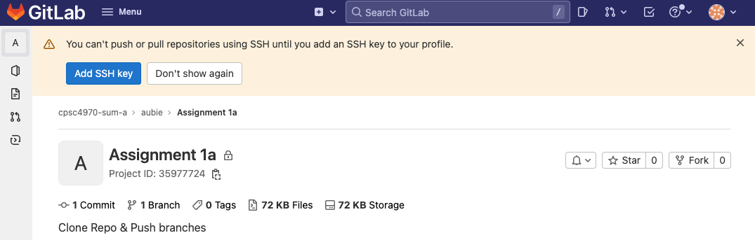
Gitlab Overview - Setup SSH Key
Select the Assignment 1a Project
Add an SSH key…following instructions.

