Slide 1
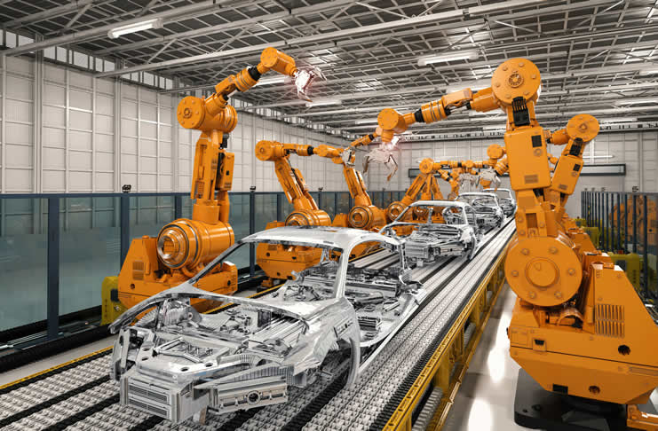
Maven Build Automation

Slide 2
What is Maven?
Automates Software Build Lifecycle
Manages external dependencies (open source, 3rd party, libraries)
Artifact generation (jar, war, etc.)
Artifact repository
Set of conventions to eliminate configuration complexity
Project kickstarter (archtypes)
Promotes modularity
Documentation

Slide 3
Automated Tools History
Makefiles - Bell Labs 1977, Unix/C
Apache Ant - ~2000 Java
Maven - 2007

Slide 4
Convention vs. Configuration
Removing unnecessary, time-consuming decisions out of development process for common tasks
Developers already know structure of codebase
Automated tools know where to find artifacts
Similar to Software Design Pattern concep.
Set of rules on how to organize a codebase
Boosts productivity by eliminating decisions, reducing tribal knowledge and work

Slide 5
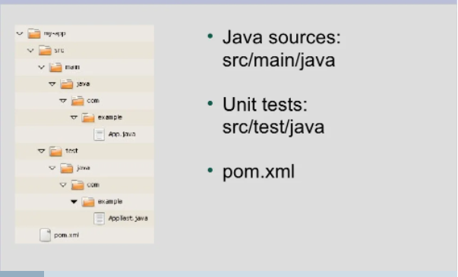
Maven Directory Structure Convention

Slide 6
Maven Lifecycle
Standard lifecycle commands or goals
clean
compile
test
package
install
Custom and advanced goals
deploy
site
documentation

Slide 7
Project Object Model
Single configuration file containing information necessary to build a project.
Provides base information
Group ID com.business.feature…
Artifact ID
Dependencies
What external software does the project depend on
What version
Environment Variables
Plugins for additional build capabilities
Testing tools
Security tools

Slide 8
Artifact Repositories
Local Repository
Local cache for dependency artifacts
Useful for offline builds
Can be erased as Maven recursively looks for dependencies and will reload
Default location in .m2/repository folder
Location can be specified through $MAVEN_HOME/conf/settings.xml
Public vs. Private repositories
Private - local machine (.m2) or internal server with repository software
Public - Maven Central located publicly on the internet

Slide 9
Repository Relationship
remote
Public
remote
internal
Organizational
local
Local Machine
local
Project A
Project B
Project A
Project B

