Slide 1
CPSC 4970 Applied Cyber Security
Module 1

Slide 2
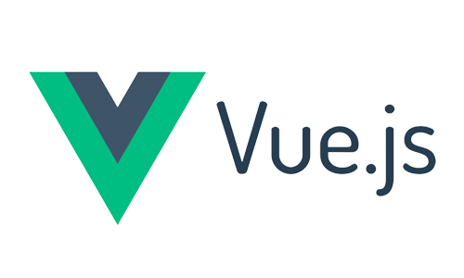



Why is Cyber Security Important
2020
2021
2022
CVE-2022-21660
CVE-2021-30116
CVE-2021-35211
CVE-2021-44228
CVE-2021-45046

Slide 3
White House Drives Legislation
Executive Order (EO) 14028 - May 12, 2021
“Improving the Nation’s Cybersecurity” requiring the government to only purchase software that is developed securely.
Sec. 4 - “Enhancing Software Supply Chain Security” - The development of commercial software often lacks transparency, sufficient focus on the ability of the software to resist attack, and adequate controls to prevent tampering by malicious actors. There is a pressing need to implement more rigorous and predictable mechanisms for ensuring that products function securely, and as intended.
July 28, 2021 - National Security Memorandum on Improving Cybersecurity for Critical Infrastructure Control Systems
Memorandum M-21-30 - Aug 10, 2021 - Protecting Critical Software Through Enhanced Security Measures
Software that controls access to data, cloud-based and hybrid software, software development tools, such as code repository systems, testing software, integration software, packaging software, and deployment software, software components in operational technology (OT).

Slide 4
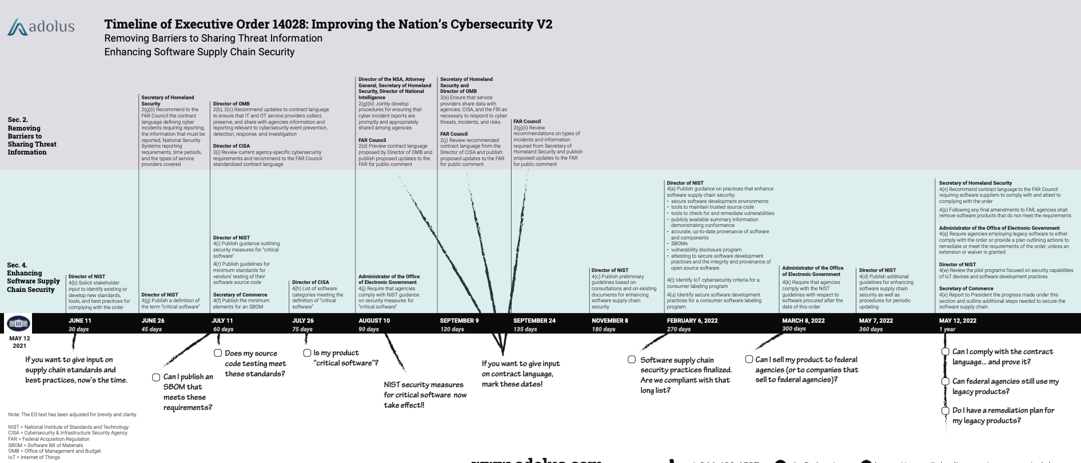
White House Drives Legislation
Improve Software Supply Chain Security

Slide 5
Improve Software Supply Chain Security
Establish baseline security standards for development of software sold to the government, including requiring developers to maintain greater visibility into their software and making security data publicly available.
Establishes concurrent public-private process to develop new and innovative approaches to secure software development and uses the power of Federal procurement to incentivize the market
Creates a pilot program to create “energy star” type of label so government and public at large can quickly determine whether software was developed securely.
Focuses on the using the purchasing power of the Federal Government to drive the market to build security into all software from the ground up.

Slide 6
Securing Software Dev Environments
Separate build environments with administrative controls
Regular audits of access controls; implement advanced authentication mechanisms (multi factor).
Employ data encryption
Employing automated tools with access to trusted source code supply chains, thereby maintaining code integrity
Automated tools to check for known and potential vulnerabilities to support quick action for remediation or risk mitigation.
Provide proof of origin of software code or components and controls on internal and 3rd party software components, tools, and services present during development process.
Perform audits on effectiveness of controls on a recurring basis.
Coming: Software Bill of Materials - what does your software contain?

Slide 7
Cyber Security Industry Standards

Slide 8
NIST & National Vulnerability Database (NVD)
US Government standards based vulnerability management data
Originally created in 1999 (called Internet - Categorization of Attacks Toolkit or ICAT
Provides common language (taxonomy) for analyzing, scoring, and classifying vulnerabilities.
Common Weakness Enumeration (CWE)
List of software and hardware weakness types that serves as a baseline for weakness identification, mitigation, and prevention efforts.
Common Vulnerabilities and Exposures (CVE)
Known vulnerability database for specific code bases, such as software applications or open source libraries
Common Weakness Scoring System (CWSS)
Provides a mechanism for prioritizing software weaknesses in a consistent, flexible, open manner.

Slide 9
CVE Program
Maintained by MITRE Corporation, sponsored by Department of Homeland Security (DHS), Cybersecurity and Infrastructure Security Agency (CISA) Division
CVE IDs are primarily assigned by MITRE
Also by authorized CVE Numbering Authorities (CNAs) such as corporations or
Maintains a centralized, searchable database of known vulnerabilities
All information contained in the project is publicly available to any interested party.
Provides a common means of discussing and researching exploits.
CVE IDs are used by vendors and cybersecurity personnel for research and the identification of new vulnerabilities.
The program do not assist in mitigating or patching vulnerabilities on the CVE list
Format for CVE IDs is: CVE-[4 Digit Year]-[Sequential Identifier]

Slide 10
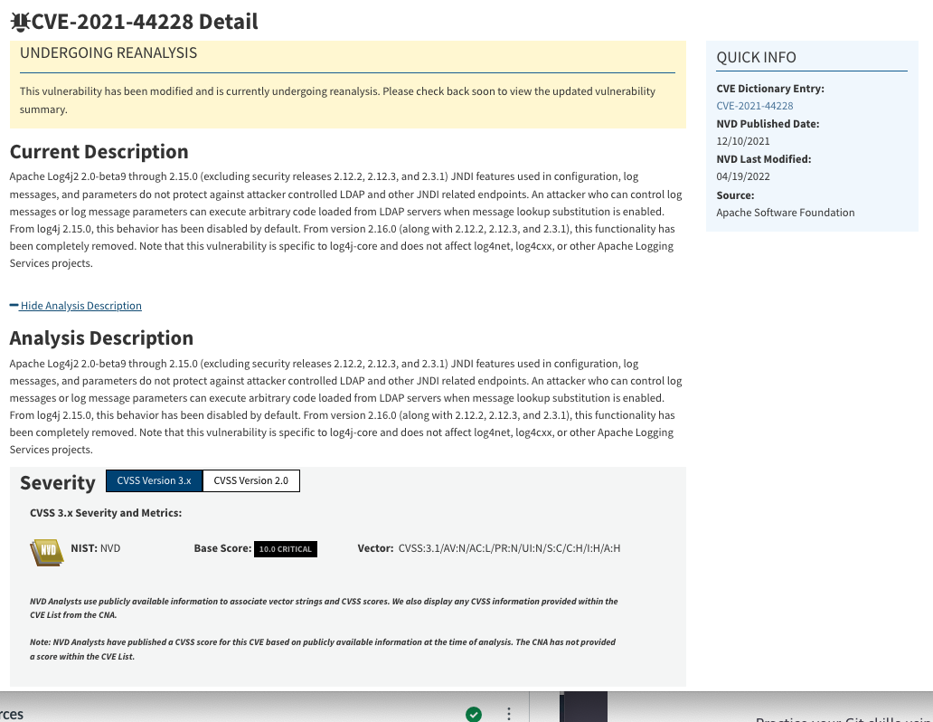
CVE-2021-33228 Log4J JNDI Vulnerability
NIST CVE Database Entry
MITRE CVE Database Entry

Slide 11
Common Weakness Enumeration (CWE)
Common language for describing and communicating software and hardware weaknesses types
Community driven to define concise and specific weakness types
List is hierarchy in design for both software and hardware. Revised on an ongoing basis as threat landscape and software/hardware architectures evolve.

Slide 12
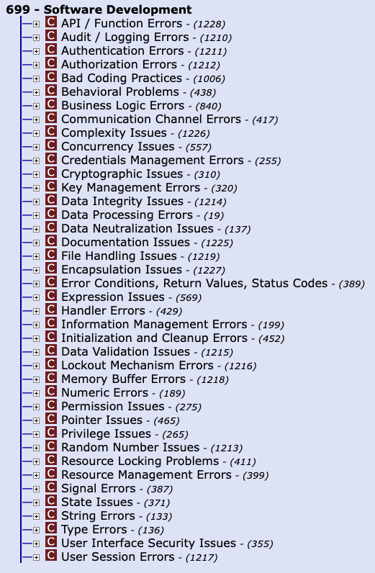
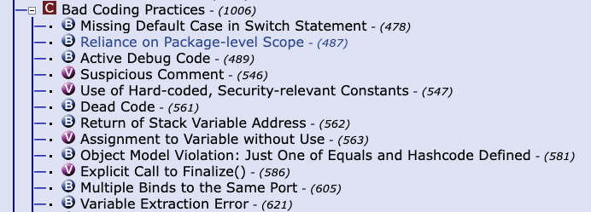
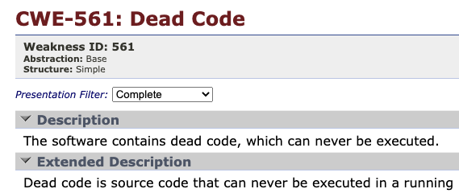
Common Weakness Enumeration (CWE)

Slide 13
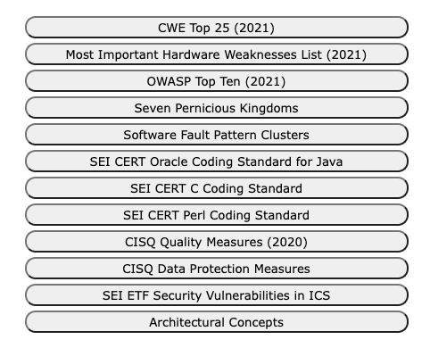
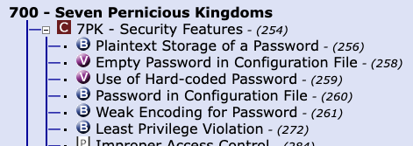
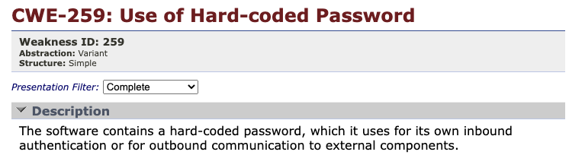
Common Weakness Enumeration (CWE)
External Mappings & Lists

Slide 14
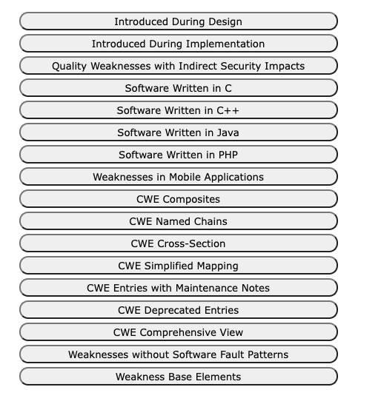
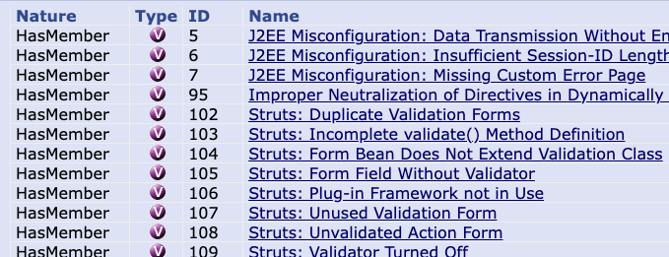
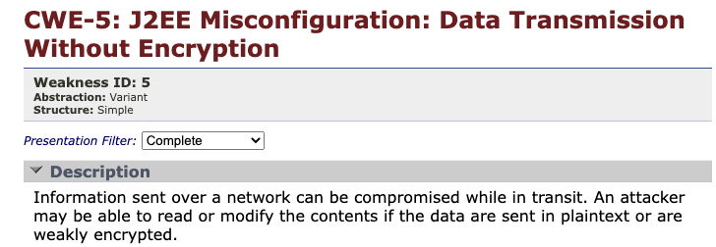
Common Weakness Enumeration (CWE)
Helpful References

Slide 15
Common Vulnerability Scoring System (CVSS)
Open framework for communicating the characteristics and severity of software vulnerabilities
Provides a numerical (0-10) representation of the severity of an information security vulnerability
Maintained by Forum of Incident Response and Security Teams (FIRST) comprised of 500+ member organizations.
CVSS Measures Severity, not Risk
A standardized scoring system provides the ability for software developers to prioritize issues so they can investigate and fix the highest risk items.

Slide 16

Software Composition

Slide 17
Software Composition
Most application software utilizes larger amounts of open source and 3rd party software
Not uncommon for application source code to be <25% of over all source code.
Your Source Code
Dependency Depth
JDK Core Libraries
Open Source S/W
3rd Party S/W
Open Source S/W
Open Source S/W
Open Source S/W
Open Source S/W
3rd Party S/W
Open Source S/W
Open Source S/W
Open Source S/W
Open Source S/W
Open Source S/W

Slide 18
Software Composition Challenges
How do you validate your developers are writing secure source code?
How do you control the introduction of open source and 3rd party software?
How are you notified when a vulnerability is uncovered in a software dependency?
Your Source Code
JDK Core Libraries
Open Source S/W
3rd Party S/W
Open Source S/W
Open Source S/W
Open Source S/W
Open Source S/W
3rd Party S/W
Open Source S/W
Open Source S/W
Open Source S/W
Open Source S/W
Open Source S/W

Slide 19
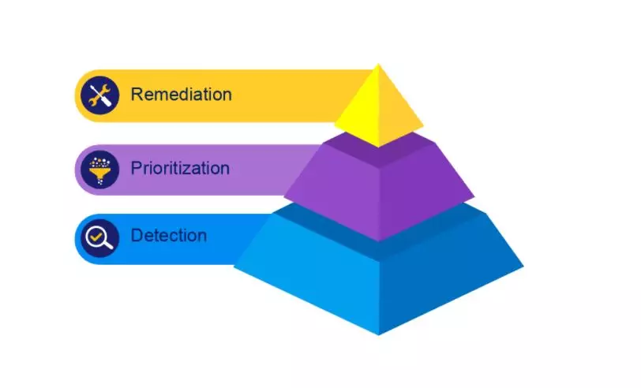
Risk and Remediation

Slide 20
Confidentiality, Integrity, Availability (CIA)
3 goals of secure software development to insure information security:
Confidentiality - Preserving authorized restrictions on information access and disclosure, including means for protecting personal privacy and proprietary information
Integrity - Guarding against improper information modifications or destruction, and includes ensuring information non-repudiation and authenticity
Availability - Ensuring timely and reliable access to and use of information.

Slide 21
Cyber Security Challenges
Software security does not equal software quality.
No point solution will provide a single solution for software security.
A holistic defense-in-depth approach is required
A blend of people, process, and technology. The most important part being people.
This course will apply techniques utilizing people, process and technology to build a secure software development process

Slide 22
Defense in Depth Approach
Historically information security industry has focused on network and application security, assuming software is secure and their security controls were sufficient protection.
Security practices during the software development cycle is now considered a first step in securing software systems and reducing risk.
Defense-in-Depth security approaches see the software development process as a essential part of policies and standards of a comprehensive cyber security system.
Defense-in-depth is a strategy that provides multiple security controls in case other security control fails or a vulnerability is exploited.
Originated from a military strategy by the same name, which seeks to delay the advance of an attack by constructing multiple defensive lines.
Defense-in-depth cybersecurity use cases include end-user security, product development, network security, etc.

Slide 23
Zero Trust Defense-in-depth approach
Client/Mobile Protection
Physical Equipment & Infrastructure
Perimeter Infrastructure
Internal Network
Compute
Operating System
Application Development & Deployment
Course Focus
Data

Slide 24
Shift Left on Software Security
By Integrating information security practices into daily work, software teams can achieve higher levels of software delivery performance and build more secure systems.
Security concerns, are addressed earlier in the software development lifecycle thus shifting left with regards to later stages of the development lifecycle.
Design
Dev
Test
Stage
Prod
Cost & Time required to identify and remediate security flaws
Shift Left in Security Practices

Slide 25
Course Project Overview

Slide 26
Course Objectives & Project
Design & Architecture
Development & Test
Production
Maintain
Continuous Integration / Continuous Delivery
Monitor
Remediate
Security Architecture & Design
Source Code Control
Test
Code Scanning (SAST)
Build
Automation Pipeline
Artifact Repository
Code Scanning (DAST)
Secrets Mgmt
Continuous Monitoring & Logging
Collab. & Work Tracking
Repository Scanning
Security Automation
Manual Security Methods
The following are commonly identified security gaps in a DevOps Pipeline:
Static code scanning to support code quality and secure coding standards
Dynamic application security testing for applications is performed
Continuous logging and monitoring of production environment
Checkpoints and gates must be implemented so security controls are in place:
Security and architecture based on attack surfaces and data sensitivity.
Ongoing source code change management controls based on code inspections and reviews.
Periodic penetration tests are performed (e.g., OWASP Zap)

