Slide 1
Git Version Control System

Slide 2
Git Version Control
Create in 2005 for Linux kernel project by Linus Torvalds
Tech Talk: Linus Torvalds on git
Git is a free and open source distributed version control system designed for distributed software development from small to large projects.
Source code can be worked on independently on a local workstation and integrated into a master or main code line.
Strong support for non-linear development
Distributed version control
Can handle large projects efficiently
Uses cryptographic functions to maintain history

Slide 3
Git Concepts - Repository
Location where all artifacts are stored (files, directories, meta data, etc.)
Contains complete change history of your artifacts
Can be shared among any number of people
Repository

Slide 4
Git Concepts - Working Copy
A local snapshot of an entire repository to perform work
Private so only a single person can perform work
Contains metadata to keep track of all changes
Woking Copy
Repository
Clone

Slide 5
Git Concepts - Update
Updates made to the repository by others can be made to working copy
Merge changes with changes you have made, but not committed
Local Workstation
Woking Copy
Update
Repository
Local

Slide 6
Git Concepts - Distributed Version Control
Local and remote have full copy of the repository
Local system pulls and pushes changes to central remote repository
Repository
Remote
Local
Local
Local
Woking Copy
Repository
Woking Copy
Repository
Woking Copy
Repository

Slide 7
Git Concepts - Push
Push copies committed changes in local repository to remote repository
Local Workstation
Woking Copy
Repository
Repository
Commits
Push
Local

Slide 8
Git Concepts - Pull
Pull copies artifacts and/or metadata from remote repository to local
Merging may need to take place if same files have been changed
Local Workstation
Woking Copy
Repository
Repository
Pull
Local

Slide 9
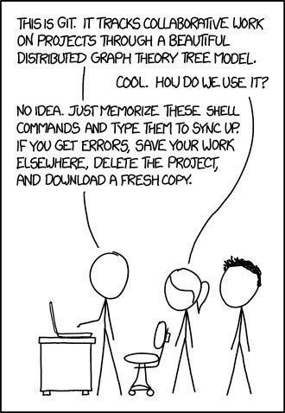
Warning

Slide 10
Git Post Installation Setup - git config
GIT VERSION CHECK
SET CONFIG VALUES

Slide 11
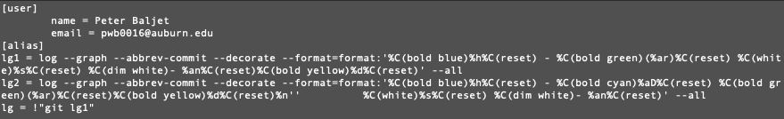
.gitconfig Configuration File
Located in user home directory: ~/.gitconfig
Contains global settings for git for a specific user
Settings can be changed in this file or through command line

Slide 12
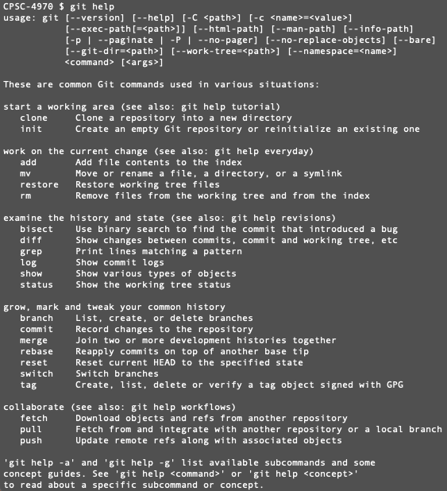
Getting Command Line Help
git help
git help -a
git help <command>
git <command> help

Slide 13


Create New Git Repository - git init
Create a new directory and change into it.
git init creates a new repository in the current directory
Creates “.git” directory which contains all git version control data.
git status shows the current status of added/modified/deleted files.
Nothing there yet!

Slide 14
Understanding how git tracks files locally
Working Directory
repo1
Staging
repo1/.git/index
Repository
repo1/.git/objects
git add
git commit

Slide 15
Understanding how git tracks files remotely
Remote
repo1
Working Directory
repo1
Staging
repo1/.git/index
Repository
repo1/.git/objects
Remote
repo1
git pull
git add
git commit
git push

Slide 16
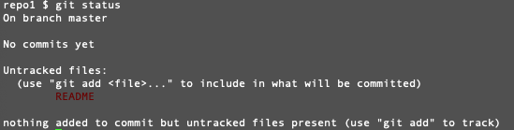
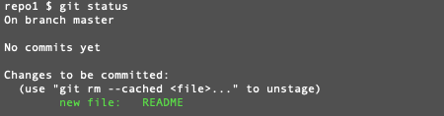
Adding files to your repository - git add
Create a README file in the root directory
git status
git add README
git status

Slide 17


Commiting files to the repository - git commit
README file is in staging area
git commit -m “Initial Version”
git status
git log

Slide 18
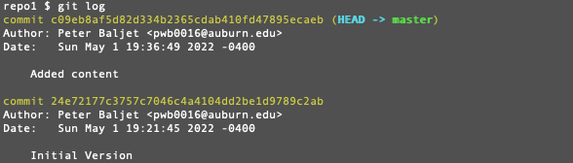
Tracking changes
Edit README and add content to the file
Let’s get it into the repository
git add README
git status
git commit -m “Added content”
git status
git log

Slide 19
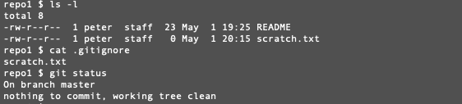
Ignoring non-repository file
Not all files need to be tracked in version control
IDE configuration files
Local scratch files
To avoid having these files show up in git commands (git status) you can add them to a .gitignore file in a directory.
.gitignore files are added to the repository and changes committed.

Slide 20
.git Hidden Directory
Located in root directory of your working space.
Contains all artifacts and metadata of your repository
Delete this directory deletes the entire repository. Your workspace is not longer tracked and is plain old files and directories.
Key files & directories
objects - contains repository files, commits, tree.
index - file containing pathnames of file in repository

Slide 21
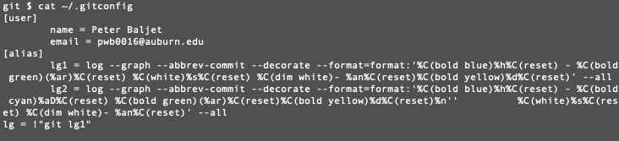
Git Config - Configuration file
.gitconfig file is located in your user home directory
Contains several sections for config information.
Changing through “git config –global” or by editing file directly

Slide 22
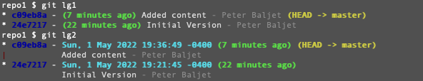
Adding git “pretty log views”
alias commands can be added to .gitconfig to provide shortcuts and customization
The following entries configure log commit history to be displayed more compact and color coded. We will use these later to view branches.
[alias]
lg1 = log --graph --abbrev-commit --decorate --format=format:'%C(bold blue)%h%C(reset) - %C(bold green)(%ar)%C(reset) %C(white)%s%C(reset) %C(dim white)- %an%C(reset)%C(bold yellow)%d%C(reset)' --all
lg2 = log --graph --abbrev-commit --decorate --format=format:'%C(bold blue)%h%C(reset) - %C(bold cyan)%aD%C(reset) %C(bold green)(%ar)%C(reset)%C(bold yellow)%d%C(reset)%n'' %C(white)%s%C(reset) %C(dim white)- %an%C(reset)' --all
lg = !"git lg1"

Slide 23
Git Branching

Slide 24
What is Branching - Security Context
Branching allows for the control of change to a central code base.
Before changes are committed to a central code base they can be reviewed from multiple perspectives:
Code quality, standards, conciseness
Code adherence to functional, architectural and performance requirements
Code security weakness
Branching from a code base allows developers to work on independent versions of the code base for specific purposes:
New feature
Bug fix
Refactoring

Slide 25
Types of branches
All branches are all the same. The name typically indicates the purpose of a branch.
Bug Fix
Main/
Master
Develop/
Release
Feature A
Feature B
Bug A
Time

Slide 26


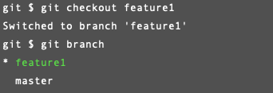
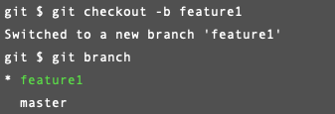
Managing Branches - git branch
Git Branch commands:
List branches:
Create branch:
Checkout branch:
Create and Checkout:

Slide 27

Watching the branch tree
A good practice to learn git is to continually watch the branch tree and try to predict the changes after git commands (branch, commit, etc.)
git log
git lg1
git lg
git lg2

Slide 28
Making Commits on a branch
git checkout - use to switch between branches.
Files not in current branch will be removed
Files that differ will be replaced

Slide 29
Gitlab DevOps Tool

Slide 30
Gitlab Dev Ops Tool
Gitlab will be used during the course to progressively build our secure software development build pipeline.
Gitlab provides the follow key capabilities:
Git repositories
Controlled change management through branch protection and change review
Automated build process based on triggers such as code checkins
Execution of compile, tests, scanning, packaging, and deployment of applications
Repository to manage dependencies

Slide 31
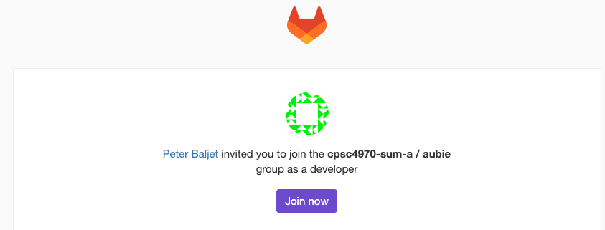
Gitlab Setup
You should have received an email providing access your Gitlab group.
Group: “CPSC4970-summer-a/<student>”
Setup an account with your Auburn email address
This Gitlab group will be used throughout the course
Assignment repositories will be added throughout the course.

Slide 32
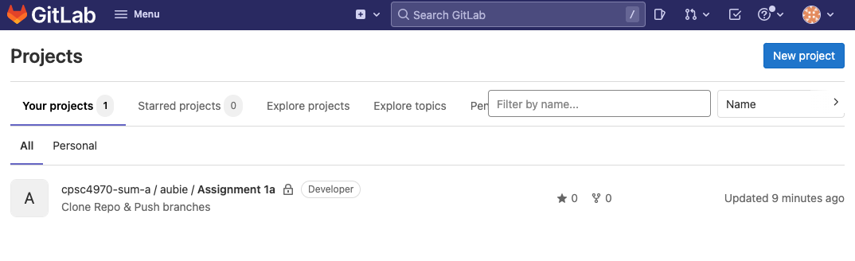
Gitlab Overview - Login View

Slide 33
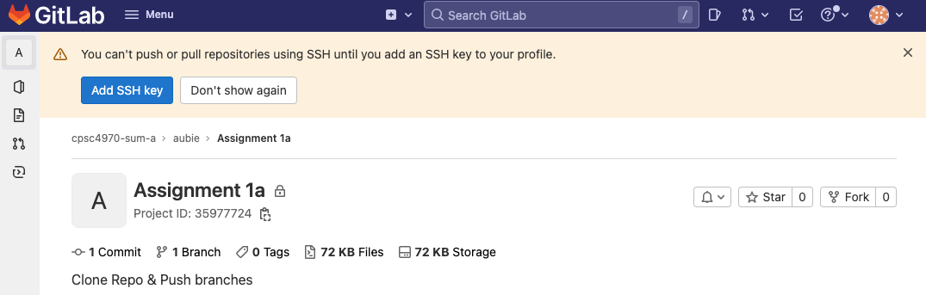
Gitlab Overview - Setup SSH Key
Select the Assignment 1a Project
Add an SSH key…following instructions.

