Slide 1

Pankesh Bamotra
OAP, Data Technology
PayPal India

Slide 2
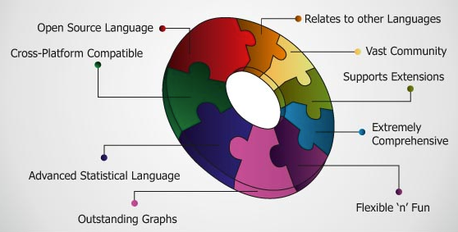
Why?

Slide 3
What I’ll cover today?
Introduction
Installation
Data types, subsetting
Reading/writing data
Control structures

Slide 4
Later …
Functions
Loop functions
Debugging
Simulation
Plotting/ Visualization (not very confident)
OOP, Data abstraction and regular expressions
+ Things I learnt while dealing R

Slide 5
No theory only hands on
The End, Let’s begin

