Slide 1



Using Interventions to Improve Out-of-Distribution Generalization of Text-Matching Systems
Parikshit Bansal, Yashoteja Prabhu, Emre Kiciman, Amit Sharma
Microsoft Research
arxiv : https://arxiv.org/pdf/2210.10636.pdf
: parikshitb52@gmail.com, site : pbansal5.github.io

Slide 2


Problem : Text-Matching Recommendation Systems fail on OOD Data
Query
Recommendation
System
Items
3M Scotchlite Reflective Tape, Silver, 1-Inch by 36-Inch
Lasko 6435 Oscillating Heater with Remote Control
Reflective Band - Made With Genuine Reflexite in America
$$f_{θ}$$
3M Scotchlite Reflective Tape, Silver, 1-Inch by 36-Inch
Lasko 6435 Oscillating Heater with Remote Control
Reflective Band - Made With Genuine Reflexite in America
Road ID - Reflective Shoe Laces
Relevant Items
Irrelevant Items
Change in Query Distribution P(Q)
3M Scotchlite Reflective Tape, Silver, 1-Inch by 36-Inch
Lasko 6435 Oscillating Heater with Remote Control
Reflective Band - Made With Genuine Reflexite in America
3M Scotchlite Reflective Tape, Silver, 1-Inch by 36-Inch
Lasko 6435 Oscillating Heater with Remote Control
Reflective Band - Made With Genuine Reflexite in America
$$f_{θ}$$
3M Scotchlite Reflective Tape, Silver, 1-Inch by 36-Inch
Lasko 6435 Oscillating Heater with Remote Control
Reflective Band - Made With Genuine Reflexite in America
Soleus Air MS-09 Oscillating Reflective Heater
Soleus Air MS-09 Oscillating Reflective Heater
Fails to match Heater and instead relies on Reflective to show irrelevant items
Notes:
Our work deals with text-matching based recommendation systems. In these systems, we are given an input query and a list of potentially relevant items.

Slide 3

Problem : Text-Matching Recommendation Systems fail on OOD Data
Query
Items
3M Scotchlite Reflective Tape, Silver, 1-Inch by 36-Inch
Lasko 6435 Oscillating Heater with Remote Control
Reflective Band - Made With Genuine Reflexite in America
Camco 57723 Dust Cover for Portable Olympian Heater
Skechers Men's Energy Downforce Lace Up
Broan 679 Ventilation Fan and Light Combination
$$f_{θ}$$
3M Scotchlite Reflective Tape, Silver, 1-Inch by 36-Inch
Lasko 6435 Oscillating Heater with Remote Control
Reflective Band - Made With Genuine Reflexite in America
Camco 57723 Dust Cover for Portable Olympian Heater
Skechers Men's Energy Downforce Lace Up
Broan 679 Ventilation Fan and Light Combination
3M Scotchlite Reflective Tape, Silver, 1-Inch by 36-Inch
Lasko 6435 Oscillating Heater with Remote Control
Reflective Band - Made With Genuine Reflexite in America
Road ID - Reflective Shoe Laces
Road ID - Reflective Shoe Laces
+
Change in Item Distribution P(L)
Camco 57723 Dust Cover for Portable Olympian Heater
Skechers Men's Energy Downforce Lace Up
Broan 679 Ventilation Fan and Light Combination
Falsely uses Lace token to match an irrelevant item
Added Items
Notes:
Our work deals with text-matching based recommendation systems. In these systems, we are given an input query and a list of potentially relevant items.

Slide 4









Background on Text Matching Systems
$$f_{θ}$$
Road ID - Reflective Shoe Laces
$$f_{θ}\left(x_{a}\right)$$
State of the Art models ([1],[2]) use
Finetuning setup :
Finetune a good pretrained sentence matching model (e.g. SBERT) : base model
Similarity :
Relevance function uses cosine similarity between sentence representation
Loss :
Contrastive/Triplet are the popular choices as on the right side
Anchor $\left(x_{a}\right)$
$$f_{θ}$$
3M Scotchlite Reflective Tape, Silver, 1-Inch by 36-Inch
$$f_{θ}\left(x_{p}\right)$$
Positive Sample $\left(x_{p}\right)$
$$f_{θ}$$
Lasko 6435 Oscillating Heater with Remote Control
$$f_{θ}\left(x_{n}\right)$$
Negative Sample $\left(x_{n}\right)$
Learning
Negative
Negative
Anchor
Anchor
Positive
Positive
[1] Sentence-BERT: Sentence Embeddings using Siamese BERT-Networks, Reimers et al., 2019
[2] NGAME: Negative Mining-aware Mini-batching for Extreme Classification, Dahiya et al., 2021
Notes:
Goal to learn function $f_{θ}\left(.\right) :x→R^{N}$ which maps text (queries and items) to vector space
Recommendations based on cosine distance in vector space
Text-embeddings finetuned starting with pre-trained (base) language model
Related Work and Cites
1 query , 1 label. Architecture for simian network

Slide 5
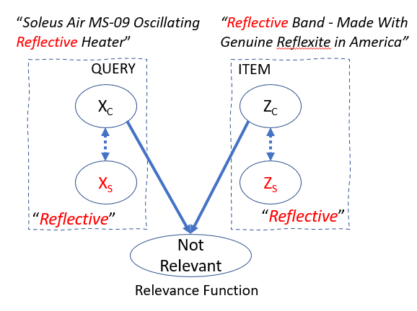
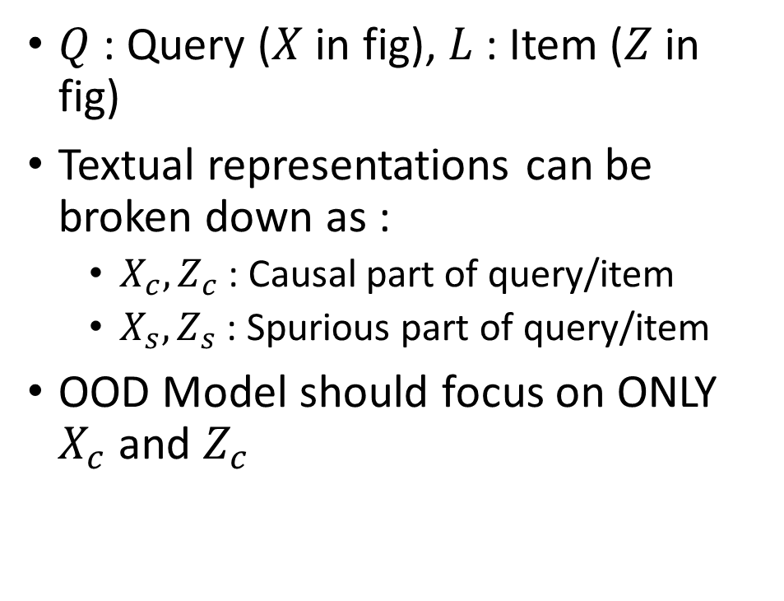
Explaining results through a causal formulation of the relevance function
$Q$ : Query ($X$ in fig), $L$ : Item ($Z$ in fig)
Textual representations can be broken down as :
$X_{c},Z_{c}$ : Causal part of query/item
$X_{s},Z_{s}$ : Spurious part of query/item
OOD Model should focus on ONLY $X_{c}$ and $Z_{c}$
Solid arrow means causation, Dotted arrows mean correlation .

Slide 6
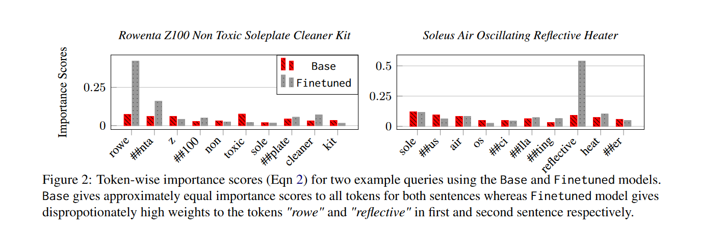

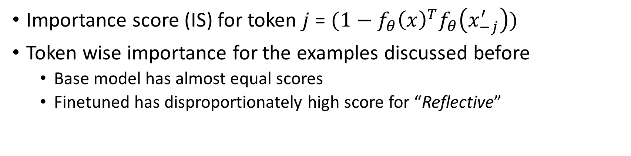
Explaining results through Intervention-based Importance score
Importance score (IS) for token $j$ = $(1−f_{θ}{{\left(x\right)}^{T}f}_{θ}\left(x_{−j}^{′}\right))$
Token wise importance for the examples discussed before
Base model has almost equal scores
Finetuned has disproportionately high score for “Reflective”

Slide 7
Finetuning overfits to training distribution such that some tokens are disproportionally weighted in the representaton. Model similarity reduces to token-matching.

Slide 8
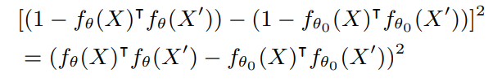
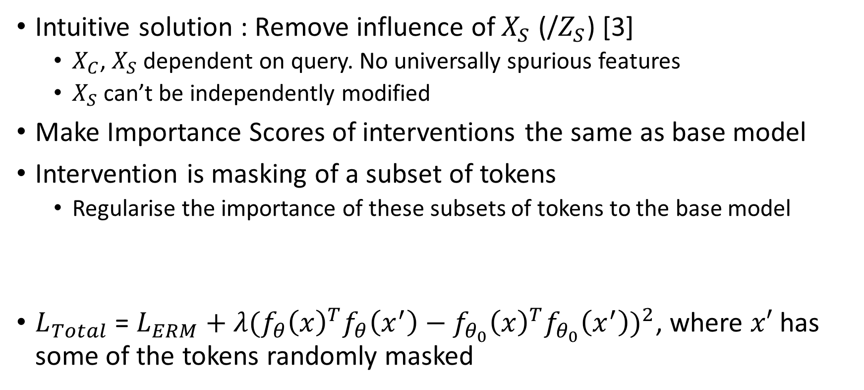
Solution : Interventional Regularizer (ITVReg)
Intuitive solution : Remove influence of $X_{S}$ (/$Z_{S}$) [3]
$X_{C}$, $X_{S}$ dependent on query. No universally spurious features
$X_{S}$ can’t be independently modified
Make Importance Scores of interventions the same as base model
Intervention is masking of a subset of tokens
Regularise the importance of these subsets of tokens to the base model
$L_{Total}$ = $L_{ERM}+λ{(f}_{θ}{\left(x\right)}^{T}f_{θ}\left(x^{′}\right)−f_{θ_{0}}{\left(x\right)}^{T}f_{θ_{0}}\left(x^{′}\right))^{2}$, where $x′$ has some of the tokens randomly masked
[3] Domain generalization in vision: A survey, Zhou et al., 2021
Notes:
Since finetuning distorts the occlusion importance of tokens, why not regularize to the base model's importance score?
Allows learning from data, without disproportionately amplifying any single token
We can assume importance scores of tokens as sufficient statistics extracted from the BASE Model
Fully Removing features is counterproductive, as is done in vision. That’s why we regularise the features. We use base model cause unlikely to capture the same set of spurious features as it is trained on a larger more diverse data
Intervention is independent change to a subset without changing rest of the input.

Slide 9
Empirical Results
Construct two realistic OOD evaluation benchmarks based on Amazon [4]
1. Category Shift: New categories of queries and items are added
Base model is better than Finetuned on OOD data
Finetuning Method | AmazonCatRemoved (ID) | AmazonCatOOD (OOD)
Base | 20.01 | 30.61
Finetuned | 38.74 | 28.31
Finetuning Method | Amazon131K (ID) | Amazon1.3M (OOD)
Base | 22.50 | 25.71
Finetuned | 39.71 | 26.02
MaskReg [Wu et al.] | 37.92 | 29.09
SimCSE [Gao et al.] | 38.05 | 28.52
Finetuning Method | Amazon131K (ID) | Amazon1.3M (OOD)
Base | 22.50 | 25.71
Finetuned | 39.71 | 26.02
MaskReg | 39.56 | 26.65
SimCSE | 39.47 | 26.05
ITVReg | 38.77 | 29.53
[4] Hidden factors and hidden topics: understanding rating dimensions with review text, McAuley et al., 2013

Slide 10
Empirical Results
Construct two realistic OOD evaluation benchmarks.
2. Temporal Shift: New queries and items are added over time
Finetuning Method | Amazon131K (ID) | Amazon1.3M (OOD)
Base | 22.50 | 25.71
Finetuned | 39.71 | 26.02
Finetuning Method | Amazon131K (ID) | Amazon1.3M (OOD)
Base | 22.50 | 25.71
Finetuned | 39.71 | 26.02
MaskReg | 39.56 | 26.65
SimCSE | 39.47 | 26.05
ITVReg | 39.72 | 27.08
Finetuning Method | Amazon131K (ID) | Amazon1.3M (OOD)
Base | 22.50 | 25.71
Finetuned | 39.71 | 26.02
MaskReg [Wu et al.] | 39.56 | 26.65
SimCSE [Gao et al.] | 39.47 | 26.05

Slide 11
Thanks for your time ☺

