Slide 1
Conception et architecture d'une plate-forme web de gestion d'enchères type «eBay»
BARBERO Pilar
BOULKRINAT Kamel
SIMON Keren
ESIEA - Paris

Slide 2
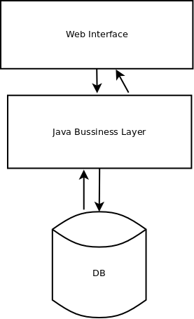
Infrastructure
Three separate layers:
Web Interface
Java Bussiness Layer
Data Base

Slide 3
Infrastructure
Web Interface :
  User interface and make requests to business layer
Java Bussiness Layer :
  Contains the logic of the application
Data Base :
  Used as persistent storage for the app

Slide 4
Architecture

