Slide 1


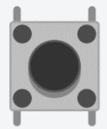
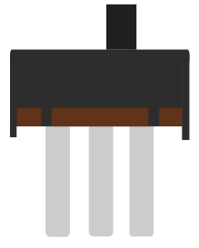
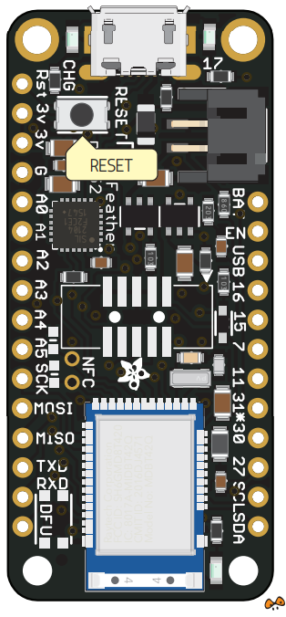

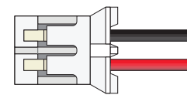

Push button (enable/disable BLE advertising)
ON/OFF Slide switch
GND
5V
Female Micro USB Jack
10 kOhm
3,7V 500mAh Lipoly Battery
GND
DIN
5VDC
GND
Neo Pixel Stick (or strip)
Adafruit feather nRF52 Bluefruit LE nRF52832

