Slide 1
SOLID y TDD basic training
Pablo Bayarri romar

Slide 2
¿Qué es y para qué SOLID?
Principios de programación.
Conseguir un código mantenible.

Slide 3
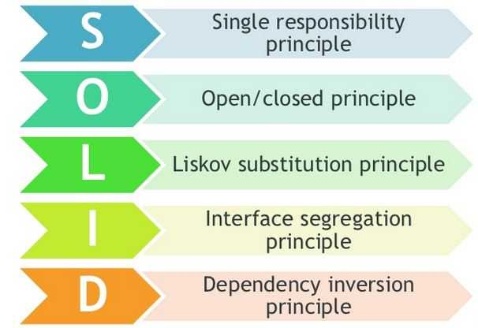
¿Qué principios?

Slide 4
¿Qué principios?
Single-responsibility Principle
A class should have one and only one reason to change, meaning that a class should have only one job.
Open-closed Principle
Objects or entities should be open for extension, but closed for modification.
Liskov substitution principle
Let q(x) be a property provable about objects of x of type T. Then q(y) should be provable for objects y of type S where S is a subtype of T.
All this is stating is that every subclass/derived class should be substitutable for their base/parent class.
Interface segregation principle
A client should never be forced to implement an interface that it doesn't use or clients shouldn't be forced to depend on methods they do not use.
Dependency Inversion principle
Entities must depend on abstractions not on concretions. It states that the high level module must not depend on the low level module, but they should depend on abstractions.

Slide 5
Típicos fallos durante el Testing unitario
Lo hacemos al “acabar”
No probamos todos los casos
Los tests prueban más de una cosa por test
Cuando los hacemos nos damos cuenta que no hicimos el código testeable y hay que cambiarlo
A veces nos parecen “probar por probar”

Slide 6
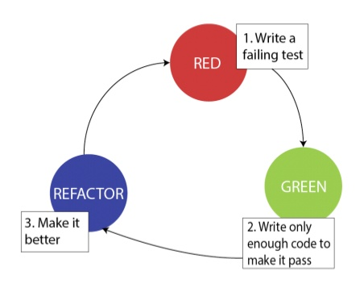
TDD (Test-driven development)

Slide 7

TDD + SOLID

Slide 8
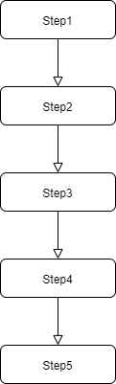
Entender métodos a simple vista
Lo que todos entendemos rápidamente… una receta de cocina

Slide 9
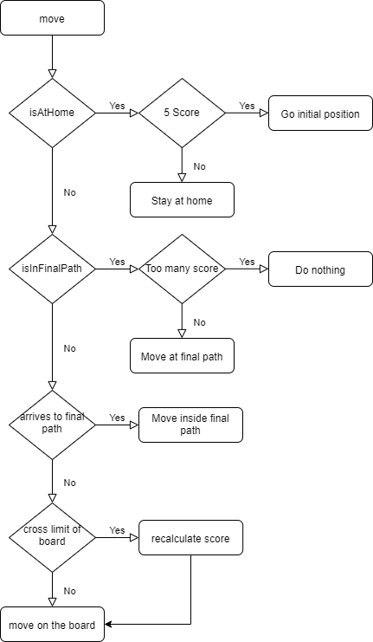
Entender métodos a simple vista
Nuestro método en el punto actual…

Slide 10
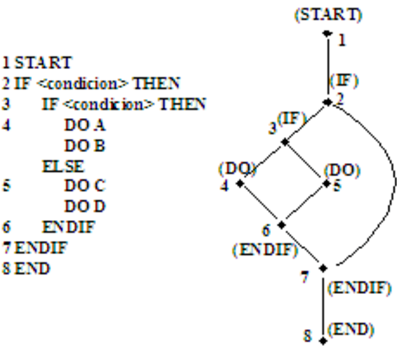
Complejidad ciclomática
Cyclomatic complexity (CYC) is a metric for software quality. It was developed by Thomas J. McCabe Sr. in 1976.
In its simplest form, CYC is a count of the number of decisions in the source code. The higher the count, the more complex the code.

Slide 11
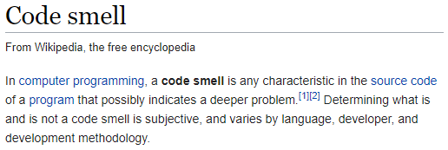
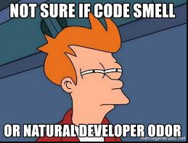
Code Smells

Slide 12
Links
https://scotch.io/bar-talk/s-o-l-i-d-the-first-five-principles-of-object-oriented-design
https://www.perforce.com/blog/qac/what-cyclomatic-complexity
https://en.wikipedia.org/wiki/Code_smell

