Slide 1
Thoughts
about
Stock market pensions
Financial education on stocks

Slide 2
Ways of helping people conceptualizing the stock market
First – a look at the historic data from the MSCI World the stocks

Slide 3
GE 38 ct
GM 32 ct
Dividends
GM 32 ct
GM 24 ct
GE 10 ct
GM
Share Price
GM
Share Price
GM
Share Price
GE
Share Price
Asset price
GE
Share Price
GE
Share Price
Today
Infl8 pct
Infl5 pct
Infl2 pct

Slide 4
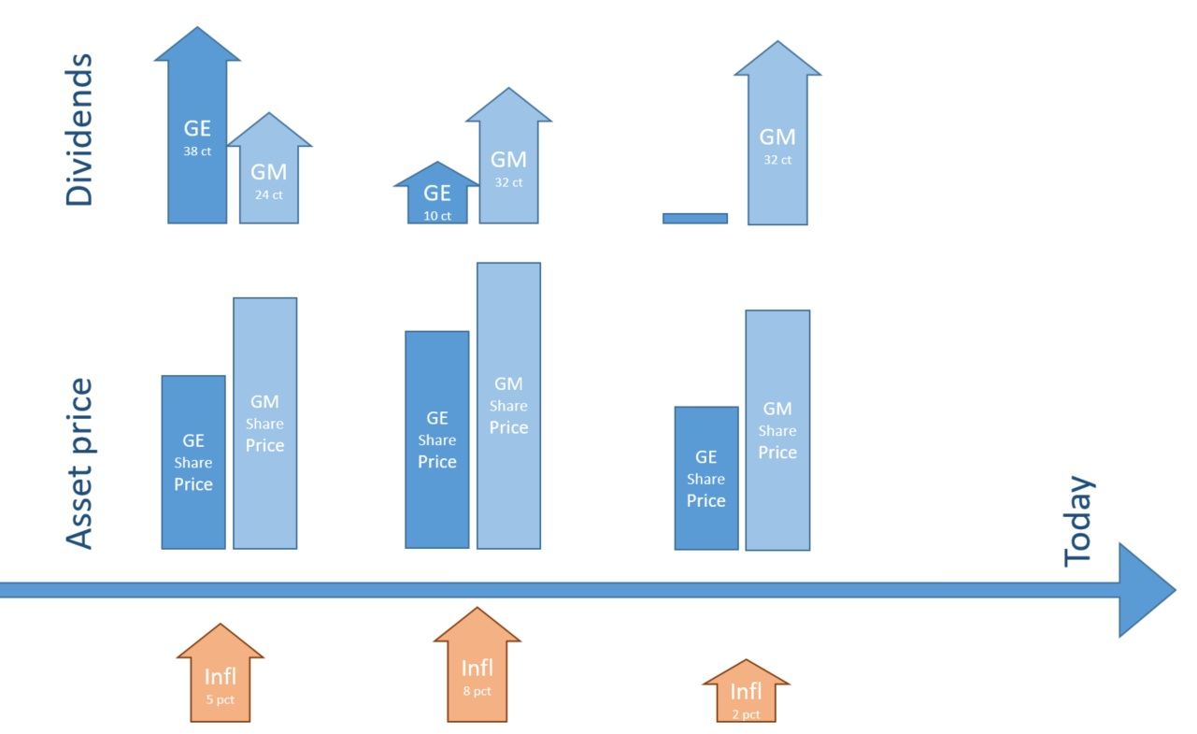
MSCI is deflated by the price index => real returns in percent
Real return
Real return
Real return
(Why do we subtract a riskless rate?)

Slide 5
A few thoughts on this past performance

Slide 6
Can we really extrapolate an average real return of 11 pct over 20 or 40 years into the future?
As a safe bet for retirement?
Can stock markets double every 7 years for the next 20 or 40 years?

Slide 7
From December 1978 to February 2022
average MSCI world annual real return was
11%
Saving the real equivalent of 1 Euro of today would yield
1,11 ^{7yrs} = 2
1,11^{10yrs} = 3
1,11^{20yrs} = 8
1,11^{45yrs} = 110

Slide 8
A radically simplified model
Saving one euro per year...
Using a simple annuity formula...

Slide 9

Present value of an annuity of 1 Euro per year given 11 percent real return
$$\frac{{1−\left(\frac{1}{1+r}\right)}^{n}}{r}∗C$$
7 year – 4,7 Euro
10 year – 5,9 Euro
20 years – 8 Euro
45 years – 9 Euro
(converging towards 1/r – 9,09)

Slide 10
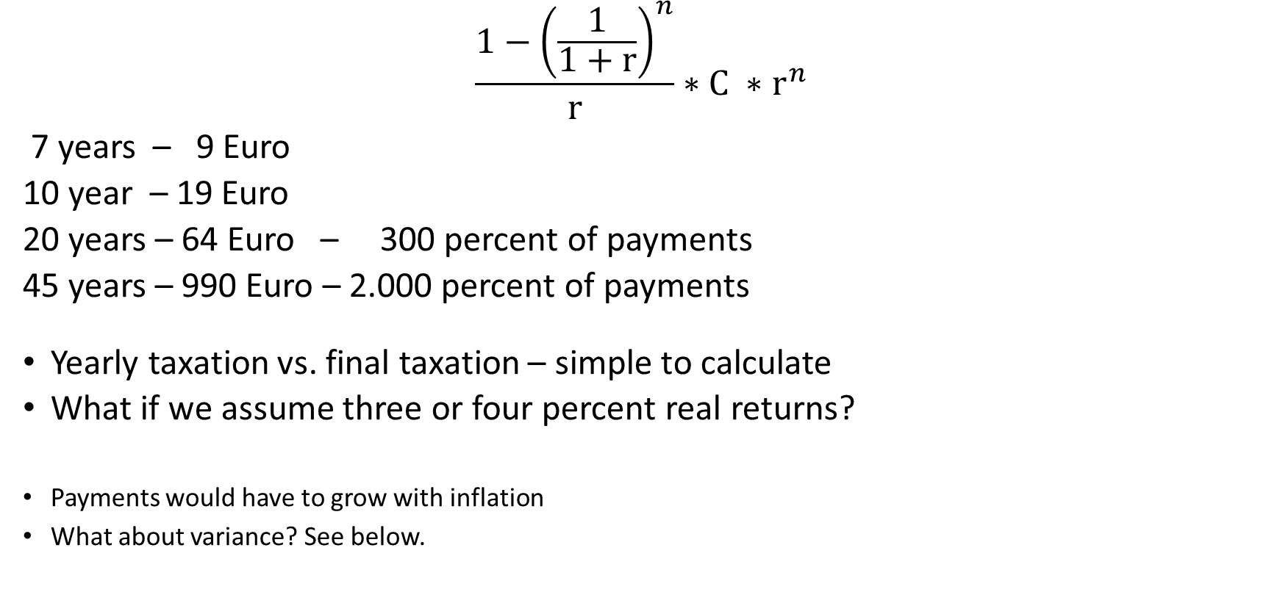
Future value of an annuity of 1 Euro per year given 11 percent real return
$$\frac{{1−\left(\frac{1}{1+r}\right)}^{n}}{r}∗C ∗r^{n}$$
7 years – 9 Euro
10 year – 19 Euro
20 years – 64 Euro – 300 percent of payments
45 years – 990 Euro – 2.000 percent of payments
Yearly taxation vs. final taxation – simple to calculate
What if we assume three or four percent real returns?
Payments would have to grow with inflation
What about variance? See below.

Slide 11
The math is sound...
And some stocks have performed amazingly over centuries. According to Robert Shiller, the Dutch East India company of 1602 delivered 7 percent real dividends for four centuries. (https://en.wikipedia.org/wiki/Dutch_East_India_Company)
But how can the entire stock market grow by 7 or by 11 percent forever?

Slide 12
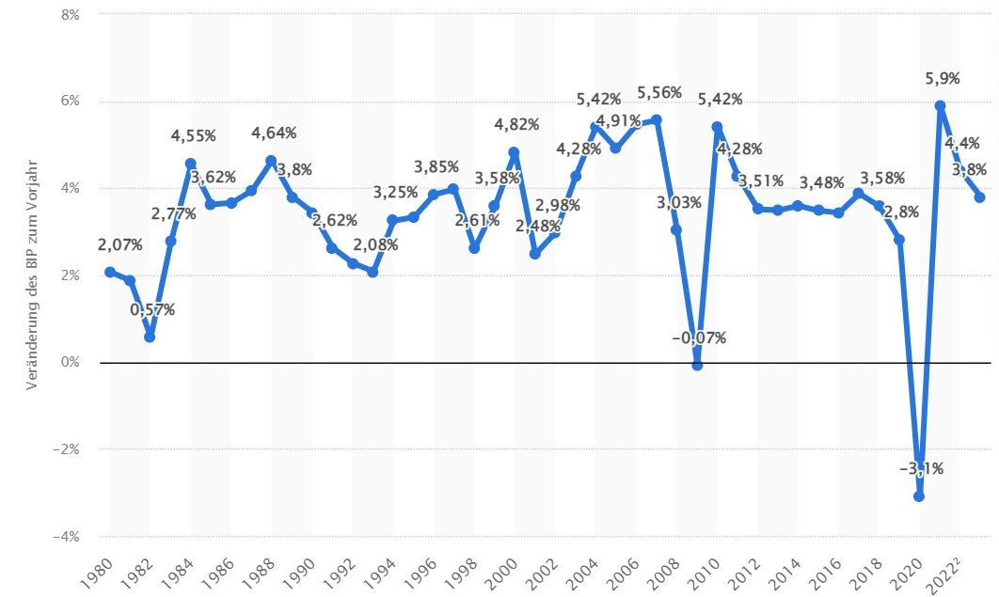
The world economy...
World GDP growth from 1980 bis 2023 ~3%

Slide 13
Maybe most of GDP growth is captured by public stock companies?
This is partly expressed in the equity premium for investments into stocks
The premium is highly volatile
0.3% in the 1970s
19% in the 1950s
Do we want to bet our pensions on this effect?

Slide 14
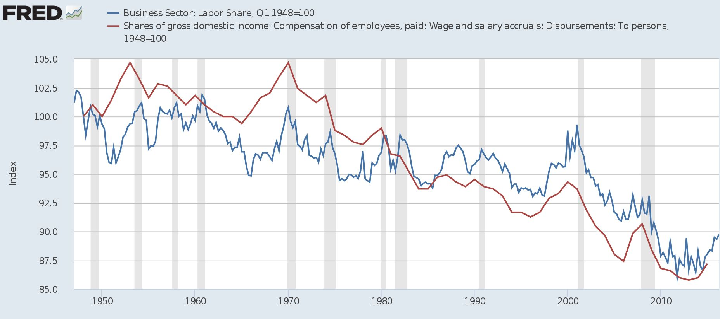
Share of profits of World GDP
Part of the excessive growth of MSCI world dividends is caused by the rising share of capital income of GDP.
But this red line cannot go below zero.

Slide 15
Public companies constitute a fluctuating share of total economy
... from 1997 to 2012, the number of corporations publicly traded on American stock exchanges dropped 45% (https://en.wikipedia.org/wiki/Public_company)
... thus, the remaining and the largest companies may have punched above their weight.

Slide 16
There are serious macro arguments, that the 11% growth of the MSCI world vs the 3% growth of the world economy may be due to a secular bull market in stock investment
Charles Goodhart, The Future Of Ageing Societies Will Be Nothing Like The Past https://fsclub.zyen.com/events/all-events/future-ageing-societies-will-be-nothing-past/
Also: Why the world is saving too much money for its own good https://www.economist.com/briefing/2022/02/05/why-the-world-is-saving-too-much-money-for-its-own-good
Some key arguments...

Slide 17
Asia and Eastern europe joining glob. economy
Favorable workforce demographics
large cohort was in prime saving age ~40+
„savings glut“
Savings by the ultra rich rose from 450 to 600% GGDP
Corporate savings rose from 8 to 15% GGDP
Central Bank reserves rose from 8 to 15% of GGDP
=> all these cannot go on forever
Positive secular factors for the future may be...
Green energy, digitalization, quantum computing, blockchain, Elon Musk, ...
=> but doubling world GDP every 7 years forever?

Slide 18
World GDP
Profit income
Central banks incr. reserves
Prime working age
employees
save for
retirement
World GDP
Profit income
Public companies
Public companies
Ultra rich seeking investments
Corporations are now net savers

Slide 19
Other thoughts about a “stochastical” interpretation of the world economy
11% includes periods of stagnation; for instance 1998 to 2009: 0%
Robert Shiller in 2012: Extreme events in financial markets are not normally distributed

Slide 20
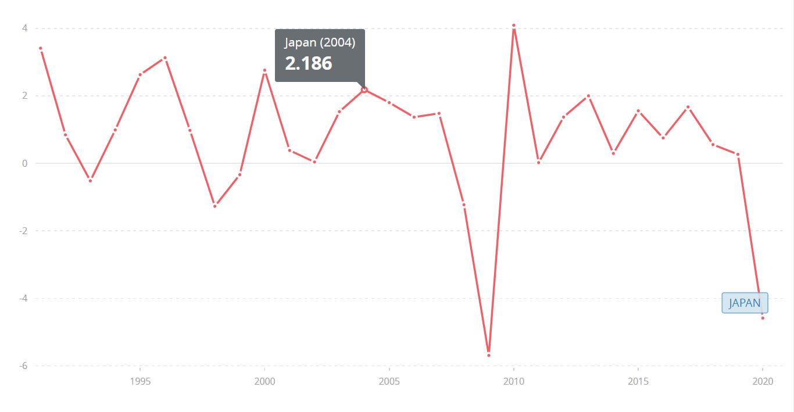
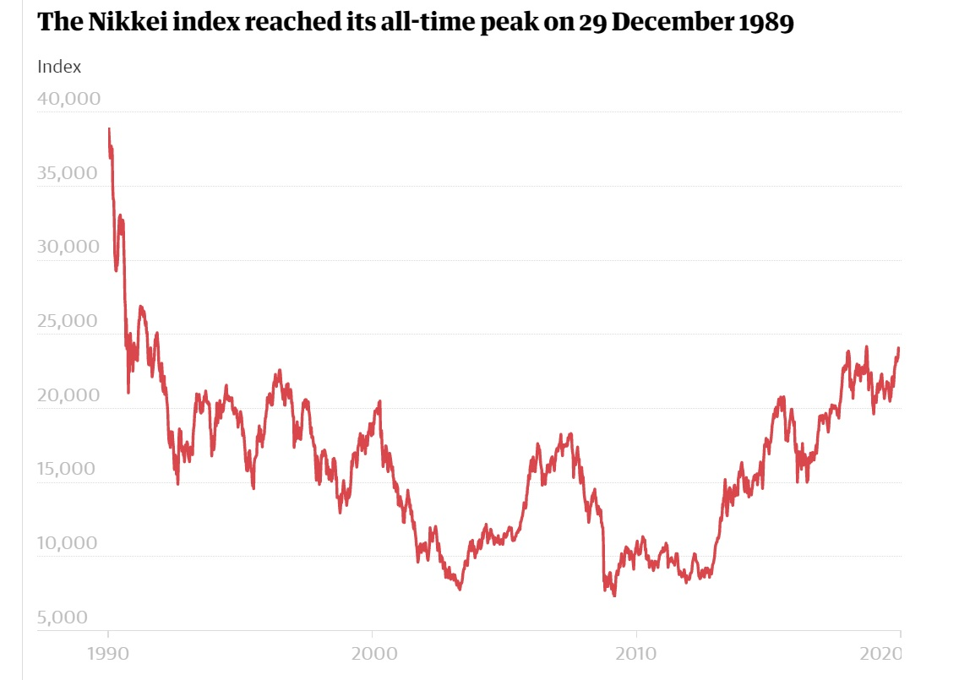
Secular trends can turn against you
Avg Japanese GDP growth: 0.8 %
Japanese stockmarket since 1990

Slide 21
Which stochastical model is suitable?
Random draws from past real returns
averaging 11 percent per year

Slide 22
We assume stock returns to be determined by lots of small uncorrelated stochastical variables. Play Galtonboard-excerpt.mp4
https://youtu.be/3m4bxse2JEQ?t=34
Is this the right “model” ?

Slide 23
Another “view”
Development of the Fortune 100 companies
Play fortune100.mp4
In modern “winner-takes-all” oligopolistic markets, a few superstar companies capture all the profits.

Slide 24
What about the variance?
Computable from the variance of MSCI returns
or
Computable from Monte-Carlo simulation
Both based on many tiny stochastical processes, not few large secular factors

Slide 25
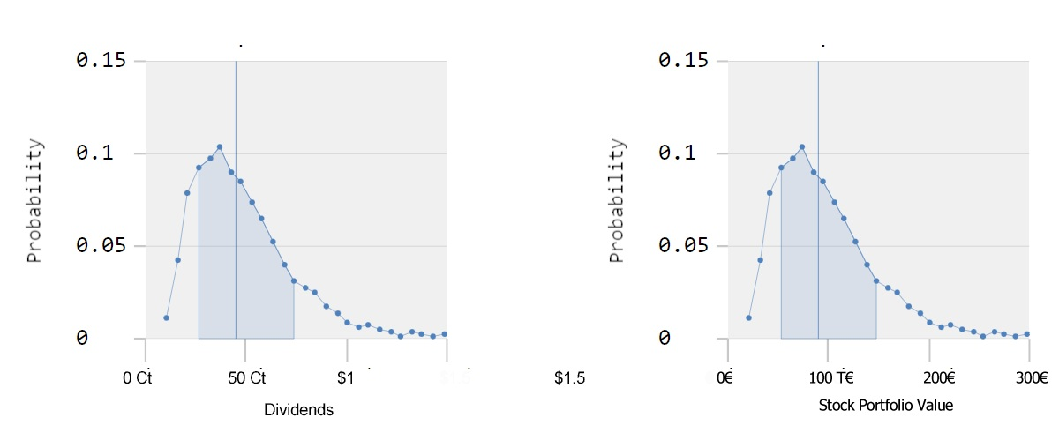
Distribution, variance
Can't we just apply the Central Limit Theoreme for distrib.+variance?
Cant we compute the distribution and standard deviation of the stock portfolio from the corpus of historical dividends? X_{new} = a + bX_{old} => s_{new} = a + sX_{old}
Why do we need Monte Carlo simulations then? Can‘t we just use the expected value of the dividend?

Slide 26
Regardless, which secular trends will dominate the future of the stock markets, they will loom large over the past variance of the MSCI world.
Some of the secular trends are certainly contained in the past variance, but to unknown degree.
Extrapolation of variance from past returns into the future seems difficult for me.
Thank you

Slide 27
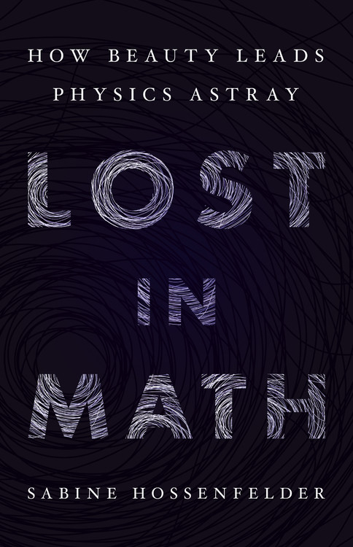
Even the “hard science” physics, has issues with moving too far away from profane reality

Slide 28

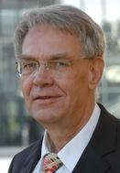
Methodik von „BWL 4“
und Bankbetriebswirten
Primitiv und ohne
Stochastik
So, wie die meisten
Nicht-Akademiker
rückständigerweise noch denken

