Slide 1
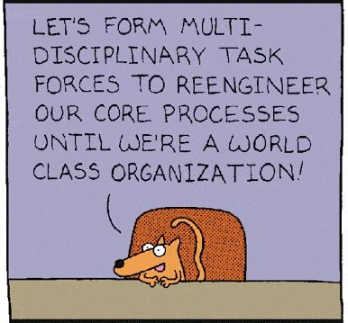
Funny but little substance

Slide 2
A boring topic – but with substance
Email
Nobody wants to be bothered thinking about email
Just make it work
Email is a service with a price of 0
Thus its bound to be overused
Market makers use open and hidden regulations resulting in steadily increasing levels of insidious obstruction

Slide 3
The world of email servers
zew.de
spiegel.de
„relay“; i.e. vodafone.de
deutsche-bank.de
web.de
volkswagen.de
...sparkassen-verbund.de
gmail.com
spam-central.ru
uni-mannheim.de
t-online.de
Heuristically, we are a small organization, sending out lots of unsolicited email.

Slide 4
Current situation
The data series of ZEW index are consistent over 30 years
Danger: Invitation emails could be blocked, ruining our data series
Symptoms
Frankfurter S&Ls block our FMT emails
T-Online servers refuse relaying of our FMT emails
Some banks refuse our FMT emails, because they are not sent with secure standards
Other banks blocked our emails because of Excel attachments
Providers introduce SMTP protocol quirks („ELHO“ only instead of „HELO“) to exclude email programs such as InxMail and Smart Serial Email
Amazon and others offer dedicated services – with „reputation management“
Google publishes „Postmaster Tools“ and lots of guidelines with conditions for acceptance of email

Slide 5
Reputation
Email servers have a „reputation“
Attributes for reputation:
Content of sent emails (spam keywords)
„Good manners“ in technical terms
Using most recent standards (TLS encryption; thanks to Sohrab!)
Signature, verification mechanism
Bayesian filter or „AI“ filter over above attributes yields a reputation
Reputation is compiled over time into public databases by large players (gmail.com, web.de, ...)

Slide 6
Measures to safeguard our mass mailings
Access restriction (IP-ranges, SMTP login)
Automation of renewal of notary seal
Monitoring
Server log
i.e. refused, but not connection refused
Domain reputation: postmaster.google.com, IP reputation
Alarm mechanism
Good behavior and „attributes“ from previous slice
No attachments, but download links
Encryption of traffic (so called TLS, equivalent of https)
Signature („notary seal“)
Demo: Signature

Slide 7
„Certification auth.“
Notary seal
renewal
destination web.de baaderbank.de
zimbra.zew.de
relay i.e. t-online.de
DNS server
web server
Emails
Emails
12 email services
Emails
Emails
Emails

