Slide 1
School project
Creators:Radoslav Ivanov 10G
Petar Borisov 10G
Plamen Petkov 10B
Roman Cernatinschi 10A
Team:Aces

Slide 2

The main idea

Slide 3
The process
•We considered the idea about our project!
•We have allocated the tasks.
•We have set a deadline for completing the tasks.
•Final changes to the code.

Slide 4




Used technologies

Slide 5
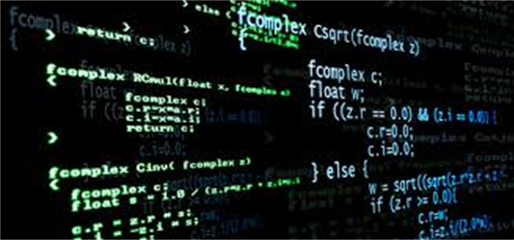
And now it’s the time for out code!

Slide 6


Slide 7
Thanks for the attention!

