Slide 1

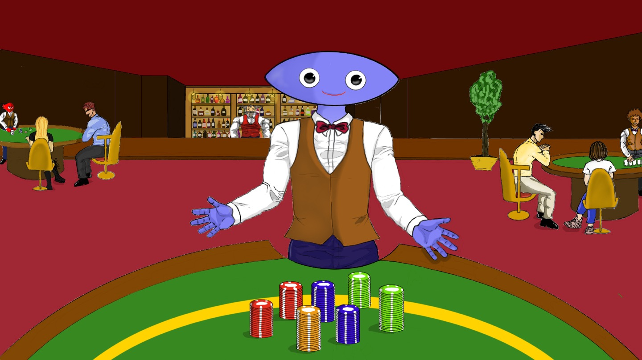
28
1
1
4
BUY
ITEM
LOAD
ITEM
TALK
&
ATTACK
RESULT
6
:
start
0
00
stop
Round
next
4
# | item | chips | attack | be attacked | rank
1 |  | 436 | 0 | 0 | 2
2 |  | 234 | +16 | 0 | 8
3 |  | 79 | +64 | 0 | 27
4 |  | 227 | +16 | 0 | 9
5 |  | 226 | +16 | 0 | 10
6 |  | 171 | +64 | 0 | 23
7 |  | 130 | +64 | 0 | 26
8 |  | 272 | 0 | 0 | 5
9 |  | 204 | +32 | 0 | 15
10 |  | 64 | +64 | 0 | 28
11 |  | 178 | +64 | 0 | 20
12 |  | 330 | 0 | 0 | 3
13 |  | 178 | +48 | 0 | 20
14 |  | 272 | 0 | 0 | 5
15 |  | 135 | +64 | 0 | 25
# | item | chips | attack | be attacked | rank
16 |  | 215 | +48 | 0 | 11
17 |  | 279 | +16 | 0 | 4
18 |  | 176 | +48 | 0 | 22
19 |  | 204 | +16 | 0 | 15
20 |  | 258 | +16 | 0 | 7
21 |  | 186 | +48 | 0 | 19
22 |  | 168 | +48 | 0 | 24
23 |  | 450 | 0 | 0 | 1
24 |  | 212 | +32 | 0 | 12
25 |  | 206 | +32 | 0 | 14
26 |  | 204 | +32 | 0 | 15
27 |  | 212 | +32 | 0 | 12
28 |  | 204 | +32 | 0 | 15

Slide 2
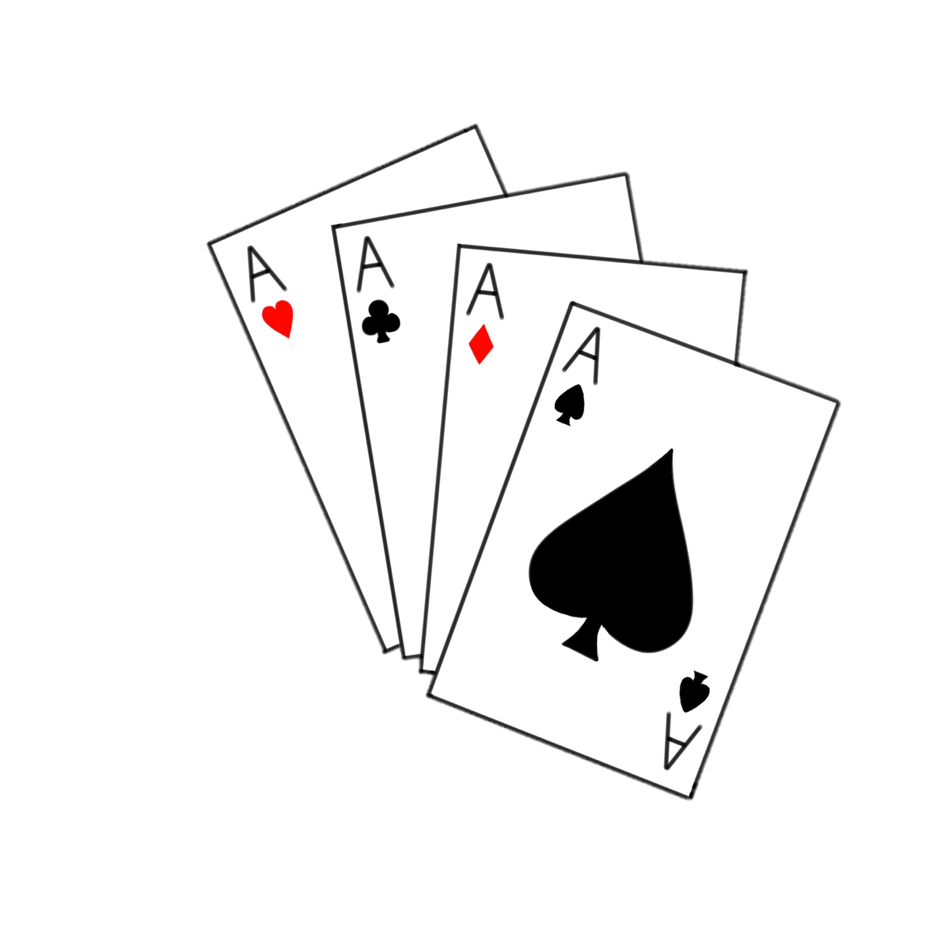








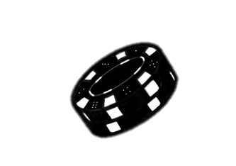






#
1 | 1 | J | 100
1 | 2 | K | 100
1 | 3 | A | 100
7
7
7
#
#
#
1 | 4 | Q | 100
1 | 5 | J | 100
1 | 6 | A | 100
1 | 7 | Q | 100
1 | 8 | K | 100
1 | 9 | J | 100
1 | 10 | K | 100
1 | 11 | A | 100
1 | 12 | Q | 100
1 | 13 | J | 100
1 | 14 | A | 100
1 | 15 | Q | 100
1 | 16 | K | 100
1 | 17 | J | 100
1 | 18 | K | 100
1 | 19 | A | 100
1 | 20 | Q | 100
1 | 21 | J | 100
1 | 22 | A | 100
1 | 23 | J | 100
1 | 24 | K | 100
1 | 25 | A | 100
1 | 26 | Q | 100
1 | 27 | J | 100
1 | 28 | A | 100
1 | 29 | Q | 100
1 | 30 | K | 100

