Slide 1

Data hiding in a image with Steganography &Cryptography
as a web application using Django

Slide 2
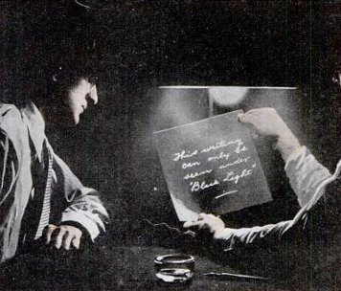
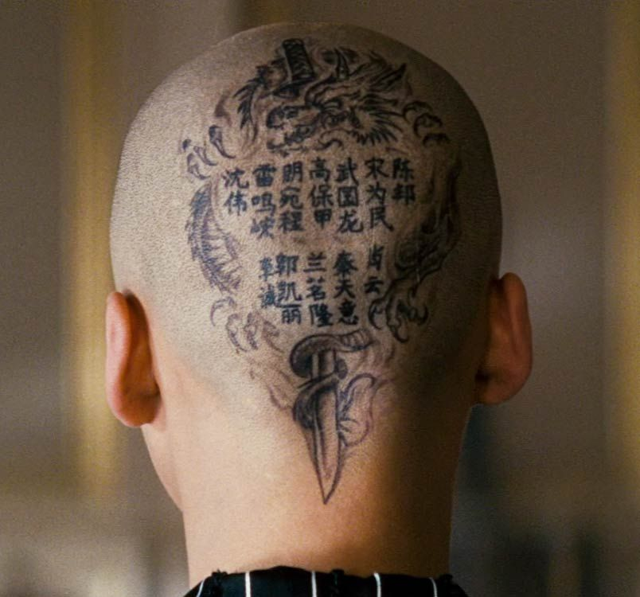
What is steganography?
Steganography is a technique of hiding information in digital media
In contrast to cryptography, it is not to keep others from knowing the hidden information, but it is to keep others from thinking that the information even exists.
Some examples of use of Steganography is past times are Invisible ink Secret message under grown hair

Slide 3


What is Cryptography?
Cryptography is the science of encrypting and decrypting data. Based On complex mathematics.
plaintext
E(key)
ciphertext
ciphertext
D(key)
plaintext
SENDER
RECEIVER

Slide 4
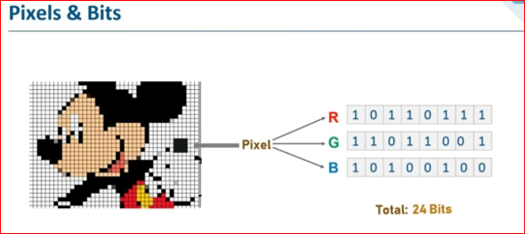
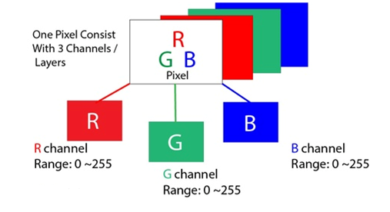
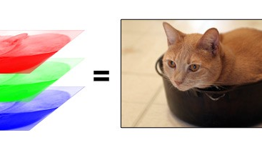
RGB Model

Slide 5
