Slide 1
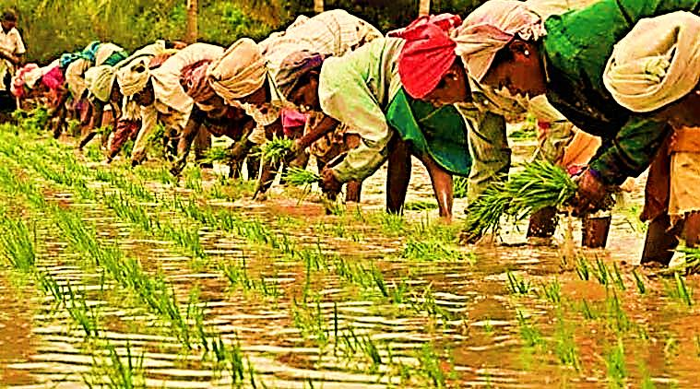
Aggregation – A Mobile Application for Farmers
TEAM DETAILS
Organisation: Kisan Forum Pvt. Ltd.
Tech-Bucket: Agriculture and Rural Development
Team Leader: Tarun Ganesh K
Team Name: Titans Cube
Problem statement: Create a mobile application for farmers that enable them to from groups and, buy and sell goods without means of a middle man.

Slide 2

IDEA:
A mobile app to ease the communication between farmers, consumers and industries.
Farmers of the same locality upon registration will be added together to form a group, which will further be divided into subgroups based on their type of produce, through which they can place bulk booking of the raw materials.
The list of raw materials such as seeds, fertilizers and pesticides, sold by the government and private sectors are made available in the app along with the cost estimation.
Farmers can notify the buyers before the harvest and decide on the selling price, so that produce don’t stock up and eventually go as waste.
Availability of machineries such as tractors and threshers for rent with the cost details will be listed.
Regular update on the schemes available for the farmers.
A e-commerce page where the farmers can sell their products to big
buyers/retailers.

Slide 3






TECH STACK:
E-Commerce
FRONT END: HTML, CSS, Android.
Database : Mongo Database, MySQL Database
Server Side : NodeJS,Python, PHP, JSP, other open APIs
SERVER
WHOLE SALE BUYERS/
CONSUMERS
FARMER
ADMIN
DATABASE

Slide 4
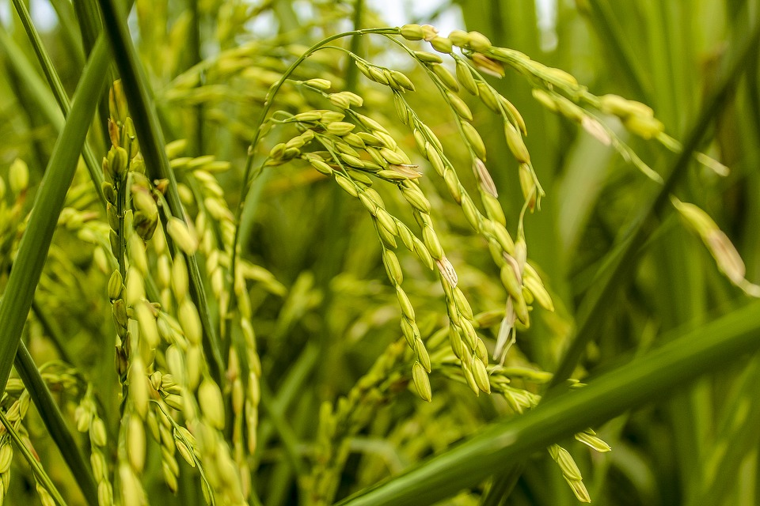


Farmer Use Case
Admin Use case
CREATE ACCOUNT
CREATE ACCOUNT
SELECT RAW PRODUCTS
MANAGE TRANSACTION
CHECK UPDATES
ADD NEW PRODUCTS
QUOTE PRICE
INTRODUCE OFFERS
DATABASE
DATABASE
FARMER
ADMIN
FORM
GROUPS
ADD BUYERS

Slide 5
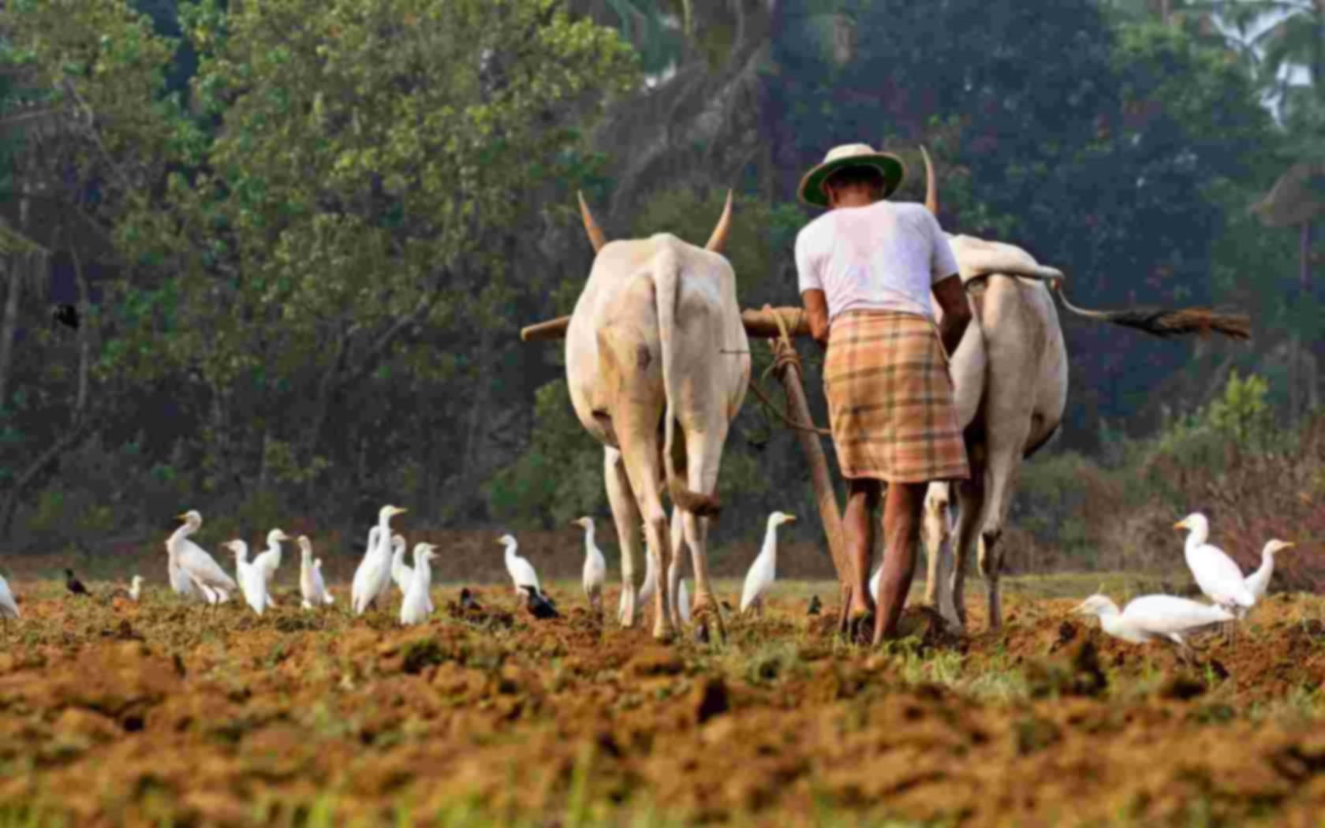
DEPENDENCIES:
A Dataset of the raw material industries in the particular locality.
Video tutorials( in at least 5 regional languages of India) to educate farmers and create awareness of the new schemes.
Data about various schemes for loan that government provide for farmers.

