Slide 1
Advance Statistical Test of Hypothesis following ECB
Pinto Bhusan Datta, Working Student
UniCredit Bank AG-HVB
(M.Sc. Student of Otto Von Guericke University, Magdeburg)

Slide 2
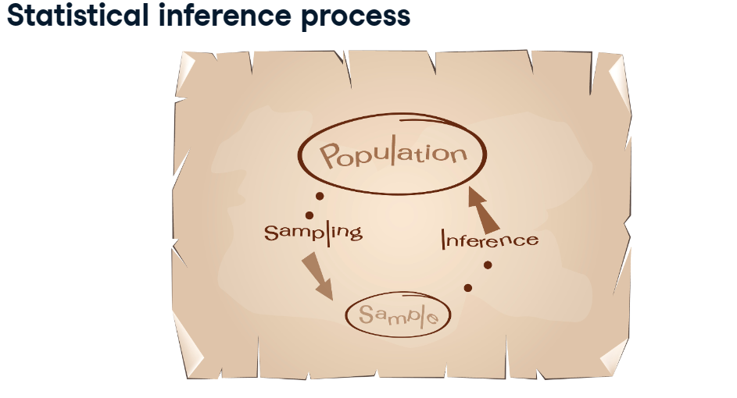
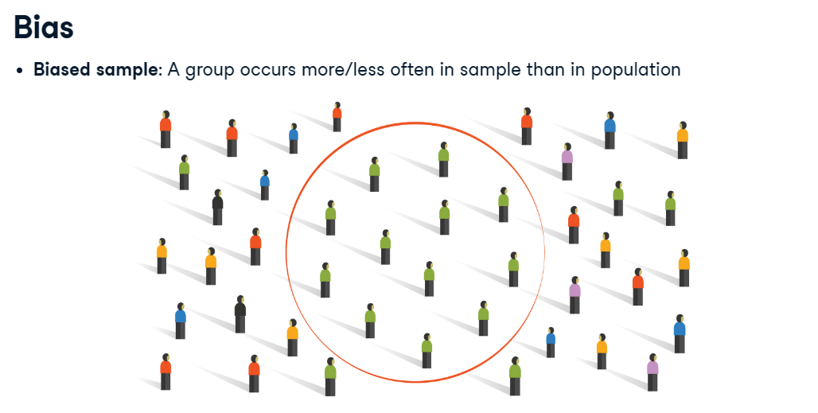

Slide 3
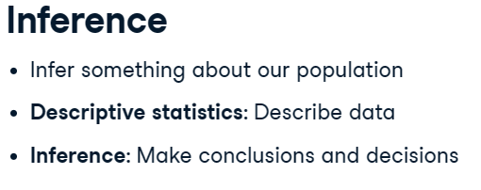
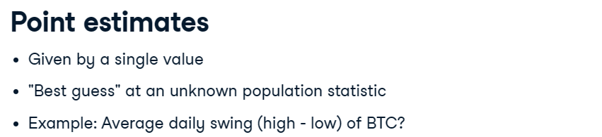

Slide 4
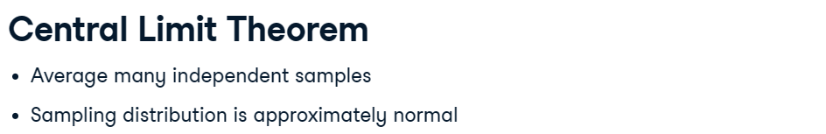
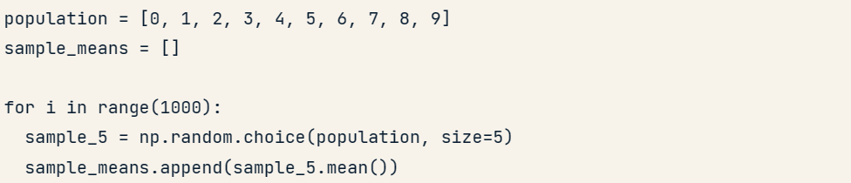
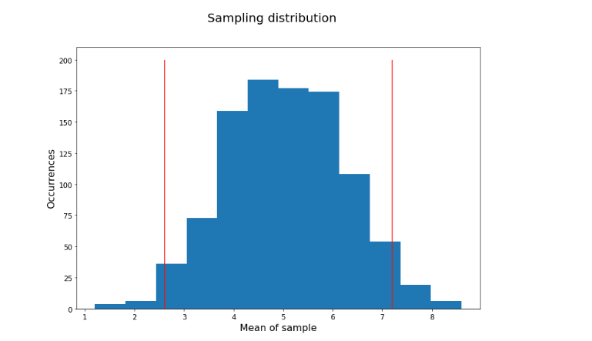

Slide 5
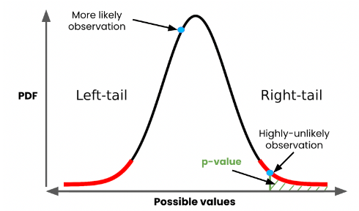

Slide 6
Area under the normal curve
50%
50%
34.1%
34.1%
13.5%
13.5%
2.2%
2.2%
68.2%
95.2%
99.6%

Slide 7
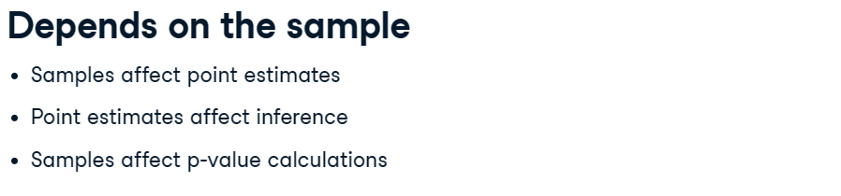
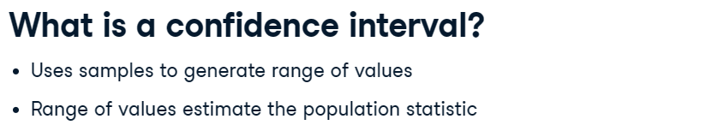
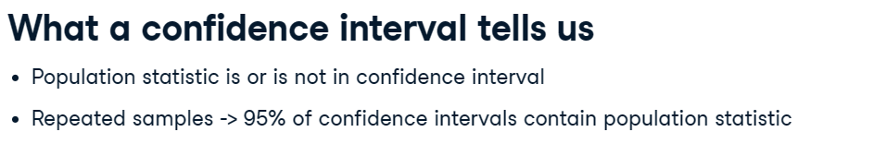

Slide 8
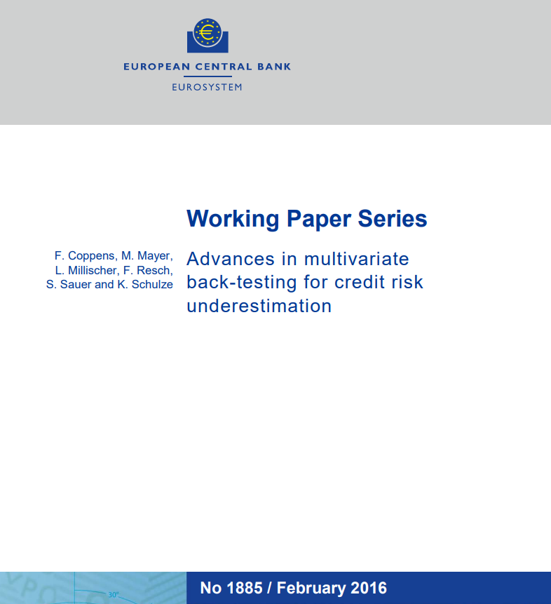

Slide 9
Abstract
When back-testing the calibration quality of rating systems two-sided statistical tests can detect over- and underestimation of credit risk. Some users though, such as risk-averse investors and regulators, are primarily interested in the underestimation of risk only, and thus require one-sided tests. The established one-sided tests are multiple tests, which assess each rating class of the rating system separately and then combine the results to an overall assessment. However, these multiple tests may fail to detect underperformance of the whole rating system. Aiming to improve the overall assessment of rating systems, this paper presents a set of one-sided tests, which assess the performance of all rating classes jointly. These joint tests build on the method of Sterne [1954] for ranking possible outcomes by probability, which allows to extend back-testing to a setting of multiple rating classes. The new joint tests are compared to the most established one-sided multiple test and are further shown to outperform this benchmark in terms of power and size of the acceptance region.
Keywords: credit ratings; probability of default; back-testing; one-sided tests; minP approach; Sterne test;

Slide 10
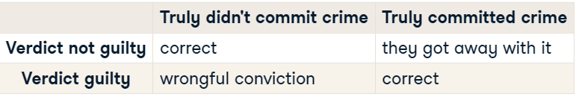
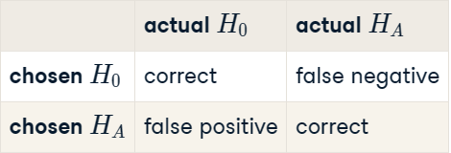
Power = Pr(Reject H0 |H1 is true)
= 1 - Pr(Do not reject H0 |H1 is true)

Slide 11
Multiple comparisons
By using a p-value of 0.05 as the criterion for significance, we’re accepting a 5% chance of a false positive (of calling a difference significant when it really isn’t).
If we compare survival of “treatment” and “control” within each of 18 subgroups, that’s 18 comparisons.
If these comparisons were independent, the chance of at least one false positive would be…

Slide 12
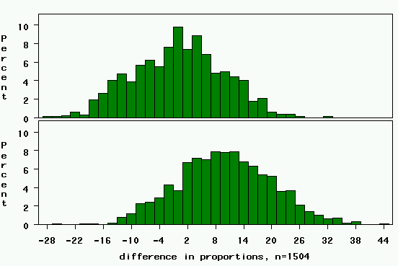
study 1: 50 cases, 50 controls
Critical value= 0+10*1.96=20
Z_{α/2}=1.96
2.5% area
Power closer to 20% now.

Slide 13
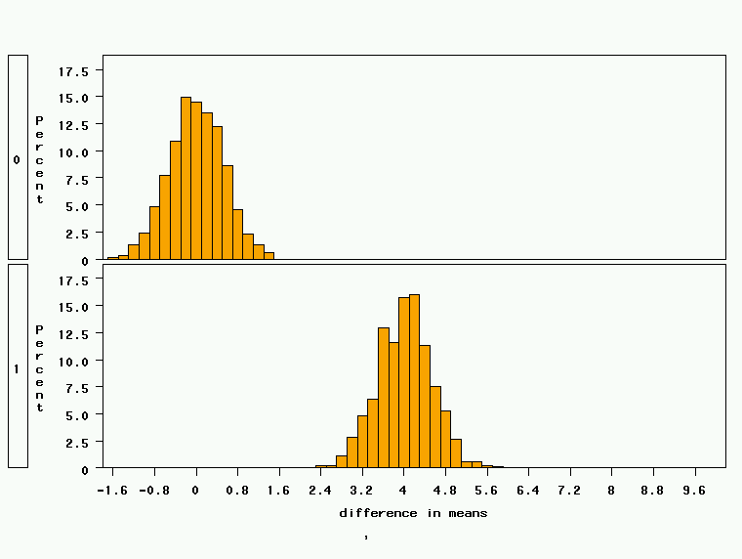
Study 2: 18 treated, 72 controls, STD DEV = 2
Critical value= 0+0.52*1.96 = 1
Clinically relevant alternative: difference=4 points
Power is nearly 100%!

Slide 14
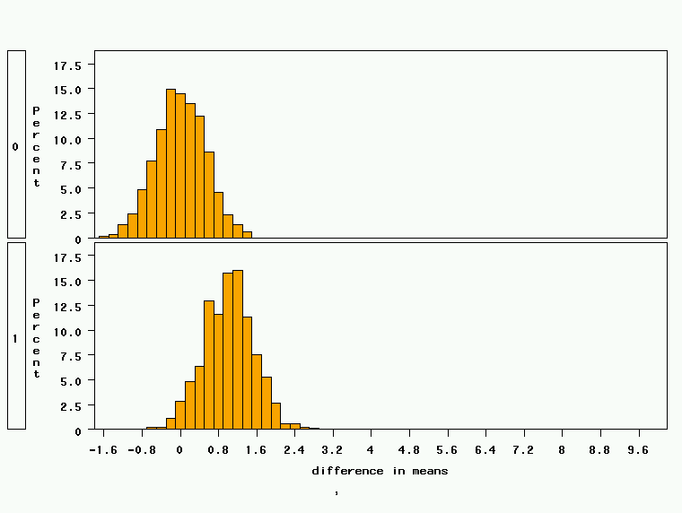
Study 2: 18 treated, 72 controls, effect size=1.0
Critical value= 0+0.52*1.96 = 1
Power is about 50%
Clinically relevant alternative: difference=1 point

Slide 15
Factors Affecting Power
1. Size of the effect
2. Standard deviation of the characteristic
3. Bigger sample size
4. Significance level desired
Notes:
It turns out that if you were to go out and sample many, many times, most sample statistics that you could calculate would follow a normal distribution.
What are the 2 parameters (from last time) that define any normal distribution?
Remember that a normal curve is characterized by two parameters, a mean and a variability (SD)
What do you think the mean value of a sample statistic would be? The standard deviation?
Remember standard deviation is natural variability of the population
Standard error can be standard error of the mean or standard error of the odds ratio or standard error of the difference of 2 means, etc. The standard error of any sample statistic.

Slide 16
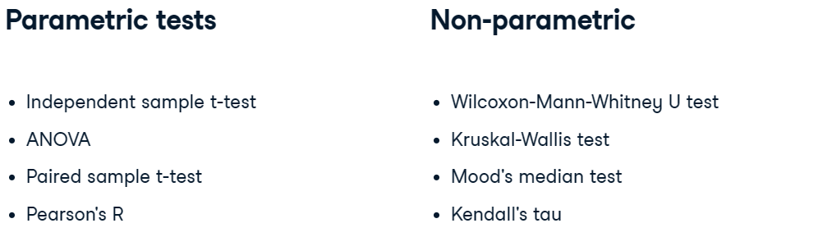
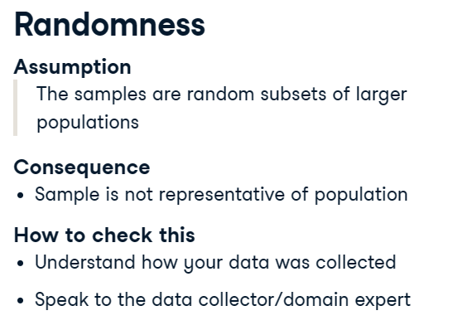
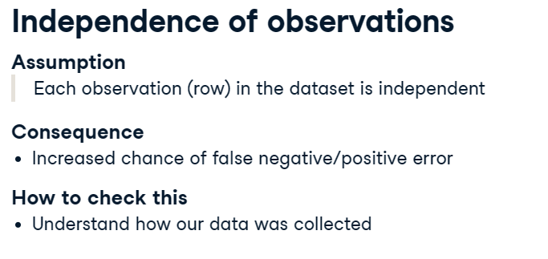
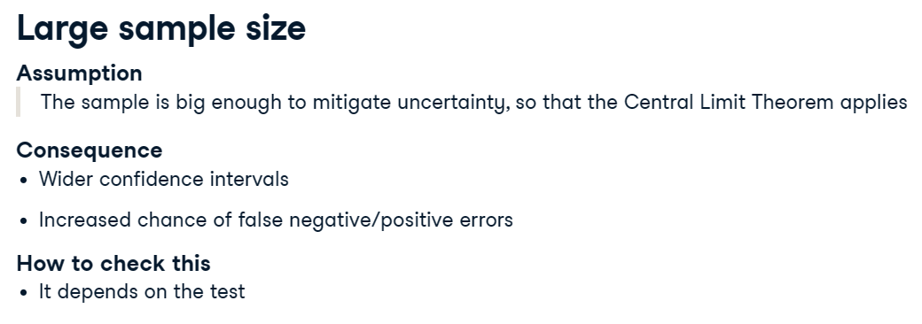

Slide 17
Univariate Statistical Analysis
Tests of hypotheses involving only one variable.
Bivariate Statistical Analysis
Tests of hypotheses involving two variables.
Multivariate Statistical Analysis
Statistical analysis involving three or more variables or sets of variables.
Data Type | Statistics Used
Nominal | Frequency, percentages, modes
Ordinal | Frequency, percentages, modes, median, range, percentile, ranking
Interval | Frequency, percentages, modes, median, range, percentile, ranking average, variance, SD, t-tests, ANOVAs, Pearson Rs, regression
Ratio | Frequency, percentages, modes, median, range, percentile, ranking average, variance, SD, t-tests, ratios, ANOVAs, Pearson Rs, regression

Slide 18
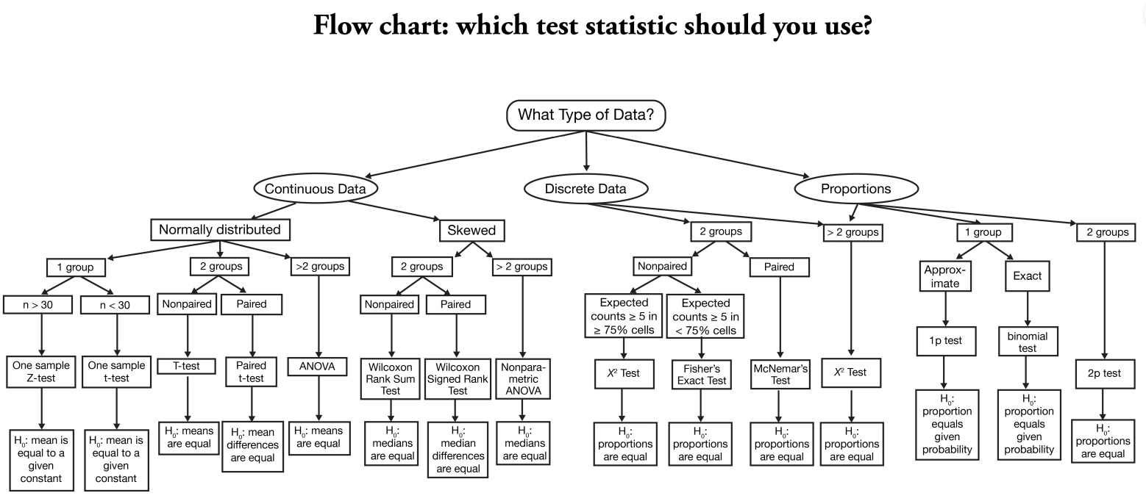

Slide 19


Slide 20
Abstract
The purpose of this paper is to promote the use of Bayesian model averaging for the design of satellite models that financial institutions employ for stress testing. Banks employing ’handpicked’ equations – while meeting standard economic and econometric soundness criteria – risk significantly underestimating the response of risk parameters and therefore overestimating their capital absorption capacity. We present a set of credit risk models for 18 EU countries based both on the model averaging scheme as well as a series of handpicked equations and apply them to a sample of 108 SSM banks. We thereby aim to illustrate that the handpicked equations may indeed imply significantly lower default flow estimates and therefore overoptimistic estimates for the banks’ capital absorption capacity. The model averaging scheme that we promote should mitigate that risk and also help establish a level playing field with regard to a common level of conservatism across banks.
Keywords: Stress testing, satellite modeling, model averaging, bank regulation and supervision JEL classification: C11, C22, C51, E58, G21

Slide 21
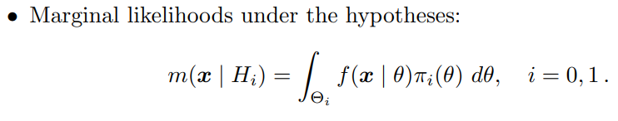
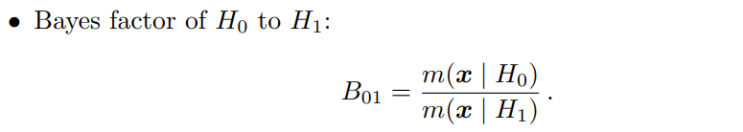
Bayesian Hypothesis basics
Notation:

Slide 22
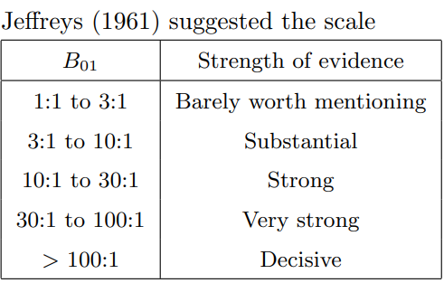
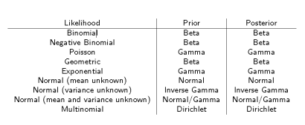
Marginal Likelihood estimation methods:
Grid Approximation
Maximum Likelihood Method
Simulation Techniques (MCMC)

Slide 23
References:
DataCamp
Conjugate Priors, Uninformative Priors (ubc.ca)
lecture2.pdf (ucsc.edu)
Wikipedia
Text Books
Web

