Slide 1
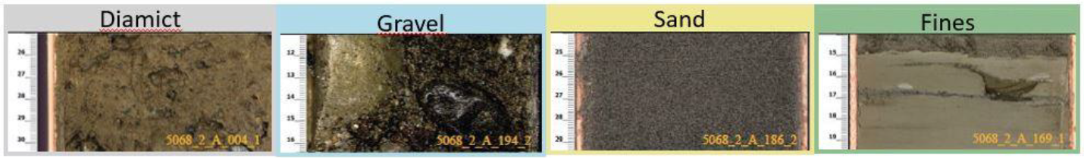
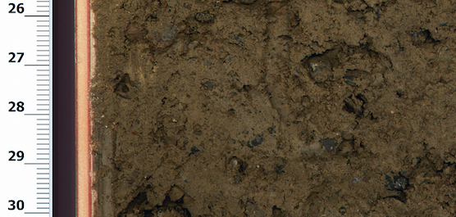
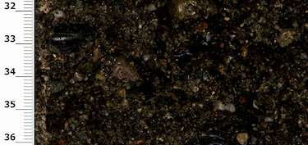
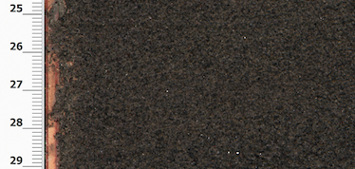
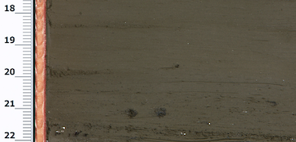
5068_2_A_004_1
5068_2_A_194_2
5068_2_A_186_2
5068_2_A_169_1
High
R1
Probability
Medium
R3
Low
R2
R4
Low
Medium
High
Impact

Slide 2
Data Acquisition
Legend:
Core drilling | Core logging and digitising
Core scanning | Visual classification
Completed before project
Partially completed during CAS Modules 2 and 3
Core section images
MSCL and wireline logs
To be done during project
Data cleaning and preparation
Data product
Selection of good images using cleaned MSCL data → Exclude rows (i.e., depths) where:
Core quality > 2 | Density < 1.5 g/cc
Magnetic Susceptibility > 100 | Natural Gamma Radiation < 0
NaN data
Subset of core images
Cleaned log data
Image labelling
Labeling of image sections according to four classes:
(D) Diamict, (G) Gravel (S) Sand, (F) Fines
Labeled images
Cleaned log data
Machine Learning sub-flow
Feature Extraction or Image Segmentation
Classification
Clustering
Dataset Split
Dimensionality Reduction
Data Augmentation
Clustering
Training
Evaluation
Model-classified images
Final visualisation
Construction of model-based stratigraphic column to compare with visual-based stratigraphic column
Fully validated model-based stratigraphic column

