Slide 1
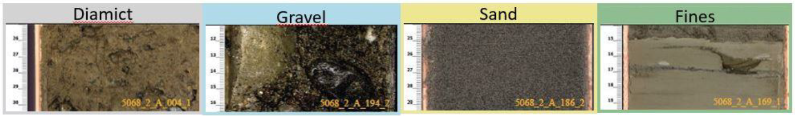
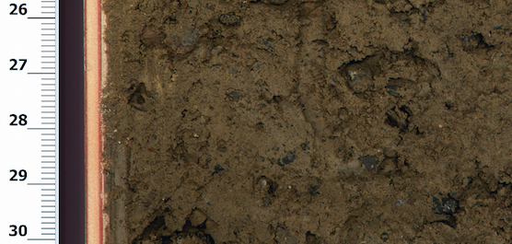
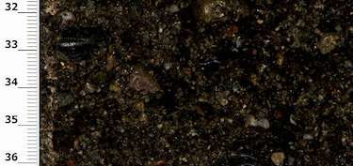
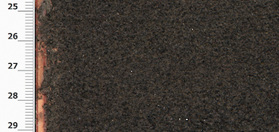
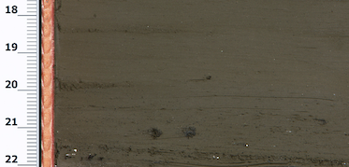
5068_2_A_004_1
5068_2_A_194_2
5068_2_A_186_2
5068_2_A_169_1
High
R1
Probability
Medium
Low
R3
R2
R4
Low
Medium
High
Impact

Slide 2
Data Acquisition
Legend:
Core drilling | Core logging and digitising
Core scanning | Visual classification
Completed before project
Partially completed during CAS Modules 2 and 3
Core section images
MSCL and wireline logs
To be done during project
Image selection
Data product
Data cleaning and preparation
Based on known quality from visual analysis of drill core
Clean MSCL data → Exclude rows where:
Core quality > 2 | Density < 1.5 g/cc
Mag. Sus. > 100 | Nat. Gam. Rad. < 0
NaN data
Subset of core images
Image labelling
Wireline data → Exclude rows based on:
Caliper quality
Borehole diameter correction
Density log quality
Labeling of image sections according to four classes:
(D) Diamict, (G) Gravel (S) Sand, (F) Fines
Labeled images
Cleaned log data
Deep Learning sub-flow
Image Segmentation
Feature extraction
Classification
Noise reduction
Dataset Split
Clustering
Data Augmentation
Dimensionality Reduction
Training
Clustering
Evaluation
Evaluation
Model-classified images
Log based lithologies
Final visualisation
Construction of image and data-based stratigraphic columns to cross-correlate with each other and with the visual-based stratigraphic column
Fully data and image-based cross-validated stratigraphic column

Slide 3
Data Acquisition
Legend:
Core drilling | Core logging and digitising
Core scanning | Visual classification
Completed during Module 6
Completed during final project
Core section images
Data product
Image selection
Based on known quality from visual analysis of drill core
Subset of core images
Image labelling
Labeling of image sections according to four classes:
(D) Diamict, (G) Gravel (S) Sand, (F) Fines
Labeled images
Deep Learning sub-flow
Image Segmentation
Classification
Dataset Split
Data Augmentation
Training
Evaluation
Model-classified images

