Slide 1


Statistical Inference for Data Science
CAS Applied Data Science – Module 2 – Day 1
Dr. Anja Mühlemann
29. August 2023

Slide 2
Welcome to Data Science!
Data Science uses
Mathematics and Statistics
Computer Science
Domain expertise
on data to build information and extract knowledge.
Computer Science
Machine Learning
Data Processing
Data Science
Mathematics & Statistics
Domain Expertise
Research

Slide 3
Module 2
Day 1 | Descriptive Statistics and Probability
Day 2 | Parameter estimation
Day 3 | Hypothesis testing
Day 4 | Putting it all together
Project | Presentation session (date to be fixed!)

Slide 4

This module aims to give a brief overview on basic statistics.
That means in a short amout of time we’ll see lot.
While this may be repetition for some,
For others there may be a lot of new things.
I’ll try my best to accomodate everyones needs.
Caution

Slide 5
Introductionary lectures
In-depth self-study of the content with notebooks
Discussion sessions based on your questions Please ask questions ☺
I am open to modifications if wished for!
Teaching

Slide 6

Formal
Group of 2-3 people
15min presentation, 15min discussion
Half-day presence on presentation session
Content
Choose your own data set
answer research questions using statistics
Project

Slide 7
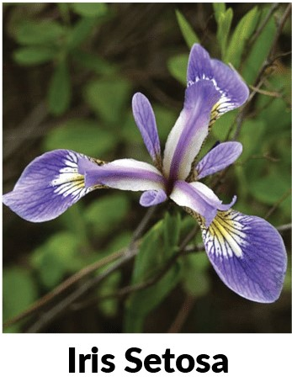
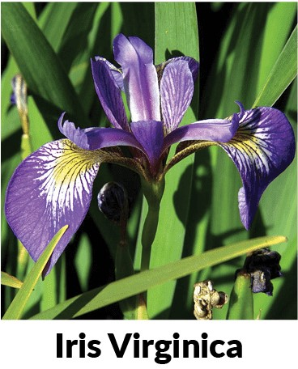
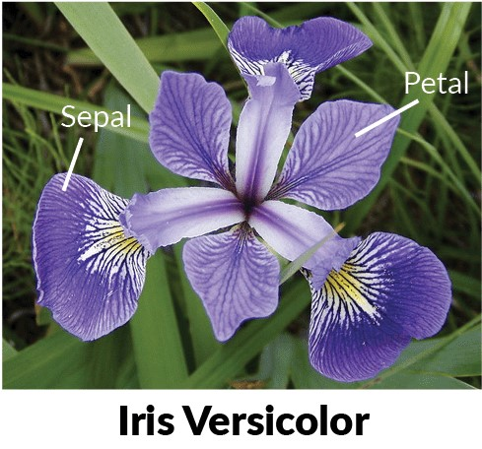
Due to time restrictions we use a single data set in this module
3 classes: versicolor, setosa, virginica
4 characteristics
petal: length, width
sepal: length, width
Iris data set

Slide 8

Any questions so far?

Slide 9
Data Collection & Preprocessing
Descriptive Statistics
Classification, Clustering,…
Inferential Statistics
Planning
General Procedure

Slide 10
Descriptive Statisics
Why?
Get an overview of the data
Identify Patterns
Identify possible problems eg. outliers
Get a feeling for the quality of the data
good description is the basis for good inference

Slide 11
Descriptive Statisics
The two main tasks of descriptive statistics are
the quantitative description and summary, and
the graphical representation of data
What tools are suitable depends on the type of the variable we want to describe.

Slide 12
Categorical Variables (quantitative)
Absolute frequency (eg. number of female participants)
Relative frequency (eq. number of female participants divided by the sample size)

Slide 13
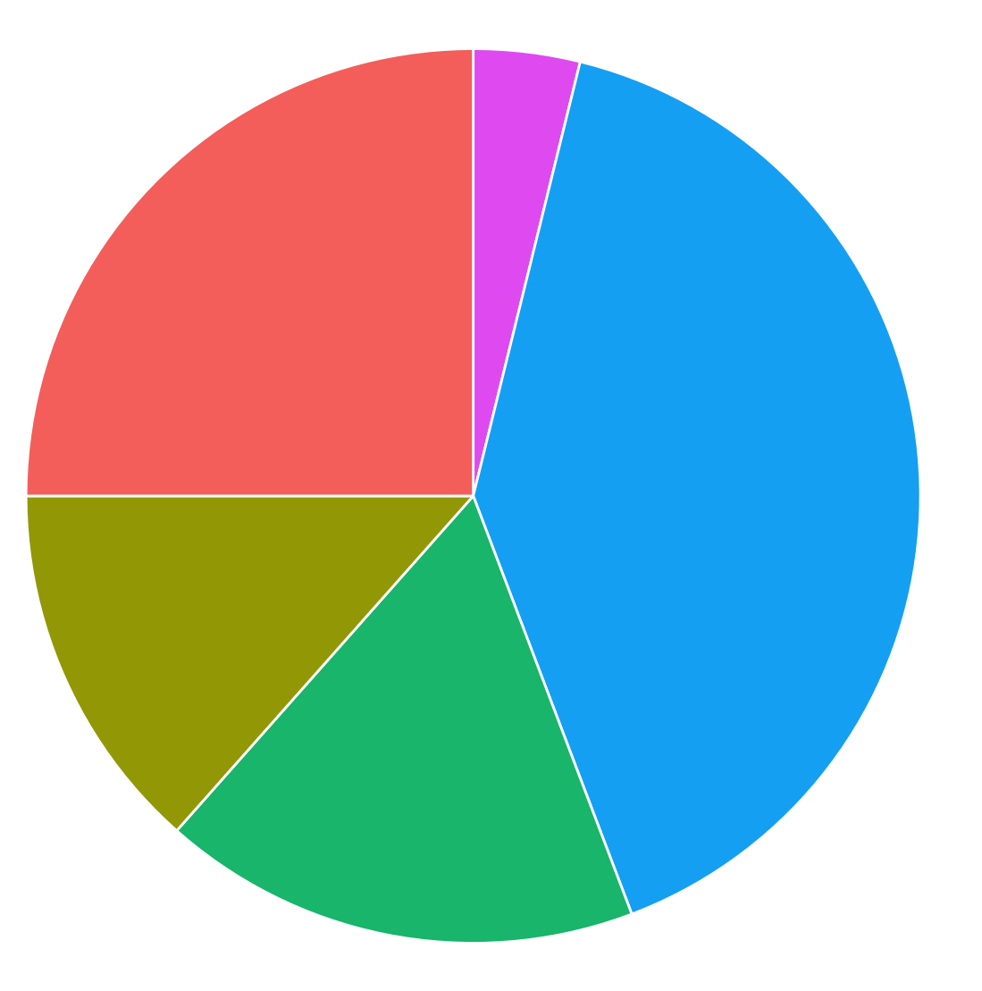
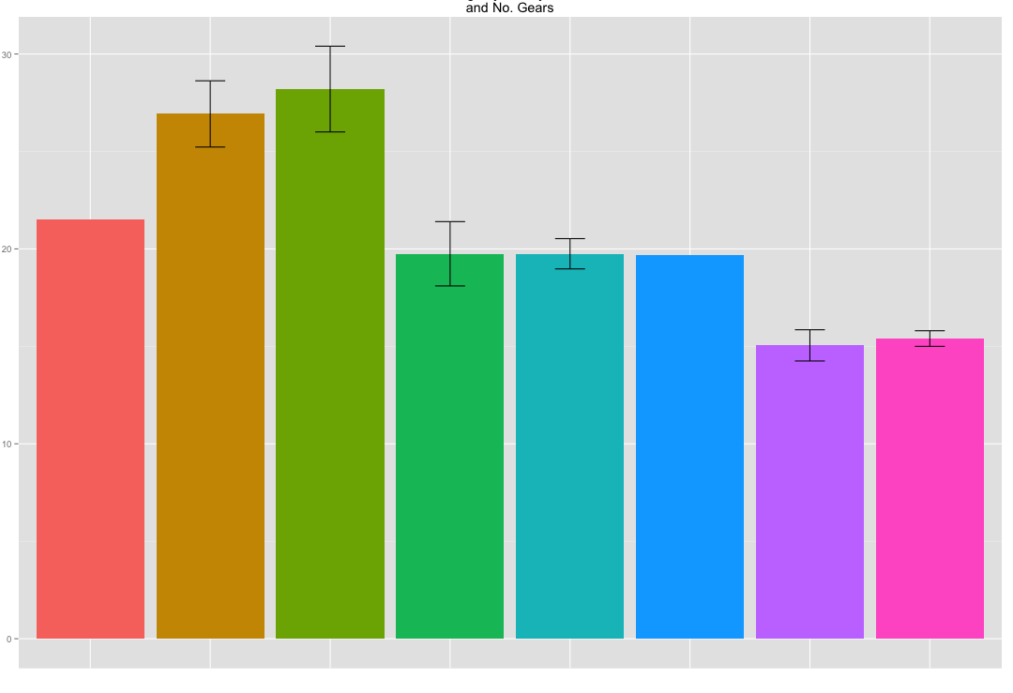
Categorical Variables (graphical)
(Either absolute or relative frequencies can be displayed)

Slide 14
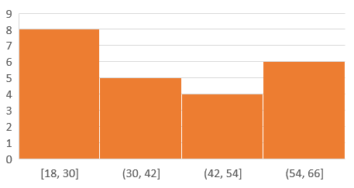
Numerical Variables (categorization)
Summary tables
Age | Nr. of People
18-30 | 8
30-42 | 5
42-54 | 4
54-66 | 6
Histograms

Slide 15

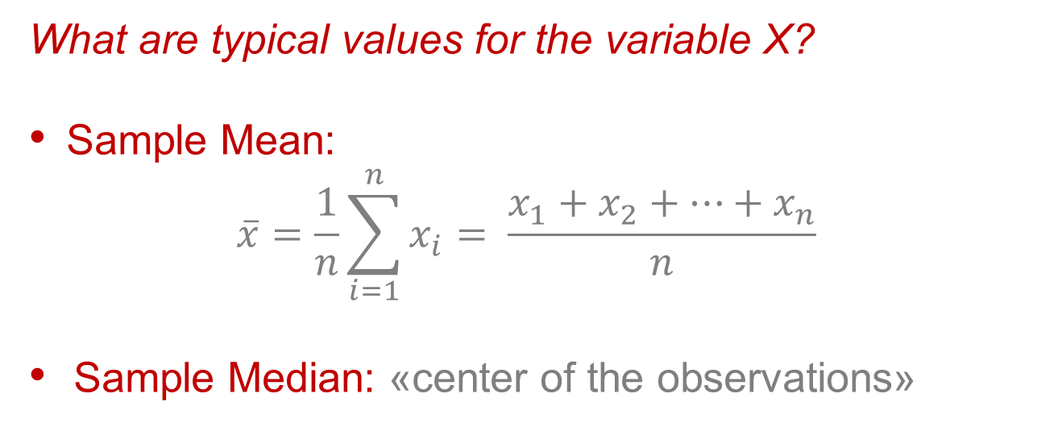

Location
What are typical values for the variable X?
Sample Mean:
$$\overline{x}=\frac{1}{n}\sum_{i=1}^{n}{x_{i}}= \frac{x_{1}+x_{2}+…+x_{n}}{n}$$
Sample Median: «center of the observations»
(Numerical Variables)
odd
$$q_{0.5}$$
even
$$q_{0.5}$$
the median is more robust than the mean

Slide 16
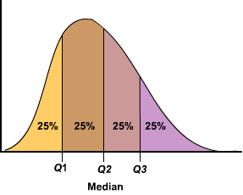
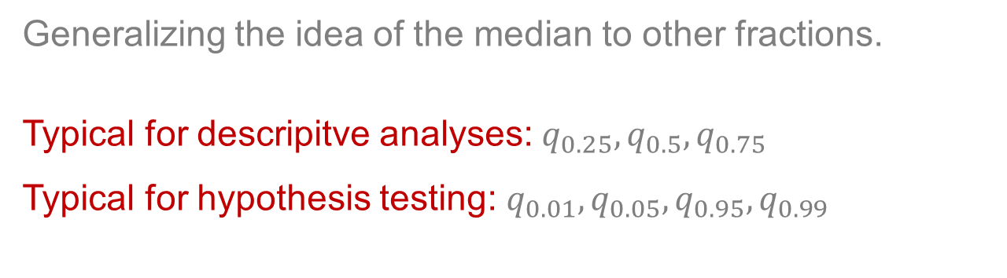



Quantiles
Generalizing the idea of the median to other fractions.
Typical for descripitve analyses: $q_{0.25},q_{0.5},q_{0.75}$
Typical for hypothesis testing: $q_{0.01},q_{0.05},q_{0.95},q_{0.99}$
(Numerical Variables)
$$q_{0.25}$$
$$q_{0.5}$$
$$q_{0.75}$$

Slide 17
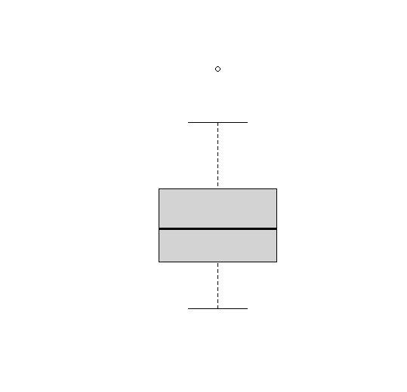

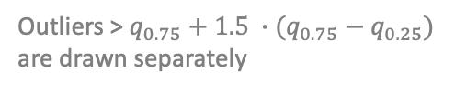


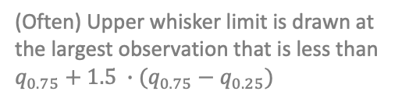






Boxplots
Graphical display of the quantiles
$$max$$
Outliers > $q_{0.75}+1.5 ∙(q_{0.75}−q_{0.25})$ are drawn separately
(Often) Upper whisker limit is drawn at the largest observation that is less than $q_{0.75}+1.5 ∙(q_{0.75}−q_{0.25})$
$$25\%$$
$$q_{0.75}$$
(Numerical Variables)
$$25\%$$
$$q_{0.5}$$
$$25\%$$
$$q_{0.25}$$
$$25\%$$
$$min$$

Slide 18

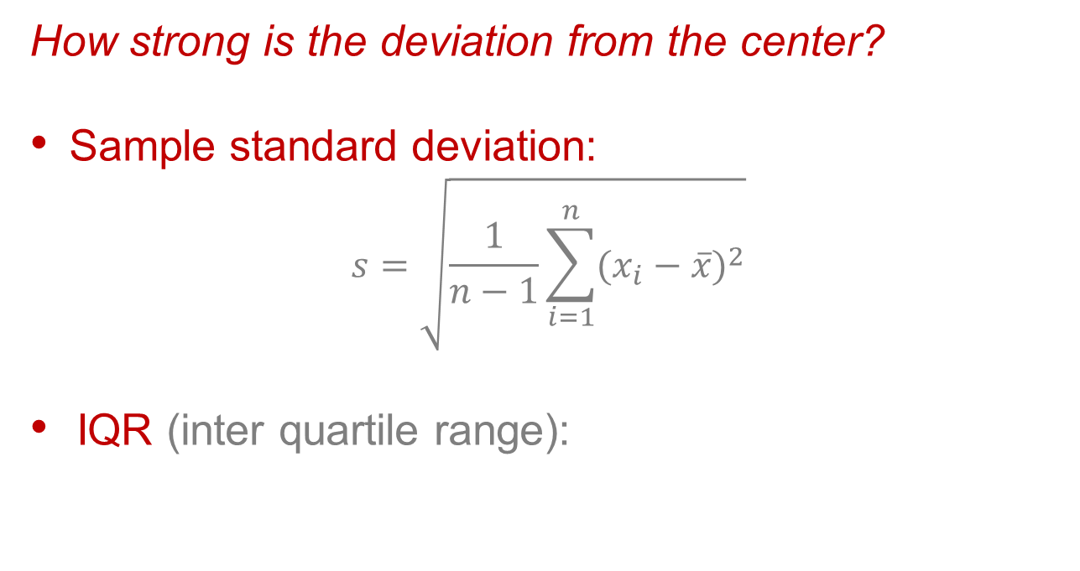


Spread
How strong is the deviation from the center?
Sample standard deviation:
$$s=\sqrt{\frac{1}{n−1}\sum_{i=1}^{n}{{(x_{i}−\overline{x})}^{2}}}$$
IQR (inter quartile range):
(Numerical Variables)
$${IQR=q_{0.75}−q}_{0.25}$$
$$S=1.16, IQR=1.34$$
$$S=4.05, IQR=5.93$$
Notes:
std dev = sqrt(var) → often the std dev is used because it will have similar units to the data points, while the variance will be squared, so it’s less intuitive.

Slide 19
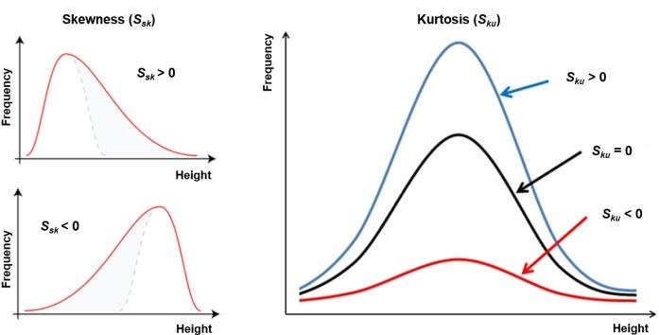
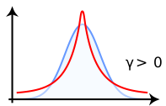
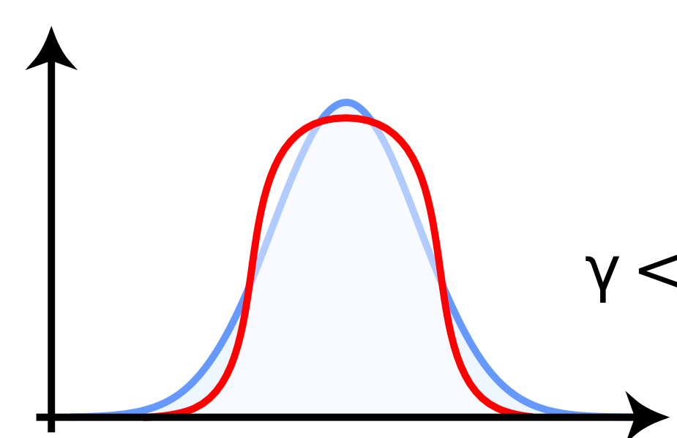
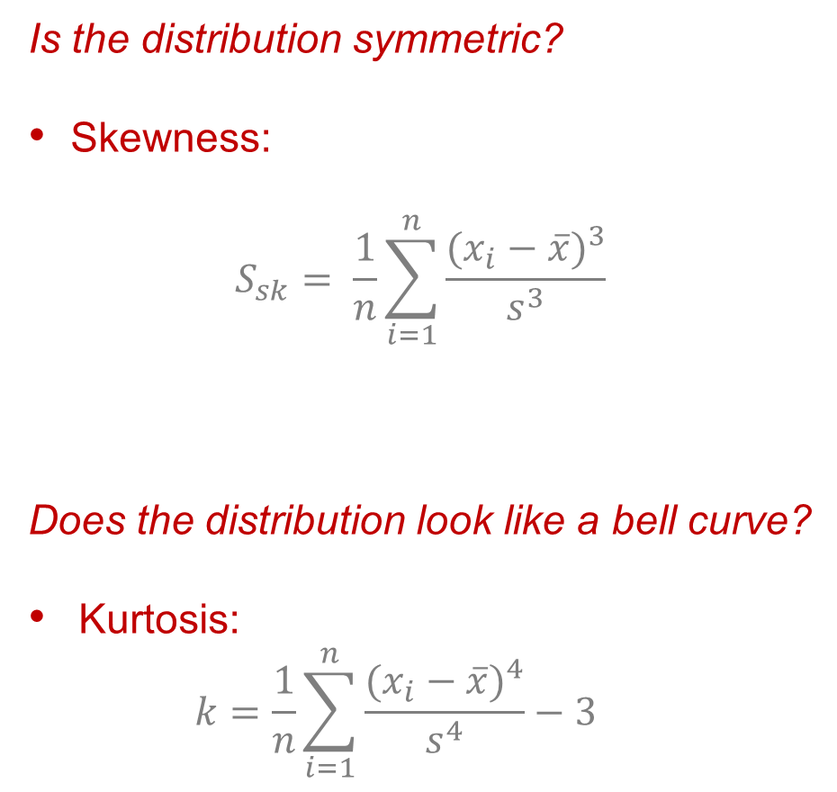
Shape
Is the distribution symmetric?
Skewness:
$$S_{sk}= \frac{1}{n}\sum_{i=1}^{n}{\frac{{(x_{i}−\overline{x})}^{3}}{s^{3}}}$$
Does the distribution look like a bell curve?
Kurtosis: $k=\frac{1}{n}\sum_{i=1}^{n}{\frac{{(x_{i}−\overline{x})}^{4}}{s^{4}}}−3$
(Numerical Variables)
k>0
k<0

Slide 20
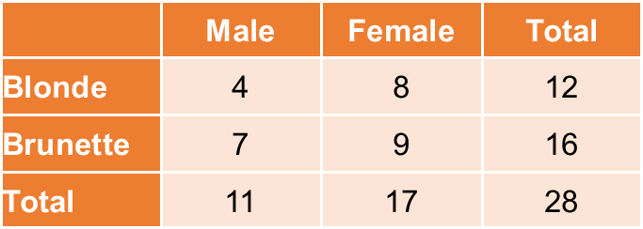
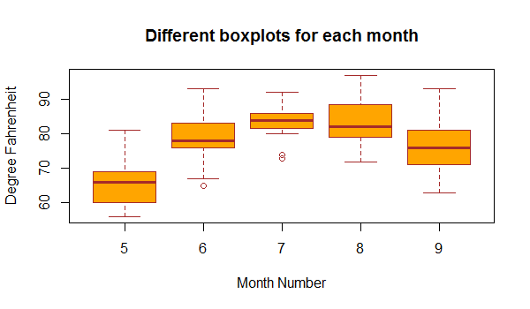
Simultaneous description (of two features)
Contigency table (2 categorical features)
Boxplots (1 categorical and 1 numerical feature)

Slide 21
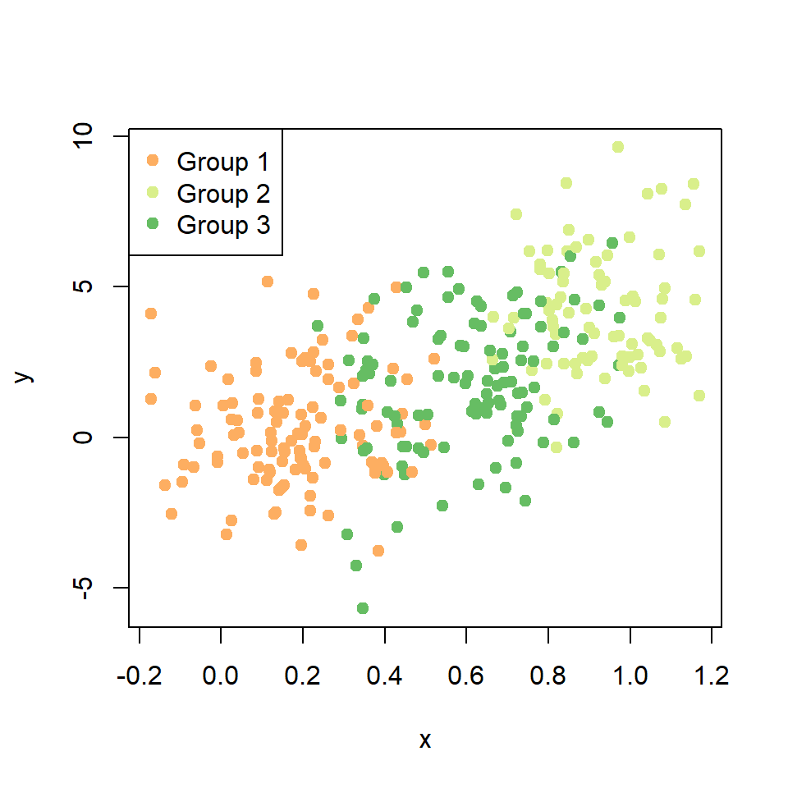
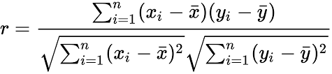
Simultaneous description (of two features)
Scatterplot (2 numerical features)
person i’s y-value
person i’s x-value
Pearson Correlation (2 numerical features)

Slide 22
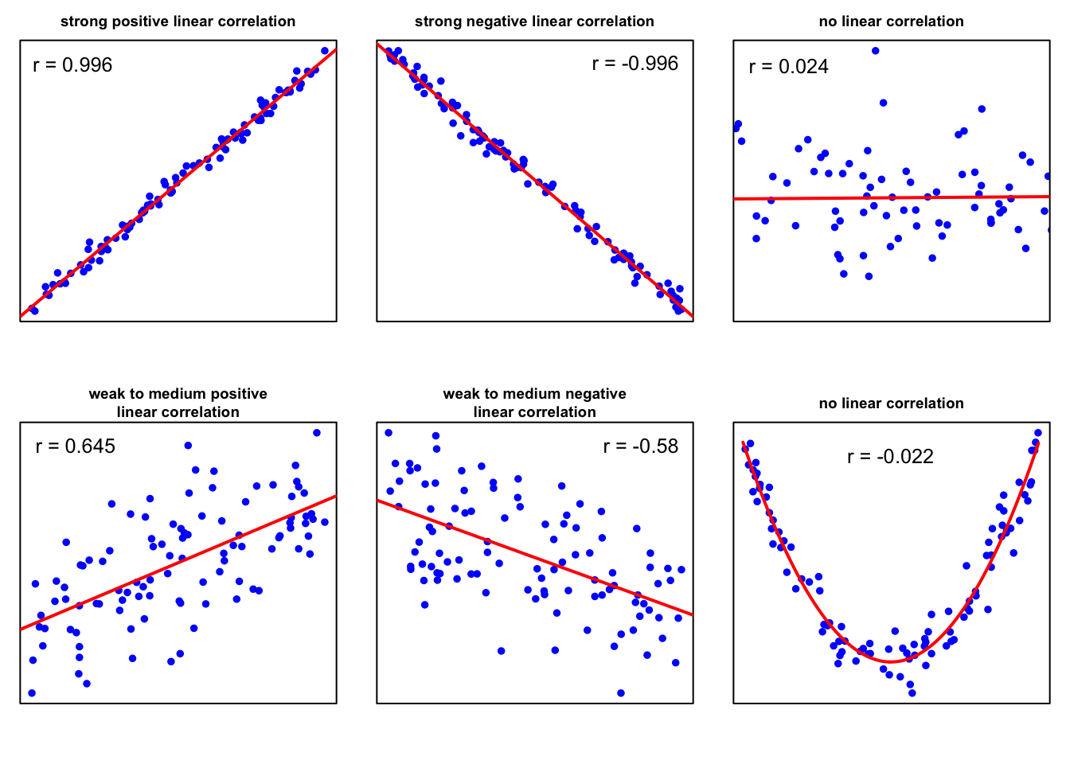
Simultaneous description (of two features)
Pearson Correlation (2 numerical features)
Notes:
Pearson correlation is useful for linear relationships only, as seen in the last plot, where there is a clear parabolic relationship between the data, but the coefficient does not show this.

Slide 23
Probability
Descriptive statistics are an important first step but do not provide us with the means we need to eventually reach our goal...
In general, we want confirm a hypothesis on a population based on a sample of said population.
To this end, we need a mathematical framework for dealing with this uncertainty.
To quantify the uncertainty one often works with probability distributions.

Slide 24
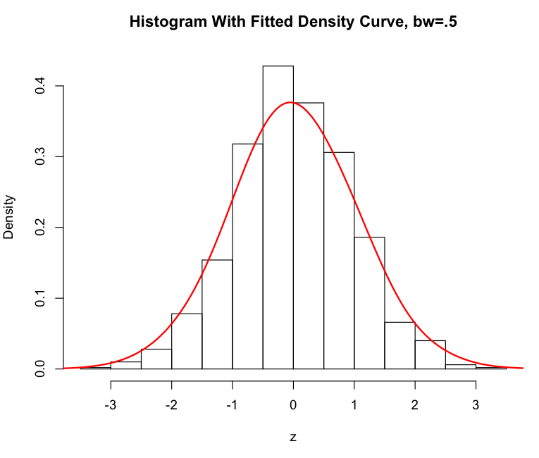
Probability
Probability density function (pdf)

Slide 25
Probability
Probability density function (pdf)

Slide 26
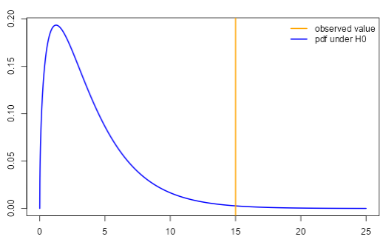
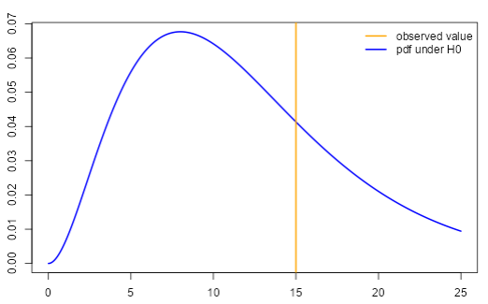
Sketch of idea

