Slide 1
Paired & Unpaired T-Test
Lenja & Ramona (Paired) ; Lara & Patricio (Unpaired)

Slide 2
Paired & Unpaired T-Test: Basics
Question that T-test tries to answer
Paired | Unpaired
Are the means of two “related” measurements similar? | Are the unknown population means of two groups equal?
Assumptions on data:
Normality
Paired = Compare means from related measurements of the same group / individual
Eg. Measure blood pressure of the same patients pre- and post-surgery and try to compare the means
Unpaired = Compare means from groups/individuals that are unrelated and where we have equal variance in the data
Eg. Measure blood pressure of males and females pre-surgery and try to compare the means
Sidenote: When variance is not equal we would conduct a unpaired T-Test with Welsh Correction
Assumptions on the data
Paired | Unpaired
Paired measurements obtained from same “subject” | Data values must be independent
Data obtained from random sample | Data obtained from random sample
Normally distributed | Normally distributed
Data values are continuous | Data values are continuous
N/A | Variances in each group assumed to be equal or similar
Sidenote: When variances are not equal or similar we would conduct an unpaired T-Test with Welsch’s Correction

Slide 3
Paired & Unpaired T-Test: Examples
Examples from real life
Paired | Unpaired
Measure blood pressure of the same patients pre- and post-surgery and compare the means | Measure blood pressure of males and females and compare the means
Measure mean width and mean length of the petal (or sepal) of the same species of Iris flower → provides information about the shape of the petal or sepal in that species | Measure mean sepal (or petal) widths of two species of Iris flower → provides information about whether each species can be distinguished by its sepal width
Measure mean ice loss from regional glaciers before and after a climatic event (e.g. volcanic eruption) | Measure mean ice loss of Alpine glaciers vs. mean ice loss of Andean glaciers over a certain period

Slide 4
Notebook conclusions: Paired T-test
We know that the mean of slength and swidth are very different. We get a p-value of 1.7724677938534726e-40 which means that we can reject the null hypothesis (=means are the same) and there is hence a significant difference between the means of slength and swidth of our sample.
If we look at a different sample of the same attribute (e.g. we compare slength of one half of the sample to the other half of the sample) we expect not to see a big difference of the means. And indeed we observe a p-value of 0.29 which means that we can not reject the null hypothesis for this test, meaning we can not exclude that the means are the same.

Slide 5
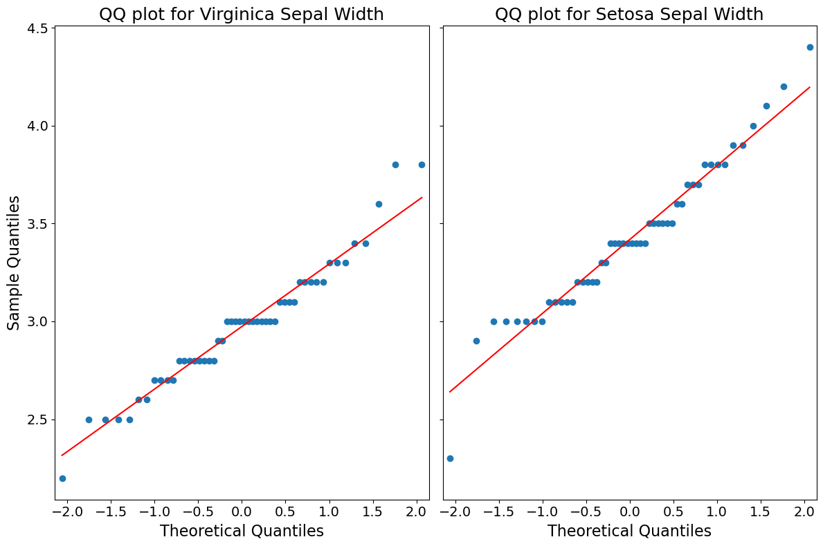
Notebook conclusions: Unpaired T-test
H1: The sample widths come from populations with different mean Sepal widths → Iris Virginica and Setosa can be distinguished by their Sepal widths
H0: The sample widths come from populations with equal mean Sepal widths → Iris Virginica and Setosa cannot be distinguished by their Sepal widths
QQ-plot of each data set shows that Normality holds
Generating random normal samples with the same mean and std as the data results in similar QQ plots.
Pandas Stdev method shows comparable standard deviations
→ Unpaired T-test is suitable
stdev = 0.322497
stdev = 0.381024
TtestResult
(statistic=6.289384996672061, pvalue=8.916634067006443e-09, df=98.0)
The p-value << 0.01 → we can confidently reject the null hypothesis; it is very unlikely that the samples come from populations with the same mean
→ It is probable that Setosa and Virginica could be distinguished by their Sepal widths

