Slide 1
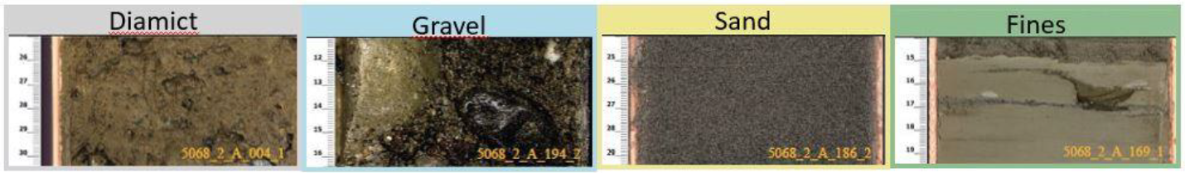
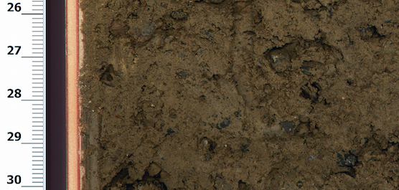
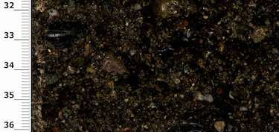
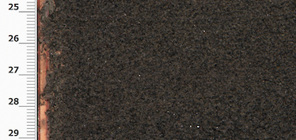
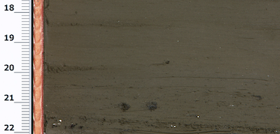
5068_2_A_004_1
5068_2_A_194_2
5068_2_A_186_2
5068_2_A_169_1

Slide 2
Data Acquisition
Core drilling | Core logging and digitising
Core scanning | Visual classification
Data retrieval & Image download
Image labelling
Data cleaning and preparation
Machine Learning sub-flow
Final Visualisation

