Slide 1


TCDSB #DataDunkers Students Workshop,
November 2023
Peter Beens
Twitter/X: @pbeens
Email: pbeens@gmail.com
Mastodon: mstdn.ca/@pbeens
bit.ly/dd-slides
The original of these slides can be found at https://bit.ly/dd-slides.

Slide 2

Our Goal?
To get you to confidently use Jupyter Notebooks and the Python programming language to analyze data from Pascal Siakam’s basketball career with the Toronto Raptors.

Slide 3
Overview
Activity Demos
Introduction to Jupyter Notebooks (Cell Types, Markdown, Running Python Code)
Shoot Some Hoops!
How Do We Get the Data? (Internal, CSV, Excel, Webpages, Google Sheets)
Activity: Mini Basketball Labyrinth
Previewing the Data (Columns, Filtering, Sorting)
Visualizing the Data (Bar Charts, Scatter Plots, Pie Charts, Histograms)
Basic Statistics (min, max, median, mean)
Activity: Mini Hoops Graph

Slide 4

Activity Demos (1/2)
Mini Hoops Activity (Intro Only)
Mini Basketball Labyrinth (Intro Only)
bit.ly/hoops-data

Slide 5

Activity Demos (2/2)
Mini Hoops Activity (Intro Only)
Mini Basketball Labyrinth (Intro Only)
bit.ly/dd-mini-bb
Key: WNBA

Slide 6
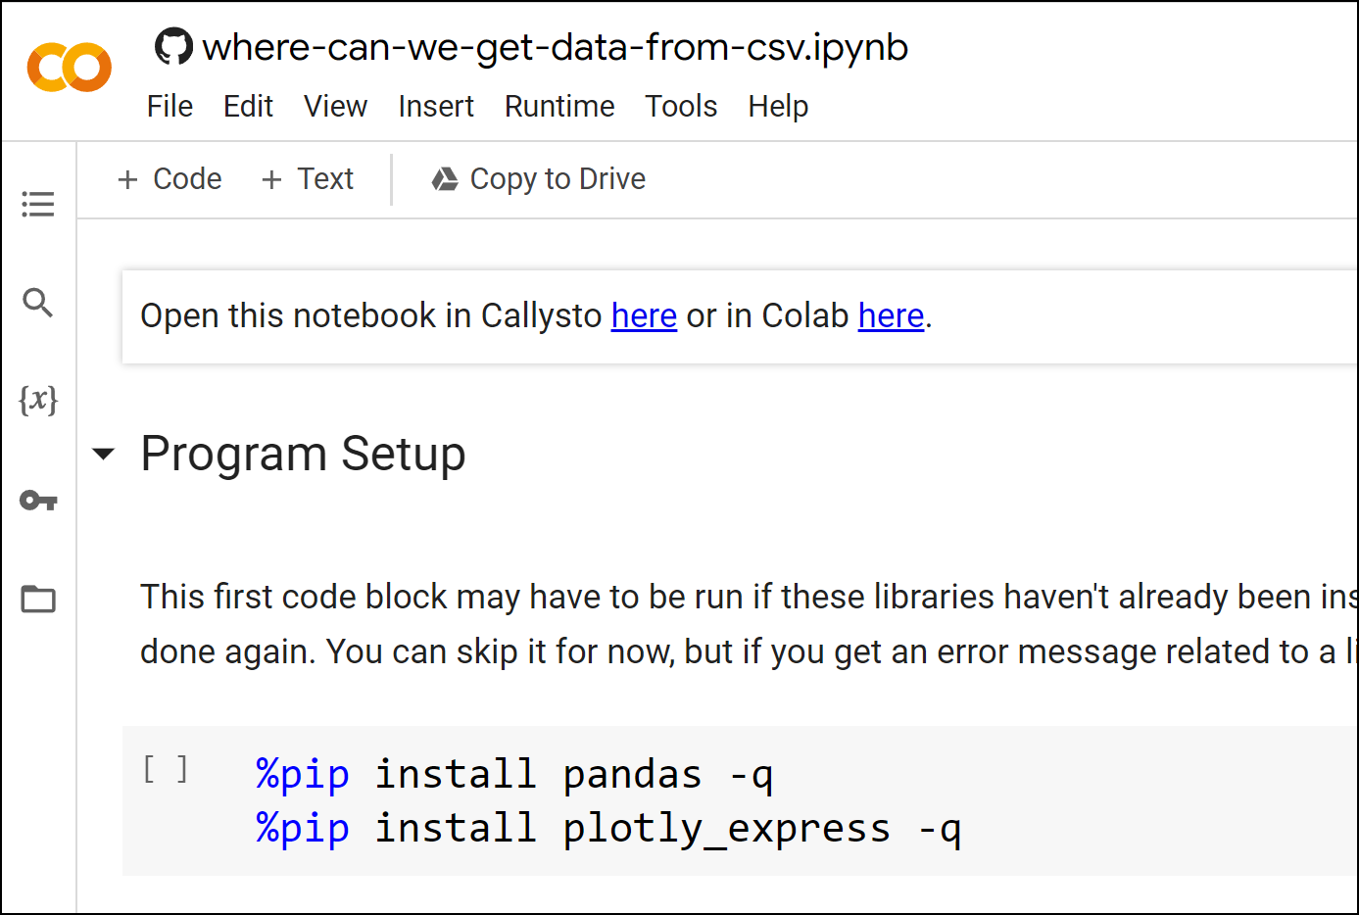
Introduction to Jupyter Notebooks (1/2)
Lesson: Jupyter Notebook Demo
Callysto vs Google Colab Discussion
Basics of Markdown
Code Cells vs Markdown Cells (Pay attention to “Hello world” example program!)
Class Activity: hello-world

Slide 7
Introduction to Jupyter Notebooks (2/2)
Lesson: Jupyter Notebook Demo
Class Activity: hello-world
Basic Python syntax
How to run code in a code cell

Slide 8

Shoot Some Hoops!
Whenever you see this graphic at the end of a lesson, shoot some hoops and enter it on the form. Clicking on the graphic will take you to the form.
Remember to always enter your name the same way, and never enter your last name.

Slide 9
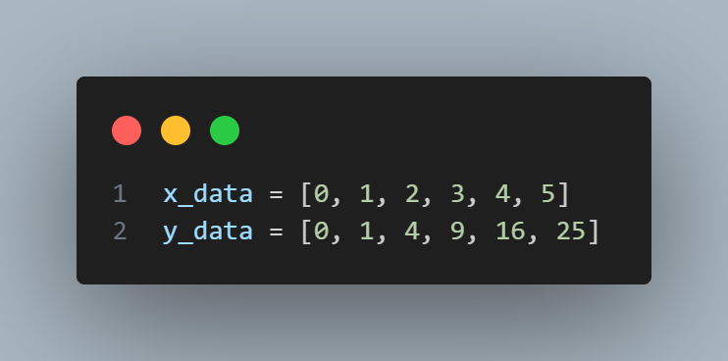
How Do We Get the Data? (1/5)
Internal List Data
Shows how to use internal list data ([]) to produce a line chart.
CSV (Comma Separated Values) File
Excel File
Webpage
Google Sheets

Slide 10
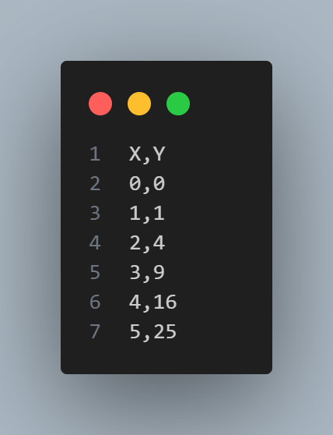
How Do We Get the Data? (2/5)
Internal List Data
CSV (Comma Separated Values) File
Shows how to access data from a Comma Separated Values (CSV) file.
Introduces how to use head() and tail() to show the top or bottom rows, respectively, of your data.
Introduces how to get the name of the columns using df.columns.
Introduces how to rename columns.
Introduces Python variables.
Excel File
Webpage
Google Sheets

Slide 11
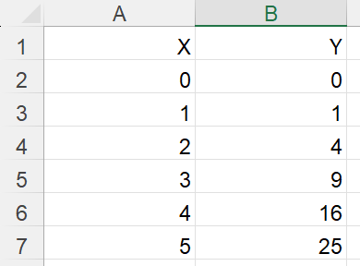
How Do We Get the Data? (3/5)
Internal List Data
CSV (Comma Separated Values) File
Excel File
Shows how to access data from an Excel file.
Webpage
Google Sheets

Slide 12

How Do We Get the Data? (4/5)
Internal List Data
CSV (Comma Separated Values) File
Excel File
Webpage
Shows how to access data from a table on a webpage.
Pay attention to how to choose which table to “scrape”.
Google Sheets

Slide 13
How Do We Get the Data? (5/5)
Internal List Data
CSV (Comma Separated Values) File
Excel File
Webpage
Google Sheets
Shows how to access data from a Google Sheet.
Pay attention to the Google Sheet permission and how to change the URL.
Shoot some hoops!

Slide 14

Activity: Mini Basketball Labyrinth
bit.ly/dd-mini-bb
Key: WNBA

Slide 15
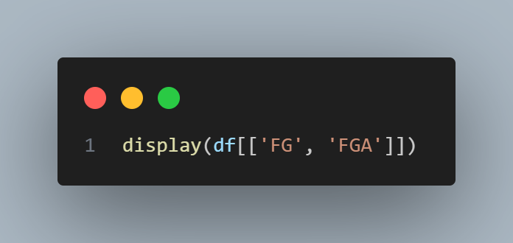
Previewing the Data (1/4)
Columns
How to see what columns are in the data.
How how to view specific columns of the data.
Making New Columns
Filtering Data
Sorting Data

Slide 16
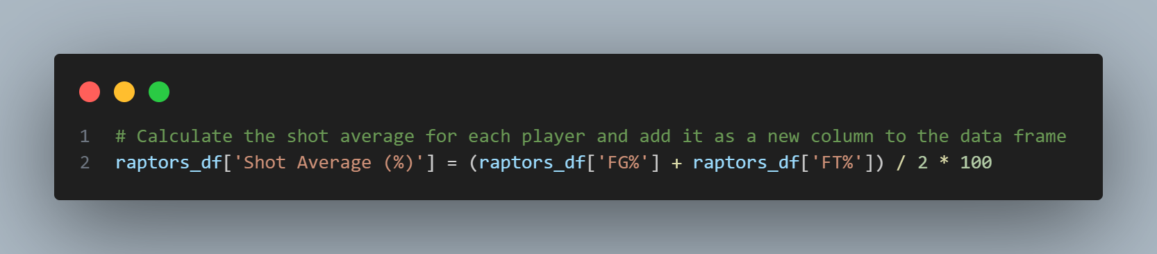
Previewing the Data (1/4)
Columns
Making New Columns
We learn how to make new columns using the data from other columns.
We learn how to use round() to round numbers.
Filtering Data
Sorting Data

Slide 17
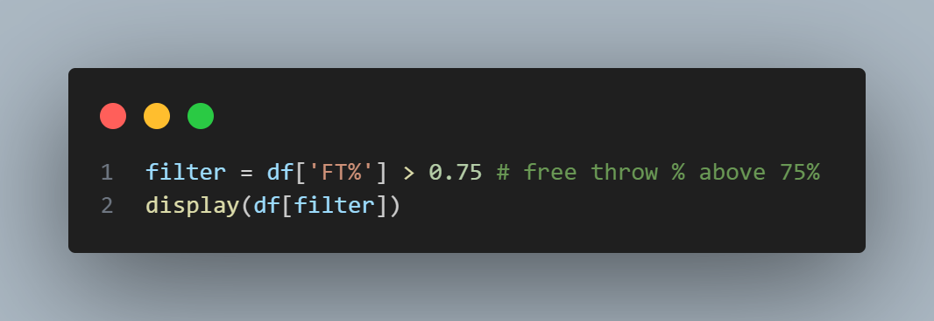
Previewing the Data (3/4)
Columns
Making New Columns
Filtering Data
How to extract data that meets specific criteria.
Sorting Data

Slide 18
Previewing the Data (4/4)
Columns
Making New Columns
Filtering Data
Sorting Data
How to sort the data using df.sort_values().
How to delete unwanted rows using df.drop().

Slide 19
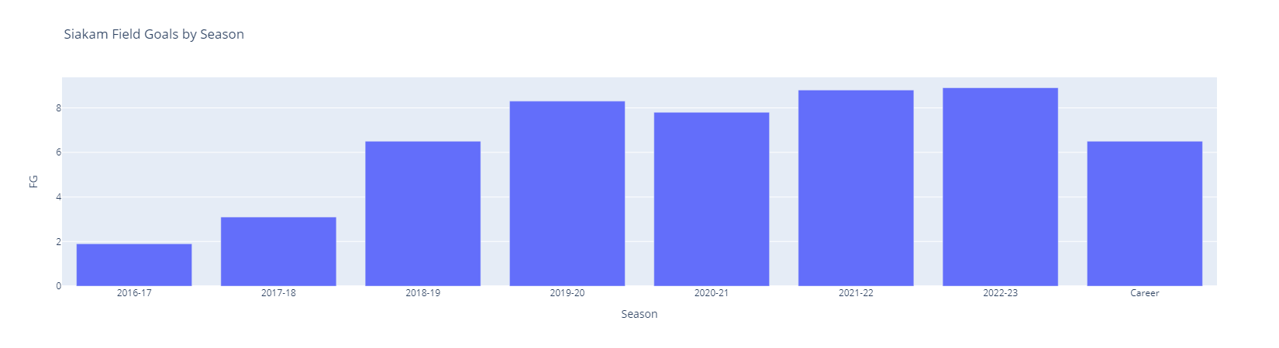
Visualizing the Data (1/4)
Bar Charts
How to create a bar chart.
How to plot multiple columns using a list ([ ]).
How to rename the x-axis using fig.update_xaxes(title='').
How to rename the y-axis using fig.update_yaxes(title='').
Scatter Plots
Pie Charts
Histograms
(We have already done Line Charts)

Slide 20
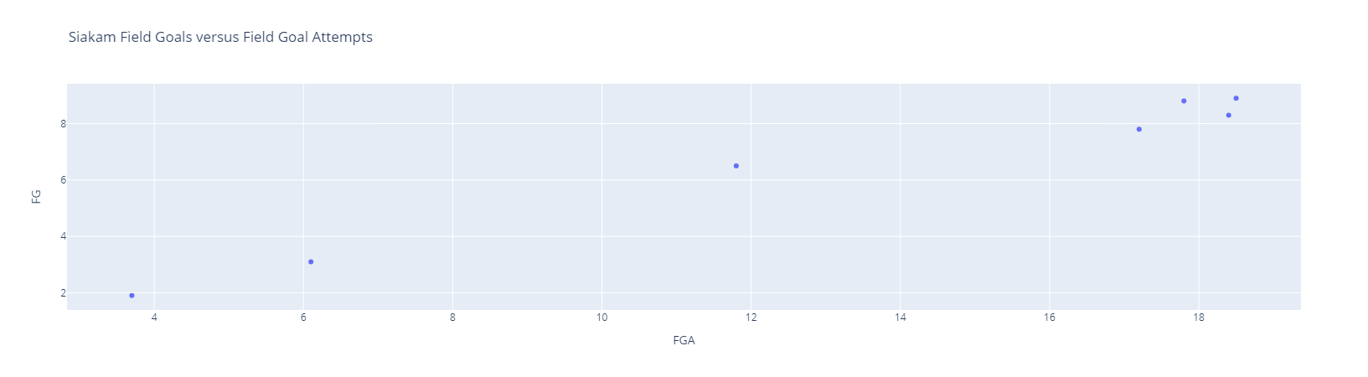
Visualizing the Data (2/4)
Bar Charts
Scatter Plots
How to create a scatter plot.
How to delete unwanted rows using df.drop(n, inplace=True).
Method chaining is introduced.
The Plotly Express color= and size= options are introduced.
Pie Charts
Histograms

Slide 21
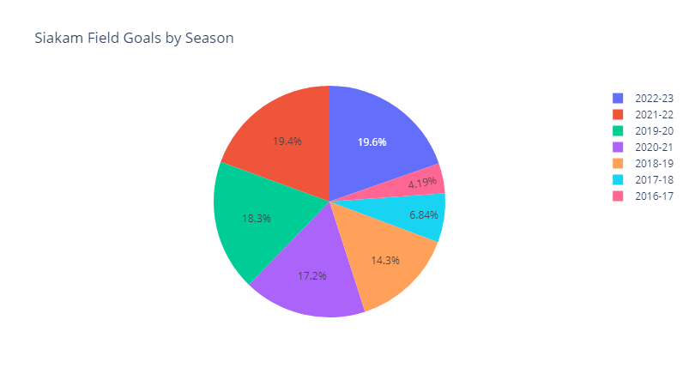
Visualizing the Data (3/4)
Bar Charts
Scatter Plots
Pie Charts
How to create a pie chart.
Histograms

Slide 22
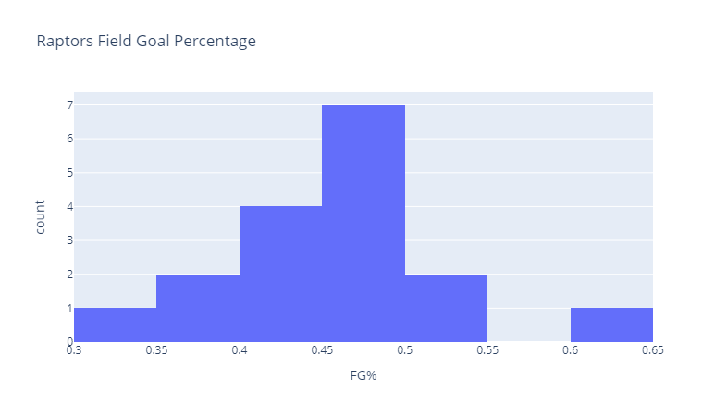
Visualizing the Data (4/4)
Bar Charts
Scatter Plots
Pie Charts
Histograms
How to create a histogram.

Slide 23
Basic Statistics
Basic Statistics
Looking at basic statistics such as min(), max(), median(), mean().
How to look at the stats of all the numeric columns.
How to look at the stats of all columns using df.describe().
How to use f-strings to control the number of decimal places that are printed.

Slide 24
Activity: Mini Hoops Graph
bit.ly/hoops-data

Slide 25
Thank you!

