Slide 1
Python for Beginners
aka Programming for Beginners
Peter Beens

Slide 2
All files for this tutorial can be found at:
https://is.gd/Python101

Slide 3
What is Programming?
Programming is a way to “instruct the computer to perform various tasks”.
Source: https://hackr.io/blog/what-is-programming

Slide 4
Why Python?

Slide 5
Top 10 Reasons Why Python is So Popular With Developers in 2021
Easy to Learn and Use
Mature and Supportive Python Community
Support from Renowned Corporate Sponsors
Hundreds of Python Libraries and Frameworks
Versatility, Efficiency, Reliability, and Speed
Big data, Machine Learning and Cloud Computing
First-choice Language
The Flexibility of Python Language
Use of python in academics
Automation
Source: https://www.upgrad.com/blog/reasons-why-python-popular-with-developers/

Slide 6
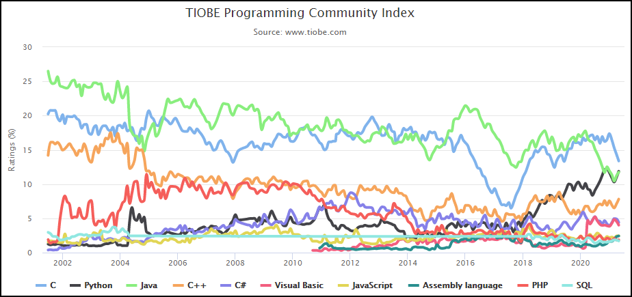
Python
Source: https://www.tiobe.com/tiobe-index/

Slide 7
Our First Program!

Slide 8
Hello, World!
A "Hello, World!" program generally is a computer program that outputs or displays the message "Hello, World!". Such a program is very simple in most programming languages, and is often used to illustrate the basic syntax of a programming language.
It is often the first program written by people learning to code. It can also be used as a sanity test to make sure that a computer language is correctly installed, and that the operator understands how to use it.
Source: https://en.wikipedia.org/wiki/%22Hello,_World!%22_program

Slide 9
Hello World -- Demo and Exercises
https://is.gd/1VHgvN
(We will also do a quick overview of Google Colab, the primary editor we will be using for our demos and exercises.)

Slide 10
Basic IPO Model of Programming
Input
Process
Output

Slide 11
Getting Input Using the Keyboard
Example:
name = input('What is your name? ')

Slide 12
Input and Variables -- Demo and Exercises
https://is.gd/yk4pYL

