Slide 1
Classifying Spectra with Machine Learning
Pablo Bee Olmedo, Lauren Taylor
Supervisor: Dr Sarah MArtell

Slide 2

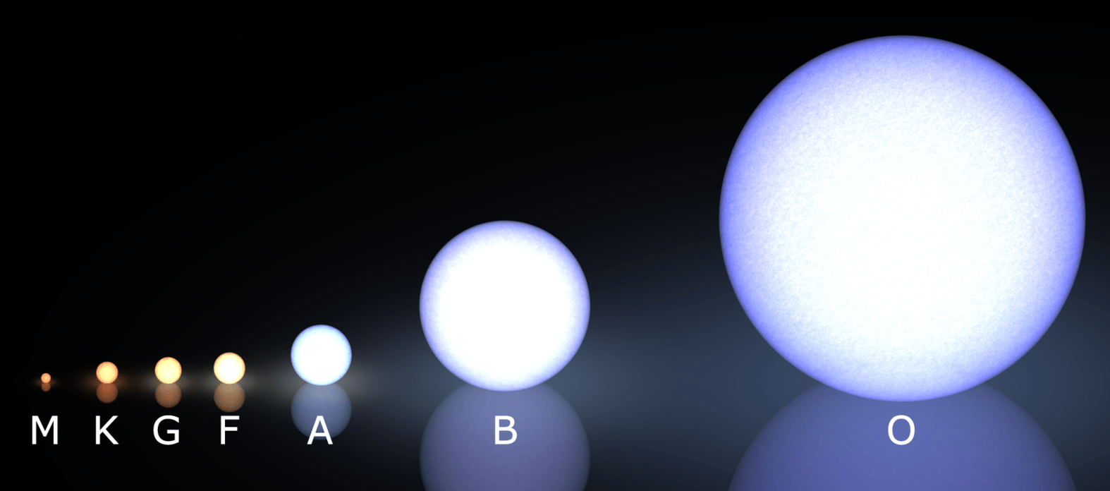

Spectral Classes
Notes:
Cain, F., 2009, What Are The Different Types of Stars?, Universe Today, https://www.universetoday.com/24299/types-of-stars/

Slide 3
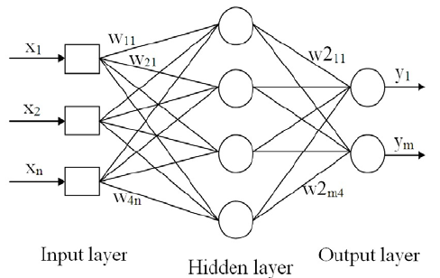
Machine Learning:
Multi-Layer Perceptron (Neural Network)
Python Keras (Tensorflow/Theano backend)
Notes:
Mohamad-Salah, J., 2019, A schematic diagram of a Multi-Layer Perceptron (MLP) neural network, https://www.researchgate.net/figure/A-schematic-diagram-of-a-Multi-Layer-Perceptron-MLP-neural-network_fig3_257071174

Slide 4
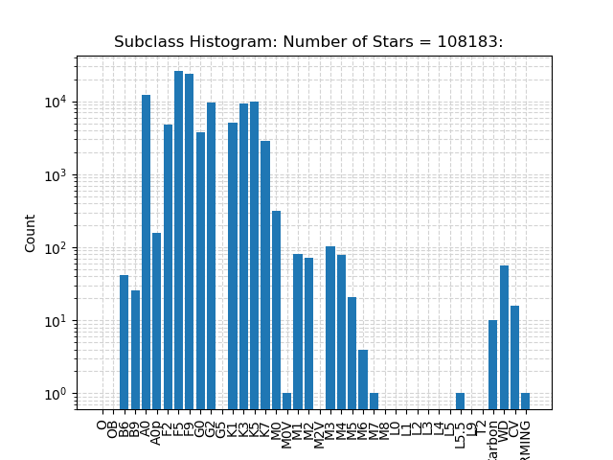
SEGUE Dataset

Slide 5
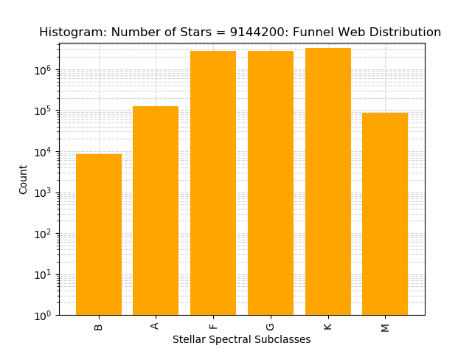
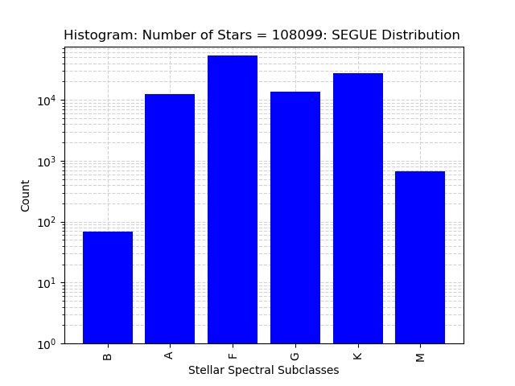
SEGUE Distribution FUNNELWEB Distribution (Galaxia Model)
Notes:
Tinney et. al, 2014, Funnel Web: Mapping the Southern Sky, https://www.aao.gov.au/files/palmcove2014/Tinney%20-%20FunnelWeb%20-%20Mapping%20the%20Southern%20Sky%20-%20No%20Movie.pdf
Sharma et. al, 2011, Galaxia: a code to generate a synthetic survey of the Milky Way, https://arxiv.org/abs/1101.3561

Slide 6
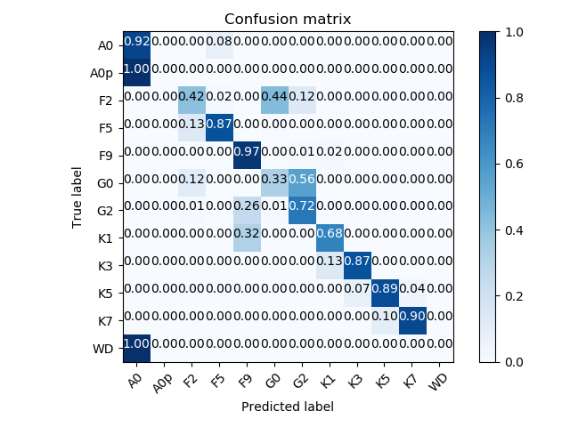
Results: NN Take 1
85.2% Accurate
Overpredicts common classes

Slide 7
How to improve?
Grid search (Katana)
Balance the distribution
Layered neural networks

Slide 8
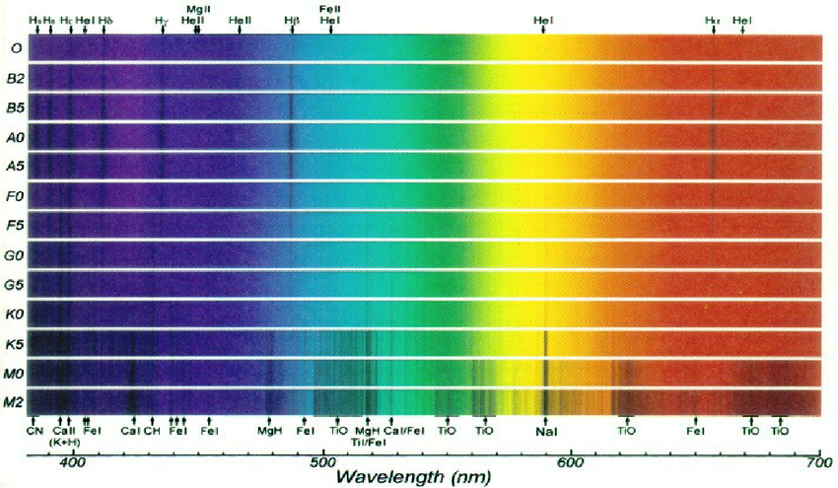
Layered Neural Networks
Notes:
From R. Bell, University of Maryland, and M. Briley, University of Wisconsin, Oshkosh, https://www.researchgate.net/figure/Stellar-spectra-with-absorption-line-spectra-characteristic-of-elements-in-the-stellar_fig2_235746971

Slide 9
Layered Neural Network
Input Spectra
All wavelengths
Neural Network for M Stars
From 4500-7000 Å
Neural Network for Remaining Classes
All wavelengths
All classes
All classes
Non-M Star classes
Classify M Stars into Subclasses

Slide 10
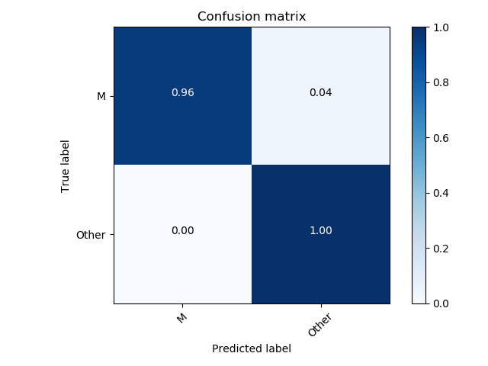
Results – M Classifier
Woo nice ☺
99.33% accurate

Slide 11
Future Work…
Add more networks to classify other rare classes (i.e. B stars)
Make network to estimate stellar parameters (Effective temp, surface gravity, metallicity etc.)
Make own training and testing splitter

Slide 12
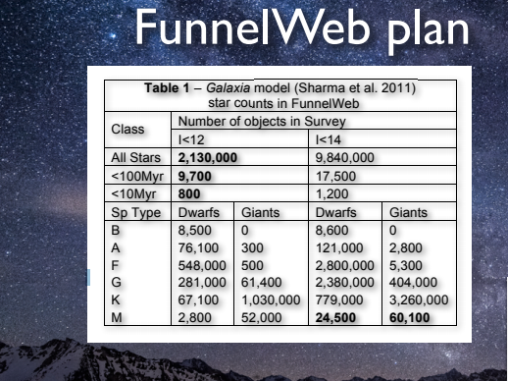
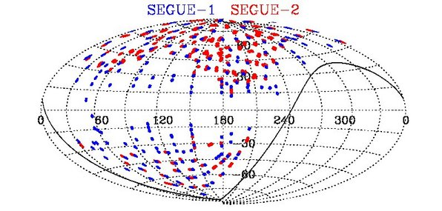
Extra Stuff

