Slide 1
Identification of TFBS
Introduction to gene transcription regulation
Data and experimental procedures
Modeling:
  Motif models
  Number and types of occurrences
Existing modeling approaches

Slide 2
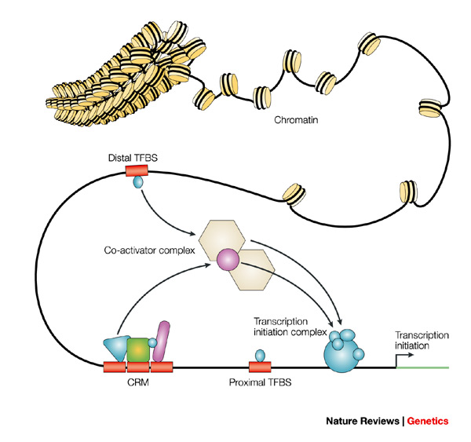
Transcription Factors
Transcription factors (TFs) bind to specific sites (transcription-factor binding sites; TFBS) that are either proximal or distal to a transcription start site. Sets of TFs can operate in functional cis-regulatory modules (CRMs) to achieve specific regulatory properties. Interactions between bound TFs and cofactors stabilize the transcription-initiation machinery to enable gene expression. The regulation that is conferred by sequence-specific binding TFs is highly dependent on the three-dimensional structure of chromatin.

Slide 3
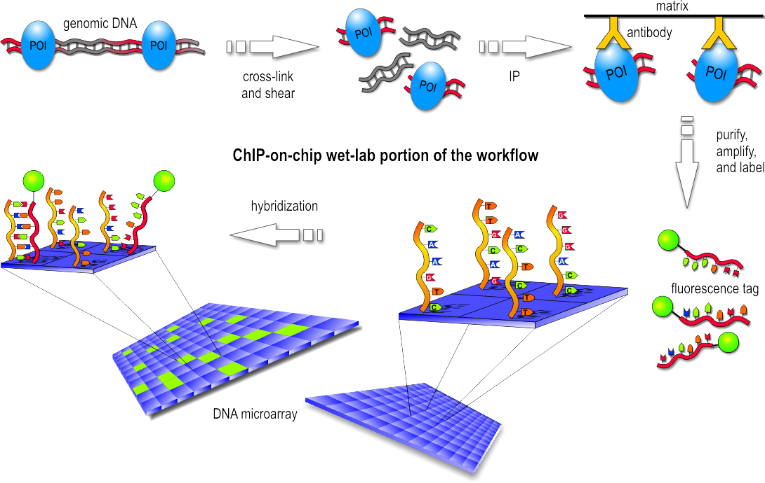
ChIP-on-Chip Experiment

Slide 4
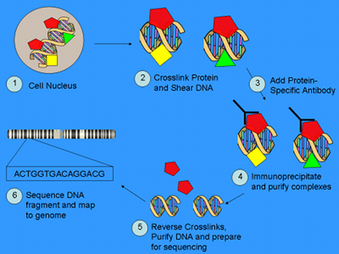
ChIP-Seq Experiment

Slide 5
Identification of TFBS
Given:
  A set of sequences that are thought to contain TFBS
Task:
  Infer a model for the TFBS
  Predict the location of occurrences

Slide 6
Phylogenetic footprinting
We also use data from different but related species (orthologous intergenic regions)
Assumption:
  TFBS are almost unaffected by mutations

Slide 7
Hierarchical Modeling
We need to model
  TFBS
  Distribution of occurrences
  (Phylogenetic relations)

Slide 8
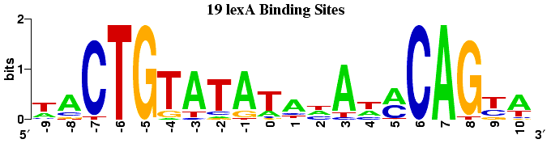
Binding-site modeling
Independence assumption (too simple)
Fixed-order Markov Model (overfitting)
Variable-order Bayesian Network

Slide 9
Drawbacks of current methods
Algorithms such as MEME contain many hidden assumptions (derivations are not well justified)
EM gets stuck in local optima
Weight matrices are mostly used as models for TFBS
Only one type of TFBS can be found
No error estimates

Slide 10
Issues and requirements
We do not know how many different transcription factor binding sites exist.
We do not know the number of occurrences of each type of TFBS on our samples.
Requirements for the hierarchical model:
  Variable models for TFBS
  Incorporation of phylogenetic knowledge

Slide 11
Difficulties in Bayesian nonparametrics
How to formulate a prior for an infinite-dimensional space?
How to compute the posterior distribution?
  (Sampling)

Slide 12
First steps...
We want the probability of a model M for a TFBS at a position S given a set of sequences D, so we need to specify
Construction of a sampler, so we approximate the posterior distribution

