Slide 1
Progress Presentation
Team Silver (권동연, 박범순, 임지훈)
CSED332, Fall 2025

Slide 2
Project Outline
Objective: Distributed Sorting System
  Satisfying Fault Tolerance,
  Master-Worker architecture,
  ASCII/Binary auto detection, read-only input directory, etc.
Environment (we selected)
  Language: Scala 2.13
  Build: SBT
  Network: gRPC + Protocol Buffers
  Test: ScalaTest (for TDD)

Slide 3
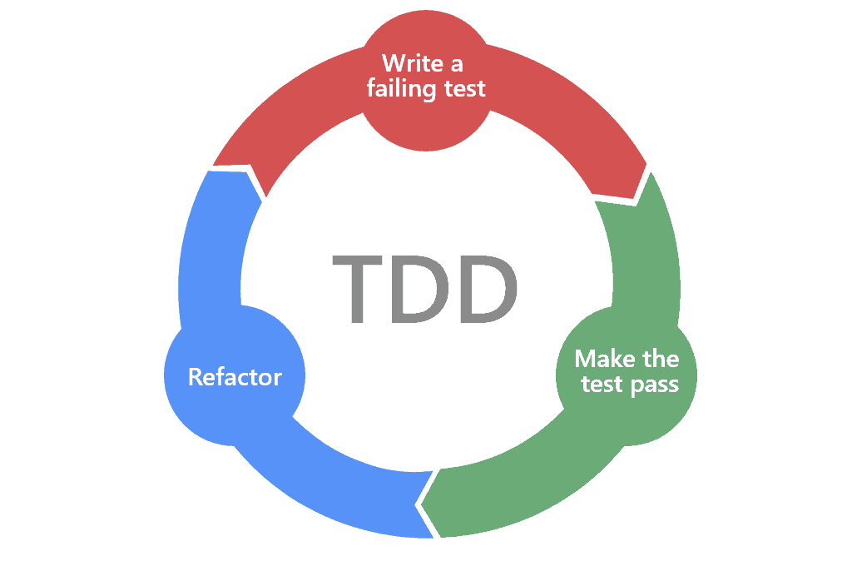
Test Driven Development
TDD: Write tests first, then implement code to pass them
Guides toward cleaner architecture
Reduces merge conflicts

Slide 4
Challenge 1: Memory Limitation
– How We Solved
The input data can be larger than memory capacity
  => Disk-based merge sort
We set the chunk size to 512 MB
  might be changed during optimization
In K-way merge, we used Streaming method.

Slide 5
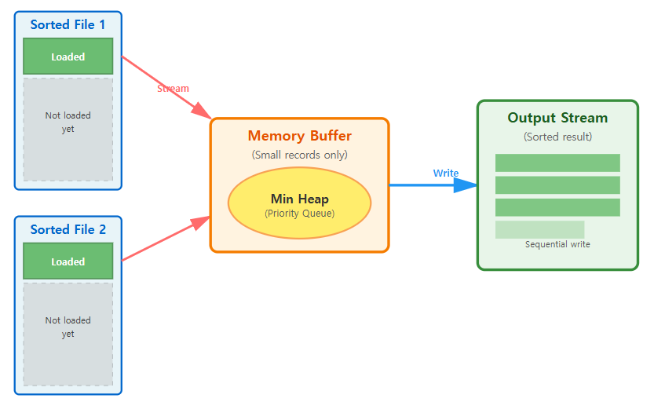
Streaming method
Continuous transmission of data, not loading whole data on memory
Streaming in K-way merge
  Store only the smallest record from each file in memory
  Only K records are kept in memory

Slide 6
Challenge 2: Distributed Storage
- How we solved
The input data can be larger than disk capacity
  => Master-Worker architecture (sampling, shuffling, …)
We used N→M Strategy for Merge Parallelization
  Not “N workers → N partitions”
  N workers → M partitions, M > N
  For multi-threading support

Slide 7
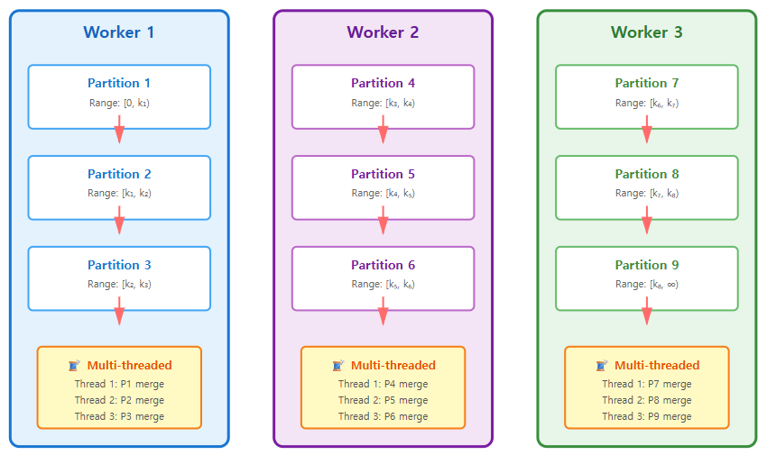
Challenge 2: Distributed Storage
- N→M Strategy
We assigned three partitions to each worker.
Each partition can be independently merged.

Slide 8
Challenge 3: Worker Crash
- How we solved
A worker process crashes in the middle of execution.
  e.g., killed by OS
We used 2-Layer Fault Tolerance for solving
  Layer 1: Checkpoint: restore the progress status
  Layer 2: Replication: recovery of intermediate data

Slide 9
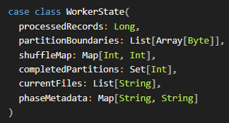
Challenge 3: Worker Crash
- Checkpoint
  After each phase is completed, a checkpoint is saved that includes the current phase and the WorkerState we defined.
  If the checkpoint points to phase 2, the preceding steps can be skipped and it can start from phase 3.
  But what if the intermediate files are lost? => Layer 2

Slide 10
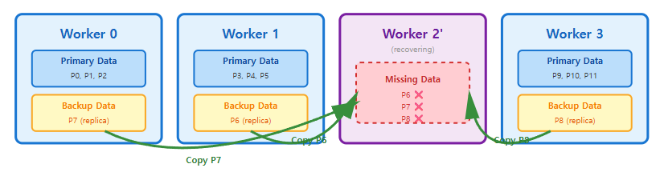
Challenge 3: Worker Crash
- Replication
  Recovers intermediate files lost during a worker crash from another worker.
  When a worker creates a partition, it replicates each partition across backup workers.

Slide 11
Review of weekly progress
Week 1-2: Design Phase
  System architecture definition
  Protocol Buffers design
  Fault Tolerance strategy decision
Week 3: Project Structure
  SBT project setup
  Record class implementation
Week 4-5: Core Components Implementation
  RecordReader (Binary/ASCII), InputFormatDetector,
  FileLayout, RecordWriter,
  ExternalSorter, KWayMerger, Partitioner

Slide 12
Remaining milestones we have set
Week 6: Master/Worker Implementation (In Progress)
  Master implementation (Worker management, Phase synchronization)
  Worker implementation (5-phase execution)
  2-Layer Fault Tolerance integration
Week 7-8: Integration Testing (Planned)
  Full system testing
  Fault Tolerance verification
  Optimization

Slide 13
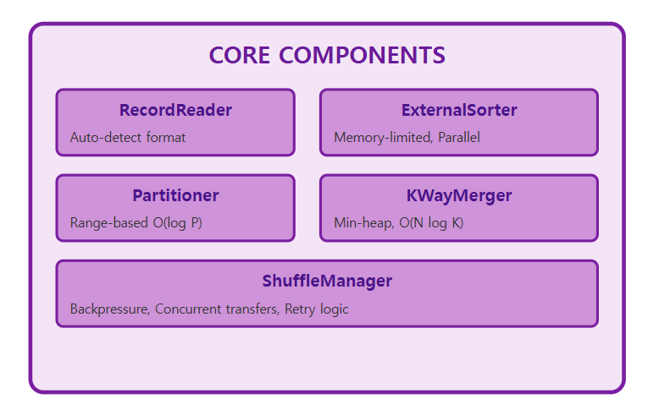
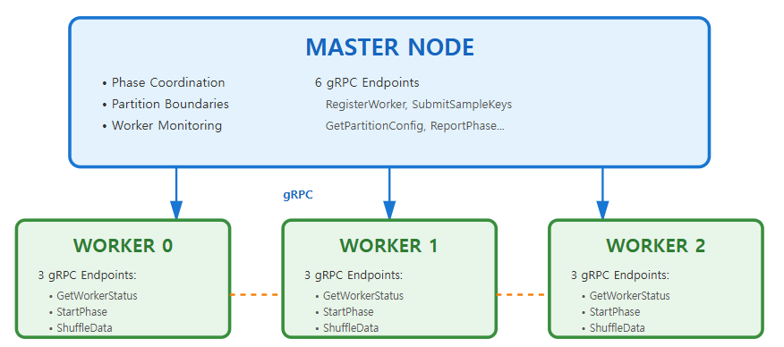
Overall Design of System

