Slide 1
COVID-19 wastewater monitoring

Slide 2
Exploratory data analysis

Slide 3
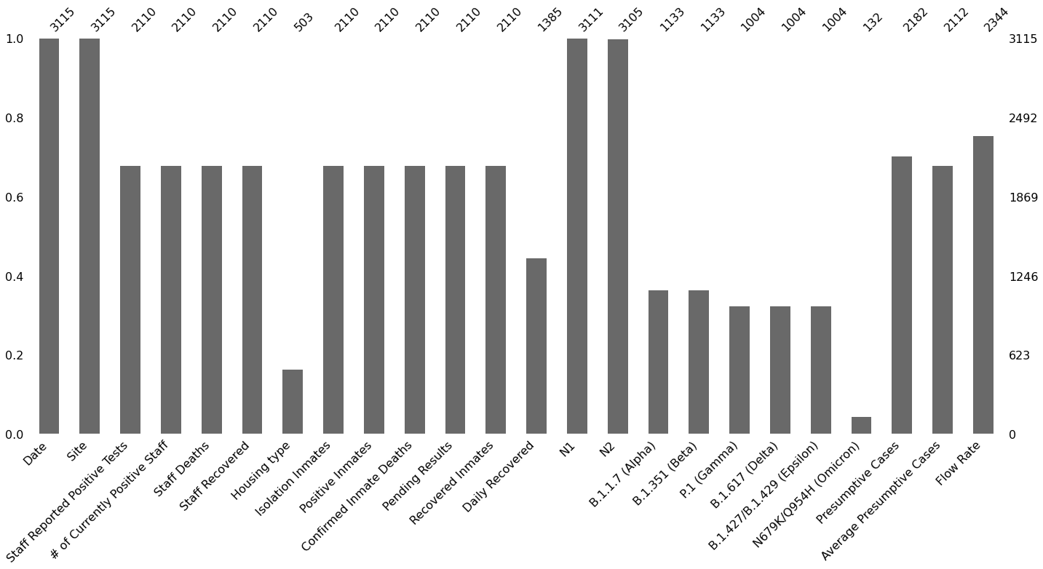
Missing data
Virus types and Daily Recovered information is missing prior to 07/2021
16 out of 45 prison sites had most of the information missing and were removed

Slide 4
Maddie’s plots?

Slide 5
Dynamics of SARS-CoV-2 pandemic across Ohio prisons through years
Polina

Slide 6
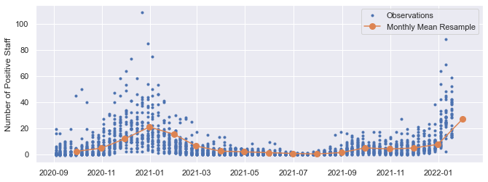
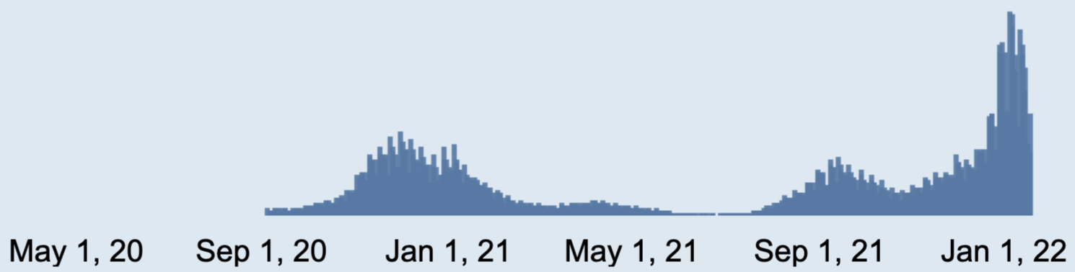
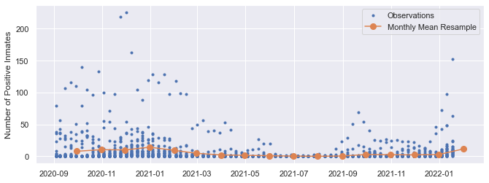
Positive cases
Spike in winters correspond to the Ohio and country-wide COVID-19 dynamics [Source: coronavirus.ohio.gov]

Slide 7
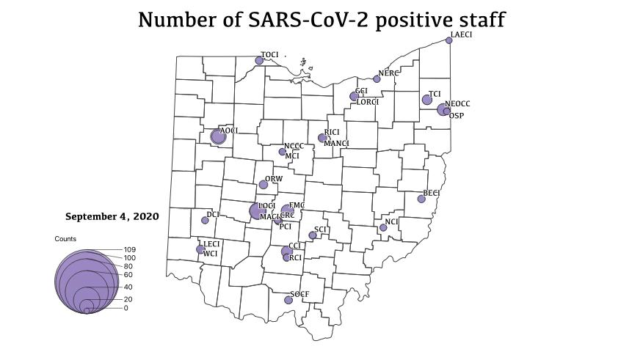
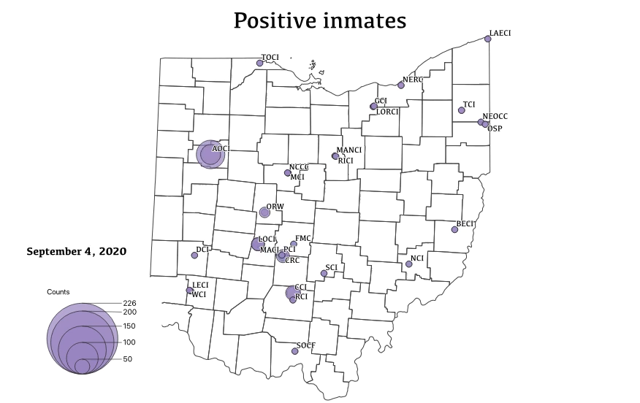
Largest weekly cases for staff were in SOCF, LORCI, TOCI, MANCI, NEOCC, GCI, all located nearby large metropolitan areas in Ohio
Unlike inmates – largest outbreaks were in rural CRC

Slide 8
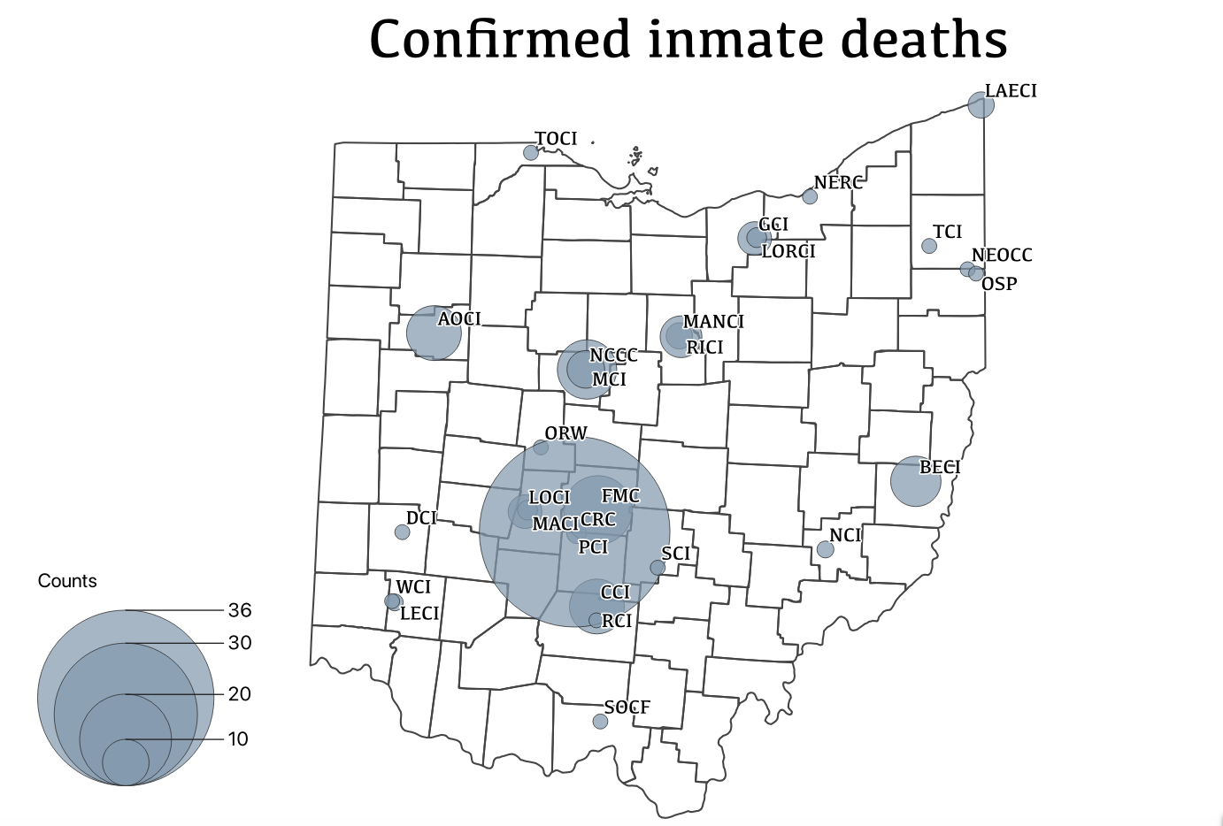
Death cases
Cumulative variable
Staff deaths are much less frequent and range between 0, 1 and 2 on a given week of observation

Slide 9
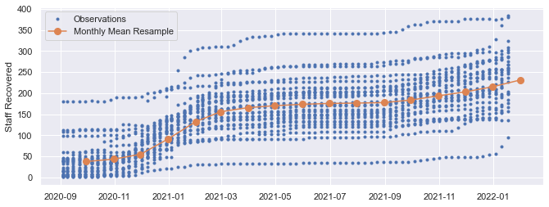
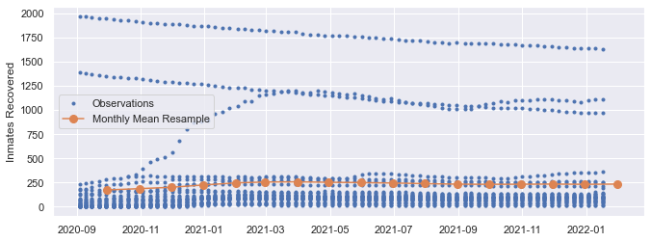
Recovered cases
Different dynamics due to inmate movement and other factors

Slide 10
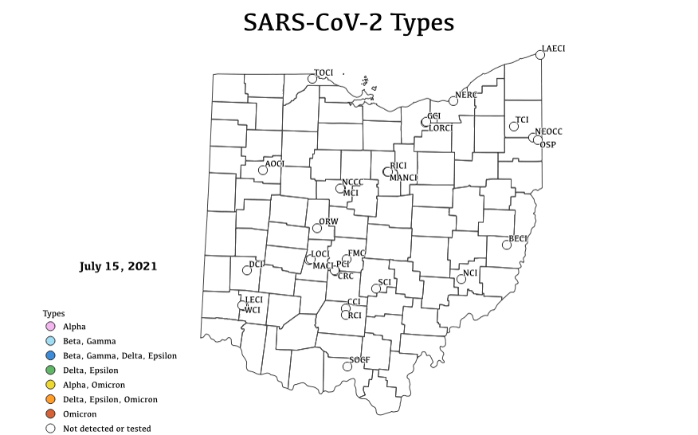
SARS-CoV-2 virus types
Alpha first detected in July 2021
Then Beta, Delta, Epsilon
Gamma was rarely detected
Omicron overtakes as a predominant type throughout Ohio since Dec 2021

Slide 11
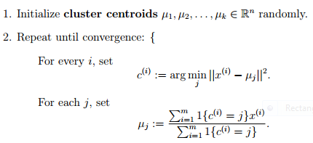
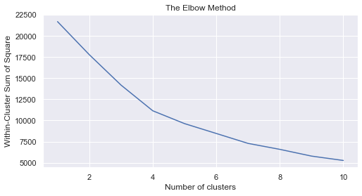
Unsupervised machine learning: K-Means
Clustering: grouping samples based on their similarity across prisons and time
K-Means partitions n=2038 observations into k clusters, where each observation belongs to the cluster with the nearest mean based on L2 norm distance
Elbow method to select number of clusters

Slide 12
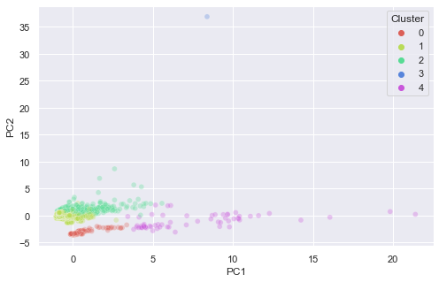
Unsupervised machine learning: K-means + PCA
For dimensionality reduction and visualization of clusters, we utilized PCA
The first 2 Principal Component explain 54% of the variance of scaled data

