Slide 1
COVID-19 wastewater monitoring

Slide 2
Exploratory data analysis

Slide 3
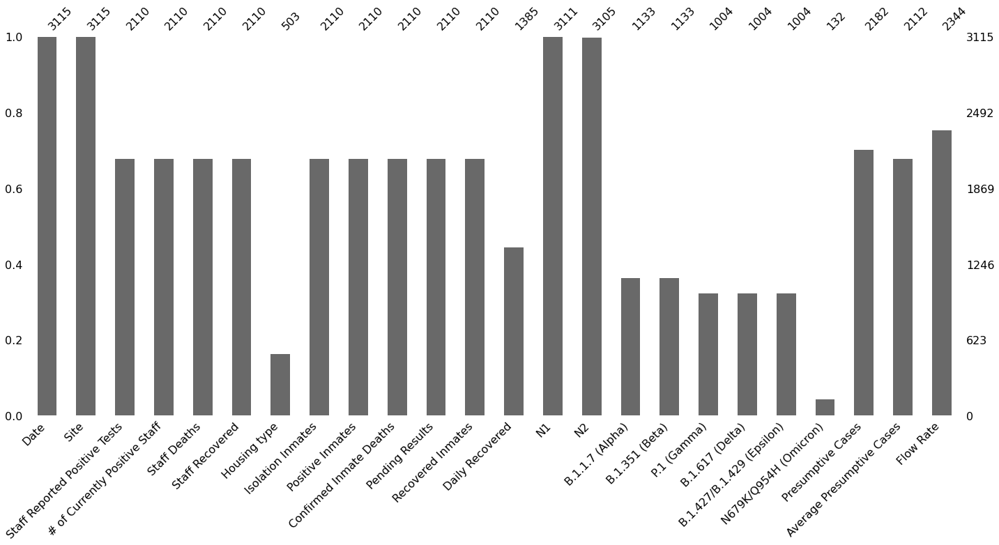
Missing data
Virus types and Daily Recovered information is missing prior to 07/2021
16 out of 45 prison sites had most of the information missing and were removed

Slide 5
Dynamics of SARS-CoV-2 pandemic across Ohio prisons through years
Polina

Slide 6
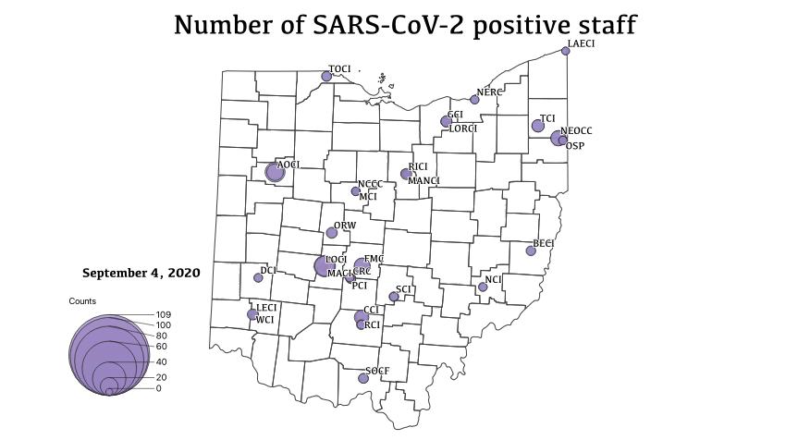
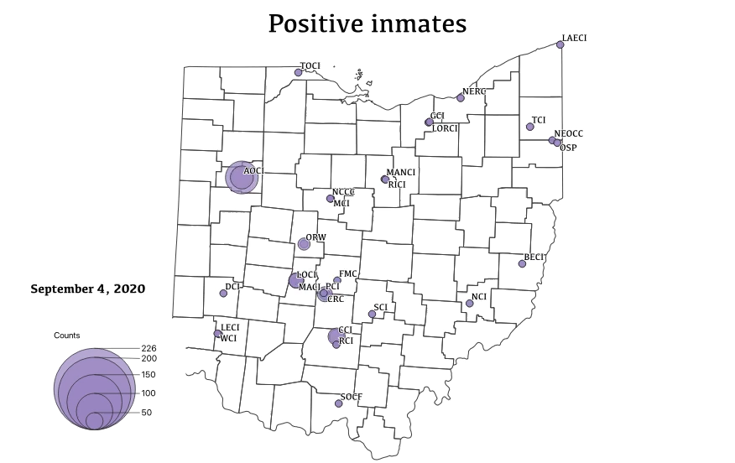
Positive cases

Slide 7
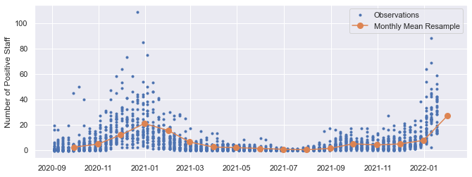
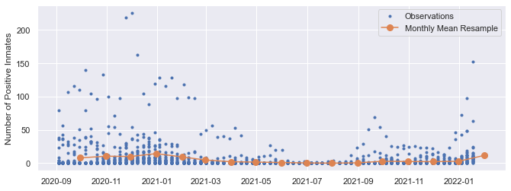
Positive cases

Slide 8
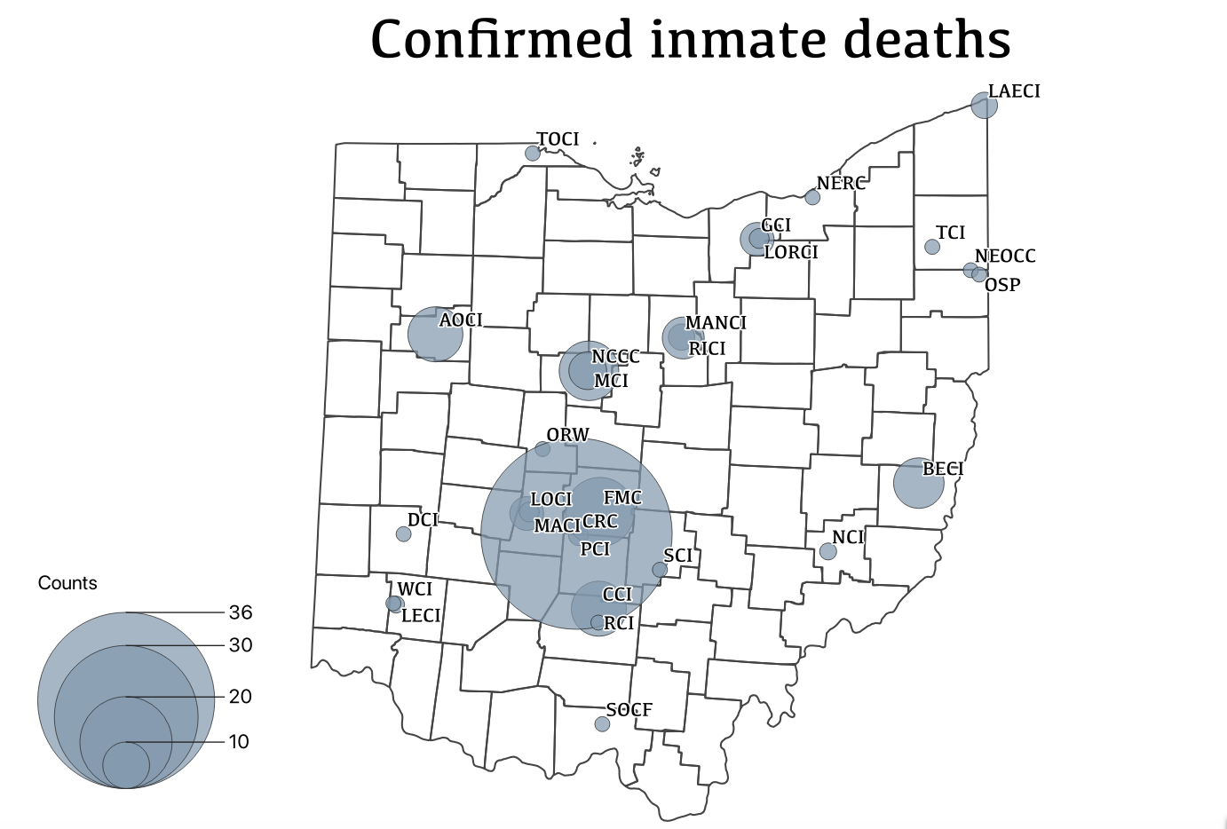
Death cases
Cumulative variable
Staff deaths are much less frequent and range between 0 to 2 on a given week of sampling

Slide 9
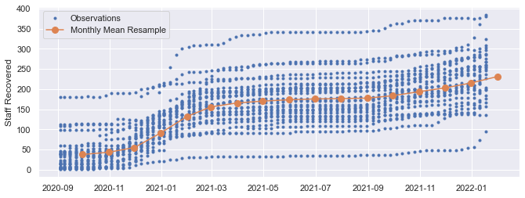
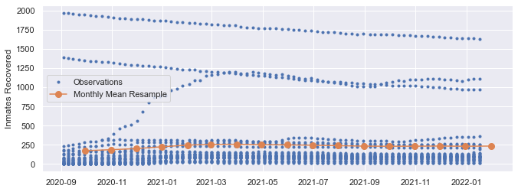
Recovered cases
Different dynamics due to inmate movement and other factors

Slide 10
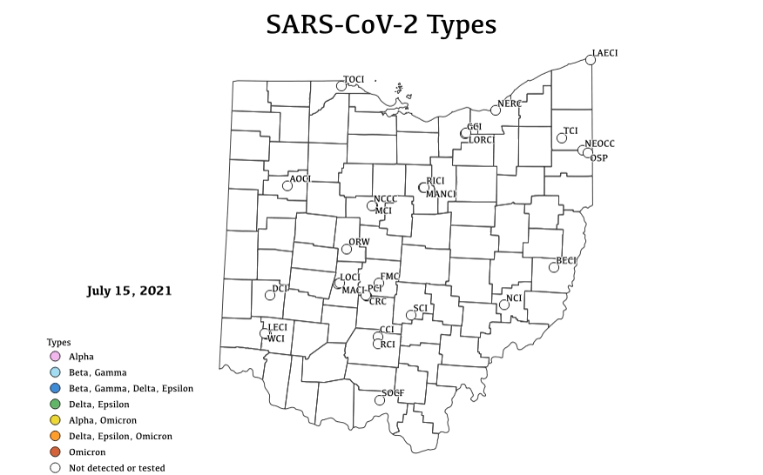
SARS-CoV-2 virus types
Alpha first detected in July 2021
Then Beta, Delta, Epsilon
Gamma was rarely detected
Omicron overtakes as a predominant type throughout Ohio since Dec 2021

