Slide 1
Energy models and Deep Belief Networks
  Definition
    examples
    overcomplete ICA: generative vs. energy-based models
  Learning
    contrastive divergence
    (score matching)
  Restricted Boltzmann Machines
  Deep Belief Networks
    infinite networks <-> RBMs
    learning: greedy + wake-sleep phase

Slide 2
Deep Belief Networks
Demo:
http://www.cs.toronto.edu/~hinton/digits.html
Other datasets:
http://www.cs.toronto.edu/~roweis/data.html

Slide 3
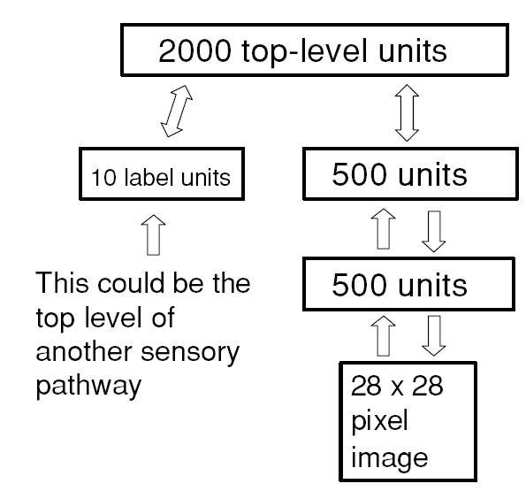
Goal architecture

Slide 4
Ingredient 1
Write code to perform inference and CD learning in a RBM
  Test that, given weights and visible unit v, you get a correct distribution over h (both probabilities and samples); same for v given h
  Test that, given v and perturbing correct w, the algorithm comes back to minimum
Optional: insert decay and momentum term

Slide 5
Ingredient 2
Write code to perform inference and CD learning in a RBM with softmax labels
  Define simple model with 2 labels, 2 hidden units, 4 input units; label 1 generates either [1,0,0,0] or [0,1,0,0]; label 2 generates [0,0,1,0] or [0,0,0,1]
  Verify that generating with fixed labels gives you correct input patterns
  Verify that after learning, labels are inferred correctly in all 4 cases
Optional: insert decay and momentum term

Slide 6
Greedy learning
At this point you can already train the DBN with the greedy algorithm
  ! The input to each RBM is given by the probabilities over the hidden states at the previous layer
  Begin using a few letters from the small dataset binaryalphadigs.mat (100 units per layer should be ok)
  Try to generate letters by clamping one of the labels
  Given all examples of one class, how invariant is the representation in the various layers? Does that change if you learn a model without labels?
  If you want to use the MNIST dataset, divide the data in balanced mini-batches (e.g., 10 examples from each class)

Slide 7
Classification
Try to classify the input letters:
  easy, inaccurate: use the recognition model, set uniform probabilities over labels; look at the probabilities over labels at equilibrium
  hard, more accurate: get representation at top hidden layer, compute free energy for that state and each label lit in turn (Teh, Hinton, 2001)

Slide 8
Up-down algorithm
Write code to refine the greedy solution using the up-down algorithm
  see Appendix B in (Hinton et al., 2006)
  increase the number of Gibbs iterations at the top during learning
Optional: how does accuracy depend on the architecture? How good can one get by just greedily learning many layers?

