Slide 1


Autism Prevalence

Slide 2
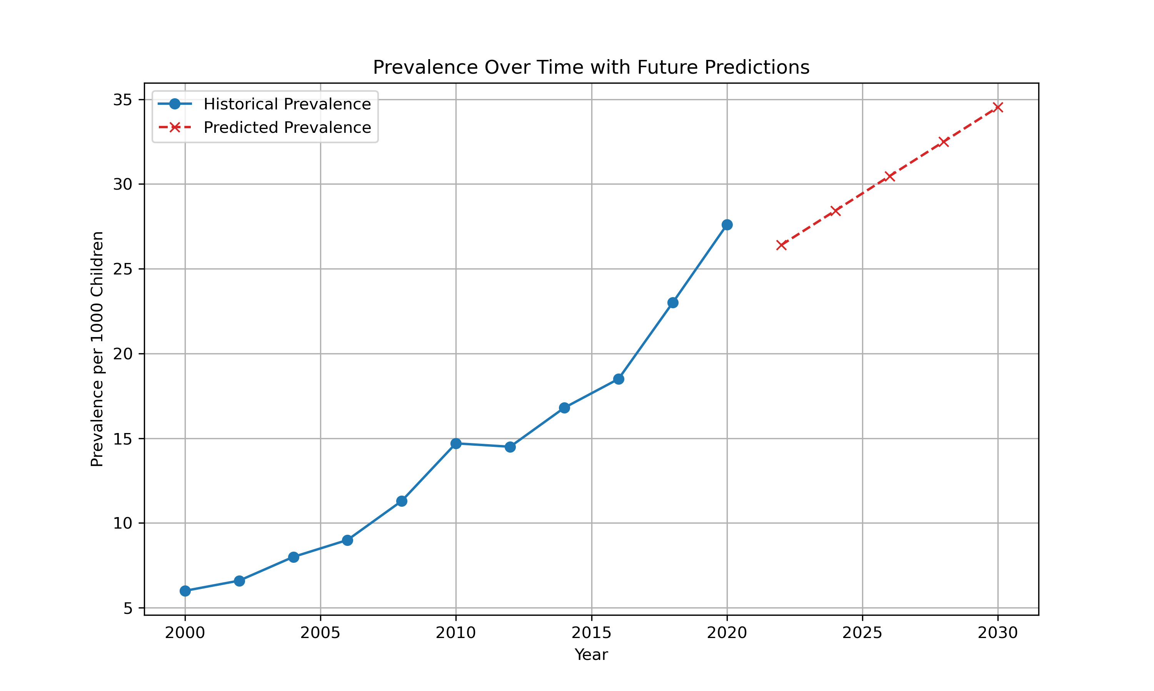
Autism Spectrum disorder
Contents:
Introduction
The Problem
The Data
Data insights
Recommendation
Centers for Disease Control and Prevention. (2023, March 23). Key findings from the ADDM network error processing SSI file. Centers for Disease Control and Prevention. https://www.cdc.gov/ncbddd/autism/addm-community-report/key-findings.html

Slide 3
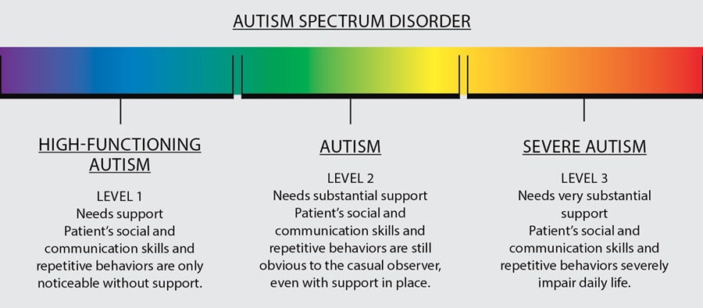
Autism Spectrum Disorder (ASD)
ASD is defined as:
Ongoing social problems that include difficulty communicating and interacting with others
Repetitive behaviors as well as limited interests or activities
Symptoms that typically are recognized in the first two years of life
Symptoms that hurt the individual’s ability to function socially, at school or work, or other areas of life
U.S. Department of Health and Human Services. (2023). Autism spectrum disorder (ASD). National Institute of Mental Health. https://www.nimh.nih.gov/health/statistics/autism-spectrum-disorder-asd
Barna, M. (2023, March 20). Everything worth knowing about ... autism spectrum disorder. Discover Magazine. https://www.discovermagazine.com/mind/everything-worth-knowing-about-autism-spectrum-disorder

Slide 4
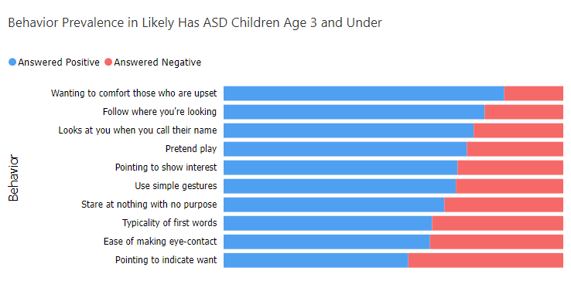
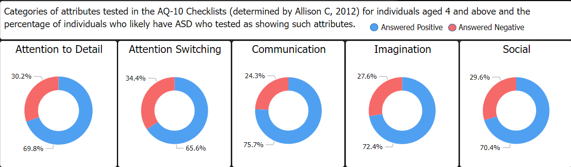
The Problem
The problem: what is the real prevalence of ASD within the population?
ASD Tests
The Q-CHAT-10 focuses on behaviors and the AQ-10 focuses on traits
The Q-CHAT-10 Behaviors on the left
The AQ-10 Traits below
Thabtah, F. (2019). An accessible and efficient autism screening method for behavioral data and predictive analyses. Health Informatics Journal, 25(4), 1739–1755. https://doi.org/10.1177/1460458218796636

Slide 5
The Data
Maenner MJ, Warren Z, Williams AR, et al. Prevalence and Characteristics of Autism Spectrum Disorder Among Children Aged 8 Years — Autism and Developmental Disabilities Monitoring Network, 11 Sites, United States, 2020. MMWR Surveill Summ 2023;72(No. SS-2):1–14. DOI: http://dx.doi.org/10.15585/mmwr.ss7202a1.
Centers for Disease Control and Prevention. (2023, March 23). Key findings from the ADDM network error processing SSI file. Centers for Disease Control and Prevention. https://www.cdc.gov/ncbddd/autism/addm-community-report/key-findings.html

Slide 6
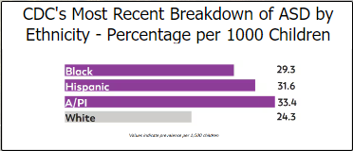

Insights
Review:
It seems the prevalence of ASD is growing. Or that people are seeking a diagnosis more often.
These questionnaires used to detect ASD are generally effective.
ASD is found most often in younger individuals, but there could be a bias surrounding this.
There’s a genetic component to the disorder.
The disorder appears to affect males more than females.
The prevalence of ASD throughout ethnicities needs to be researched further.

Slide 7

Recommendation
How can we continue to gather data on the prevalence of ASD while increasing the accuracy of the data?
Make assessments more accessible.
Make screenings standardized.
Support apps and online quizzes that gather information on the general population.
Data relating to potentially autistic individuals can help.
Spreading information and resources to help those who seek a diagnosis.
Notes:
Notes

Slide 8
Thank You
By: Pamela Berry

