Slide 1

The Food Chain
Eat, or Get Eaten!

Slide 2

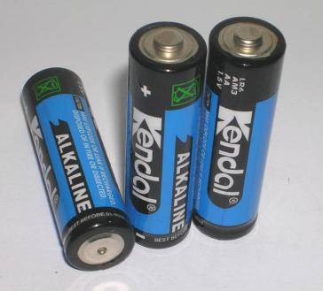
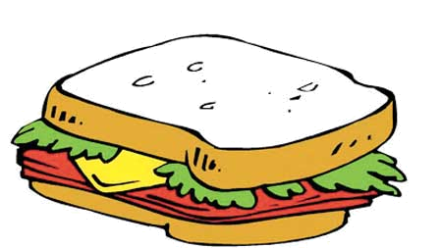
What do these three things have in common?

Slide 3
Energy!

Slide 4
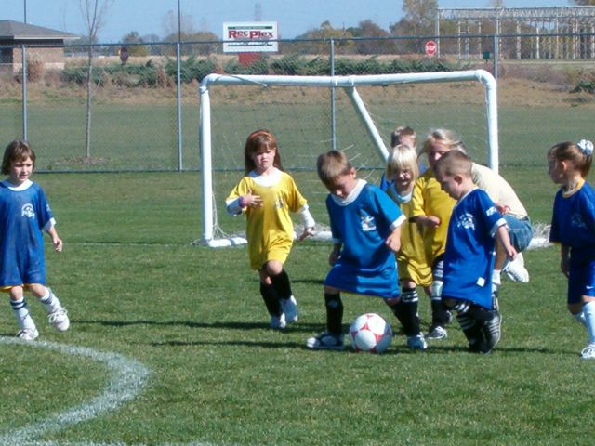
Where does your body get the power it needs to move, work, and play?

Slide 5
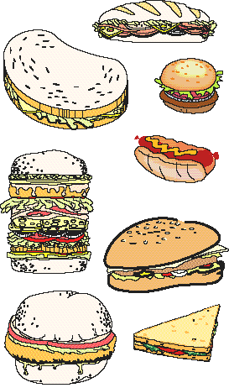
You get energy from food.
But it is not quite as simple as that.

Slide 6

Start at the beginning. . .
Plants are called producers because they are able to use light energy from the Sun to produce food (sugar) from carbon dioxide and water.

Slide 7
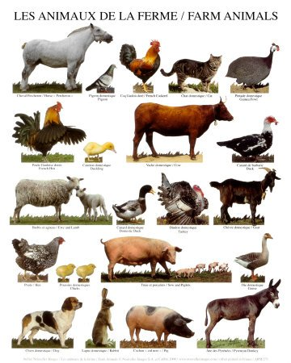
Animals cannot make their own food so they must eat plants and/or other animals. They are called consumers. There are three groups of consumers.

Slide 8
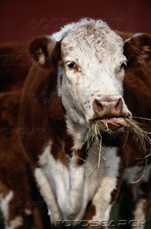
Animals that eat ONLY PLANTS are called herbivores.

Slide 9
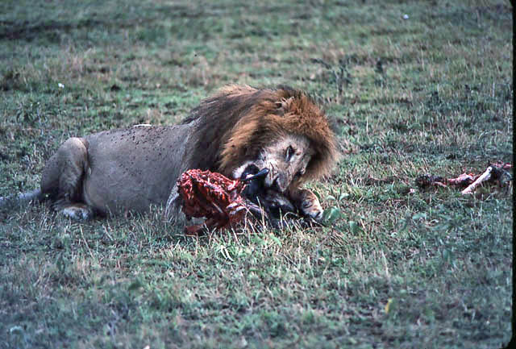
Animals that eat OTHER ANIMALS are called carnivores.

Slide 10
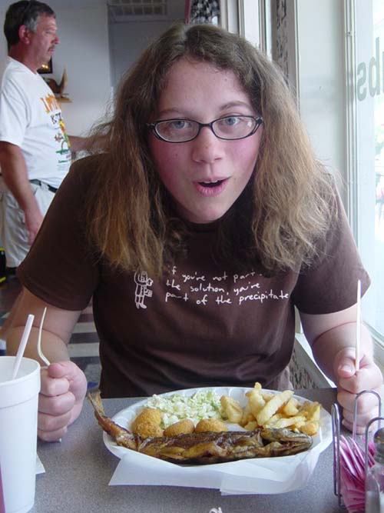
Animals and people who eat BOTH animals and plants are called omnivores.

Slide 11

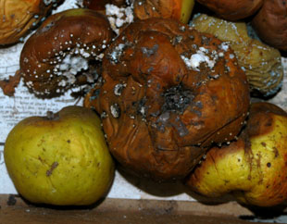
Then there are decomposers (bacteria and fungi) which feed on decaying matter.
These decomposers speed up the decaying process that releases mineral salts back into the food chain for absorption by plants as nutrients.

Slide 12
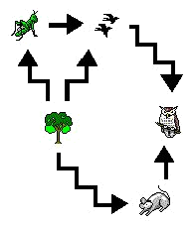
Energy flows from one organism to another. However, since each organism uses up some of its energy to survive, there is less and less energy as you go up the food chain.

Slide 13
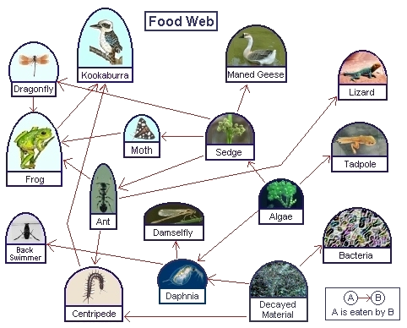
An example of the transfer of energy from the sun, to micro-organisms to other organisms.

Slide 14
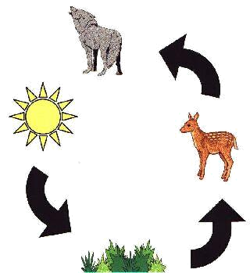
This is a simple food cycle.

Slide 15
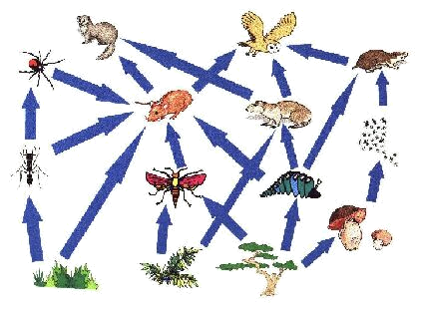
Use the marker option to draw in lines to form a correct food web.

Slide 16
Answer Key

Slide 17
A creature that only eats plants is called . . .
a. A carnivore
b. An heribvore
Quiz
c. An omnivore
d. A decomposer
Next Question

Slide 18
Wrong
A carnivore eats only meat.
Click here to return to Quiz

Slide 19
Correct!
Click here to return to Quiz.

Slide 20
Wrong
An omnivore eats both plants and animals.
Click to return to Quiz.

Slide 21
Wrong
A decomposer is a bacteria or fungus that breaks down dead plants and animals and returns nutrients to the soil.
Click here to return to Quiz.

Slide 22
Why is there less energy available at the top of the food chain, than at the bottom?
Quiz
a. Bigger animals use up more energy than smaller animals.
b. Energy gets burned out, or worn out, as it goes up the food chain.
c. Each organism on the food chain uses up some of the energy to survive.

Slide 23
Wrong!
Click here to try again.

Slide 24
Correct!
Energy begins with the sun, feeds into microorganisms, and flows up the food chain into larger and larger organisms. But each creature is passes through uses up some of the energy to survive.
Good Job!
You’re Done!

