Slide 1
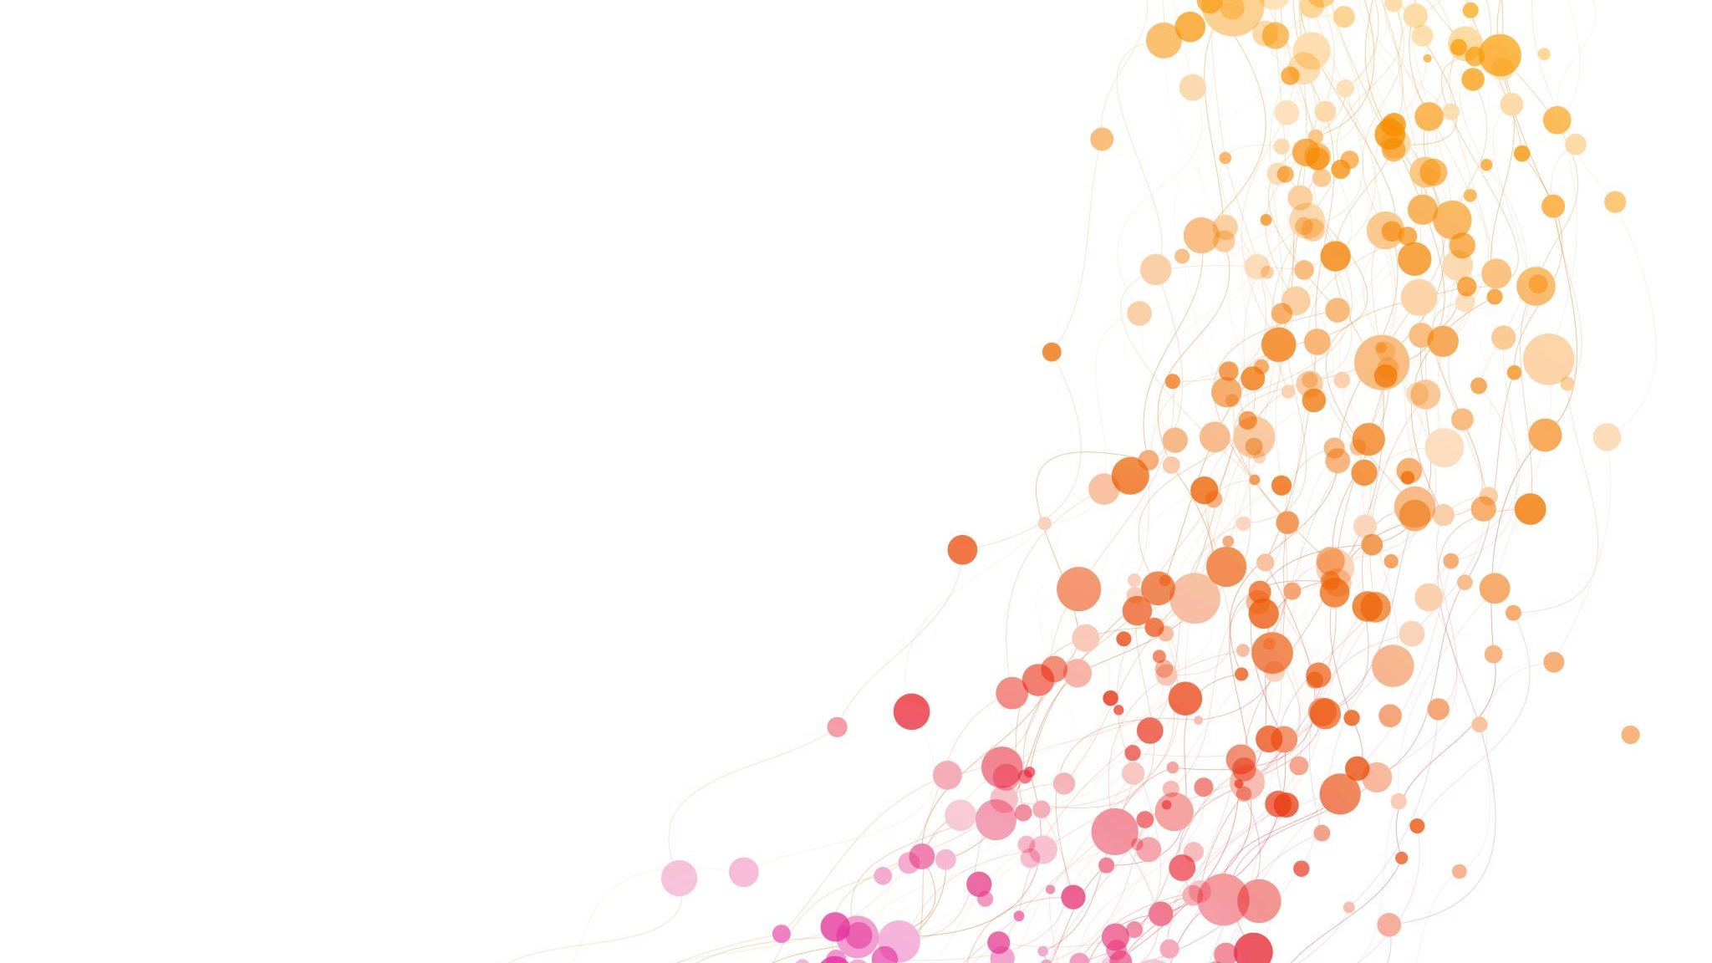
Medical Insurance Cost Prediction Using Machine Learning
Group 1 (py_slytherin)

Slide 2
INDEX
Problem Statement
Data Description
Data Preprocessing
Visualization
Model Evaluation
Conclusion

Slide 3
GOAL
Problem Statement: Determining appropriate insurance coverage is a critical task, necessitating accurate assessment and evaluation of insured amounts. Setting client premiums is a difficult undertaking for health insurance providers.
Goal: The Goal is to predict the “Charge” of the insurance based on various on various attributes of an individual

Slide 4
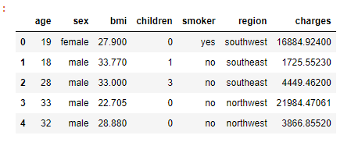
DATA DESCRIPTION
5000+ rows and seven features make up the acquired dataset, three of which have categorical values and the other four have numerical ones.
The 7 features include:
Age: age of primary beneficiary
Sex: insurance contractor gender, female, male
BMI: Body mass index (kg/m2), which uses the ratio of height to weight and is best used for weights between 18.5 and 24.9, gives a knowledge of the body and weights that are high or low in relation to height.
Children: Number of children covered by health insurance / Number of dependents
Smoker: Whether a person smokes or not
Region: Where customer lives northeast, southeast, southwest, northwest
Charges: Medical fee customer has to pay

Slide 5
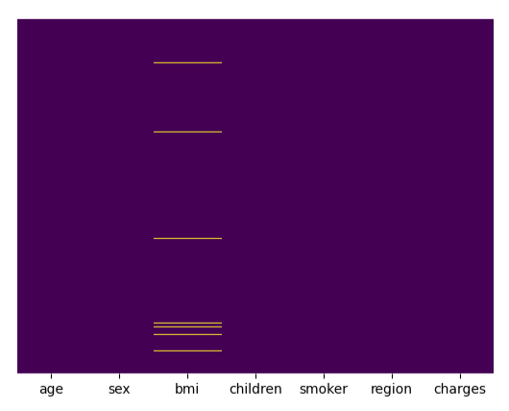
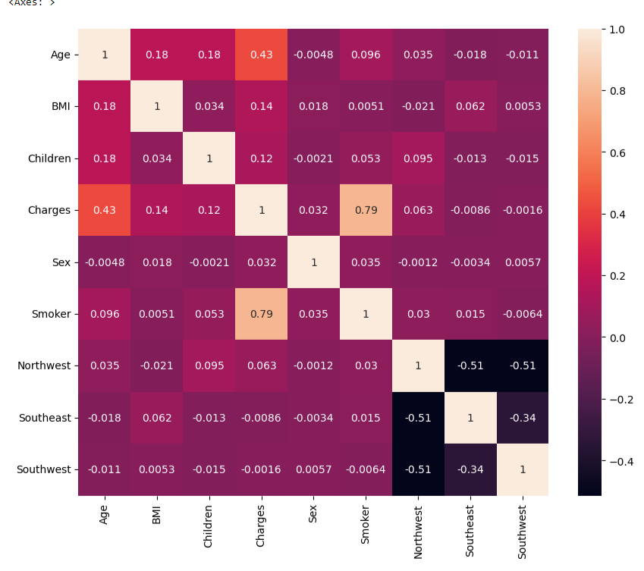
DATA PREPROCESSING
Missing Values
Filled NA values using Mean of particular Age and Sex using groupby
Multicollinearity
Evaluated using correlation Matrix

Slide 6
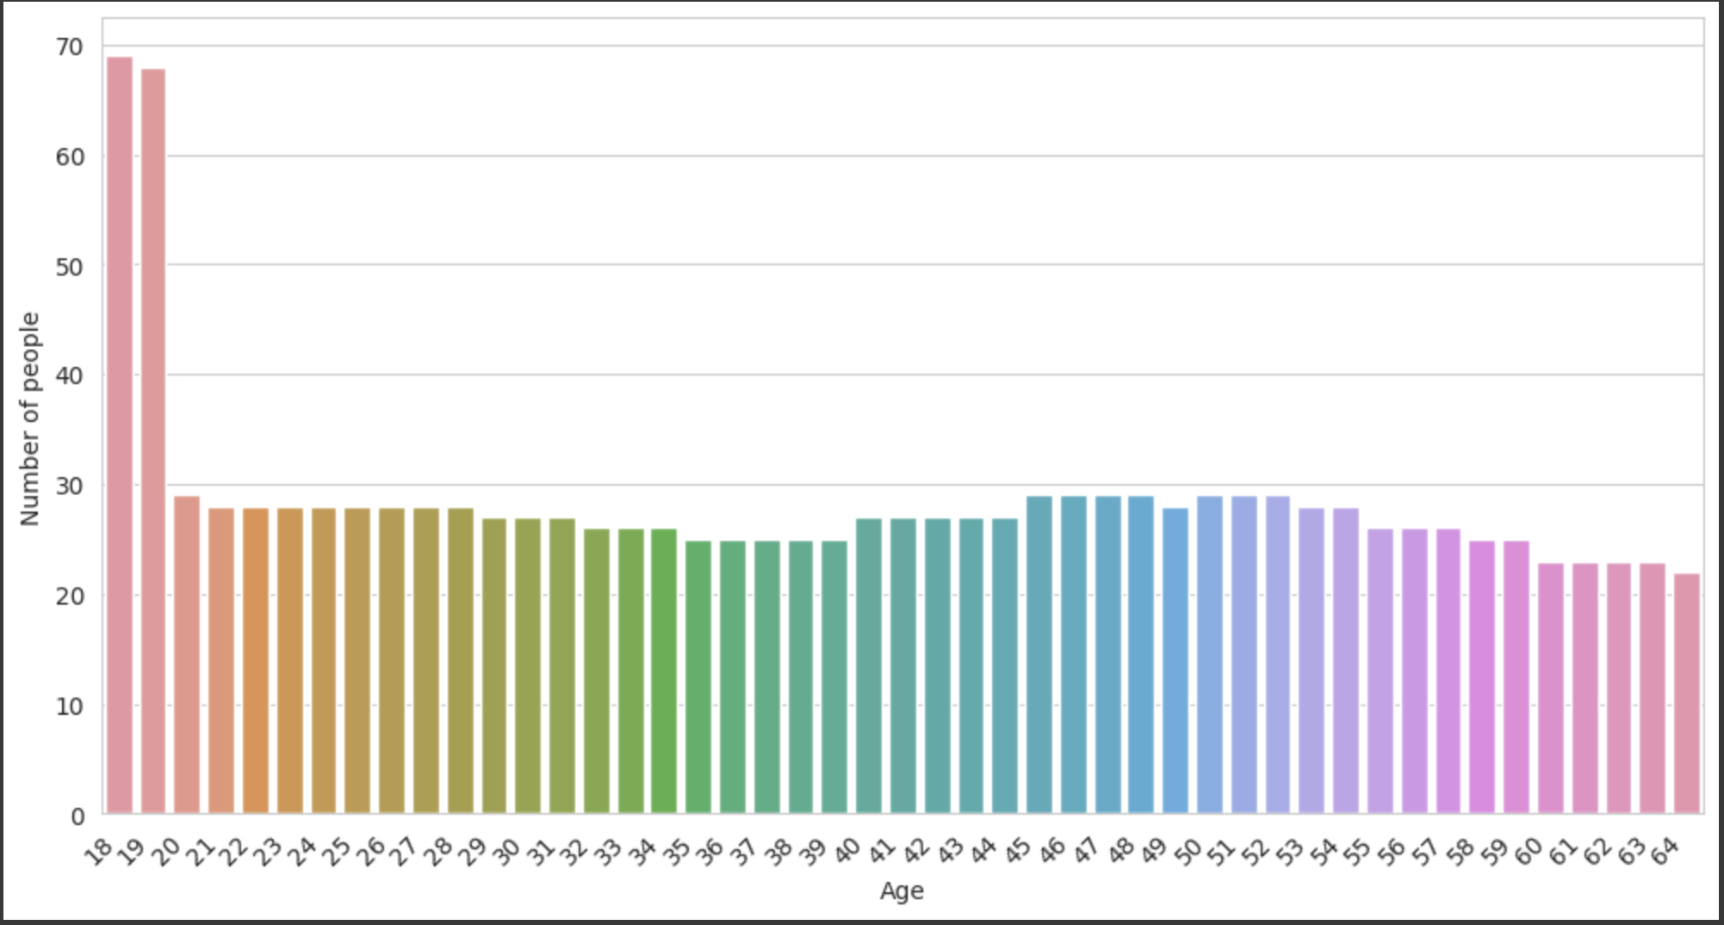
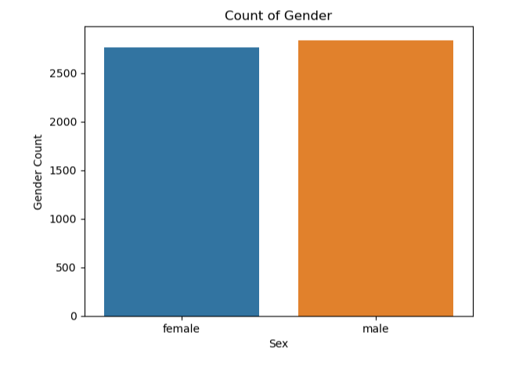
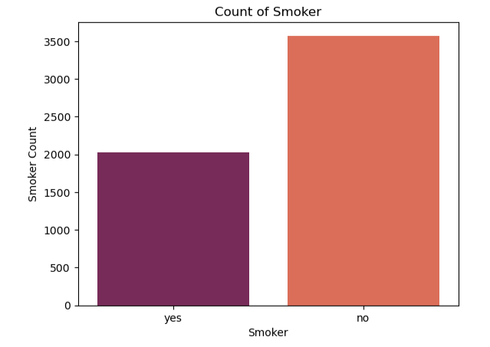
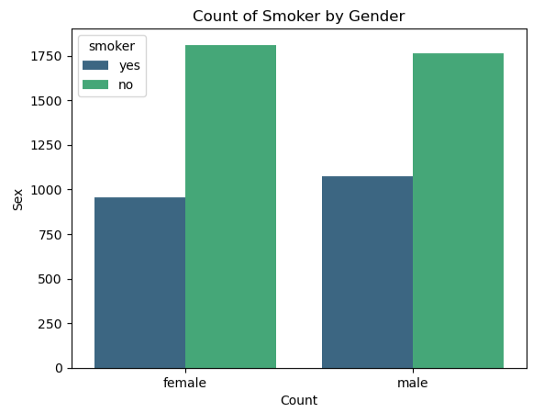
VISUALIZATION

Slide 7
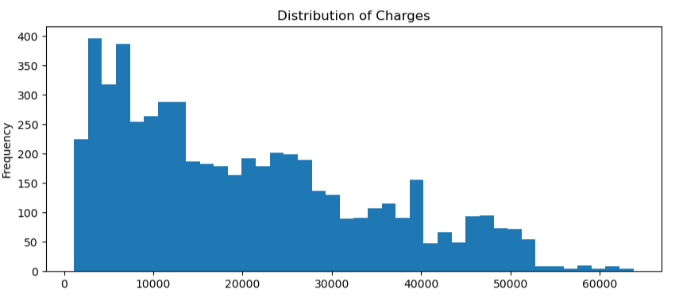
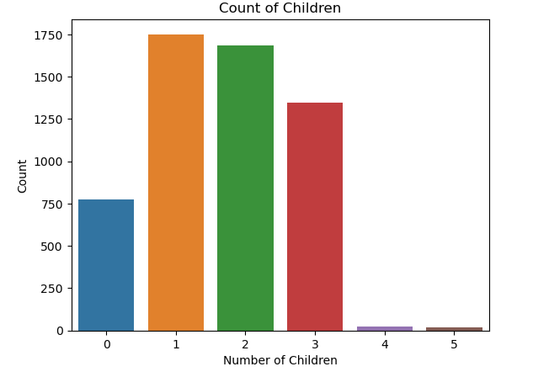
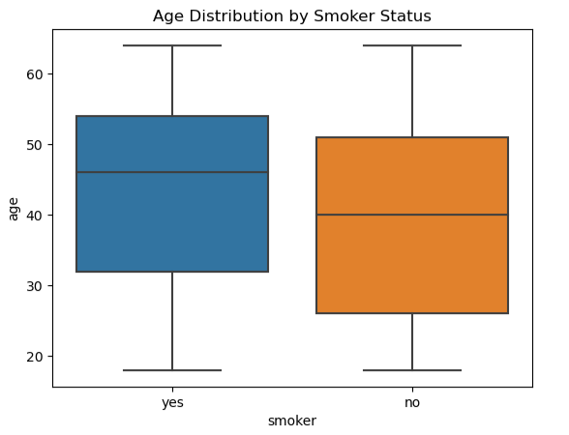
VISUALIZATION

Slide 8
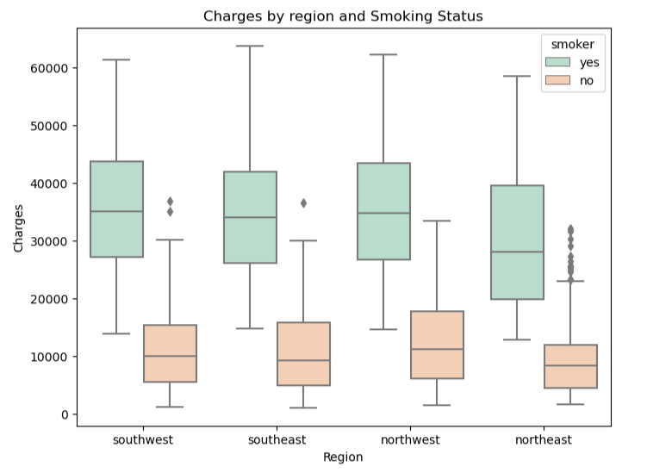
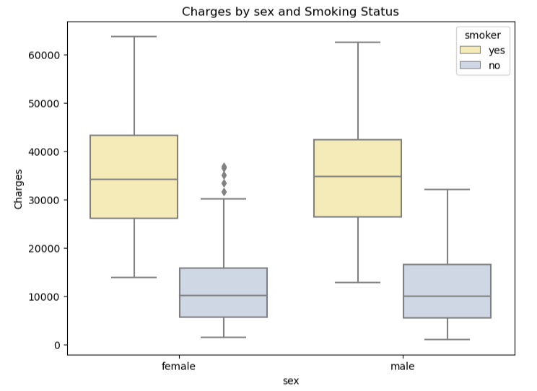
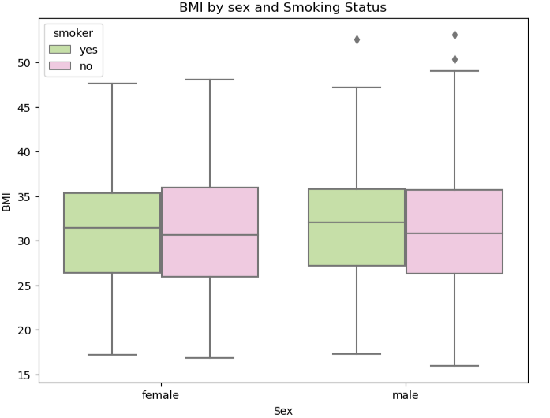
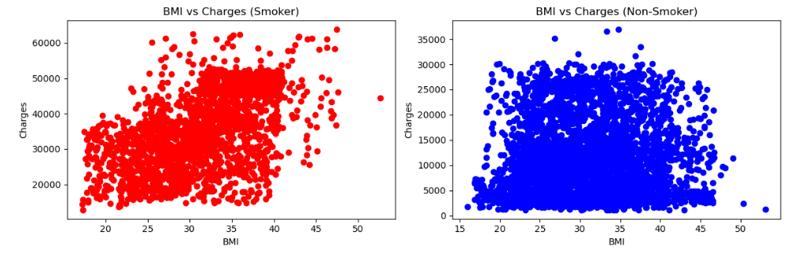
VISUALIZATION

Slide 9
MACHINE LEARNING MODELS USED
Linear Regression
OLS
Ridge Regression
Random Forest

Slide 10
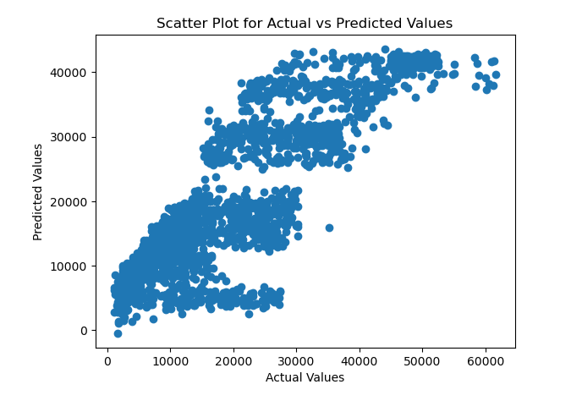
LINEAR REGRESSION
The graph shows Linear Prediction between the Actual and Predicted values with some noise
R2: 0.75
Adj_R2: 0.75
Intercept -9856.890657362728
 | Coefficeint
Age | 334.952830
BMI | 192.997097
Children | -12.879684
Sex | 262.890150
Smoker | 22063.979687
Northwest | 2605.349475
Southeast | 1859.506937
Southwest | 2168.588076

Slide 11
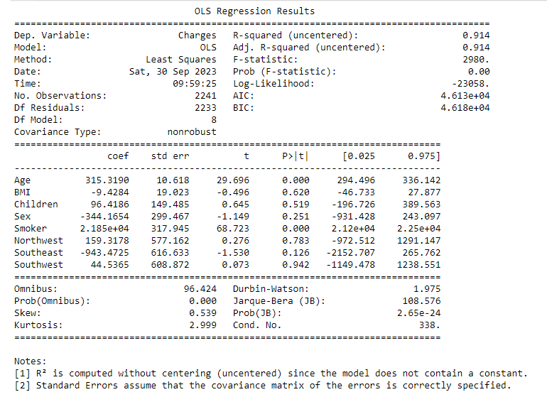
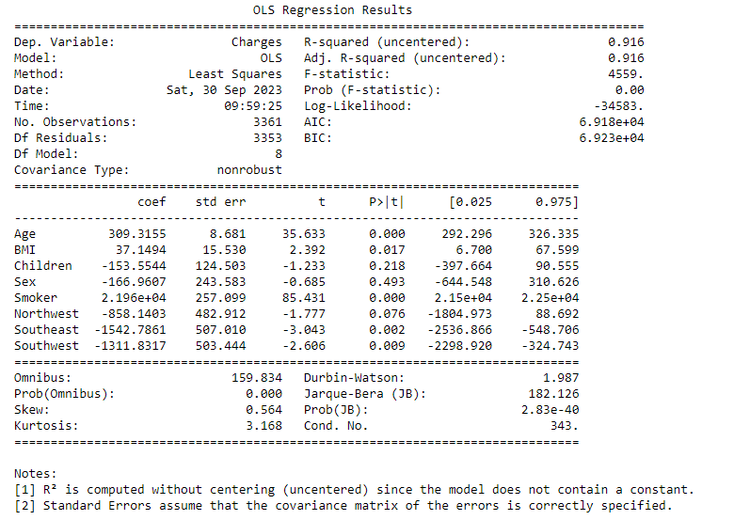
OLS
Test
Train

Slide 12
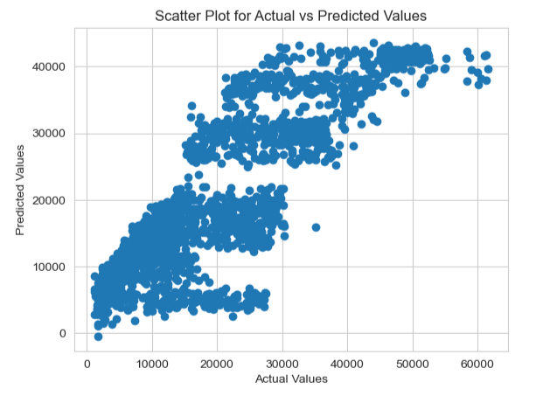
RIDGE REGRESSION
The graph shows Linear Prediction between the Actual and Predicted values with some noise
R2: 0.75
Adj_R2: 0.75
Intercept -9839.983535031788
 | Coefficeint
Age | 334.996275
BMI | 193.024567
Children | -12.093231
Sex | 263.088355
Smoker | 22050.312811
Northwest | 2588.622966
Southeast | 1842.821982
Southwest | 2151.378607

Slide 13
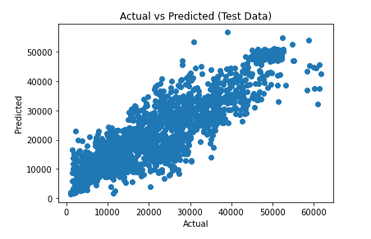
RANDOM FOREST
The graph shows Linear Prediction between the Actual and Predicted values with some noise
R2: 0.82

Slide 14
CONCLUSION
Comparing all the models we conclude that OLS fits the best.
While the Random Forest model exhibits a training accuracy of 90%, its performance on the test data drops to 82%, indicating a reduction in efficiency and suggesting that the model may be overfitting.
Hence, OLS model fits the best and also its overfall performance is 91% both with test and training sets.

