Slide 1
ECE 4012 : Proposal Presentation
The AiR Drummers
Shurjo Banerjee
Pujun Bhatnagar
Justin Eng
Jingyuan Liang
Mallika Sen
Qisi Wang

Slide 2
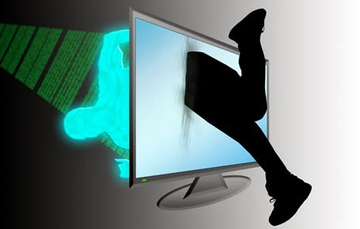
Background
Virtual Reality Headsets
VR applications for instructional purposes, gaming, etc
Notes:
We see the oculus rift as a tool to enhance the immersive qualities of the simulations. Though still in developmental stage, we believe that adding hardware peripherals to interact with the virtual environment will revolutionize the VR experience. We intend to break down the human computer barrier. Human computer interaction.

Slide 3

Project Objective
Inexpensive, portable interactive VR system
Drumming experience - learn, play
Designed for amateur drummers & VR enthusiasts @ $515

Slide 4
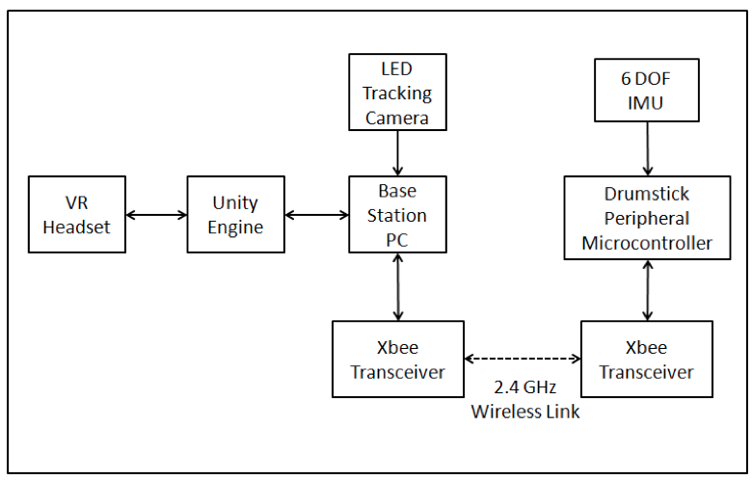
Design Approach

Slide 5
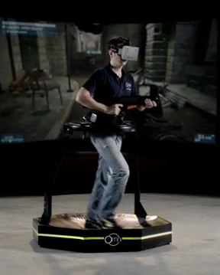
Hardware Implementation
Custom Drumsticks
3D printed
inserted with PCB & IMU
Constraints
Weight
Seamless design

Slide 6
Hardware Implementation
Interfacing
PCB creation
Serial port communication
Constraints
Real time operation
Wireless communication

Slide 7
Hardware Implementation
IMU & Pixy Integration system
Used for Drumstick calibration
Constraints
IMU drift correction
Pixy 2D

Slide 8
Hardware Implementation
Haptic Feedback*
provide drumstick collision
feedback
Constraints
Find appropriate feedback
Using collision time, visual &
audio O/P to provide feedback
Hard to implement in real time

Slide 9
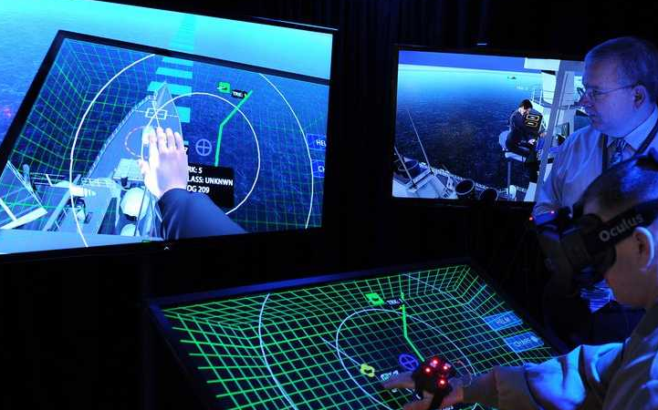
Software Implementation
Drumset Simulation
making 3D drumset
model in Unity
Constraints
getting the actual size,
shape & feel of drumset

Slide 10
Software Implementation
Drumstick VR rendering in
Unity
Using data from IMU &
Pixy to simulate moving
drumsticks
Constraints
Implementing a feedback system
to correctly simulate moving sticks

Slide 11
Software Implementation
Interface communication
Connecting Unity with
microcontroller to get
sensor input
Constraint
Never done before

Slide 12
Software Implementation
Vision System - Pixy
Using Pixy detection to
correct IMU drag
Constraints
Pixy limited to 2D
Coordinating Pixy & IMU output

Slide 13
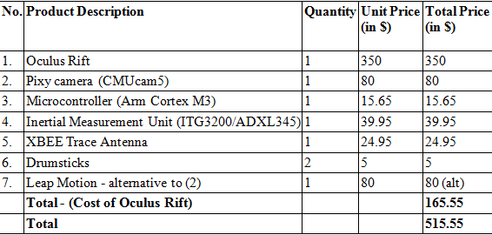
Cost analysis

Slide 14
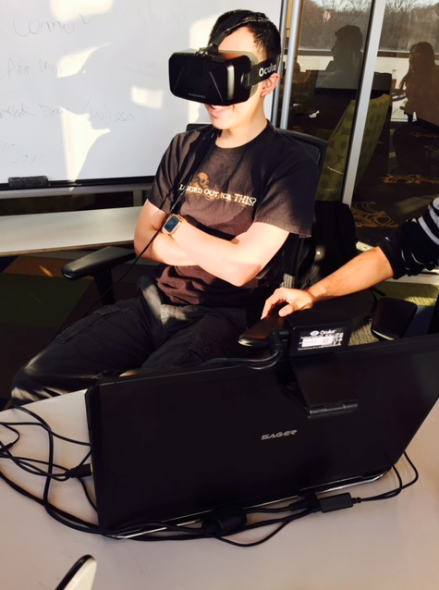
Status
Oculus Rift setup
Simple Unity application with Oculus
rift integration implemented

Slide 15
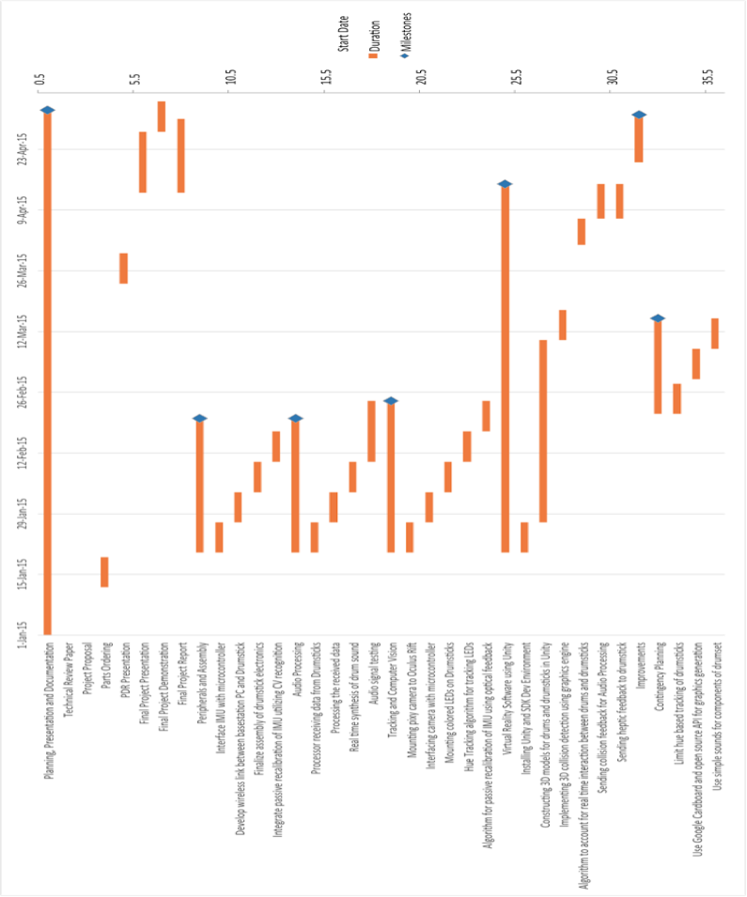
Schedule
Notes:
Significant milestones occur in the middle of March and April, with the completion of the
initial hardware and software designs, respectively. The hardware implementation of the
project is scheduled to be completed by end of February to provide a stable development
environment for the software development. Following this point will be testing and
debugging and working on project demonstration and final presentation.

