Slide 1

Total Correlation Filter
${TC}_{i}$ = total correlation of concept i
$Q_{i}$ = # of questions in which concept i is tagged

Slide 2
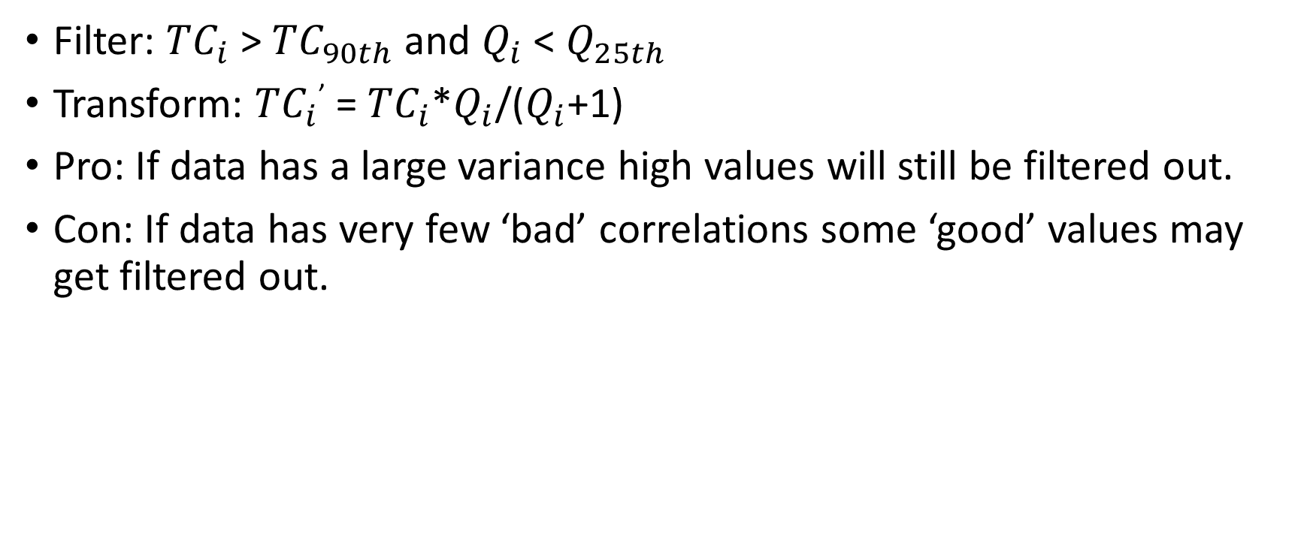
Original Filter
Filter: ${TC}_{i}$ > ${TC}_{90th}$ and $Q_{i}$ < $Q_{25th}$
Transform: ${TC}_{i}$’ = ${TC}_{i}$*$Q_{i}$/($Q_{i}$+1)
Pro: If data has a large variance high values will still be filtered out.
Con: If data has very few ‘bad’ correlations some ‘good’ values may get filtered out.

Slide 3
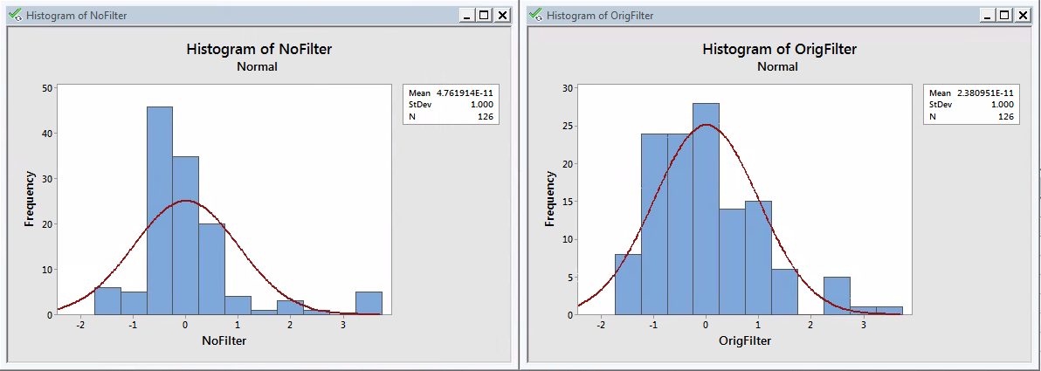
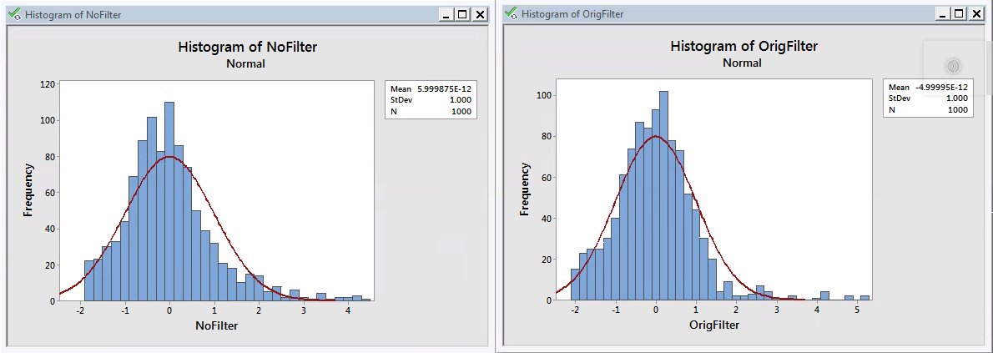
Original Filter
ITS Data
Test Data

Slide 4
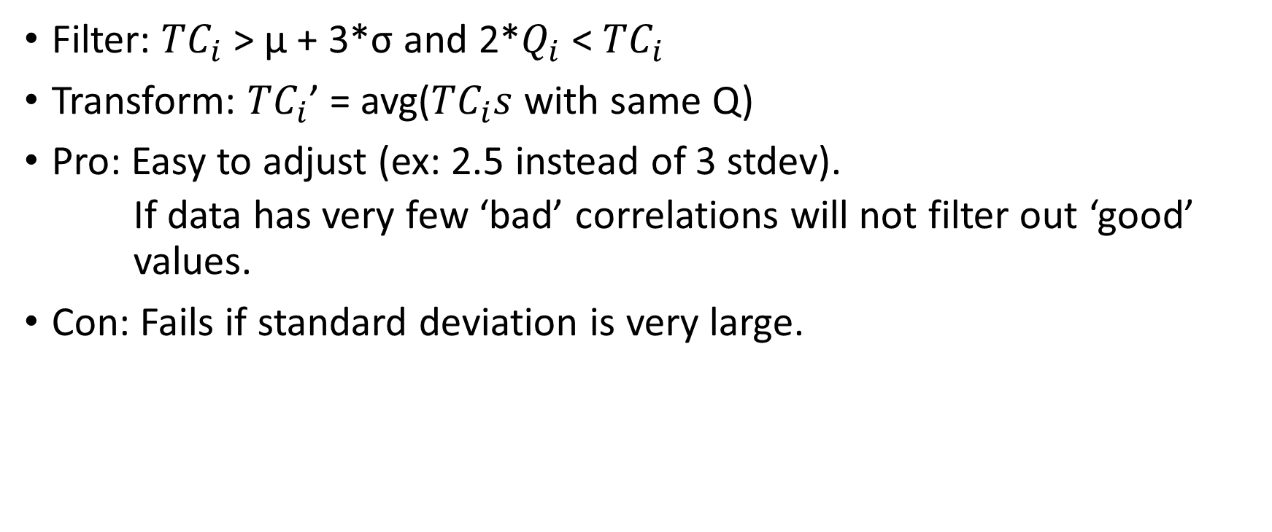
3 Standard Deviations
Filter: ${TC}_{i}$ > μ + 3*σ and 2*$Q_{i}$ < ${TC}_{i}$
Transform: ${TC}_{i}$’ = avg(${TC}_{i}s$ with same Q)
Pro: Easy to adjust (ex: 2.5 instead of 3 stdev).
If data has very few ‘bad’ correlations will not filter out ‘good’ values.
Con: Fails if standard deviation is very large.

Slide 5
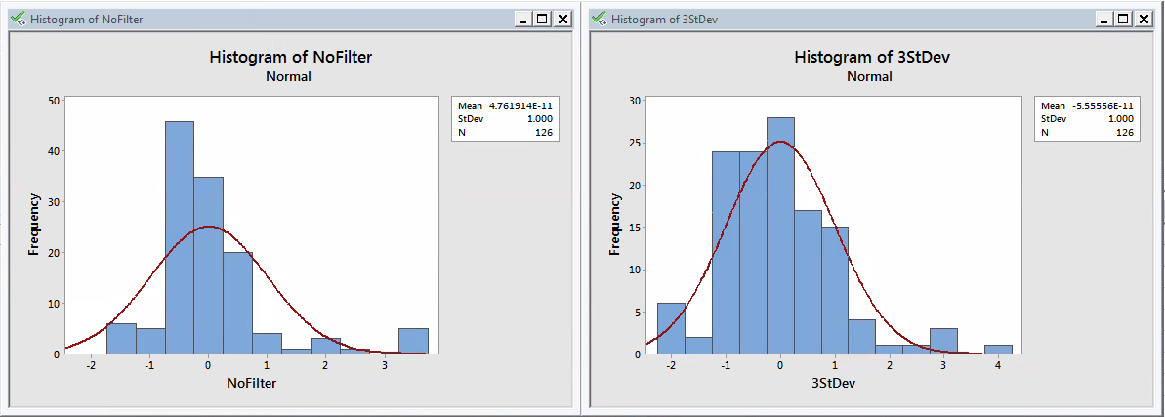
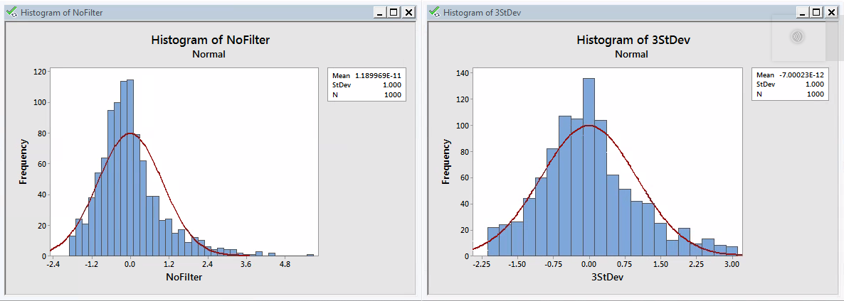
3 Standard Deviations
ITS Data
Test Data

Slide 6
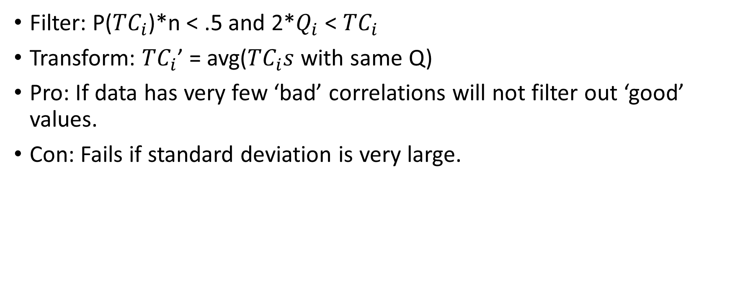
Chauvenet’s Criterion
Filter: P(${TC}_{i}$)*n < .5 and 2*$Q_{i}$ < ${TC}_{i}$
Transform: ${TC}_{i}$’ = avg(${TC}_{i}s$ with same Q)
Pro: If data has very few ‘bad’ correlations will not filter out ‘good’ values.
Con: Fails if standard deviation is very large.

Slide 7
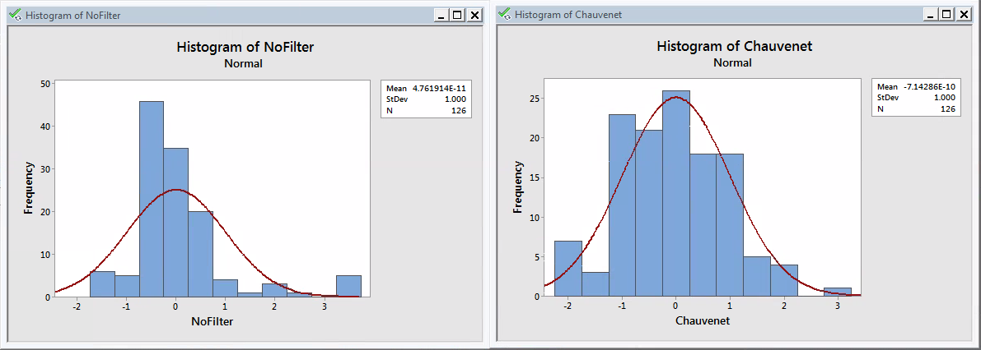
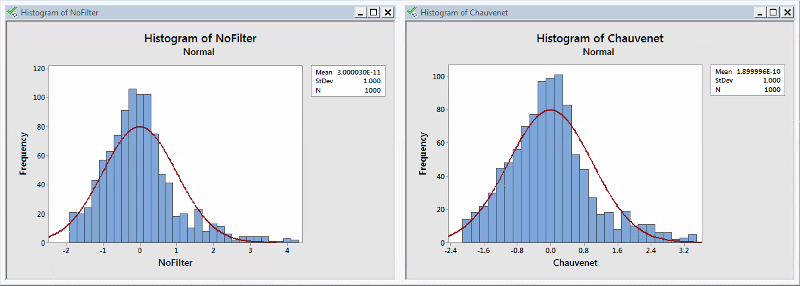
Chauvenet’s Criterion
ITS Data
Test Data

Slide 8
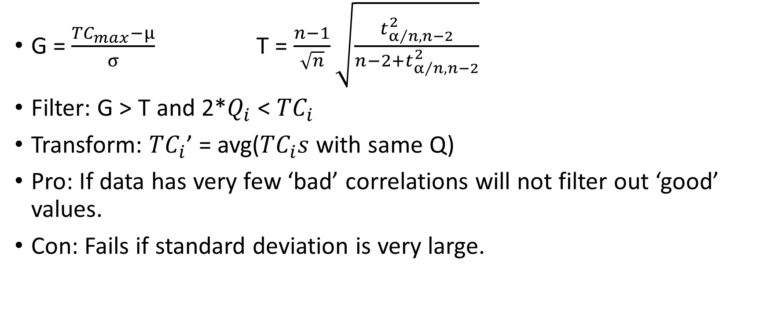
Grubb’s Test
G = $\frac{{TC}_{max}−μ}{σ}$T = $\frac{n−1}{\sqrt{n}}\sqrt{\frac{t_{α/{n, n−2}}^{2}}{n−2+t_{α/{n,n−2}}^{2}}}$
Filter: G > T and 2*$Q_{i}$ < ${TC}_{i}$
Transform: ${TC}_{i}$’ = avg(${TC}_{i}s$ with same Q)
Pro: If data has very few ‘bad’ correlations will not filter out ‘good’ values.
Con: Fails if standard deviation is very large.

Slide 9
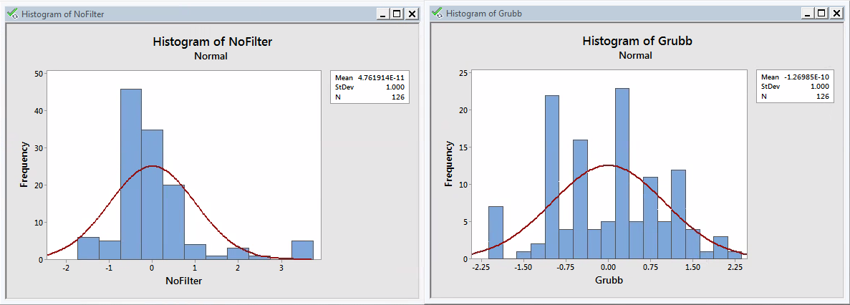
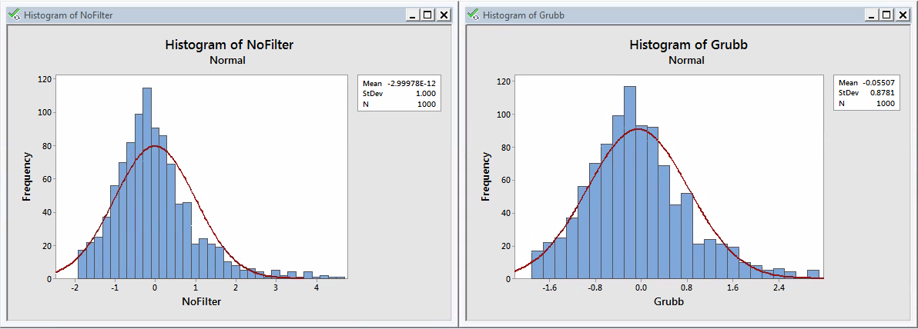
Grubb’s Test
ITS Data
Test Data

