Slide 1

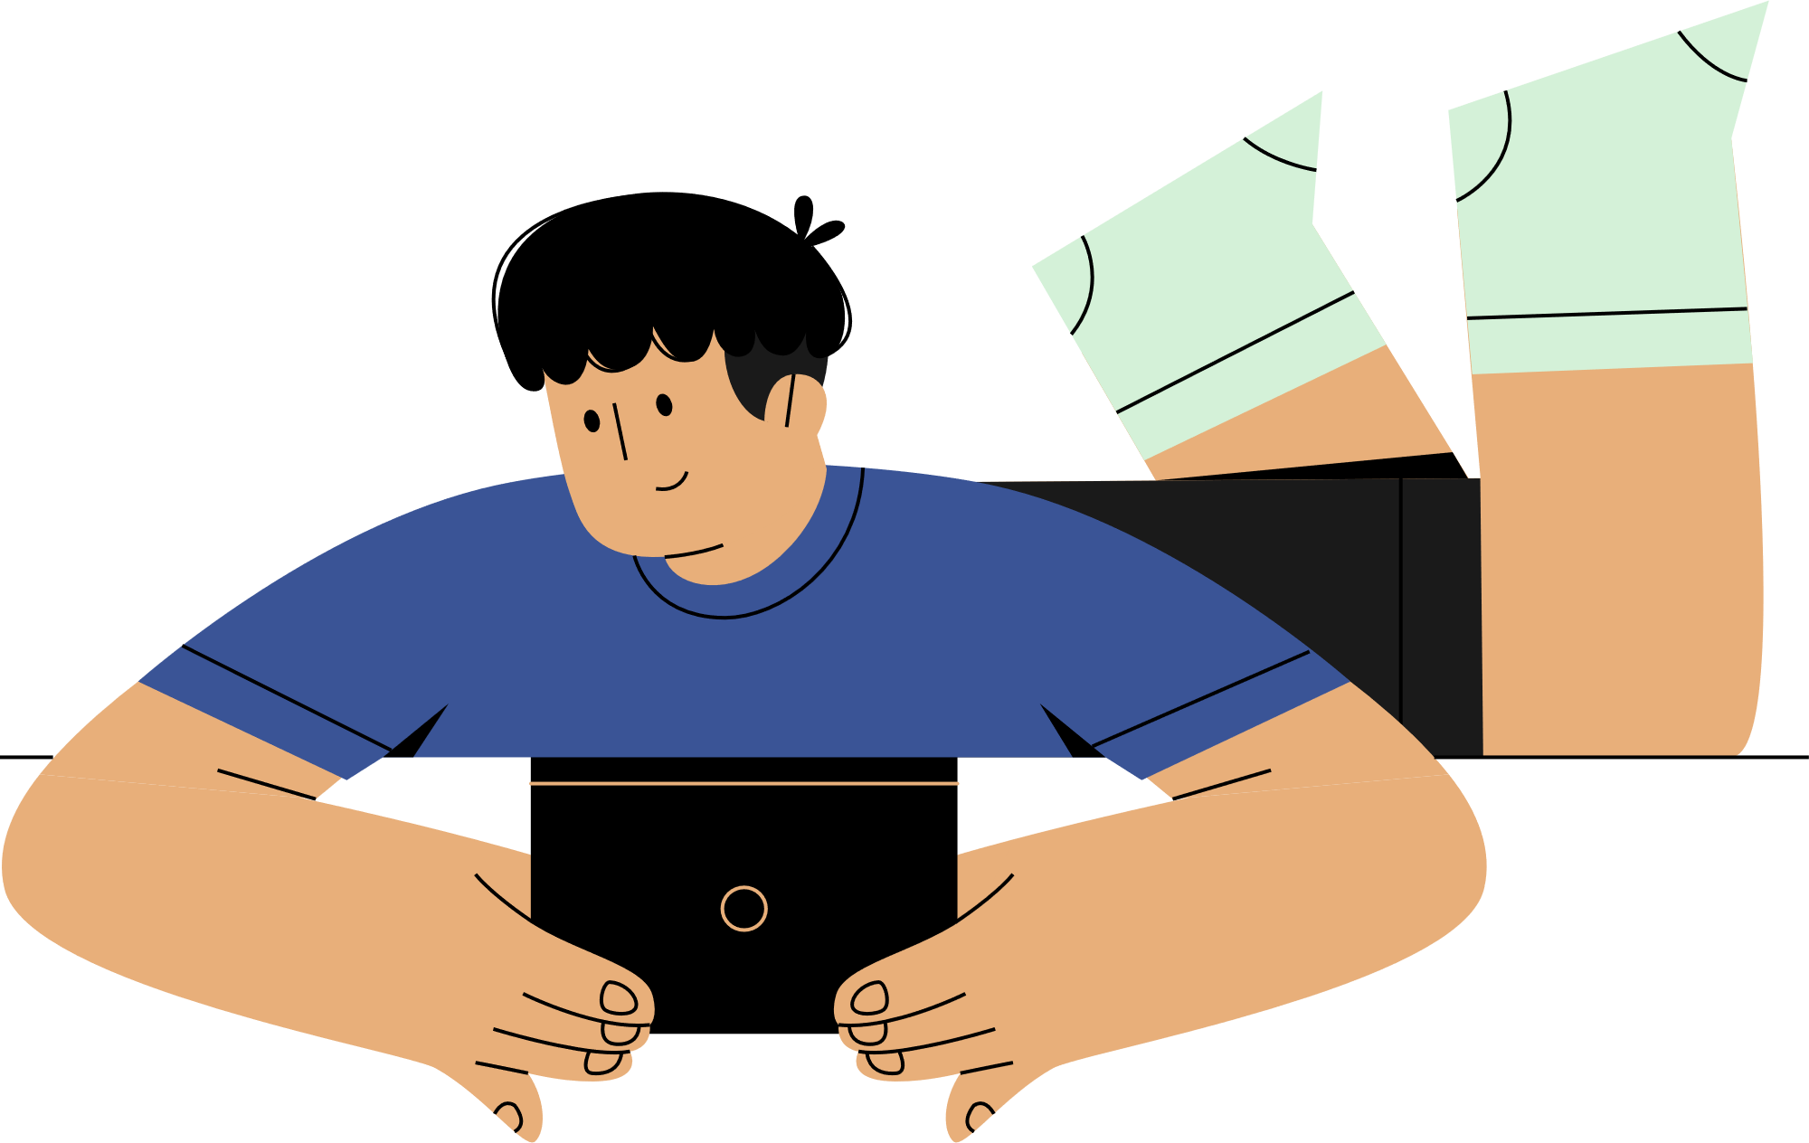
What’s real online?
Be SMART
Notes:
This Netsafe presentation is licensed under a creative commons attribution - non commercial - Sharealike 4.0 New Zealand License CC BY-NC-SA 4.0 NZ: https://creativecommons.org/licenses/by-nc-sa/4.0/deed.en
We all love a good story, and most of us are happy to watch a movie and pretend it's real so we can see a hero save the world. But in the online world, people sometimes lose track of what's real and what's not. Online information can be a mix of fact, opinions and edited stories. So let's practice being SMART so we can tell what's real online.

Slide 2

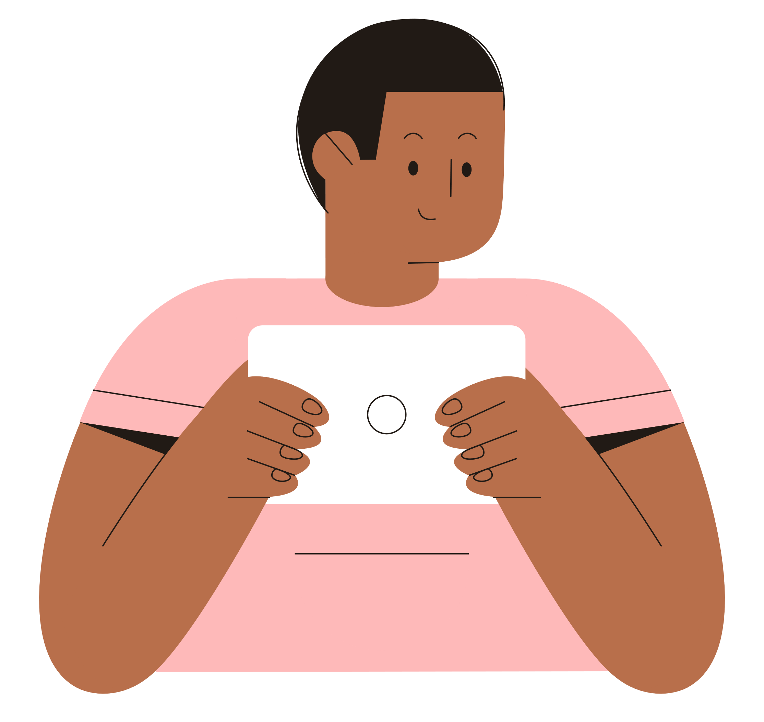

Fact?
Opinion?
Notes:
The internet is a global electronic communication network. People share facts, opinions and stories online through images, videos, messages, emails, articles, blogs, websites, adverts and games on the World Wide Web.
Anyone can post information on the web. That's one of the great things about the internet - it lets everyone contribute and makes information accessible to everyone with an internet connection. But the web itself can't tell us whether the person who posted the information is sharing the facts, making it up, expressing their opinion, or even if they're an AI bot.
Technology like search engines, social media and AI can help us search for and share information on the web but they can't help us make sense of what's 'real'. More often than not, popular made-up stories or opinion pieces throw off the results. The information we see online is a mixture of opinions, facts and stories. It's up to us to work out what's real.

Slide 3
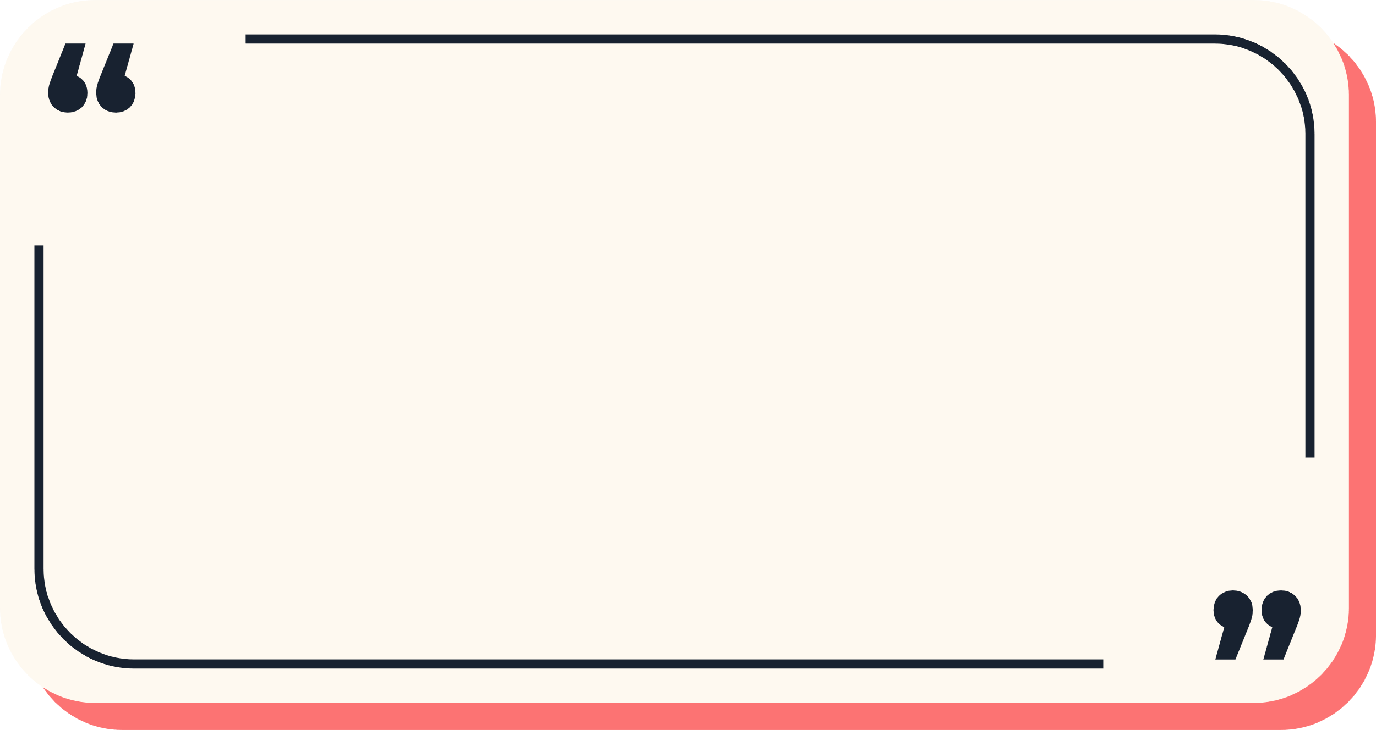


To believe or not to believe, that is the question.
SMART
Notes:
To believe, or not to believe, that is the question. (alluding to the famous quote from Shakespeare’s Hamlet)
To help us check what’s real online, there are lots of things we can check for. For example, information is more likely to be real when:
we know we can trust the source
the information comes from someone in authority
we can find the same information across two different sources.
To help us remember what to check for, let's put on our SMART glasses to work out what's real.

Slide 4
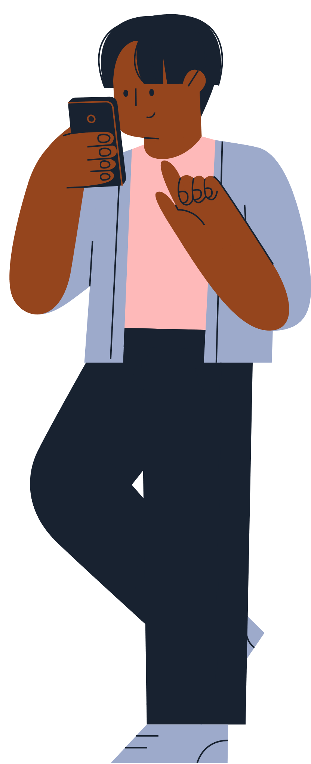
S
MART
S is for Source
Notes:
Source
Ask yourself:
Who or what is the source? Is it from a company, an individual?
Do you trust the person who shared this information?
Where did it come from?
Nowadays, not all online information comes from people. Artificial Intelligence (AI) can now use existing data to generate new content like text, images, videos or music. And AI can respond to you in language that sounds like natural conversation. The problem is, the data AI uses isn’t just fact-based. Because it’s based on what people have already written and shared, it’s full of opinions, stories, and misinformation as well as facts.
So it's even more important than ever to track online information back to the original source, to help us decide if it's trustworthy.

Slide 5
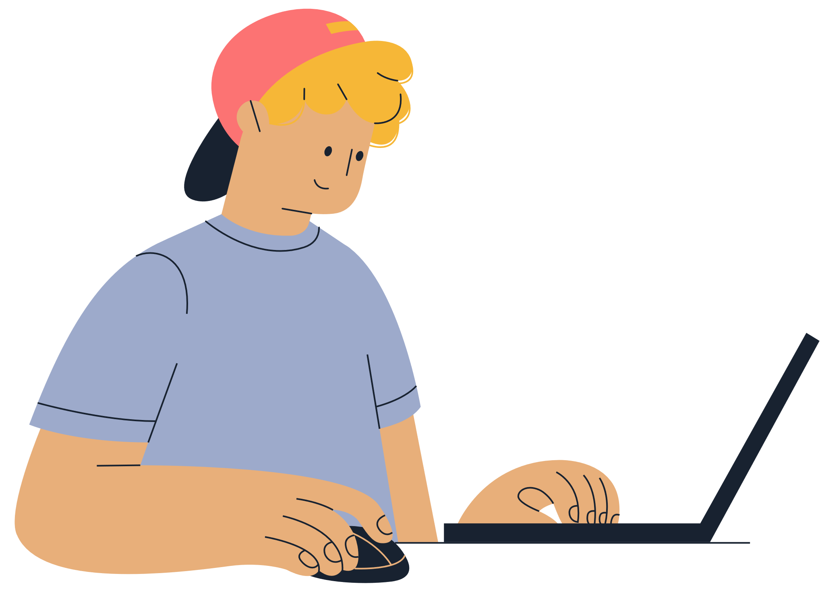
M
S ART
M is for Motive
Notes:
Motive
Note: Motive= a reason for doing something.
Motives matter. People write information and make images for all sorts of reasons. Sometimes it's to inform others, sometimes to entertain others, sometimes it's to convince other people do something (download, share, buy now), and sometimes it's to make money for themselves. So it's important to stop and think about what the motive could be.
Ask yourself:
Why would someone spread this story?
What could someone gain if you believed this information? Are they being paid to promote a product or service?

Slide 6
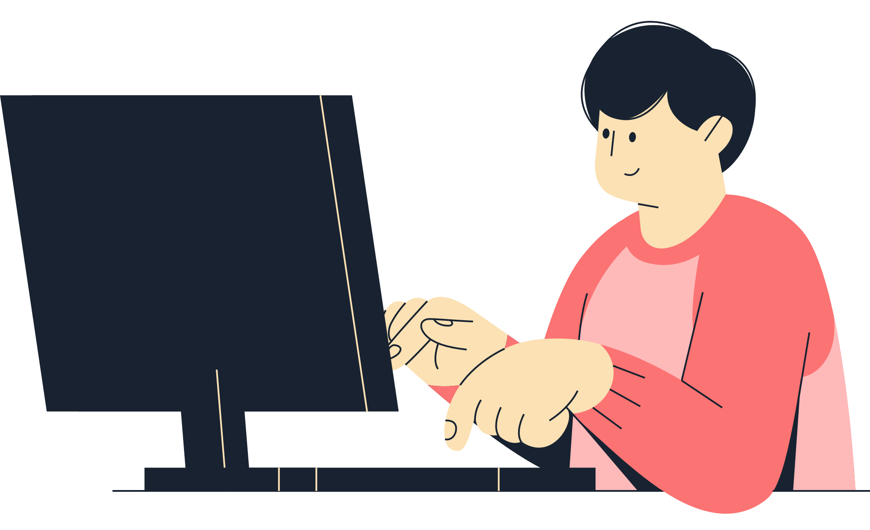
A
SM RT
A is for Authority
Notes:
Authority
Ask yourself:
What makes this story believable?
Why should/shouldn't you believe this story coming from this source?
Ask the class what makes someone an authority on a subject. Consider discussing the following points:
Evidence
Lived experience
Expertise – qualifications, experience, authority, well-known and respected
Sometimes even people with authority may share their opinions rather than the facts – so how can we tell the difference?

Slide 7


Fact
Opinion
Based on research/
observation
Can prove
Based on belief/
judgement
Probably can’t prove
Notes:
Fact or opinion
A fact is a universal truth based on research/observation. It can be proved to be true.
An opinion is a personal belief or judgement that’s debatable and probably can’t be proven.
Examples (You can get the class to guess fact/opinion)
Oranges are the best fruit (opinion)
Te Reo Māori is an easy language to learn (opinion)
Our school principal is nice (opinion)
Homework will be put on Google Classroom (fact)
There’s a school assembly this week (fact)
It takes 5-10 days to grow a seedling from a tomato seed (fact)

Slide 8
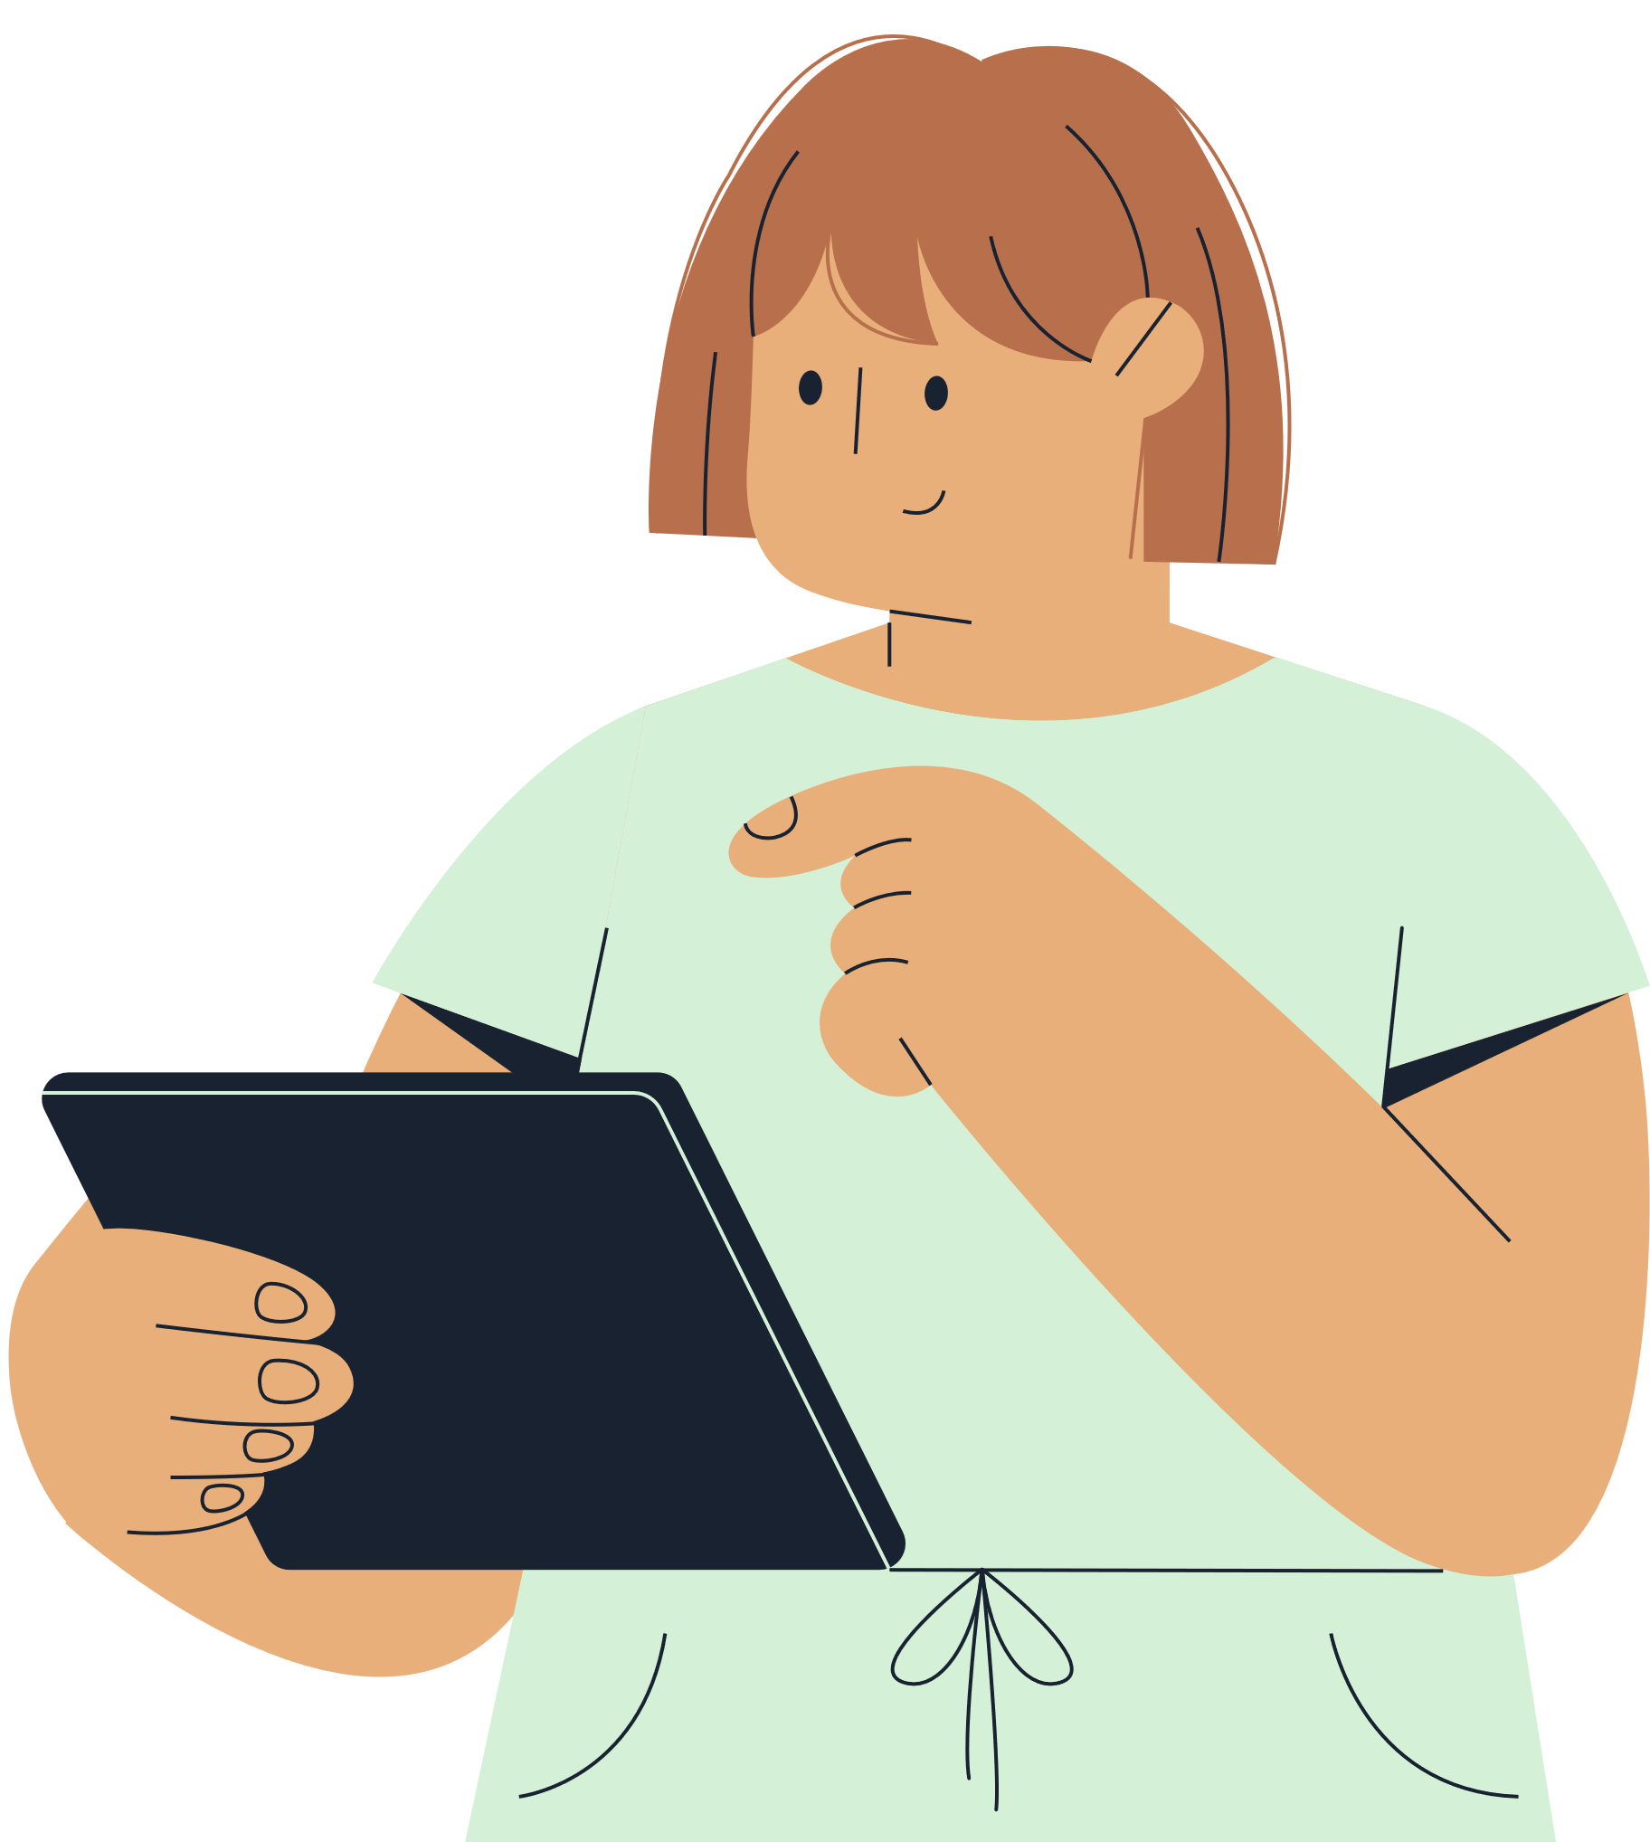
R
SMA T
R is for Review
Notes:
Review
Read over the information you’ve found and check the information for anything that jumps out at you:
Fact-check - Check the source of any statistics or data
Time-check – Check the publish date and see if the facts the information is based on is current or if it could be out of date
Bias-check – could there be another side to this story? What’s been left out?
Let’s take a look at bias and why it’s important when we’re figuring out what’s real.

Slide 9

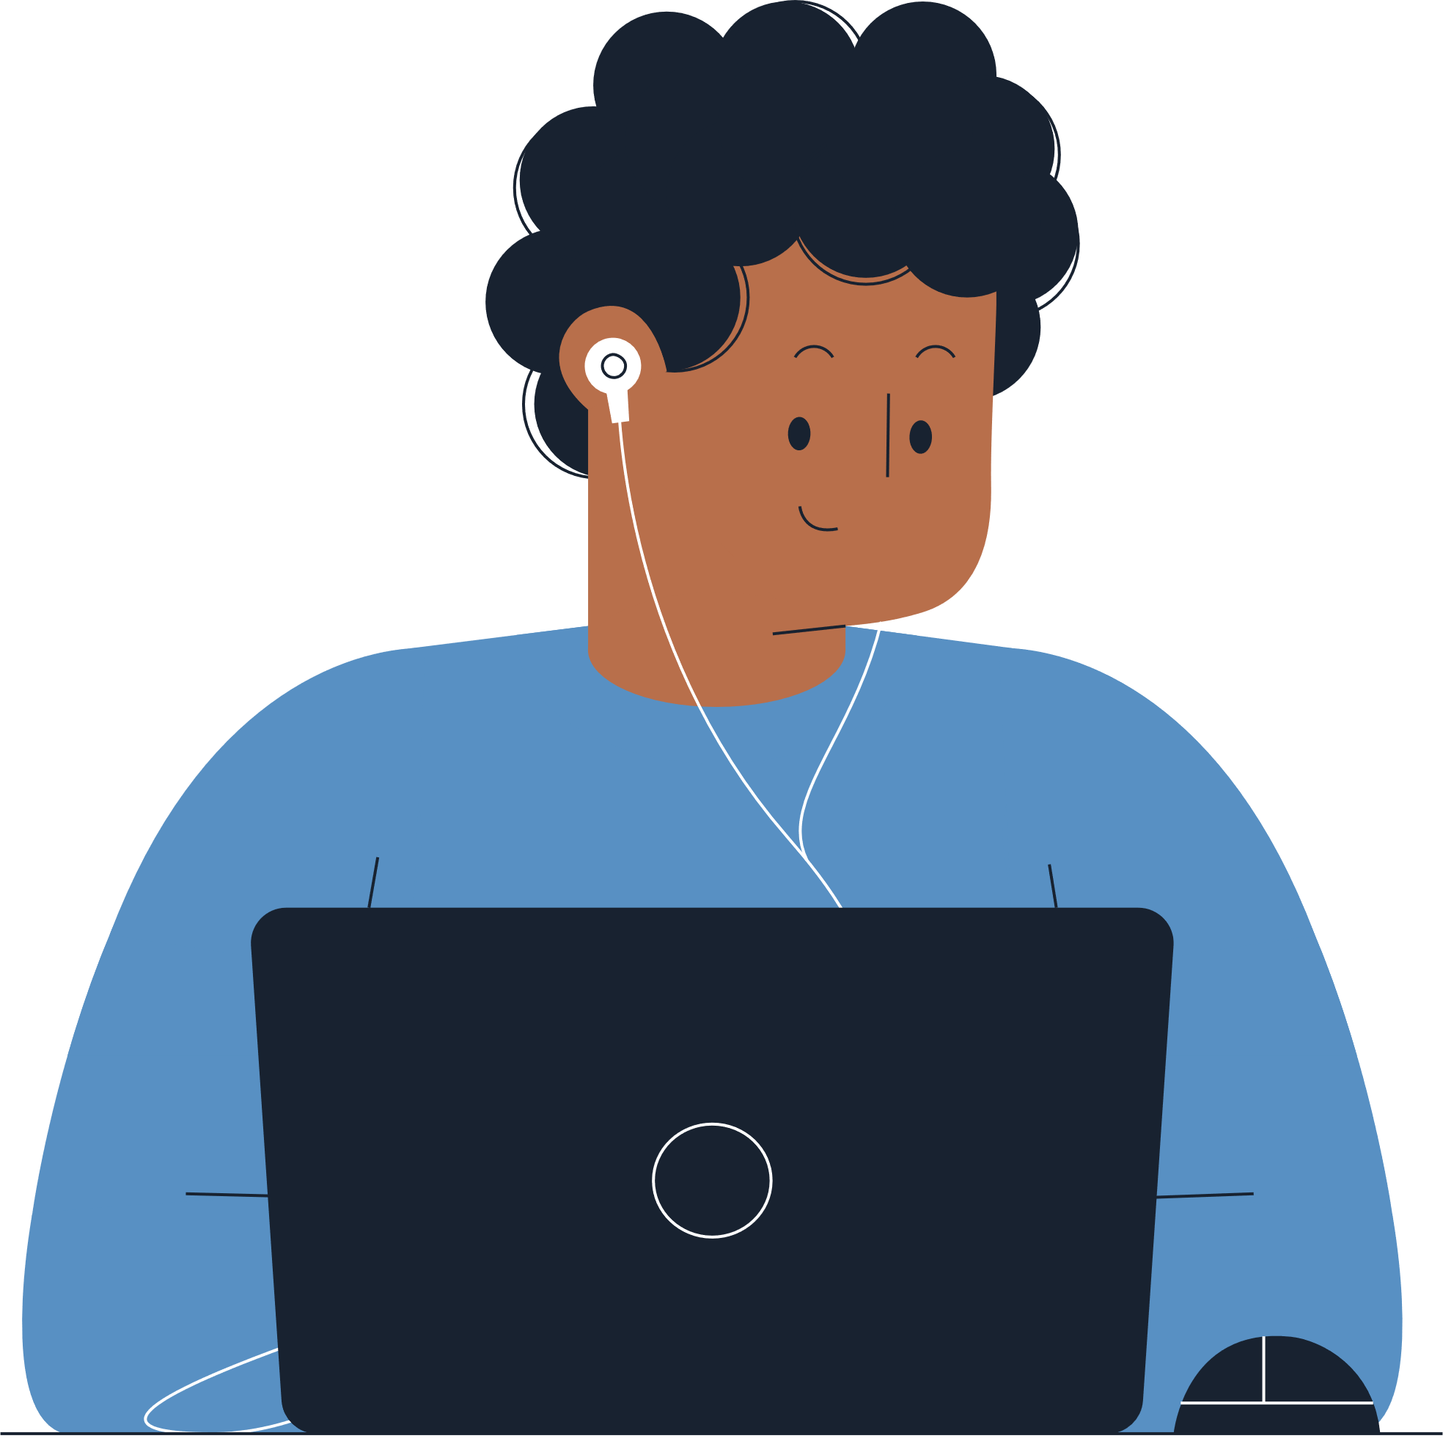
Our Biases
Bias - something we tend towards
Notes:
Our biases
A bias is when we lean toward an answer before doing any research. This is important because sometimes bias can change what we check for or which facts we check.
When we’re searching for information online, bias can impact which words we use to ask a question. This can then limit the perspectives we find and the answers we come up with.
Being aware of our bias can help us overcome it. So it’s a good idea to ask yourself, when I’m thinking about [this topic], what ideas do I already have?

Slide 10

T
SMAR
T is for Two-Source Test
Notes:
Two-source test
Check the information you've found with another source from a different authority.
Ask yourself:
How does the information compare?
What's the same, and what's different?
Information that stays the same across different sources is more likely to be factual and real.

Slide 11

S
M
A
R
T
- Source
- Motive
- Authority
- Review
- Two-Source Test
Notes:
So when you find information online in your chats, in your email, or on a search engine, remember to put on your SMART glasses to help you check if it’s real.

Slide 12
Notes:
If you have questions about keeping safe online, talk to a trusted adult and contact Netsafe. Netsafe is a NZ charity with a free and confidential helpline for anything to do with keeping safe online.

