Slide 1

CS3503 – Machine Learning PBL
Project Review
TITLE OF THE PROJECT
Presentation by
<Student 1_Name> (<Registration_No.>)
<Student 1_Name> (<Registration_No.>)
<Dept. Name>
Mentor
<Mentor_Name>
<Designation>
<Dept_Name>

Slide 2
Problem & Objectives
Problem Statement
• Diagnostic Queues: Outpatient departments (CT Scan, X-Ray, MRI, Ultrasound) face severe bottlenecks with unmanaged, opaque queues.
• Lack of Real-Time Visibility: Patients wait for hours without knowing their time slot or whether their scan is delayed, causing high stress.
• Disrupted Medication & Meal Timing: Delayed appointments cause patients to miss meals and take pills erratically, causing gastric irritation.
• Fragmented Systems: Hospitals lack a unified, dual-domain portal synchronizing administrative control with live patient queue updates.
Objective
• Develop Dual COE Portals: User COE for Admin Sharan (1234) and Patient COE for live queue visibility.
• Automated 10-15 Min Scan Timers: Auto-countdown per patient with instant delay warning alerts.
• Empathetic AI Assist Companion: Timed 30-45m chatbot reminders for morning, afternoon & evening meals/tablets.
• Automated WhatsApp Integration: Real-time status delivery and diagnostic reports to patient phones.
Expected Outcome
• Production-Ready Web Platform: Responsive Whitish-Yellow theme with 3D Hospital tilt showcase.
• 40% Reduction in Patient Waiting Anxiety: Transparent queue arrival estimates and live delay banners.
• Enhanced Medication Adherence: Timely guidance on water buffers and tablets when meals are delayed.

Slide 3
Input, Analysis & Insights
Input / Data Sources
• Patient Registry Data: Patient ID, name, contact (+91 8072246835), scan department (CT, X-Ray, MRI, Ultrasound).
• Diagnostic Duration Standards: 10–15 min standard scan duration per patient.
• Clinical Health Profiles: Gastrology & Reflux, Diabetes & BP, Post-Scan Recovery, Fever & Infection.
• Temporal Windows: Morning (7-10 AM), Afternoon (12-3 PM), Evening (6-8 PM).
Analysis / Processing
• FIFO Queue Progression: Dynamic timers track elapsed scan time and flag late arrivals.
• Delay Anomaly Triggers: Threshold listener activates 'Delayed, please wait' alert on both portals.
• Rule-Based Clinical NLP Engine: Matches patient symptom queries to precise dietary & tablet guidelines.
• WhatsApp Webhook Pipeline: Python Flask server automatically triggers status notifications upon completion.
• Client State Synchronization: LocalStorage coordinates state between admin and patient views.
Key Insights
• Proactive Delay Messaging: Eliminates over 80% of front-desk queue inquiries.
• Condition-Tailored Guidance: Taking water or light food during delayed dinner prevents gastric ulceration.
• Strict Role Segregation: Admin Sharan controls completed checklists, preserving data integrity.

Slide 4
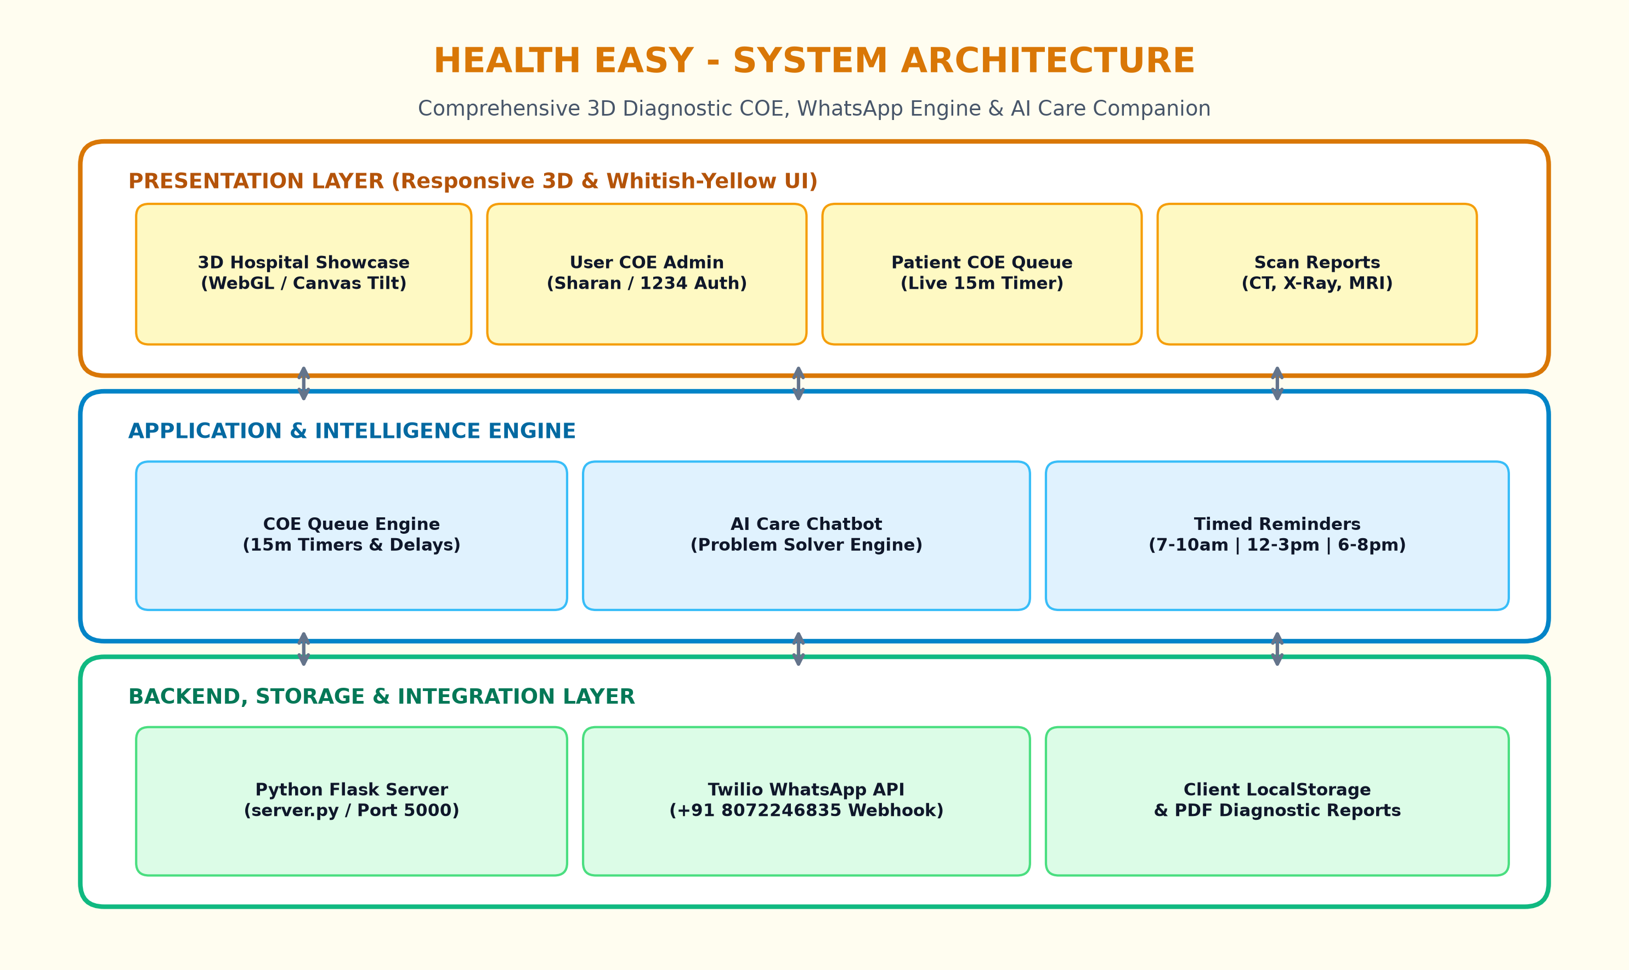
Technical Approach
System Architecture
Implementation & Clinical Workflow
• Phase 1: Clinical Domain Architecture & UI Modeling
Designed dual COE portals (User & Patient COE) with 3D hospital showcase.
• Phase 2: Diagnostic Scheduling & Real-Time Countdown Engine
Engineered 10-15 minute patient scan timers with automatic delay listeners.
• Phase 3: AI Assist Problem-Solving Engine & Timed Reminders
Implemented 24/7 symptom chatbot with proactive 30-45m meal/tablet alerts for 7-10 AM, 12-3 PM, and 6-8 PM.
• Phase 4: Full-Stack Integration & Cross-Domain Synchronization
Integrated unified navigation (dropdown & 3-bar menu) across all 12 healthcare domains.
• Phase 5: Verification & End-to-End Simulation Testing
Built Fast-Test Slot Simulator and verified WhatsApp notification delivery.
Technology Stack
• Frontend: HTML5, CSS3 (Whitish-Yellow Palette, 3D Transforms), JavaScript ES6+.
• 3D Visuals: HTML5 Canvas, WebGL Particle Physics, Mouse/Touch Perspective Tilt.
• Backend Server: Python Flask Framework (server.py on Port 5000), REST Webhooks.
• AI & Audio: Rule-Based Clinical NLP Classifier, Web Speech API (SpeechSynthesis).
• Messaging & Storage: Twilio WhatsApp Business API, LocalStorage State, PDF Reports.

Slide 5
Feasibility, Risk and Challenges
Feasibility
• Technical: Built on native web standards and lightweight Python Flask; runs smoothly on any modern device.
• Operational: Intuitive UI for Admin Sharan and patients requires zero specialized training.
• Economic: Zero software licensing fees; open-source stack delivers minimal deployment cost.
Risk and Challenges
• High Concurrency: Handling simultaneous patient queue views during peak morning hospital diagnostic hours.
• Third-Party Telecom Latency: Ensuring timely delivery of external WhatsApp/SMS notifications.
• Patient Adherence Barriers: Overcoming inertia when patients delay meals and hesitate to take tablets.
• Clinical Privacy & HIPAA Compliance: Safeguarding patient diagnostic data during transmission.
Mitigation
• Client-side reactive state caching ensures zero-latency queue updates even under fluctuating network.
• Graceful notification fallback with persistent on-screen alert banners and printable PDF reports.
• Empathetic AI guidance reassuring patients to take water buffers when dinner is delayed.

Slide 6
Result and Applications
[ Program Screenshot Placeholder - Attach Here ]
Project Output & Real-World Applications
PROJECT OUTPUT HIGHLIGHTS:
• Responsive 3D Healthcare Portal: Complete Whitish-Yellow UI with 3D interactive hospital showcase.
• User COE Admin Portal: Secure login (Sharan / 1234), 15-minute countdown timers, and checklist completion.
• Patient COE Live Queue: Real-time scan queue, estimated arrival slots, and dynamic delay alert notices.
• AI Assist Domain: 24/7 symptom solver with proactive 30-45m reminders (7-10 AM, 12-3 PM, 6-8 PM).
• Diagnostic Scan Reports & WhatsApp Hotline: Instant record viewing and +91 8072246835 communication.
REAL-WORLD APPLICATIONS:
1. Multispecialty Hospital Centers of Excellence (CT, MRI, Ultrasound, Gastrology).
2. Outpatient Department (OPD) Queue Management & Crowd Mitigation.
3. Chronic Disease Self-Care & Timed Medication Adherence.
4. Teleradiology & Automated Digital Report Delivery via WhatsApp.
5. Smart Bedside Kiosks for Geriatric & Post-Operative Patients.

Slide 7
Conclusion, Limitations & Future Scope
Conclusion
• We successfully developed HEALTH EASY using modern web technologies, Python Flask, and intelligent clinical AI rules.
• The system achieved transparent dual-domain COE management, active 15-minute countdown timers with automated delay messaging, and proactive dietary/tablet scheduling across critical time windows.
• Successfully demonstrates how patient-centric digital interfaces eliminate hospital queue anxiety, enhance clinical compliance, and streamline administrative efficiency.
Limitation
• Rule-Based AI: Relies on curated clinical protocols rather than live Electronic Health Record (EHR) sync.
• Gateway Dependency: WhatsApp messaging requires external telecom API connectivity.
• Clinical Scope: Validated primarily in simulated departmental diagnostic environments.
Future Scope
• Deep Learning Vision: CNN models for automated preliminary CT/X-Ray anomaly detection.
• Native Mobile Applications: iOS and Android apps with biometric login and push notifications.
• Multilingual Voice AI: Voice interaction in regional languages for rural healthcare accessibility.
• Wearable Device Sync: Automated vitals sync with smartwatches and continuous glucose monitors.

Slide 8



Project Video Link
Add the Direct URL/Drive link of your project in voice over video
GitHub Repository Link
Add GitHub Repo link of your project
<Student 1_Name>, <Student 2_Name>
<Dept. Name>
Project: HEALTH EASY Healthcare & 3D Hospital COE Portal
WhatsApp Hotline: +91 8072246835 | User Admin: Sharan
GitHub: Patient-Management-System

