Slide 1
Sitzung 8: Die Kluft zwischen Persönlichkeitsmaßen/Psychopathologie und den Neurowissenschaften
Dr. Philipp Bierwirth
Differentielle Psychologie und Persönlichkeitsforschung
SoSe 2026

Slide 2
1. Introduction

Slide 3
Self-reported negative affect and neuroscience
Negative affect related traits (NARTs)
Negative Emotionality
Trait Anxiety
Negative dispositional affect
Harm avoidance
Neuroticism
Negative affectivity
Valid predictors of overall life quality and the development of psychopathology
Huge interest in the neurobiological foundations
Interindividual differences in experiencing negative affect are reflected by systematic interindividual differences in brain structure and function

Slide 4
Gruppenarbeit
Sie sind ein Team aus forschenden Diagnostikern und Psychologen, das von einem großen Forschungsinstitut rekrutiert wurde. Bisher verlässt sich das Institut bei der Diagnostik von Trait-Ängstlichkeit und Neurotizismus fast ausschließlich auf Selbstauskunft-Fragebögen (wie den NEO-PI-R oder das STAI). Das Problem: Fragebögen sind anfällig für soziale Erwünschtheit und mangelnde Introspektionsfähigkeit.
Ihre Mission: Das Institut möchte eine neue, objektive und multimodale "Diagnostik-Batterie" entwickeln. Ihre Aufgabe ist es, Ihr bisheriges Wissen über die Neurobiologie und Psychophysiologie zu nutzen, um fundierte biologische und physiologische Marker (Korrelate) vorzuschlagen, die Ängstlichkeit und Neurotizismus messbar machen.
Arbeitsauftrag: Diskutieren Sie in Ihrer Forschungsgruppe (ca. 3-4 Personen) die folgenden Bereiche und entwerfen Sie eine diagnostische Testbatterie.

Slide 5
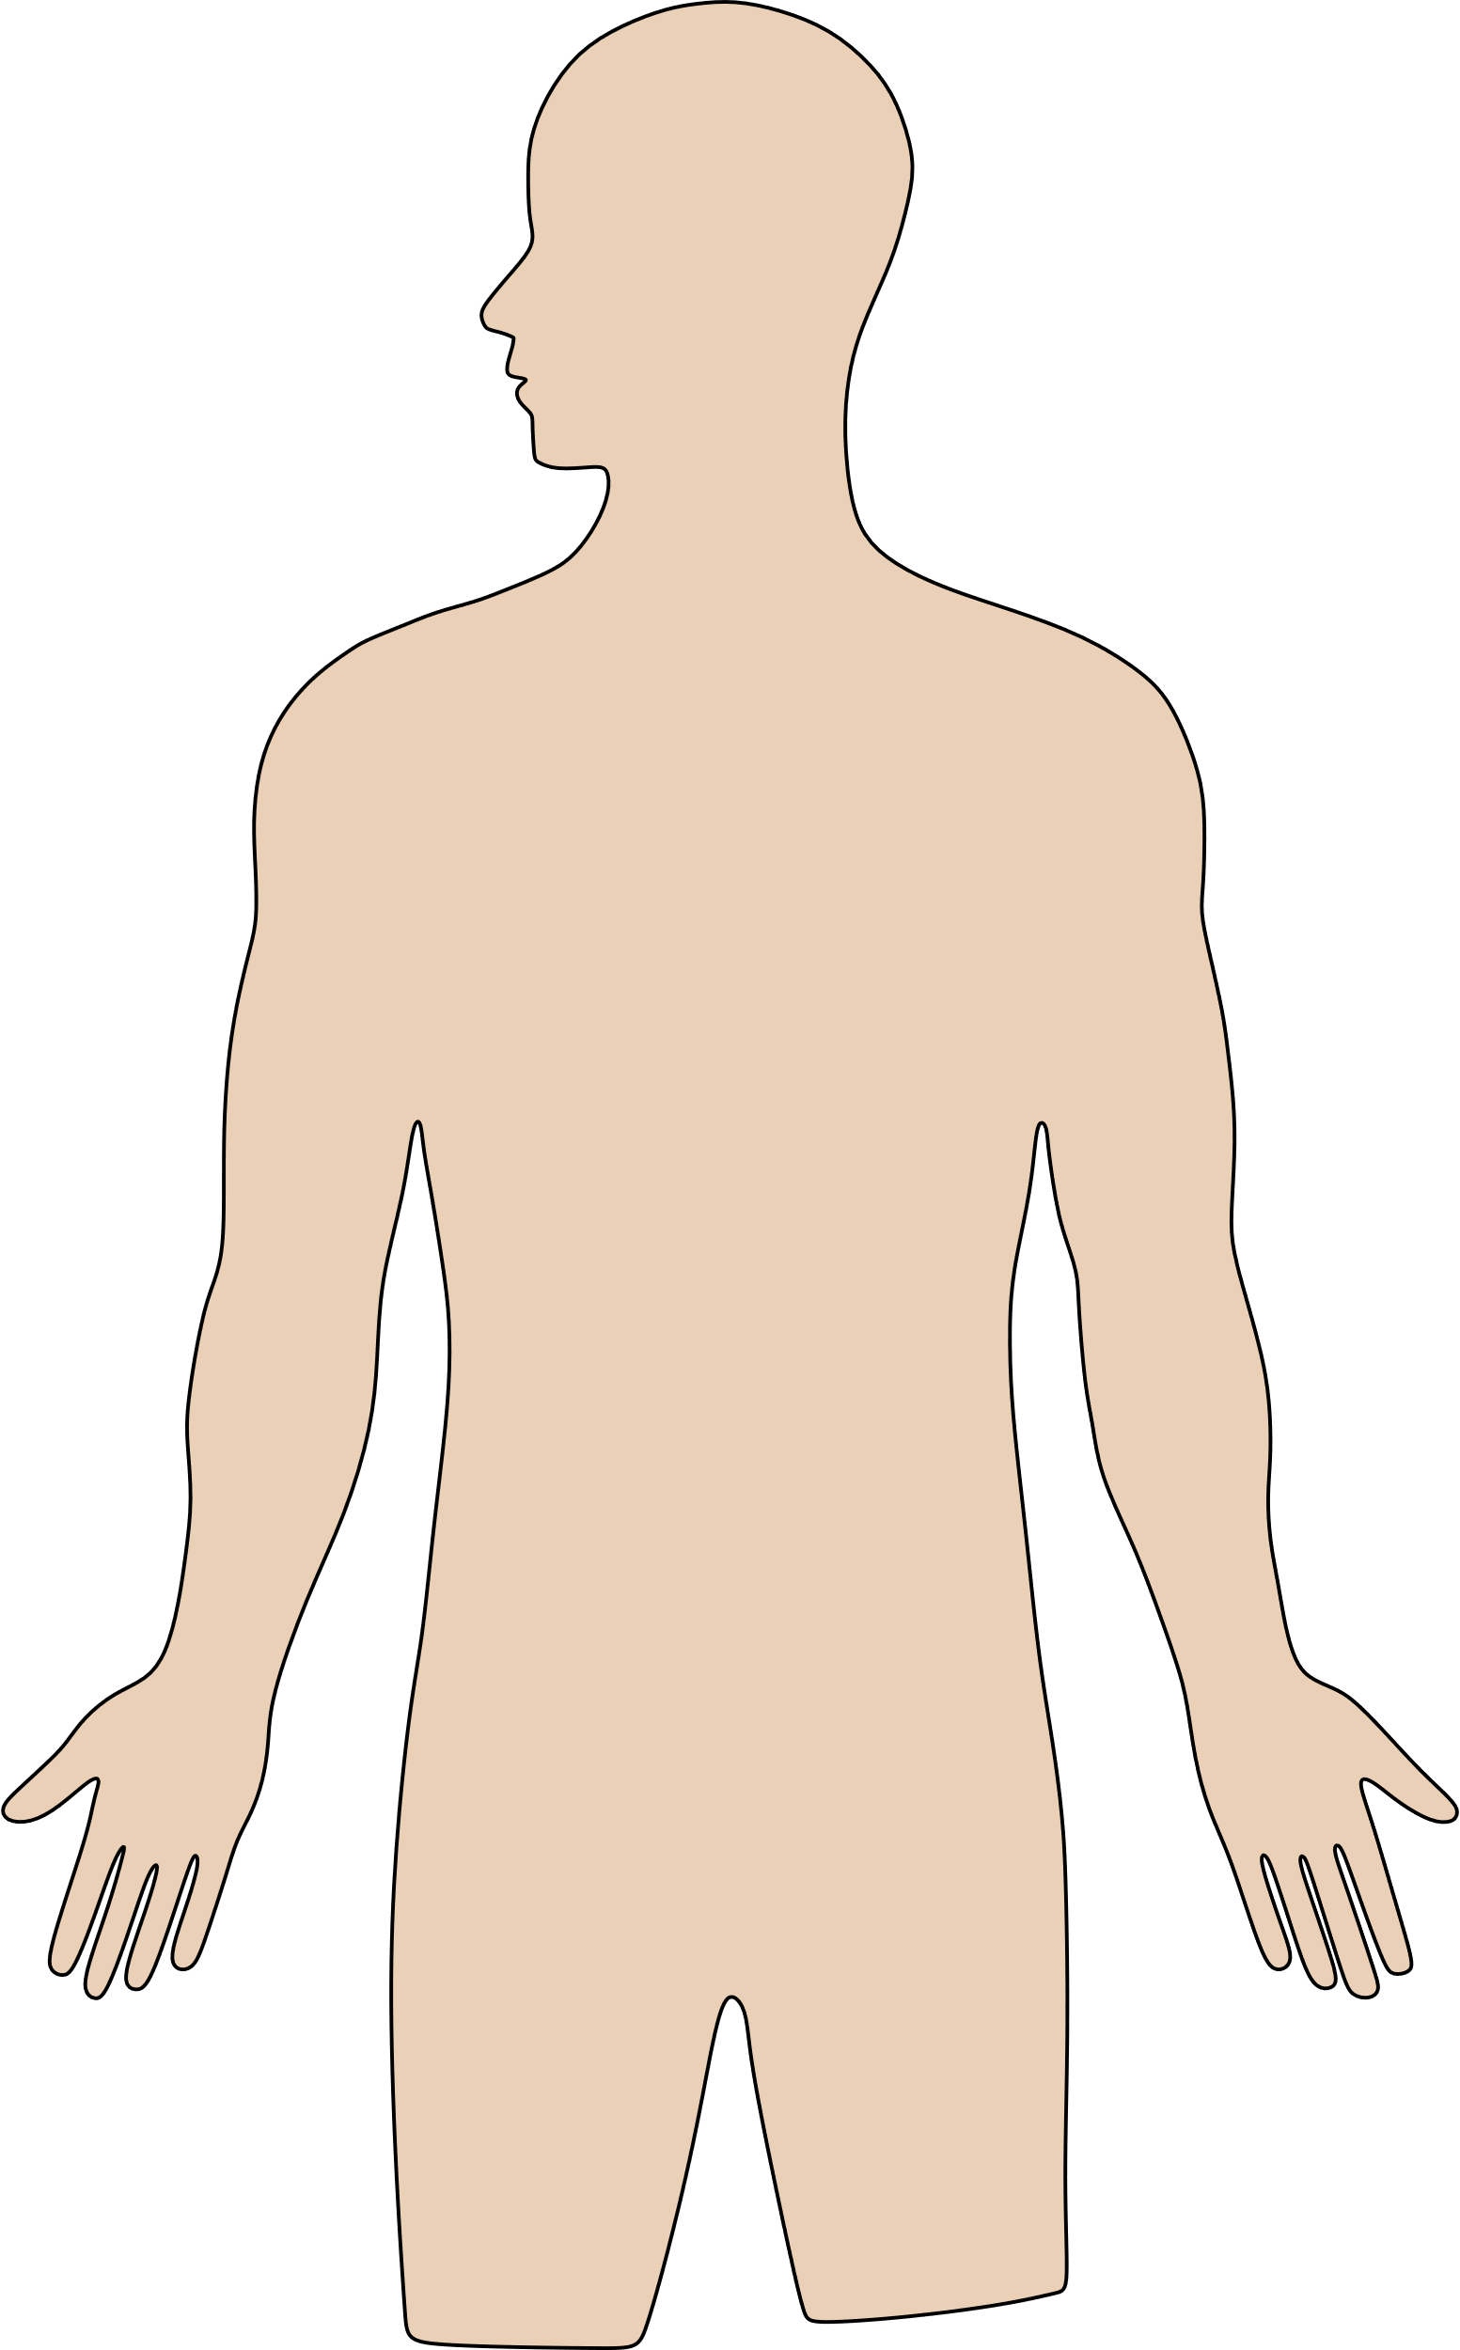
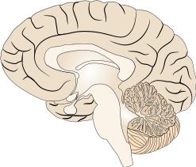
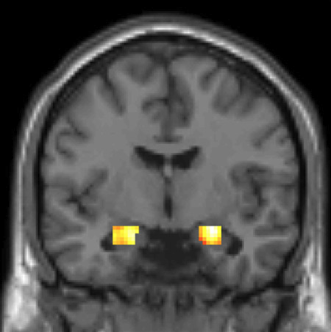

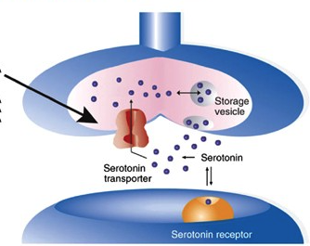
Neurobiological correlates of NARTs
Most promising candidates show small effect sizes, are hard to replicate, and often depend on further moderating variables:
Increased cognitive control-related EEG activity (e.g., FM-⍬, ERN, FRN & CRN)^{1,2}
Threat reactivity⁴
(e.g., heightened
amygdala reactivity)
Reasons for the chasm between self-reported NARTs and neurobiological variables?
Interindividual differences in the serotonergic system ³
(e.g., 5-HTTLPR, serotonergic challenge tests)
¹Cavanagh & Shackman (2015); ²Saunders & Inzlicht (2020); ³Wright et al. (2019); ⁴Servaas et al. (2013)

Slide 6
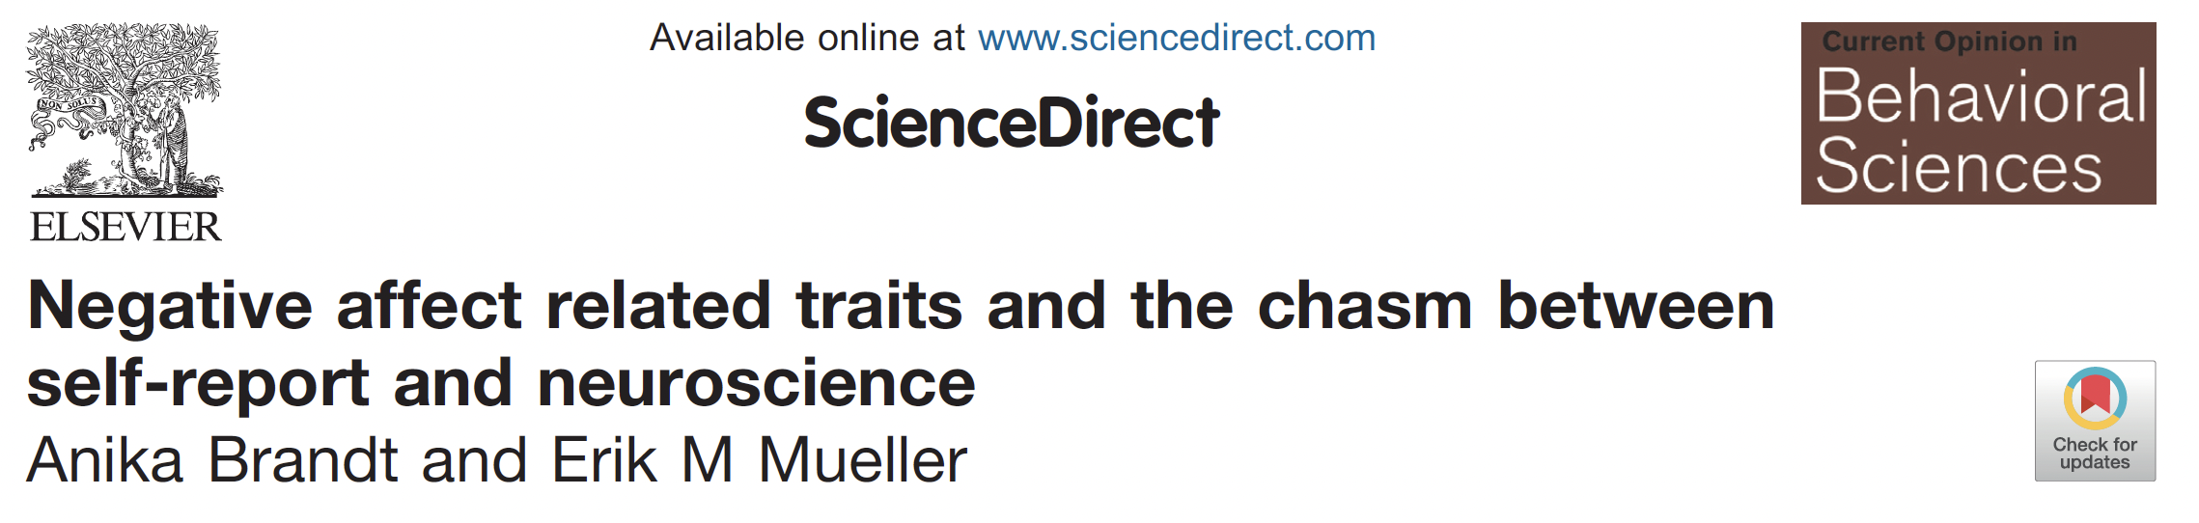
Why is it so hard to link neurobiological variables to NARTs?
Reasons that are responsible for the replication crisis (Researchers degrees of freedom, small sample sizes, etc.)
Reasons that might be specific for personality neuroscience¹:
Measurement of interindividual differences in neurobiological variables and trait variables
The hypothetical relationship between trait and neurobiological variables
1: Neuropsychometrics
2: Size-assumption
3: Trait-scale semantics
4: Trait-hierarchy specification
5: Brain-trait theory
6: Abstraction-Level
7: Contextualized Trait
8: Context Taxonomy
9: Double-gap
10: Coherent reduction
¹Brand & Müller (2021)

Slide 7
2. Measurement of interindividual differences in neurobiological and trait variables

Slide 8
Reliability of both measures
The reliability of each variable sets an upper limit for the maximum correlation between both variables:
?
r_{yy} ≈ 0.75 - 0.95 ^{e.g., 6,7}
r_{xx} ≈
Neurobiological variable (x)
Trait variable (y)
Studies from our own lab showed moderate to high (retest-) reliabilities between r_{xx}= 0.78 – 0.98 for raw N1 and P2 amplitudes¹
Other studies also reporting moderate to high reliabilities for raw ERP amplitudes: ~ 0.70 - 0.95 (e.g., ERN, FRN, LPP)^{e.g., 3,4,5}
¹Gerpheide et al., (2024); ³Weinberg et al, (2011); ⁴Clayson et al. (2021); ⁵McGhie et al. (2021); ⁶Carver & White et al. (1995), ⁷Costa & McCrae (1992)

Slide 9
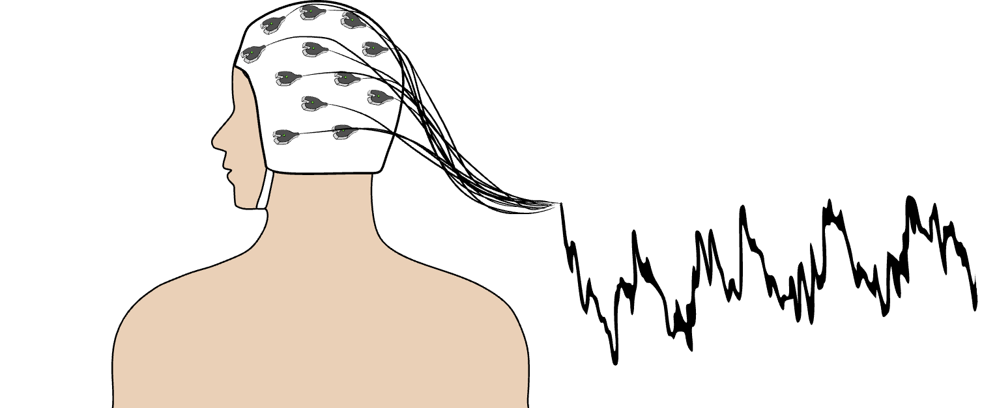
Reliability of neurobiological variables
Factors that probably increase reliability,
but are unrelated to the neurocognitive process of interest:
Skull
thickness¹
Cortical surface
area recruited¹
Sulcal
anatomy¹
Scalp preparation¹
Systematic noise increases reliability but decreases validity of (neurobiological) measurements.
¹Cohen, 2014

Slide 10
Reliability of neurobiological variables
Factors that probably increase reliability,
but are unrelated to the neurocognitive process of interest:
N1 component in a threat of schock paradigm²:
N1_{Amplitude}: r_{xx} = 0.91
N1_{threat-safe}: r_{xx} = 0.67
N1_{residualized}: r_{xx} = 0.54
N1_{Amplitude} & Trait Anxiety: r = -0.07
N1_{threat-safe} & Trait Anxiety: r = 0.30*
N1_{residualized} & Trait Anxiety: r = 0.34*
Skull
thickness¹
Cortical surface
area recruited¹
Sulcal
anatomy¹
Scalp preparation¹
Systematic noise increases reliability but decreases validity of (neurobiological) measurements.
¹Cohen, 2014; ²Gerpheide et al. (in prep)

Slide 11

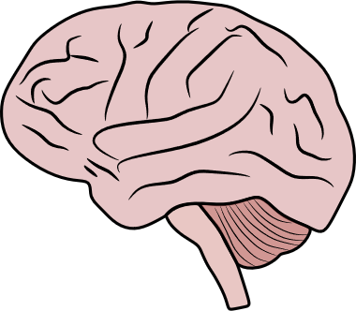


Validity of neurobiological measures
Very robust within-subject effects of threat/feedback on FM-⍬ and heart rate
But do these variables also capture valid between-subject variability?
Size-assumption
problem
Threat
between-subject
variability

Slide 12
Validity of neurobiological measures
e.g., the size-assumption problem
Example:
Baseline heart rate is correlated with the evoked heart response towards external stimuli (e.g., threats)
Resulting problem:
Between-subject variability is influenced by physiological differences in the response system
This between-subject noise makes it harder to detect meaningful correlations
Potential solutions:
Multivariate assessment of dependent neurobiological variables, e.g., via within-subject correlations or functional connectivity

Slide 13
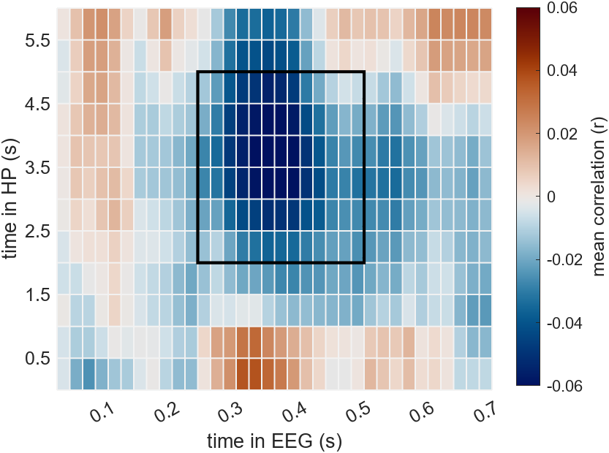
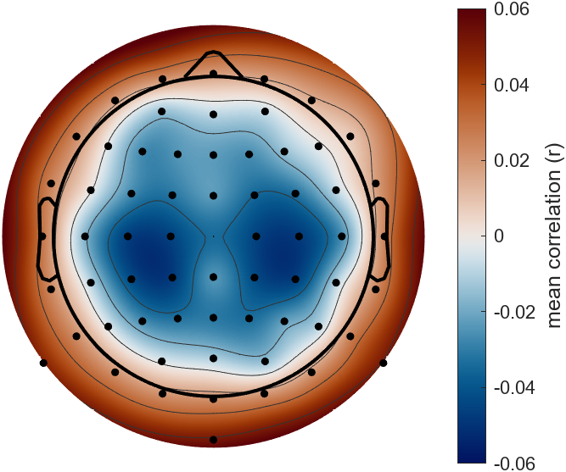
Within-subject correlations to assess Brain-heart coupling
One solution might involve the use of multivariate brain measures like within-subject correlations and functional connectivity
Example: Cardio-electroencephalographic covariance tracing (CECT, Mueller et al. [2010]) is a multivariate measure that relies on within-subject correlations between single trial cardiac- and EEG-activity to assess functional brain-heart-coupling.
Predefined time-window
EEG: 250-500 ms
HP: 2-5 s
Scalp distribution of the N300H
average p-correlation within the time window 250-500ms (EEG) and 2-5s (HP)
Feedback onset

Slide 14
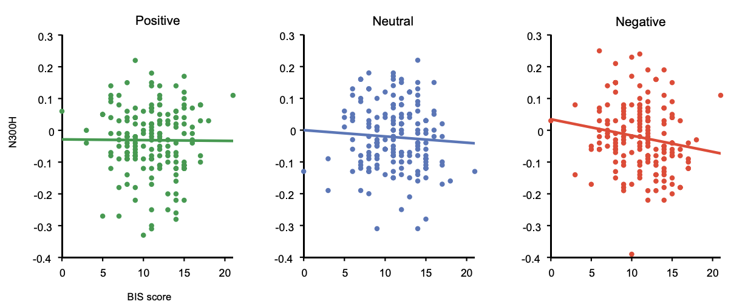
Brain-heart coupling and trait anxiety
Studies using the CECT method showed that…
n=165
Lower coupling
Higher coupling
r = -.16*
… stronger brain-heart coupling to negative feedback is associated with trait anxiety (Mueller et al., 2013; see Figure above)
…. panic disorder patients show elevated brain-heart coupling (Mueller et al., 2014, Unterschemmann et al., 2024)
Thus, multivariate assessed brain-heart coupling might be a marker for trait and pathological anxiety….

Slide 15
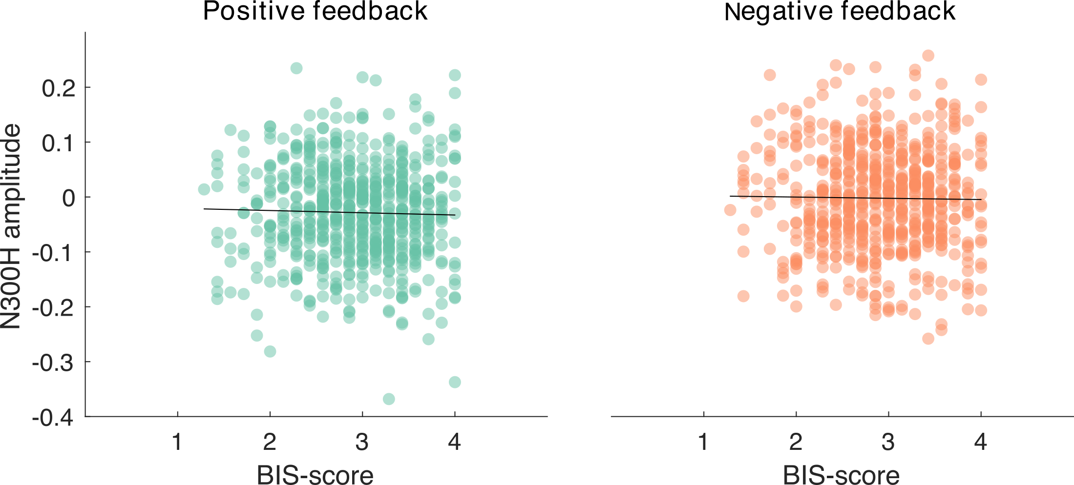
Brain-heart coupling and trait anxiety
…in context of the multilab CoScience project¹, we aimed at replicating the observed association between trait anxiety and brain-heart coupling in n = 662 subjects.
Preliminary results showed no association between the strength of brain-heart coupling and trait anxiety
Lower coupling
Higher coupling
Bierwirth et al. (in prep)
¹Paul et al., 2022

Slide 16
3. The hypothetical relationship between trait and neurobiological variables

Slide 17
Abstraction level problem
FM-theta power
Neuroticism
FM-theta in a given task
Facet of Neuroticism
Abstraction level
Single trial
FM-theta
Context specific behavior
Potential solutions:
Attempting to match abstraction level (e.g., threat-evoked theta power during fear conditioning and the neuroticsim facet fearfulness)
Aggregating neurobiological variables over different tasks to get a higher abstraction level (also reduces task specific noise)

Slide 18
The double-gap problem
Neurobiological personality research needs to fill two gaps:
Neurobiological variable – Neurocognitive process
Trait variable – Neurocognitive process
FM-⍬
or amygdala reactivity
Neurobiological variable
Trait variable
Neuroticism
(2) ?
(1) ?
Threat sensitivity
Neurocognitive
process
Potential solution:
Investigating one gap at a time to reduce uncertainties about the association between each variable and the neurocognitive process

Slide 19
4. Summary

Slide 20
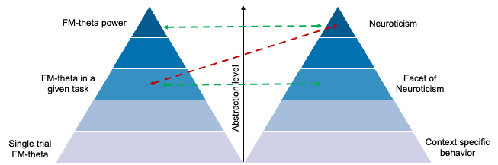
Summary
Acknowledging the presented (and other) problems, along with adopting good open science practices, could help detecting meaningful associations between neurobiological variables and NARTs.
(A) r_{xx} ≈ 0.75-0.95
(A) r_{yy} ≈ 0.80 - 0.95
Neurobiological variable (x)
Trait variable (y)
(A) Validity?
(A) Validity?

