Slide 1
Pharmacy Company
Group 2

Slide 2
Client Requirements
Firstly, it will carry basic information about a medicine i.e. its name, description and particular I’d which will be unique.
Secondly it will be classified according to their categories which will carry information about the type of disease they are, I’d, colour, for which age group the medicine is recommended.
Then it will carry the whole stock data in which information spread will be telling you about the date manufactured the date it was sold, quantity we persist, to be sold on a particular date, quantity after selling medicine on a particular date and the cost of that medicine.

Slide 3
Then we want the names to which we sold our medicines it can be other companies, retail shops or to direct customers.
The medicines which we import from other (companies). The companies can be in foreign too, so the table will also contain the price at which we purchased, the amount of gst applied and various other taxes.
There will be info about the raw materials which are required to make medicines, there quantity, the amount in which that particular quantity is purchased and the left-over quantity which is to be purchased further to complete the whole purchasing of that particular raw material.

Slide 4
Improved Functional Requirements
1. Information about medicine which will include unique id for each product, its name , generic name and disease it cures.
2. Production is divided with respect to batch number and batch number is assigned to different lot of same medicine which are manufactured on different dates.
3. Also each lot of medicine is developed from different batches of raw material.
4. Finished products are kept in warehouse and termed as inventory.
5.Inventory is further divided into raw material inventory , manufactured inventory and purchased medicine inventory.

Slide 5
6. Manufactured inventory keeps record of products ready for sale and are identified according to their batch number which is assigned at the time of production.
7. Manufactured inventory contains information about batches of medicine which include their acquisition date , expiry date , quantity initially acquired , quantity left and medicine ID.
8. Purchased inventory keeps the record for medicines which are bought from other companies and are identified with respect to batch number which are assigned at the time of purchase.
9. Purchased inventory contains information about batches of medicine which include their acquisition date , expiry date , quantity initially acquired , quantity left , medicine ID and seller ID.
10. Inventory for raw material include raw material divided with respect to batches and raw material ID, their acquisition date , expiry date , initial quantity, quantity left.

Slide 6
11. Invoice is generated for every order which includes unique invoice ID, generation date, contents, quantity, buyer ID, tax applied, discount given, total amount to be paid.
12. To buy goods by the firm, purchase orders are used.
13. Purchase order are made up of Unique purchase order ID, its generation date, contents, their quantity, seller ID, tax applied, discount given, and amount to pay.
14. A separate record of sales is maintained which contains record of different products with their selling date , their batch number, buyer ID and quantity sold.
15. A separate record of Buyer and Supplier Companies are kept which contains unique buyer and seller ID, their email Id, phone number and medicines which are bought or supplied respectively.

Slide 7
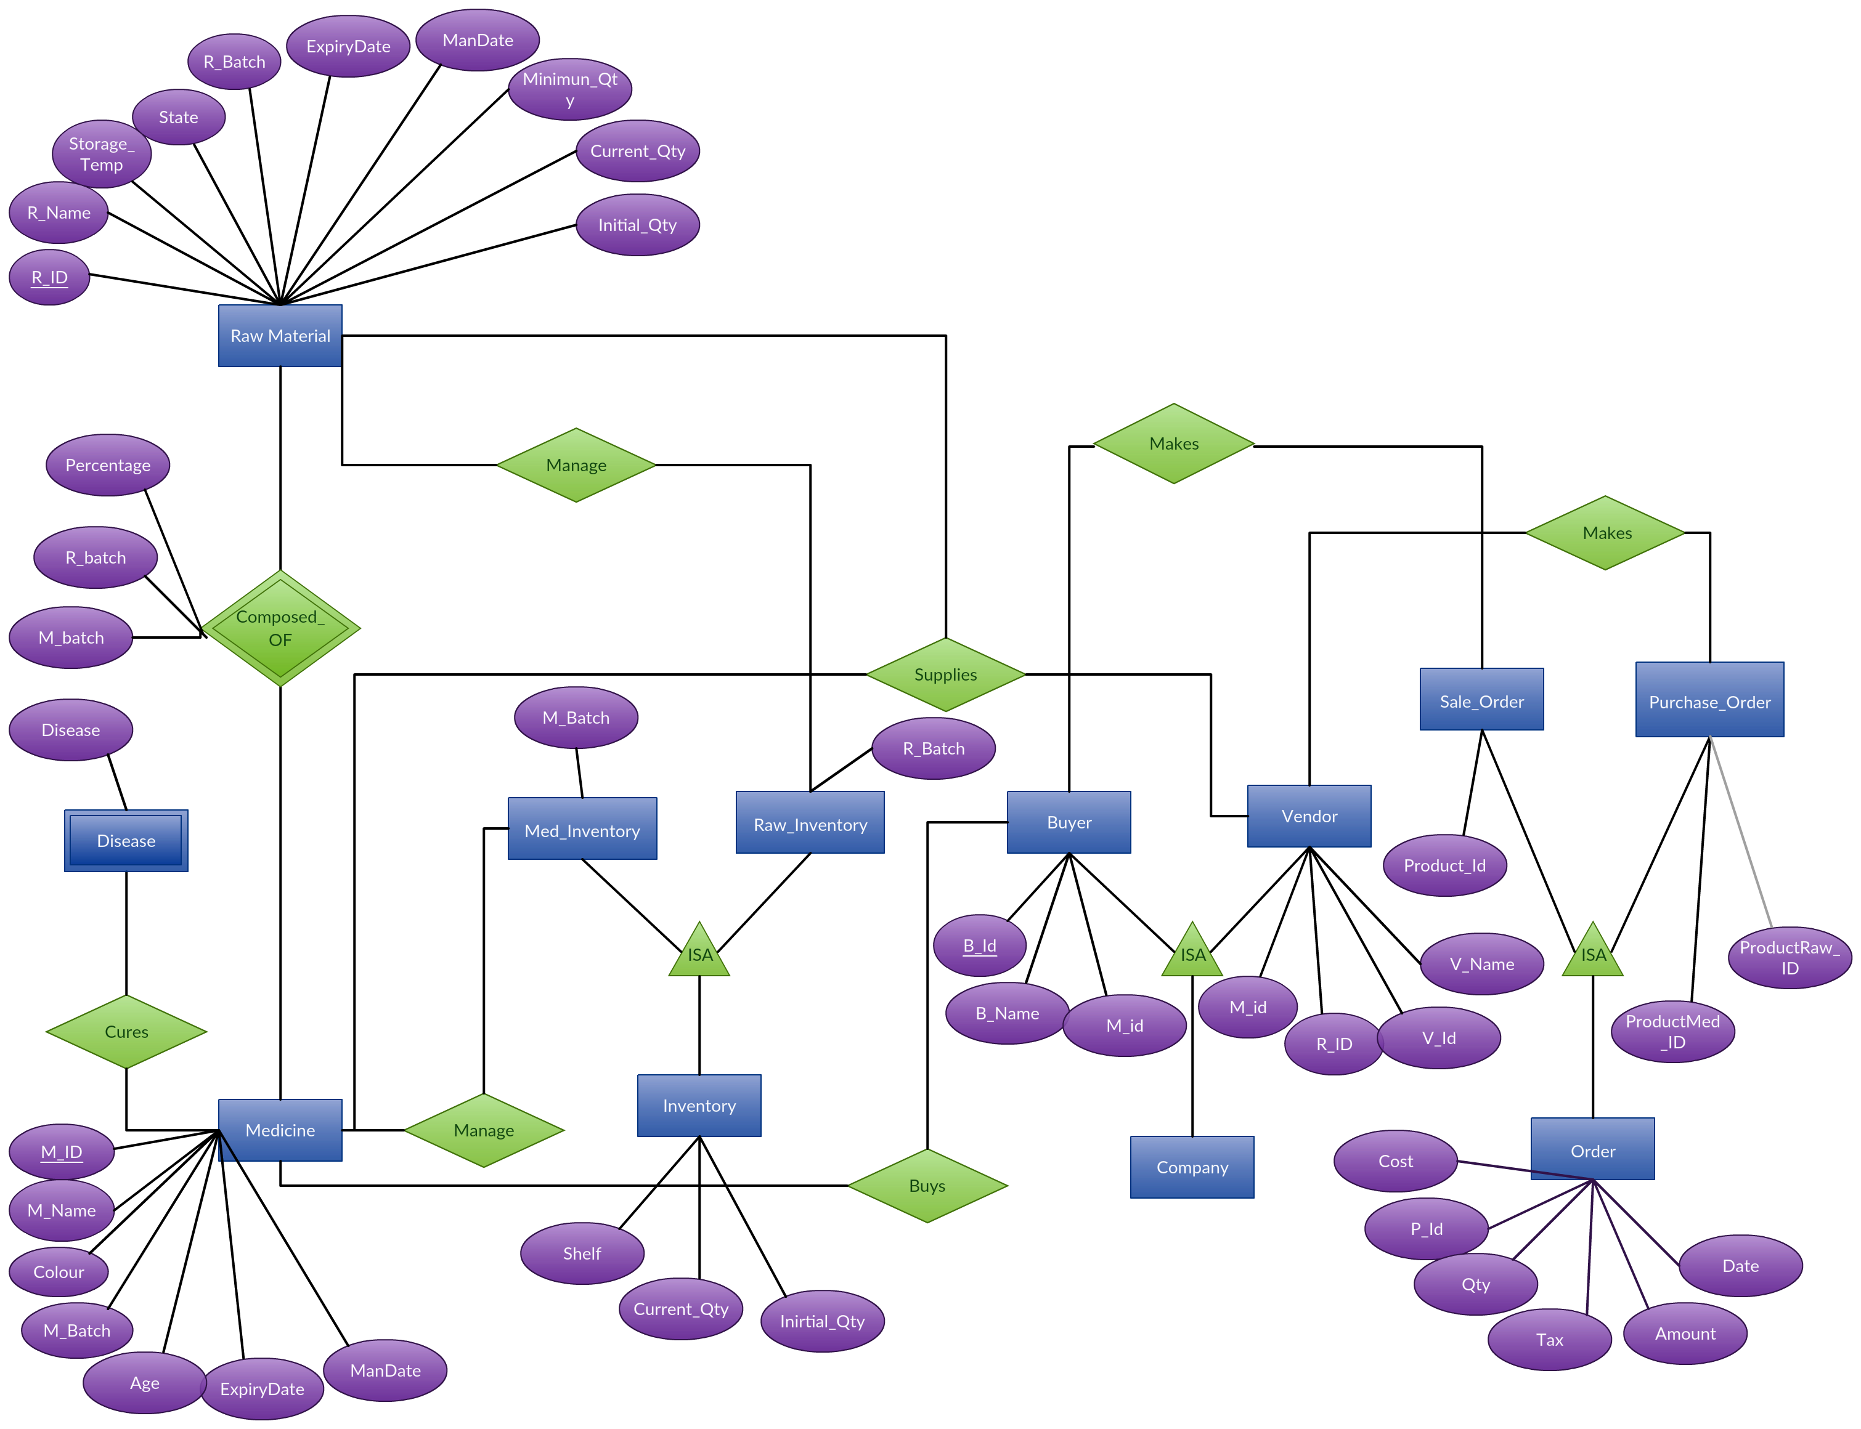

Slide 8
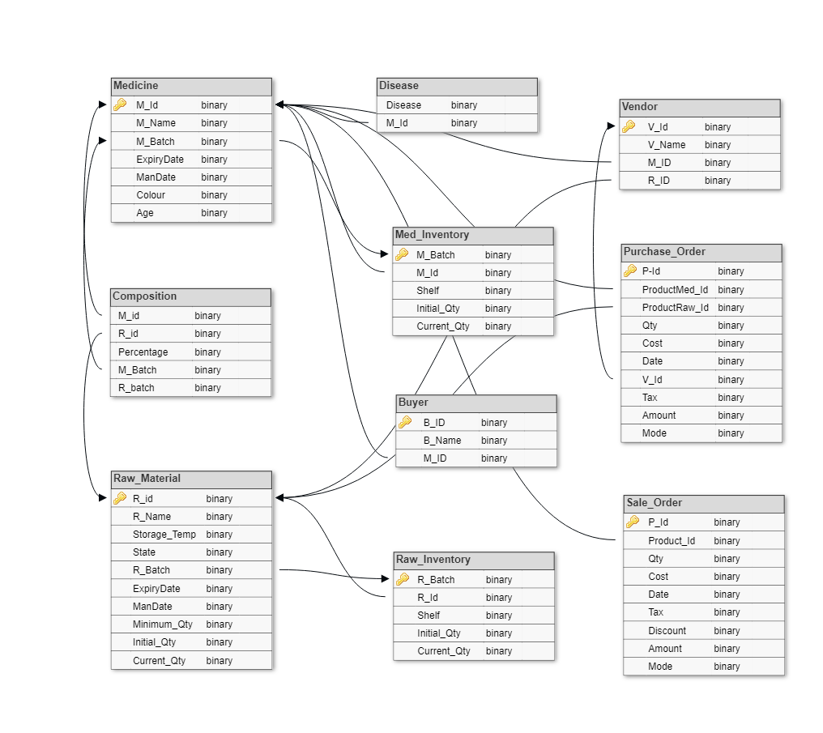

Slide 9
Relational Model
Medicine M_Id, M_name , M_batch, Expirydate, ManDate ,Color,Age }
Disease {Disease , M_id}
Composition {M_Id, R_Id,Percentage, M_batch, R_batch }
Raw_Material {R_Id, R_name, Storage_temp,State R_batch,
ExpiryDate, ManDate, Minimun_Qty,
Initial_Qty, Curreny_Qty}
Buyer {B_Id,B_name , M_Id }

Slide 10
Vendor {V_Id,V_name ,M_Id,R_Id }
Raw_Inventory {R_batch, R_Id, Shelf , Initial_Qty, Current_Qty }
MedInventory {M_batch, M_Id,Shelf, Initial_Qty,Curreny_Qty }
Purchase_Order {P_Id, ProductMed_Id, ProductRaw_Id ,Qty , Cost, date, V_Id, Tax, Amount , Discount, Mode}
SaleOrder {P_Id, Product_Id , Qty, Cost, date, B_Id, Tax, Amount , Discount, Mode}

Slide 11
Normalised Tables
Medicine:
Medicine_Info {M_Id, M_name,Color,Storage_Temp,Age}
Disease {Disease, M_Id}
Medicine_Batch- {M_batch, M_Id, Expirydate, ManDate}
Composition:
Composition- {M_Id, R_Id,Percentage}
Batch_composition- {M_batch, R_batch}

Slide 12
Raw_Material:
Raw_Material {R_Id, R_name,Storage_Temp,State}
Raw_Batch {R_batch, R_Id, R_ExpiryDate, Minimun_Qty, Initial_Qty,Curreny_Qty}
Company:
Buyer_MedCompany {BM_Id,BM_name , M_Id }
Vendor_MedCompany {VM_Id,VM_name M_Id }
Vendor_RawCompany {VR_Id, VR_name,R_Id }

Slide 13
Inventory:
Raw_Inventory {R_batch, R_Id, Shelf , Initial_Qty,Curreny_Qty}
Manu_MedInventory {M_batch, M_Id,
Shelf, Initial_Qty,Curreny_Qty}
Pur_MedInventory {M_batch, M_Id, Shelf, Initial_Qty,Curreny_Qty}
Payment:
SaleOrder {S_Id, date, C_Id, Tax, Amount , Discount, Mode}
M_PurOrder {P_Id, date, C_Id, Tax, Amount , Discount, Mode}
R_PurContent {S_Id, VR_PId, R_Qty, Cost}
M_SaleContent {S_Id, ,BM_PId M_Qty, Cost}
M_PurContent {P_Id,VM_PId, M_batch, M_Qty, Cost}

Slide 14
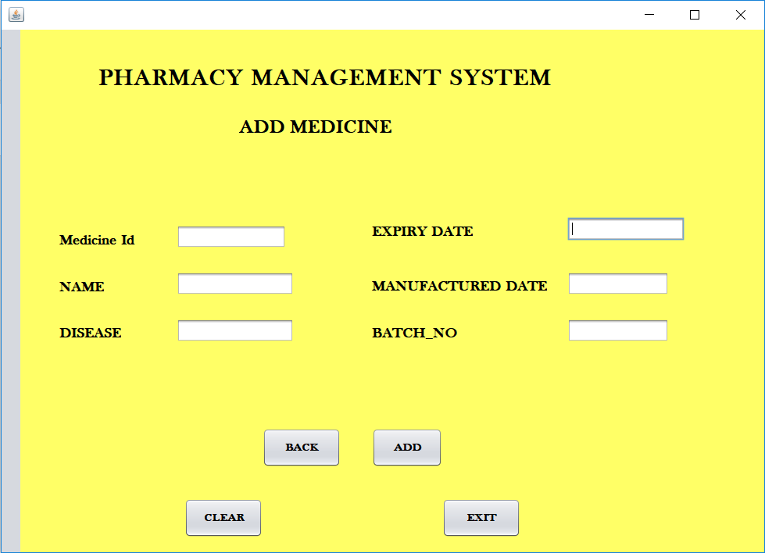
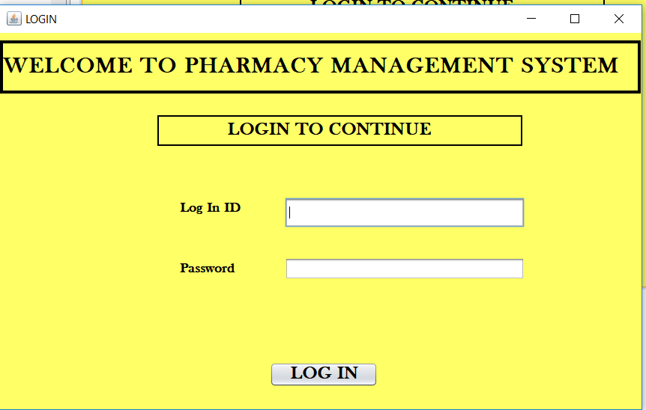
Front End

Slide 15
