Slide 1
Workshop: ONT read metagenomics
Pedro Humberto Lebre

Slide 2
What are ONT reads:
ONT stands for Oxford Nanopore Technologies
ONT sequencers (such as the MinION MkD1) are not limited by a specific length: generate long-reads, but can also do short.
Pipelines that process ONT reads are often referred to as long-read pipelines: these can be used to process other long-read datasets

Slide 3
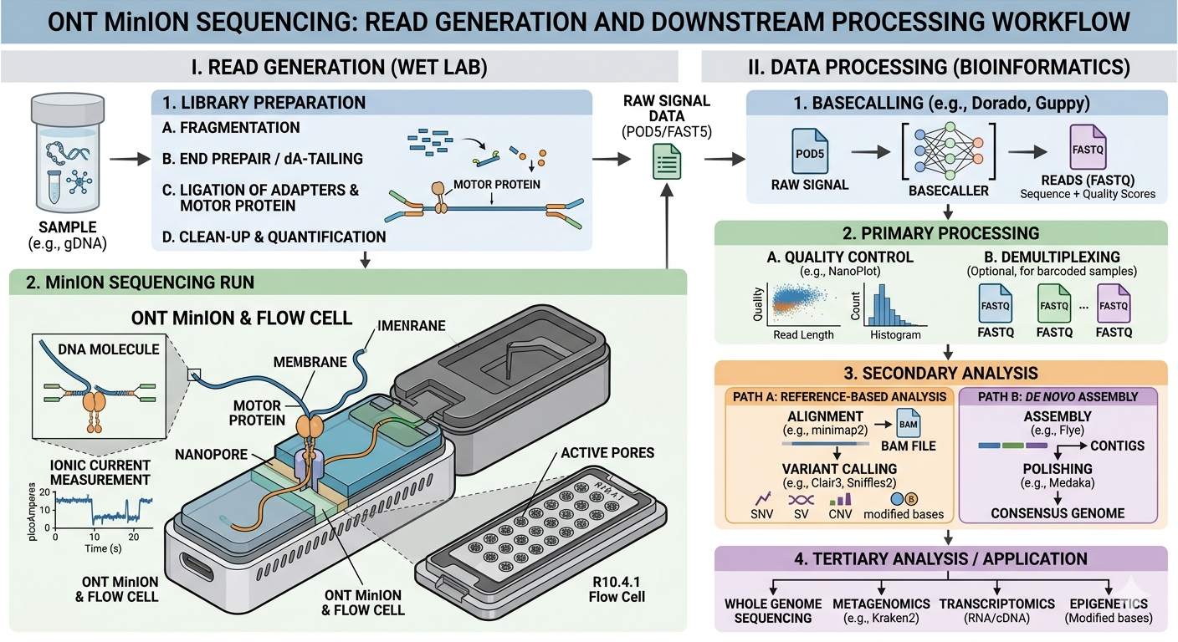

Slide 4
Why are we using Docker:
Docker is a platform that allows deployment of packages with applications and everything they need: containers
Docker Desktop is needed for Windows and Mac to use these containers, by creating a Linux Machine inside your PC.
It allows access to library of pre-made containers, including many bioinformatics tools.

Slide 5
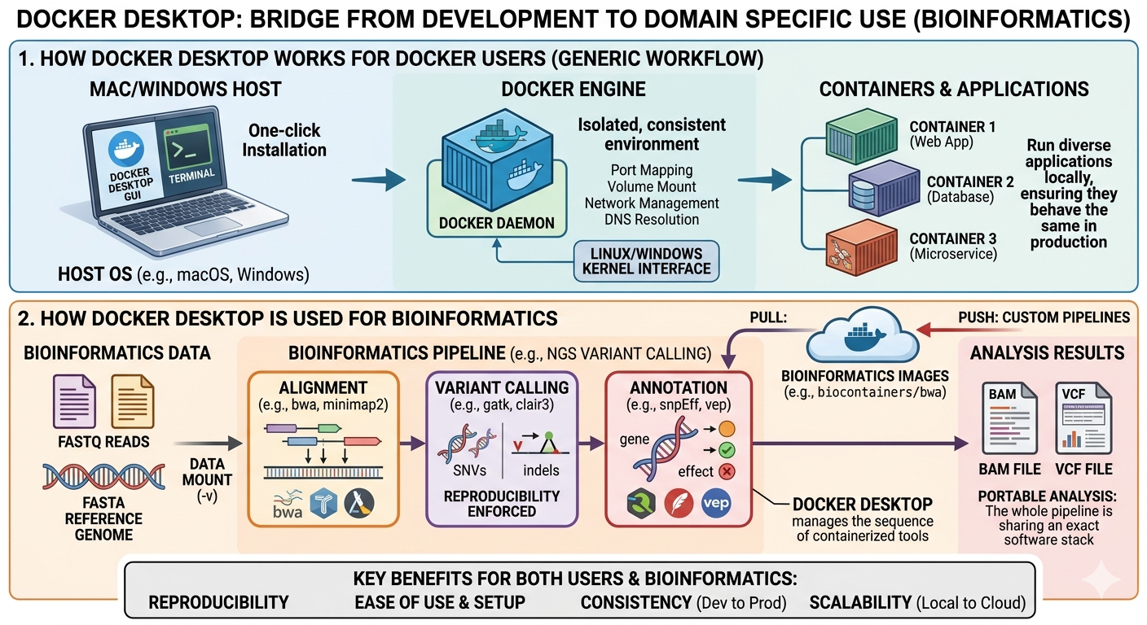

Slide 6
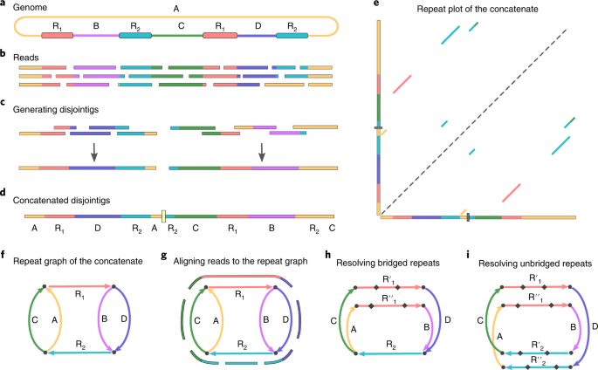
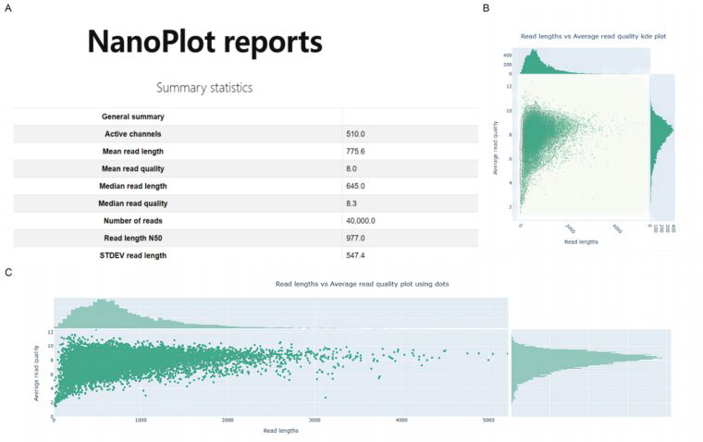
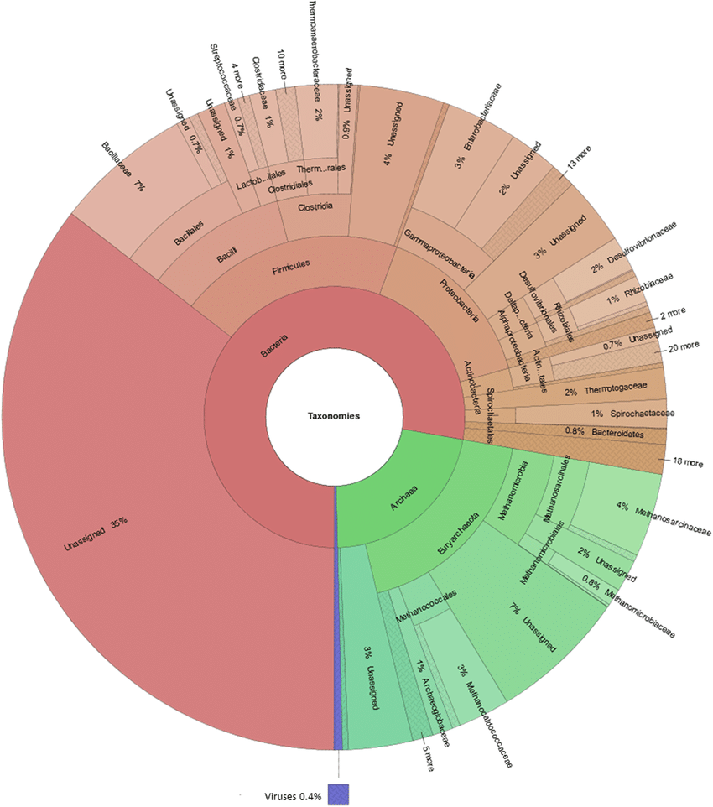
What we are going to run:
What are they doing?
Mock Dataset
QC
Trimming
Filtlong
Nanoplot
MetaFlye
Taxonomy
Assembly
Kraken2
Krona
Who is there?
Mapping
https://github.com/pbixirao86/Long_read_metagenomics_tutorial
Minimap2

Slide 7
Rules for the Workshop:
Type the command lines if you can on your Terminal/Powershell
If you have a question/ problem, please raise your hand on Teams
The outputs for each step are available in the Github link

