Slide 1
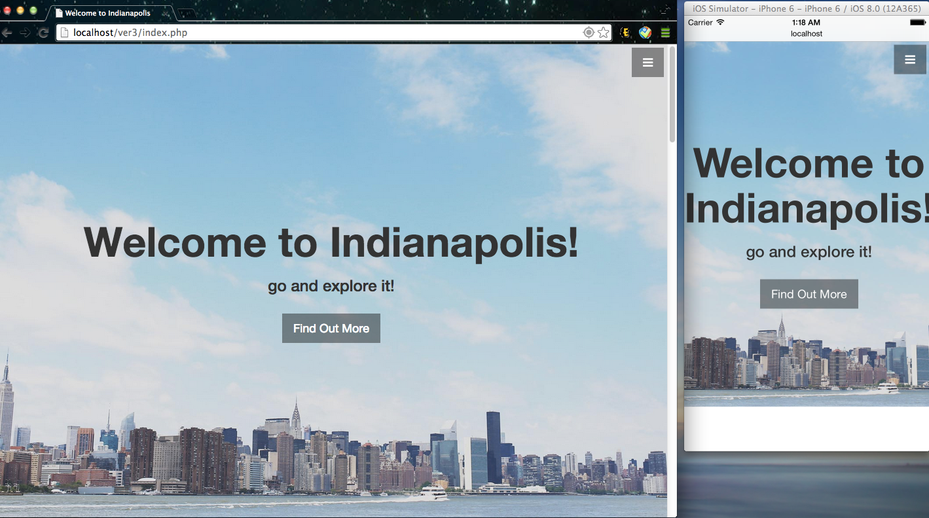
This is a system that can recommend the event that is going to happen, the movie in the theatre, the food and landmarks in Indianapolis to people and let them have a good view of this wonderful city.
Which are a MAMP based web application and it is mobile compatible too.

