Slide 1
Preventing Memory Leaks in Javascript
Peter Lukarov
Mitchell Aharon

Slide 2
Motivation: the Dangers of Javascript
Web Apps more complex (eg, AJAX)
Browser Windows Remain Open for Longer

Slide 3
Common Causes of MemLeaks
Closures
Circular References
Cross-Page Leaks
XmlHttpRequest()

Slide 4
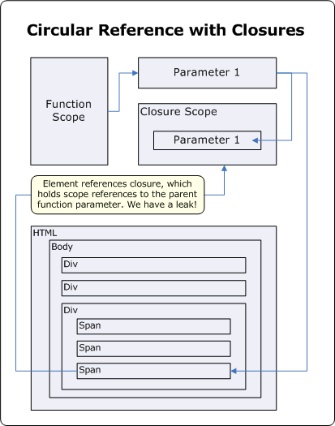
Closures
<script type="text/javascript">
document.write("Program to illustrate memory leak via closure");
window.onload = function outerFunction() {
var obj = document.getElementById("element");
obj.onclick=function innerFunction(){
alert("Hi! I will leak");
};
obj.bigString=new Array(1000).join(new Array(2000).join("XXXXX"));
// This is used to make the leak significant
};
</script>
<button id="element">Click Me</button>
</body>
</html><html> <body> <script type="text/javascript"> document.write("Program to illustrate memory leak via closure"); window.onload=function outerFunction(){ var obj = document.getElementById("element"); obj.onclick=function innerFunction(){ alert("Hi! I will leak"); }; obj.bigString=new Array(1000).join(new Array(2000).join("XXXXX")); // This is used to make the leak significant }; </script> <button id="element">Click Me</button> </body> </html><html> <body> <script type="text/javascript"> document.write("Program to illustrate memory leak via closure"); window.onload=function outerFunction(){ var obj = document.getElementById("element"); obj.onclick=function innerFunction(){ alert("Hi! I will leak"); }; obj.bigString=new Array(1000).join(new Array(2000).join("XXXXX")); // This is used to make the leak significant }; </script> <button id="element">Click Me</button> </body> </html>

Slide 5
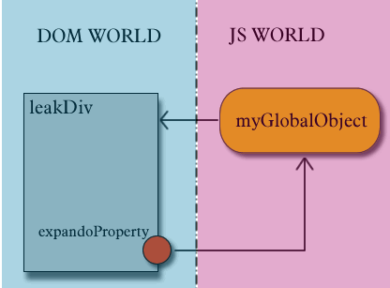
Circular Reference

Slide 6
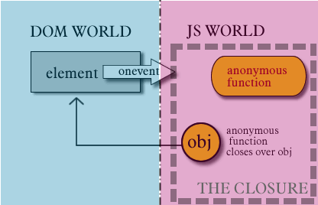
Closure with Circular Reference

Slide 7
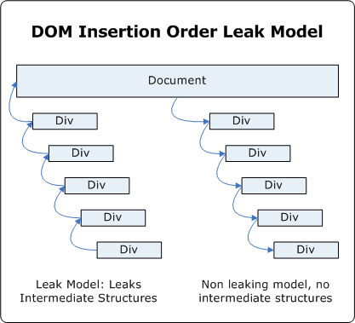
Cross-Page Leaks

Slide 8
Common Causes of MemLeaks
Closures
Circular References
Cross-Page Leaks
XmlHttpRequest()

Slide 9
Questions

