Slide 1
Preventing Memory Leaks in Javascript
Peter Lukarov
Mitchell Aharon

Slide 2
Motivation: the Dangers of Javascript
Web Apps more complex (eg, AJAX)
Browser Windows Remain Open for Longer

Slide 3

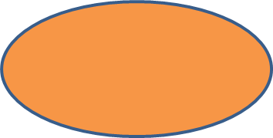
Garbage Collection: Requires Reachability
Stack
Heap
Ref 1
Object 1
Ref 2
Object 2

Slide 4
Garbage Collection: Requires Reachability
Stack
Heap
Object 1
Ref 2
Object 2

Slide 5
Common Causes of MemLeaks
Closures
Circular References
Cross-Page Leaks
XmlHttpRequest()

Slide 6
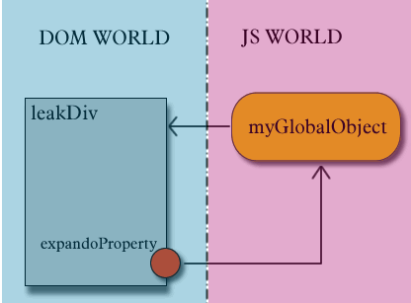
Circular Reference
<head>
<title></title>
<script type="text/javascript">
var myGlobalObject;
function SetupLeak()
{
// First set up the script scope to element reference
myGlobalObject = document.getElementById("LeakedDiv");
// Next set up the element to script scope reference
document.getElementById("LeakedDiv").expandoProperty =
myGlobalObject;
}
</script>
</head> <body onload="SetupLeak()">
<div>
<div id="LeakedDiv">
Leaked Div
</div>
</div> </ body>

Slide 7
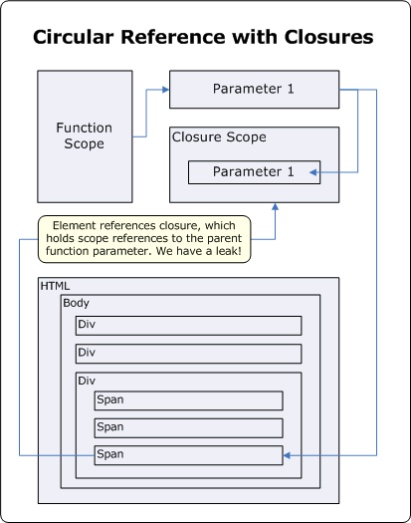
Closures
<head>
<script type="text/javascript">
function AttachEvents(element)
{
// This structure causes element to ref ClickEventHandler
element.attachEvent("onclick", ClickEventHandler);
function ClickEventHandler()
{
// This closure refs element
document.getElementById("LeakedDiv").innerHTML = “ ";
}
}
function SetupLeak()
{
// The leak happens all at once
AttachEvents(document.getElementById("leakedButton"));
}
</script>
</head>
<body onload="SetupLeak()">
<div>
<div id="buttonContainer">
<input id="leakedButton" type="button" value="Leak" />
</div>
</div>
</body>

Slide 8
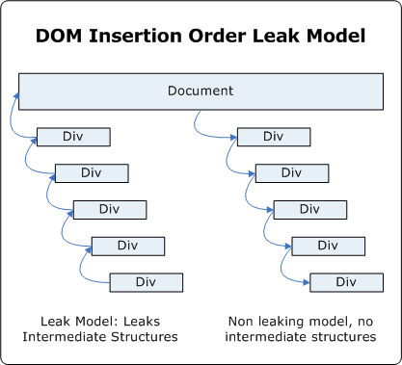
Cross-Page Leaks
<script type="text/javascript">
function LeakMemory()
{
var hostElement = document.getElementById("hostElement");
// Do it a lot, look at Task Manager for memory response
for (i = 0; i < 5000; i++)
{
var parentDiv =
document.createElement("<div onClick='foo()'>");
var childDiv =
document.createElement("<div onClick='foo()'>");
// This will leak a temporary object
parentDiv.appendChild(childDiv);
hostElement.appendChild(parentDiv);
hostElement.removeChild(parentDiv);
parentDiv.removeChild(childDiv);
parentDiv = null;
childDiv = null;
}
hostElement = null;
}
</script> <body>
<div id="buttonContainer">
<button onclick="LeakMemory()">
Memory Leaking Insert
</button>
</div>
</body>

Slide 9
Common Causes of MemLeaks
Closures
Circular References
Cross-Page Leaks
XmlHttpRequest()

Slide 10
Identifying Leaks with Graphs
Construct a directed graph
Nodes: DOM elements and JavaScript objects
Edges: References DOMElement---->JSObj and JSObj---->DOMElement
Add nodes and edges when DOM element refers a JS object and vice versa
Use Graph algorithms to identify all the cycles in the graph. If cycle exists then there is a circular reference that may result in memory leak

Slide 11
Identifying Leaks with Graphs cont.
Will identify most of the leaks resulting from Circular References, and Closures with Circular References
Most of the leaks in the existing applications are of this kind

Slide 12
Implementation and Demo

Slide 13
Evaluation
Haven’t done evaluation yet
Use existing tools to validate that a web page leaks memory
Run our tool to identify what are the leaks and if they correspond to the ones reported by the other tools

Slide 14
References
Memory Leaks:
https://wiki.mozilla.org/Performance%3aLeak_Tools#Common_leak_patterns
http://msdn.microsoft.com/en-us/library/Bb250448
http://javascript.info/tutorial/memory-leaks
http://www.ibm.com/developerworks/web/library/wa-memleak/
http://stackoverflow.com/questions/5046016/jquery-memory-leak-patterns-and-causes
http://stackoverflow.com/questions/2450761/why-does-jquery-leak-memory-so-badly
http://msdn.microsoft.com/en-us/library/dd361842%28v=vs.85%29.aspx
http://blogs.msdn.com/b/gpde/archive/2009/08/03/javascript-memory-leak-detector-v2.aspx
http://blogs.telerik.com/blogs/posts/11-04-26/memory-leaks-and-memory-consumption-in-web-applications-part-1.aspx
http://blogs.telerik.com/blogs/posts/11-05-02/memory-leaks-and-memory-consumption-in-web-applications-part-2.aspx
http://blogs.telerik.com/blogs/posts/11-05-09/memory-leaks-and-memory-consumption-in-web-applications-part-3.aspx
//How to find leaks in FireFox
http://stackoverflow.com/questions/5028479/finding-memory-leaks-in-javascript-using-firebug
http://hacks.mozilla.org/2012/05/dom-mutationobserver-reacting-to-dom-changes-without-killing-browser-performance/
https://developer.mozilla.org/en-US/docs/DOM/MutationObserver
https://blog.mozilla.org/addons/2009/01/28/how-to-develop-a-firefox-extension/
https://developer.mozilla.org/en-US/docs/XUL_School/The_Essentials_of_an_Extension
http://ejohn.org/blog/pure-javascript-html-parser/
https://developer.mozilla.org/en-US/docs/XUL_School/Intercepting_Page_Loads
http://answers.oreilly.com/topic/1634-how-to-attach-objects-and-data-to-dom-with-jquery-data-to-avoid-memory-leak-issues/
//Browser Internals Manual
http://trac.webkit.org/wiki
https://wiki.mozilla.org/Gecko:Home_Page

Slide 15
Questions

